Slide 1
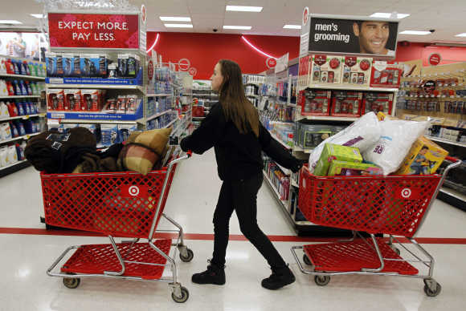

Shopping!

Slide 2
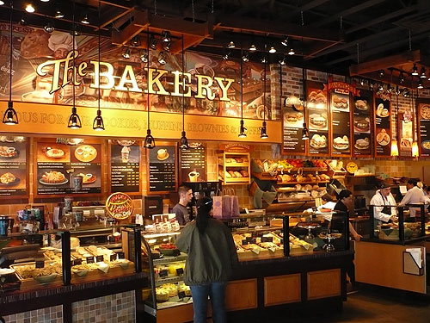
A Baker’s

Slide 3
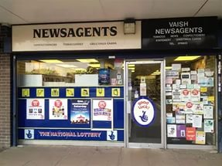
A Newsagent’s

Slide 4
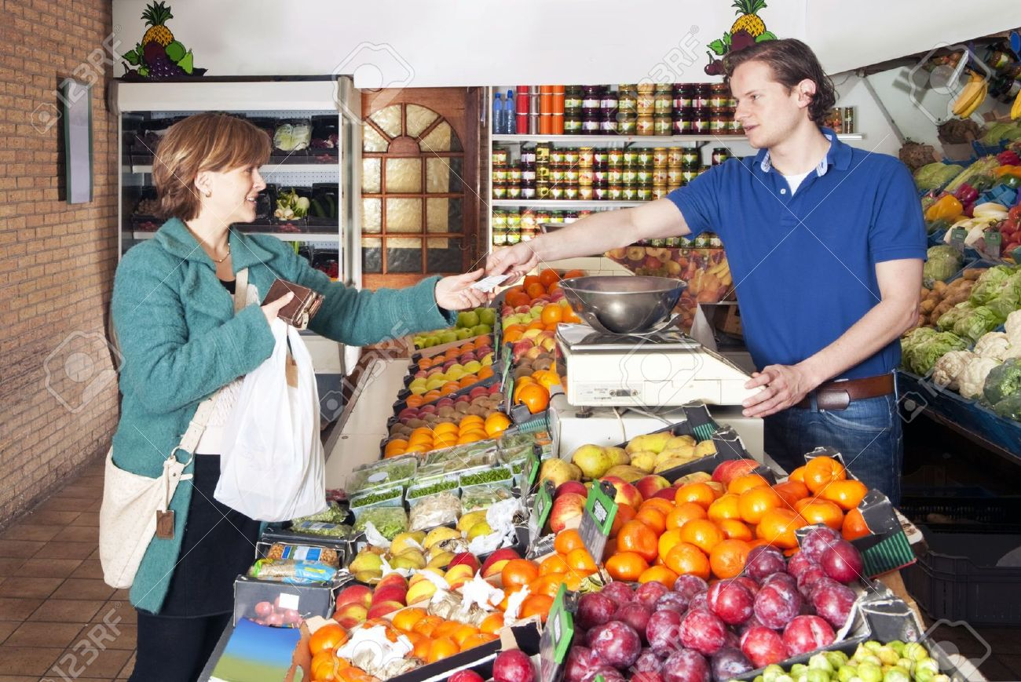
A Greengrocer’s

Slide 5
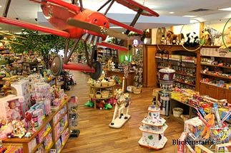
A Toy shop

Slide 6

A Chemist’s

Slide 7
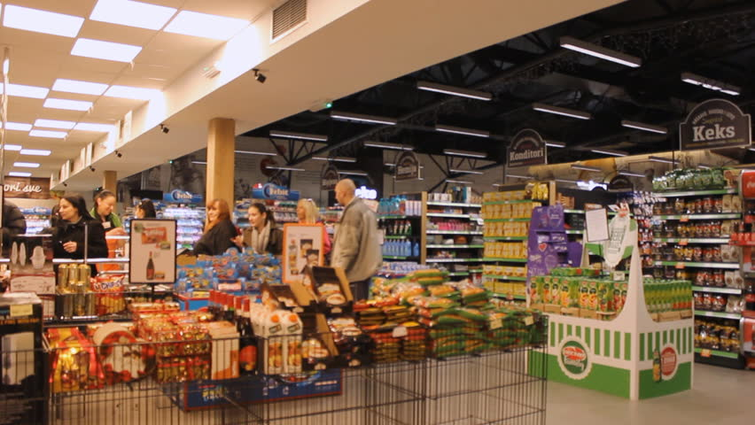
A Supermarket

