Slide 1

FAMILY
MATTERS
If there is light in the soul,
There will be beauty in the person,
If there is beauty in the person,
There will be harmony in the home.
There will be order in the nation.
There will be peace in the world.
Chinese proverb

Slide 2
Family Types
Word | Definition
Nuclear family | A family where couples either cannot or choose not to have children.
Extended family | A family that consists only of one parent who lives with the children.
One-parent family (single parent) | A family that consists not only of parents and children but also of grandparents and other family members.
Blended family (Step family) | A family that consists only of a husband, wife and their children.
Childless family (Married couple) | A family where one parent has children that are not related to the other parent.

Slide 3
Harry Webber-Mary Webber
Ann Webber
Ronald Hunter
Joseph Webber
Catherine Cook
Peter Hunter
Helen Webber

Slide 4
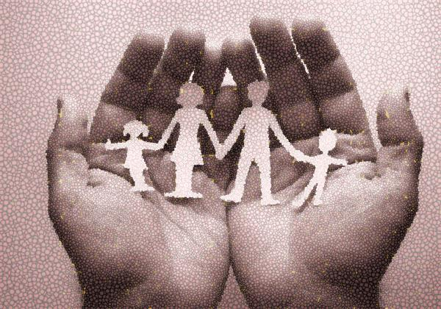
1. Harry is Ann’s
2. Mary is Joseph’s
3. Harry is Mary’s
4. Ann is Ronald’s
5. Helen is Catherine’s
6. Peter is Mary’s
7. Joseph is Ann’s
8. Helen is Harry’s
9. Catherine is Harry’s
10. Peter is Helen’s
11. Catherine is Peter’s
12. Mary is Ronald’s
13. Peter is Joseph’s
14. Helen is Ann’s
father
mother
husband
wife
daughter
grandson
brother
granddaughter
daughter-in-law
cousin
aunt
mother-in-law
nephew
niece

Slide 5
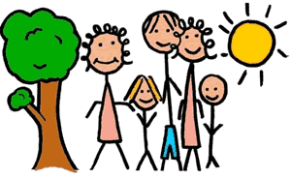
Say the male/female equivalent:
stepfather…………………
brother-in-law………….
nephew …………………….
half-sister………………….
mother-in-law……………
grandson……………………
great-grandfather…...
ex-husband…………………
widow…………………………
twin-sister…………………

Slide 6
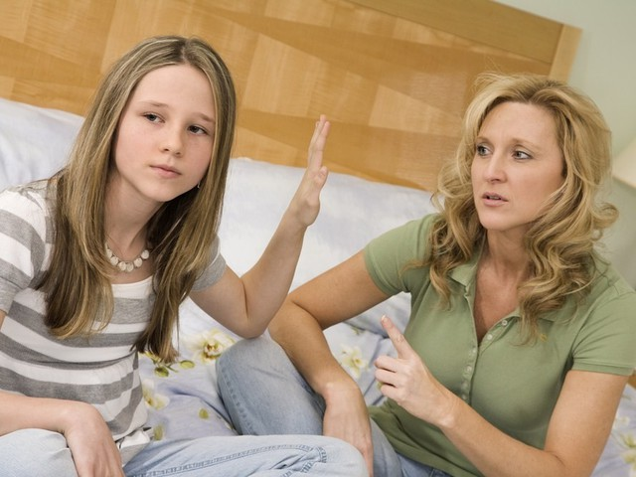
Which of the Following are relatives by birth and which are relatives by marriage?
Brother-in-law
Uncle
Niece
Stepmother
Half-brother
Great grandparents
Siblings
Cousins

Slide 7
Complete the sentences with the words in brackets:
1. Weren’t the ……….vows beautiful at Anna and Nick’s ……..(wedding/marriage)
2. There are just four people in my ………family? But more than twenty in my ……….family. (extended/immediate)
3. My …. who came to the family celebration spanned three ….(generations/relations)
4. Some …..of ours recently gave us a photo album full of pictures of our ……(ancestors/relatives)
5. My …….grandmother lives in a little …….cottage.(old/elderly)
6. A …….family consists of father, mother and children whereas a ….. family consists of one parent and children. (single parent, nuclear)

Slide 8
Fill in: engaged, married, divorced, separated, single, get, widow, stepmother, in-laws.
1. My sister is ……to be …….to a wonderful man.
2. When she ……from her husband, she moved to her parents’ house.
3. It’s difficult to be a ……parent.
4. Her parents didn’t …..on well so they decided to get….
5. Mrs. Hams’ husband died four years ago and she hasn’t married again. She is a ……….
6. These are my husband’s parents. They are my …..
7. When her mother died, her father got married to another woman. Her………..looked after her well.

Slide 9
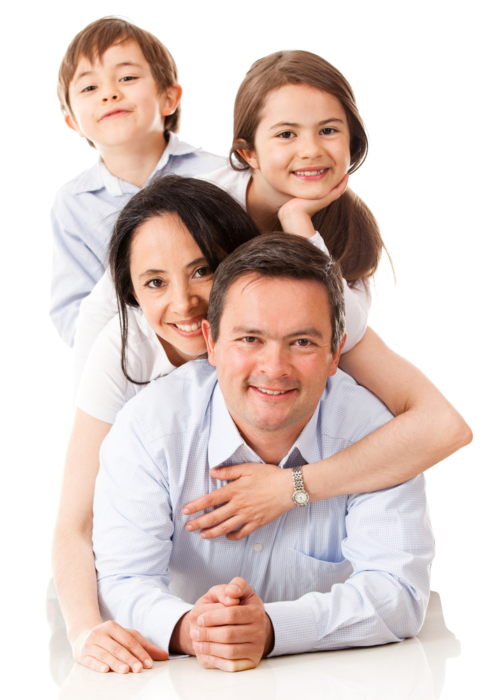
Explain the following words
Sister-in-law
To date
Engaged
Bride
Divorce
Custody
Ancestor
Generation Gap

Slide 10
Grammar Task
Choose one of these modal verbs (can, may, must, should) to complete the sentences:
Conflicts … lead to bad relations.
We … hear what the other person is saying.
We … prevent conflicts.
We … have respect for other people.
Political parties …resolve conflicts by peaceful means.
States … prevent wars if they decide to resolve conflicts peacefully.
You … have better relations with people if you resolve a conflict peacefully.
You … learn about conflict resolution if you read books about conflict.
You … have more friends if you learn to resolve conflicts peacefully.

Slide 11
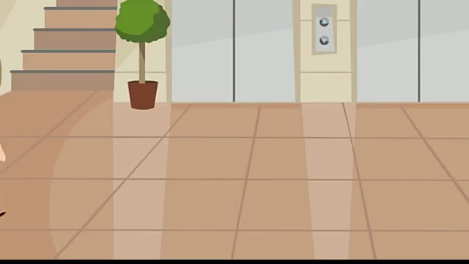
Generation Gap

Slide 12
1- Parents think I’m lazy
2 - Parents think I waste much time with my gadgets
3 - Parents think I can have better marks at school
4 - Parents interfere in the relationships with my friends
5 - Parents don’t like the music I listen to
6 - Parents try to solve my personal problems without me
          7 - Parents don’t like my hair cut
8 - Parents break their promises
Make up a sentence “…per cent of children consider that their parents…”

Slide 13
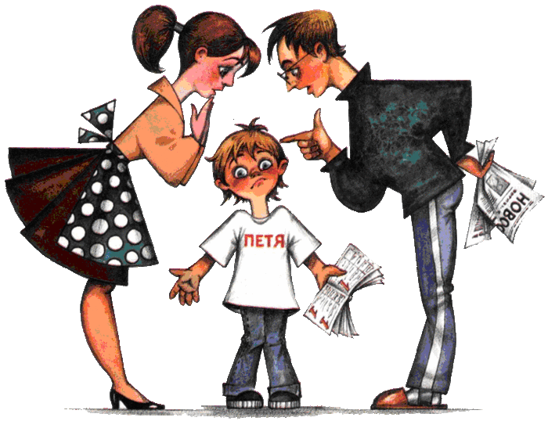
Suggest how to prevent family conflicts.
Begin with:
People should…
People shouldn’t…

Slide 14
How to avoid the conflicts in The Family?
People should | People shouldn’t
Be able to listen to each other, to quarrel without children, calm down and talk very calmly, find any compromise, give some pieces of advice (to ask for advice), respect smb’s opinion, work out a list of rules, get along with, try to forgive and approve, understand the younger (older) generation, rely on own family, cheer smb up … | Tell day and night to keep the room tidy, spoil the mood, threaten or frighten (bully), make fun of smb., make smb feel uncomfortable, make smb suffer from…, envy smb’s success(to feel jealous), betray our friends, criticize smb, shout and quarrel in a loud voice, irritate smb, trouble with some boring or unpleasant things…

Slide 15

Assess your work at the lesson
(from 3 to 5)
I took part in the speaking activities
I listened attentively
I did grammar exercise
I worked hard

Slide 16
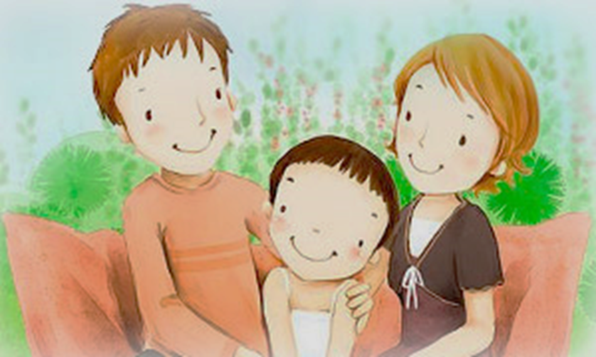
Thank you for the lesson
We can do not great things, only small things with great love.
Mother Teresa

