Slide 1
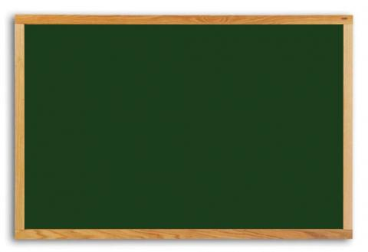
Articles with professions
Form 7
Unit 7
Lesson 1

Slide 2
Inventor | actor
scientist | singer
military leader | painter
Hero | writer
engineer | ballet dancer
astronaut | Tsar
cosmonaut | king/queen
surgeon | explorer

Slide 3
AB #1, p.92-93
Grigory Oster
Svyatoslav Fedorov
Yuri Bashmet
Sergey Korolev
Ilua Repin
Georgy Grechko
Ulyana Lopatkina
Faddey Bellinsgausen & Michail Lazarev
is/was/were ….

Slide 4
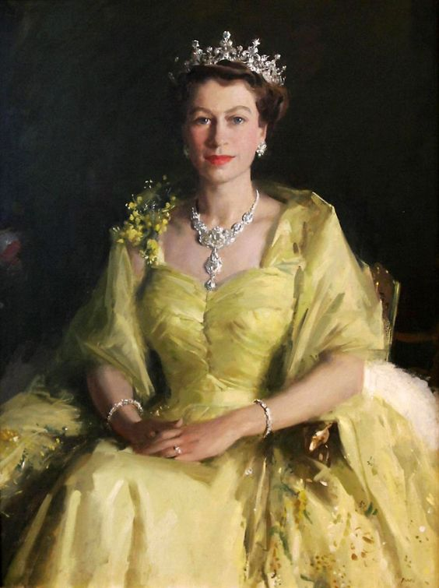
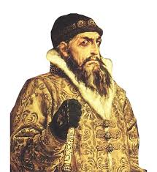
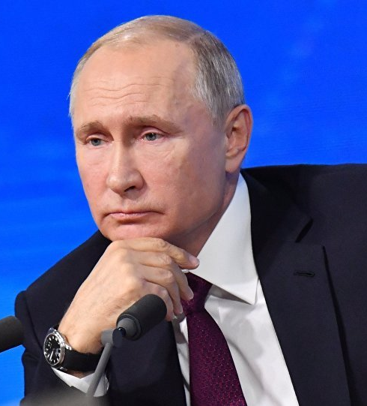
Elizabeth ….II became… queen on the 6th of February 1952.
… tsar Ivan …Terrible was crowned in 1547.
Vladimir Putin has been … President of Russia since 2018.
SB p.189

Slide 5
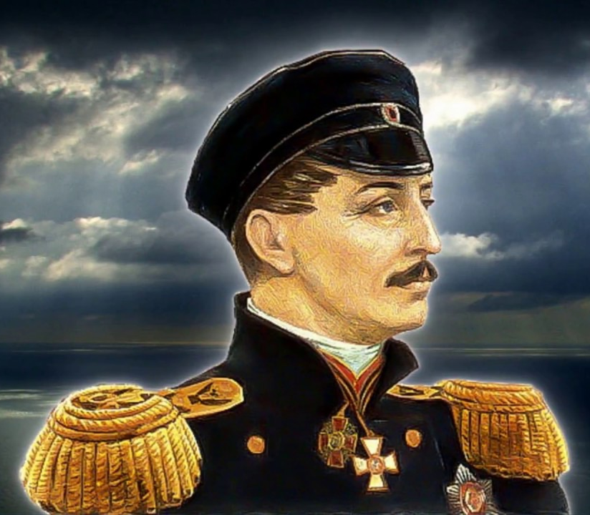
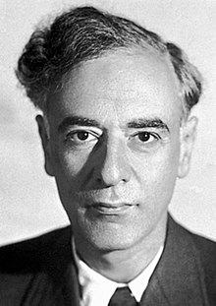
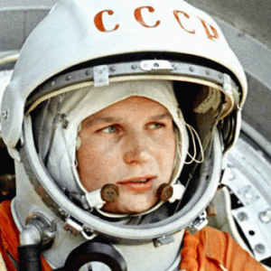
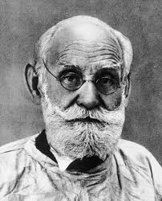
Valentina Tereshkova is … cosmonaut.
Ivan Pavlov,… doctor and …scientist, won the Nobel Prize in 1904.
… Admiral Pavel Nakhimov was … outstanding Russian military leader.
… famous Soviet physicist Lev Landau made fundamental contributions to many areas of theoretical physics.

Slide 6
Задания на рефлексию

Slide 7
Tick the people you know
Name |  | Name
I. Newton |  | L. Landau
H. Nelson |  | P. Nakhimov
W. Shakespeare |  | A. Pushkin
F. Nightingale |  | D. Sevastopolskaya
Ch. Darwin |  | I. Pavlov
J. Cook |  | F. Bellinsgauzen/M. Lazarev
R. Dahl |  | G. Oster
N. Armstrong |  | A. Leonov
M. Gibson |  | V. Livanov

Slide 8
Match the names & professions
1 | Scientist | A | V. Tereshkova
2 | Writer | B | Ch. Chaplin
3 | Explorer | C | S. Korolyov
4 | Astronaut/cosmonaut | D | M. Twain
5 | Actor | E | Vl. Shukhov
6 | Sportsman(woman) | F | Leif Eriksson
7 | Military leader | G | P. Yablochkov
8 | Architect | H | G. Zhukov
9 | Doctor | I | A. Ovechkin
10 | Inventor | J | L. Roshahl

Slide 9

R №1 р.54-55

Slide 10
Заполни карточку «ПМИ»
«+» Положительные стороны/моменты урока
«-» отрицательные
«Интересно»- что заинтересовало на уроке

