Slide 1
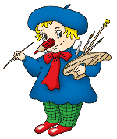
School Land

Slide 2
What’s the time?
What date is it today?
What day of the week is it?
What’s the weather like today?

Slide 3
Read the Proverb and Give Russian Equivalent. Then Learn the Proverb.
It‘s never late to learn.

Slide 4
READ THE POEM
School is something,
We must all embrace.
Knowledge we need,
To seek out and chase.

Slide 5

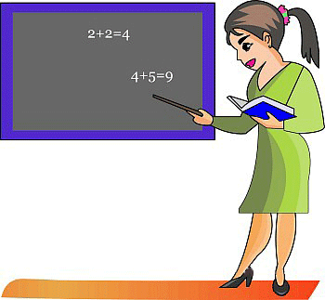

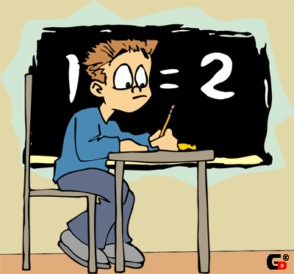
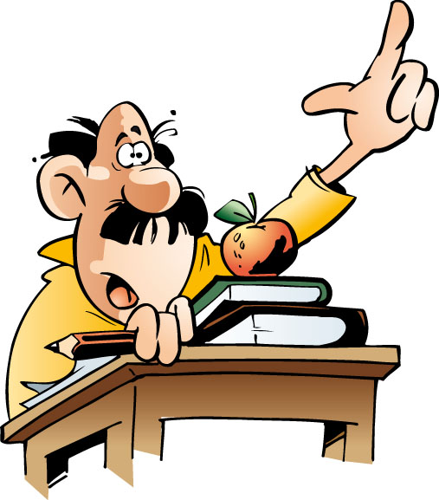
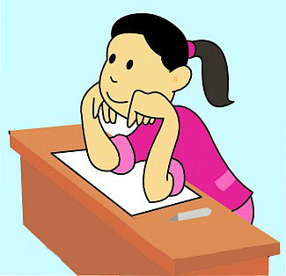
subjects
teachers
objects
school
a headmaster
classrooms
pupils

Slide 6
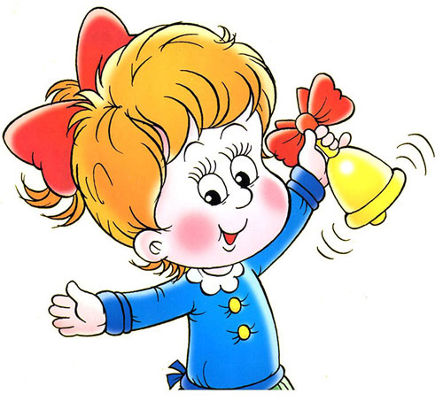
Russian
Mathematics
History
Nature study
school subjects
English
Reading
IT
Music
Art
PE

Slide 7

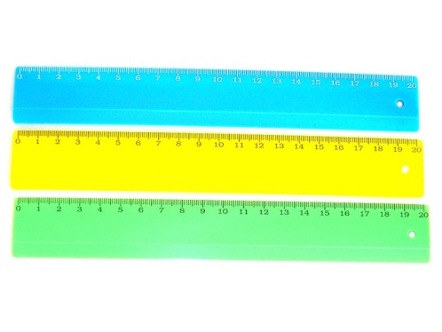

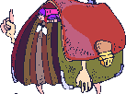

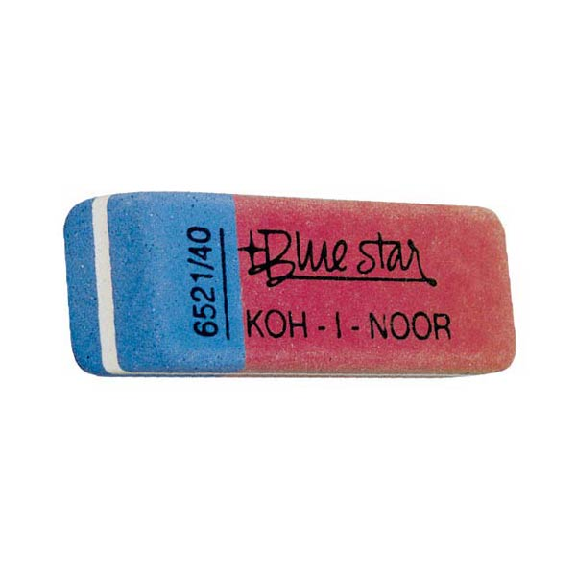
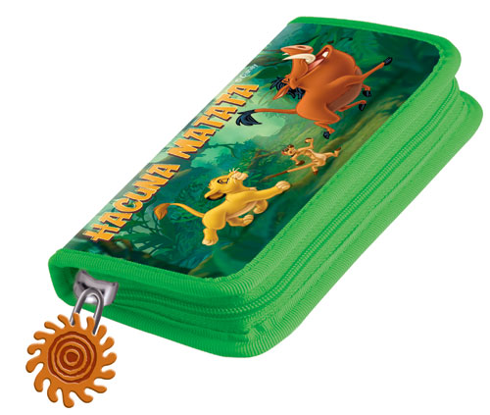

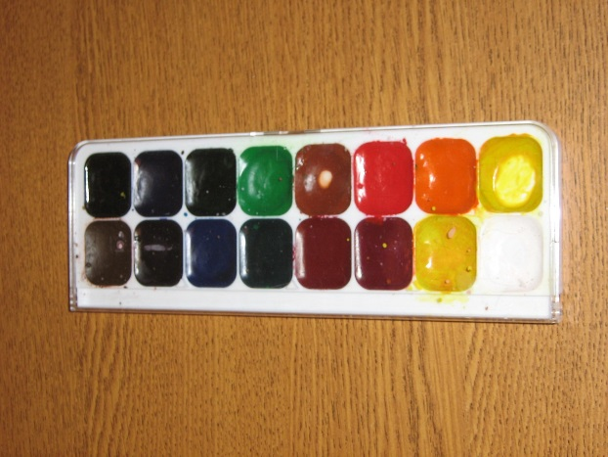
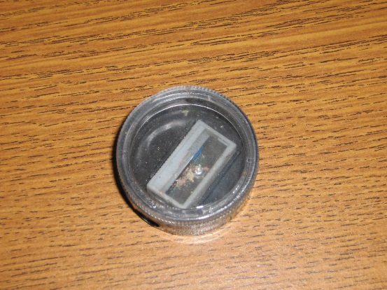
school objects

Slide 8
days of week
Sunday
Monday
Tuesday
Wednesday
Thursday
Friday
Saturday

Slide 9


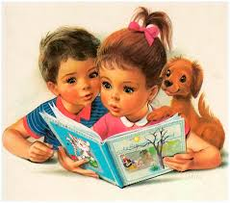


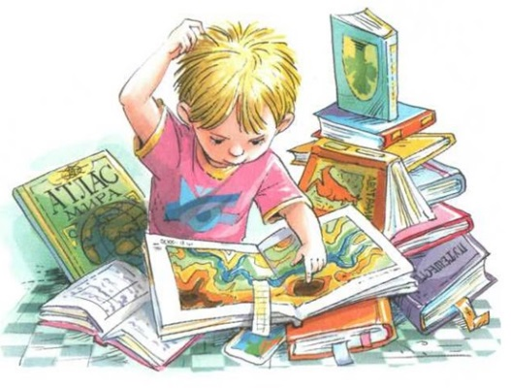

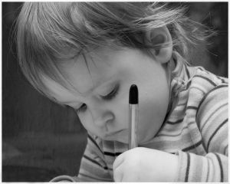
You are pupils. You go to school. What do you do at school every day?
dance
draw
read
count
write
listen
jump
speak
sing
learn
run
sit
stand
ask
answer
translate

Slide 10
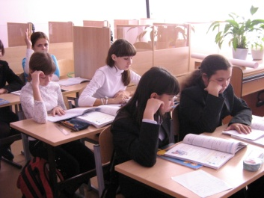
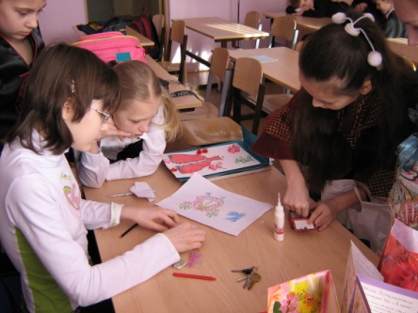
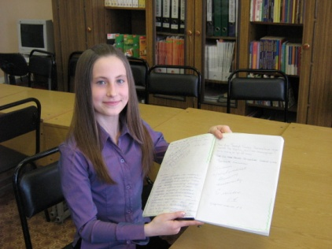
Time to play!
talk loudly
learn new words
read comics
draw funny pictures at the lesson.
ask a lot of questions
We listen to a teacher
copy long words
discuss different problems
play with a phone during the break.
learn poems by heart
jump between desks
get good marks

Slide 11
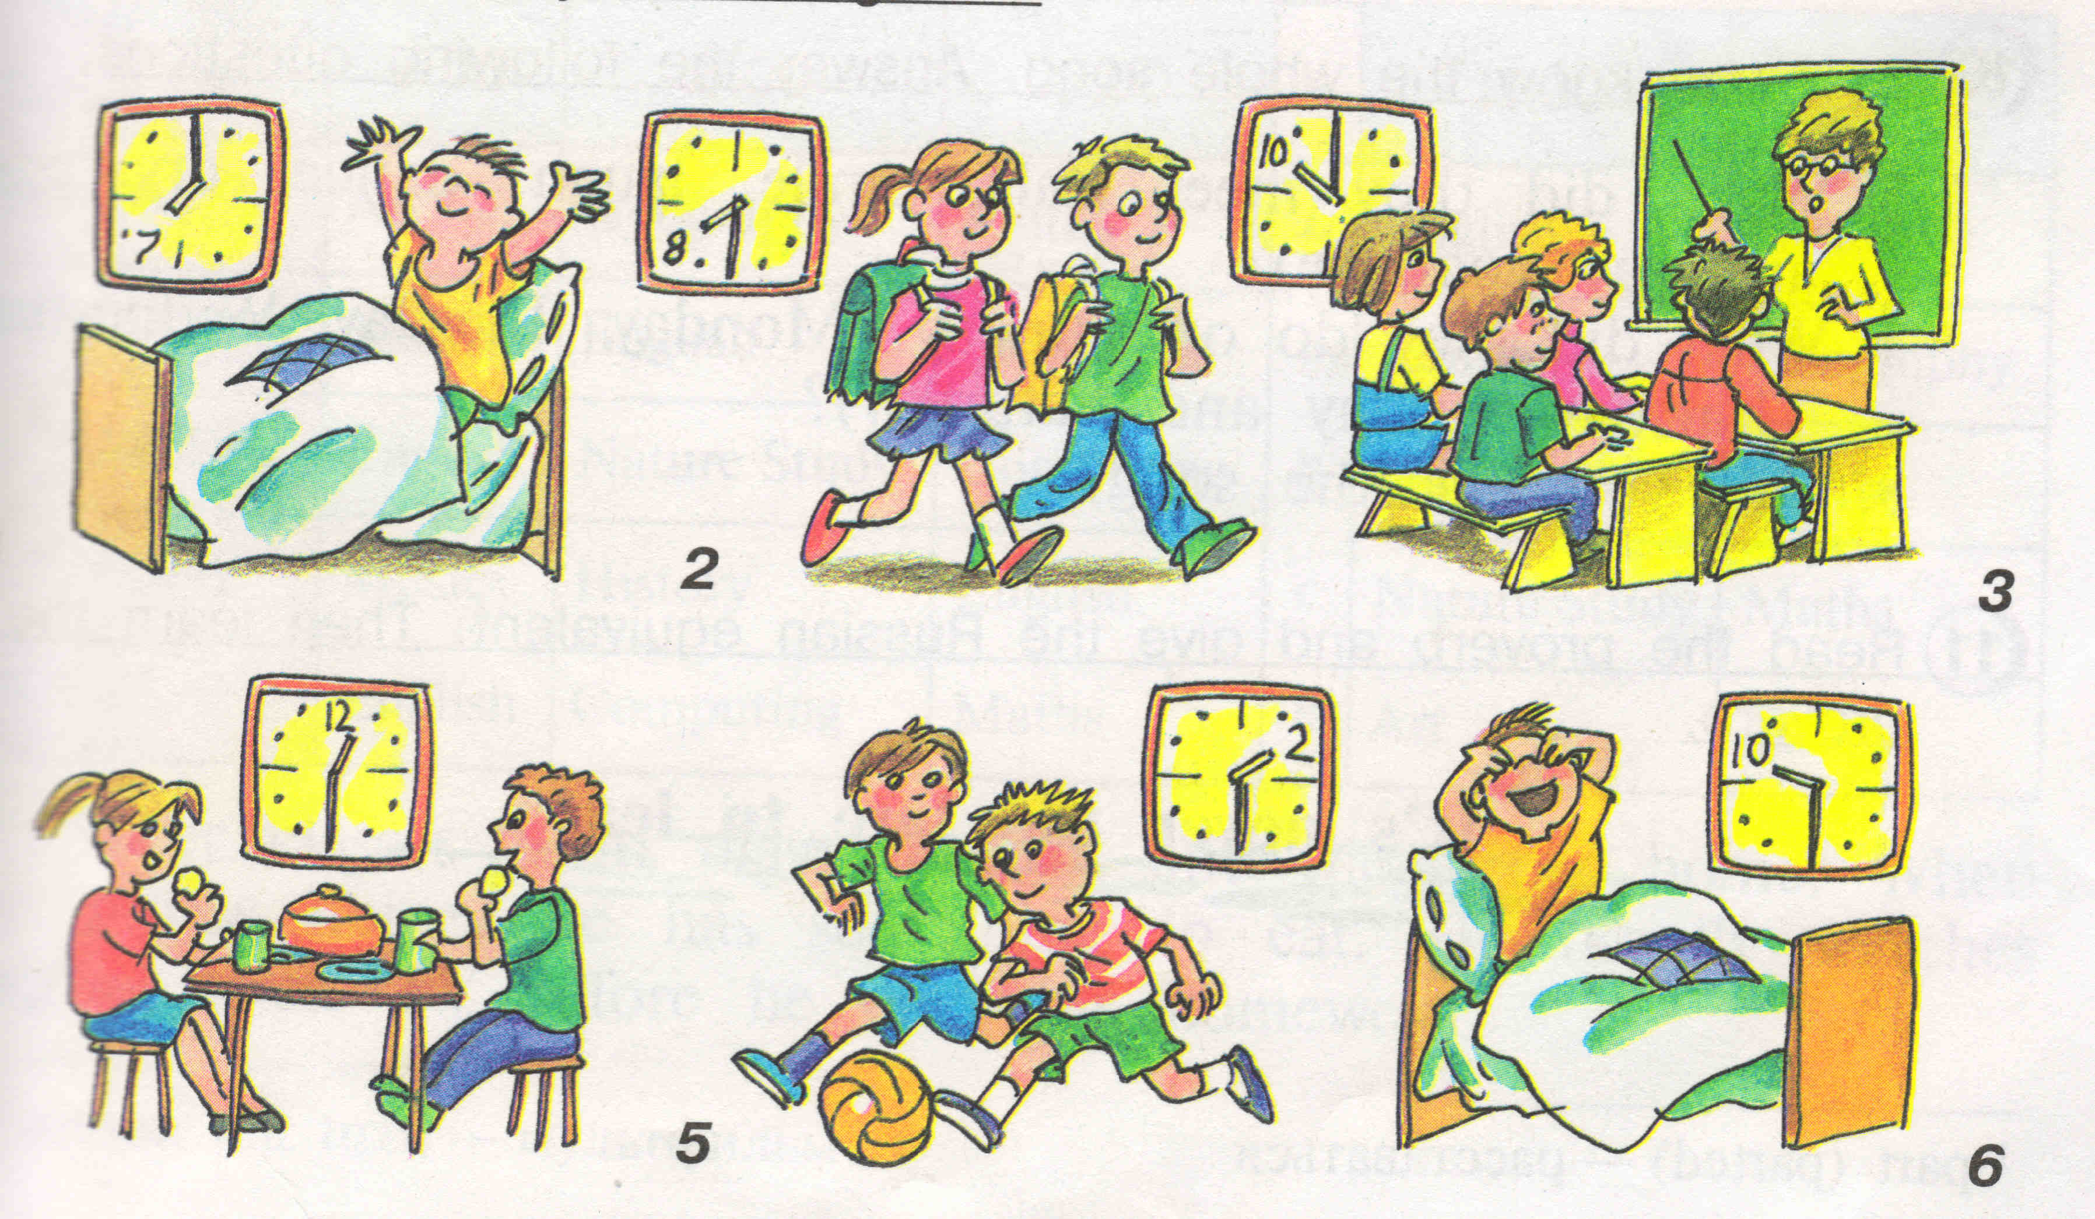
Look at the pictures and say: what they usually do at the time .

Slide 12
ANSWER THE QUESTIONS about your classroom:
1.How many chairs are there?
2.How many desks are there?
3.Is there a board?
4.Is there a computer?
5.Is there any bookcase?
6.Is there a teacher’s table?
7.Are there many windows ?
8.Are there any boys and girls?

Slide 13
Put in: at, on, in, after, before.
1.Pete gets up ….. 7 o’ clock in the morning.
2. We clean our teeth …..in the morning.
3.They play football …..classes.
4. ….. Sunday we shall go to the zoo.
5. We never drink coffee ….class.
6. We always meet …….classes in the morning.

Slide 14
liengsh
ingdrea
chlogyteno
tar
rusansi
EP dynastuture
themamatics
simuc

Slide 15
Make up your story about school life.
1. Every day I go to …and have many… .
2. My school starts at … .
3. During the lessons I …, … and…
4. My favourite subjects are … .
5. Our classroom is… .
6. After classes I like to… .
7.
It‘s never late to learn.

Slide 16
Home task: SB revise the vocabulary on the topic.
Our lesson is over!
You worked very well today.
Well done!
Good-bye children!

