Slide 1
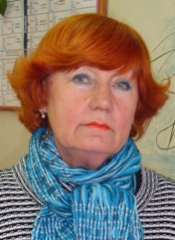
A lesson in the 5-th Form
“SCHOOL DAYS”
Teacher Teacher N.D.Golovko

Slide 2
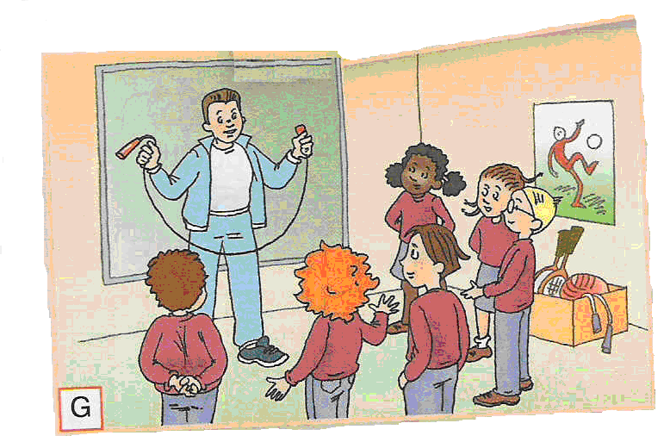
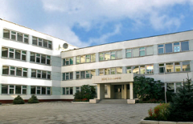

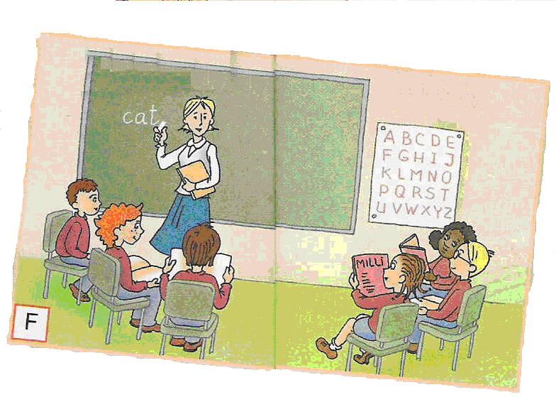

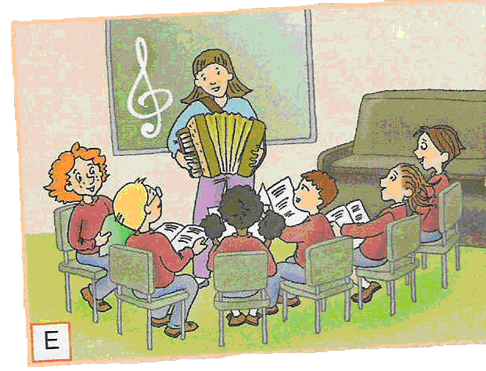

cat

Slide 3

What do you associate your school with?
When I think of my school I imagine…

Slide 4
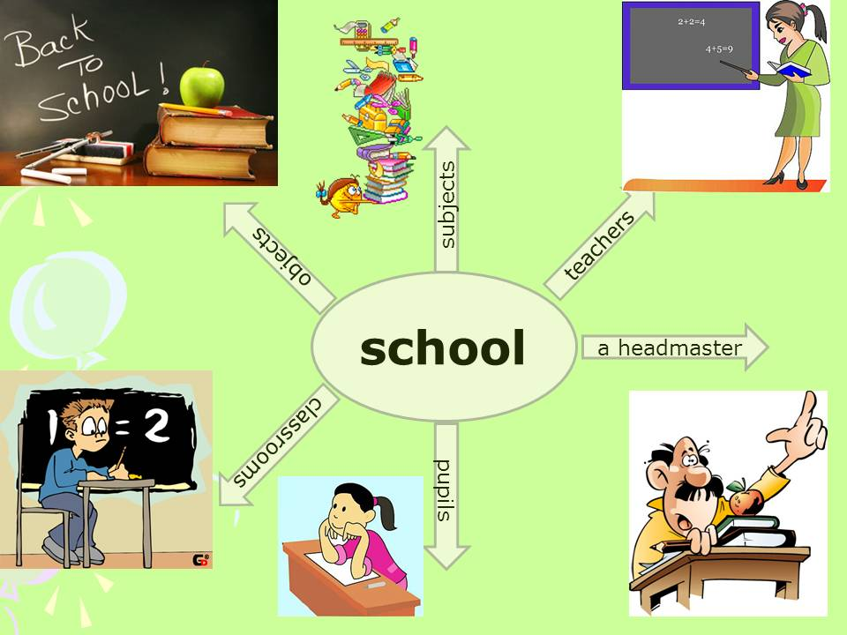

Slide 5
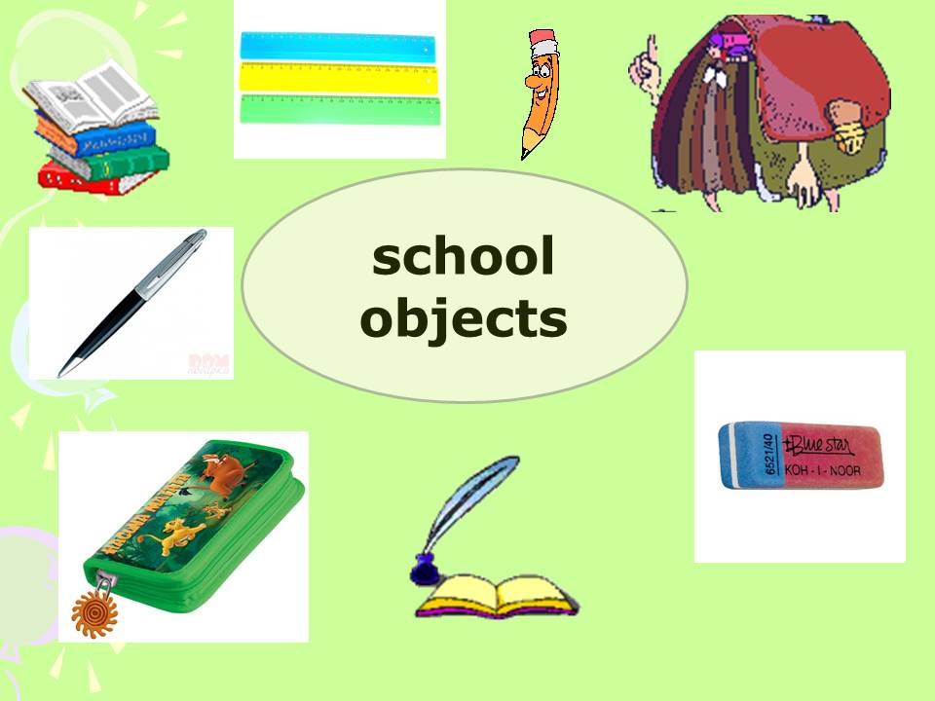

Slide 6
Guess a riddle: What is there in the black box?
WE CAN HEAR IT BEFORE AND AFTER THE LESSON. What is it?
What is there in the black box?

Slide 7
It’s a school bell!

Slide 8
Guess the riddles
1. You need it for cleaning.
2. You need it for counting.
3. You need it for carrying things.
4. You need it for writing.
5. You need it for reading.
6. You need it for drawing.
7.You need it for working and playing games.

Slide 9
Answer key
1. a rubber (an eraser);
2. a calculator;
3. a schoolbag;
4. a pen (a pencil);
5. a book (a textbook);
6. paints (a brush);
7. a personal computer

Slide 10
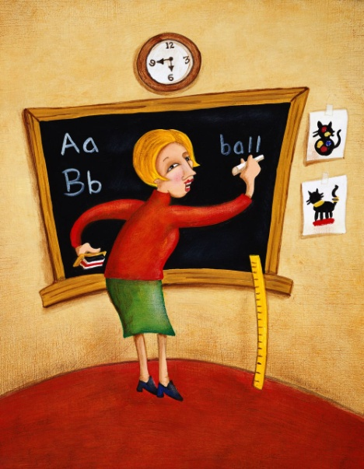
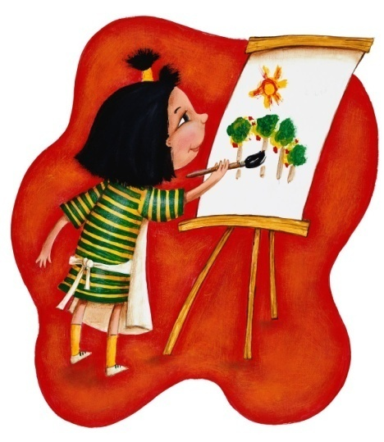
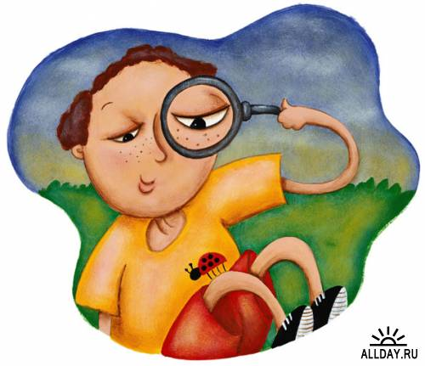

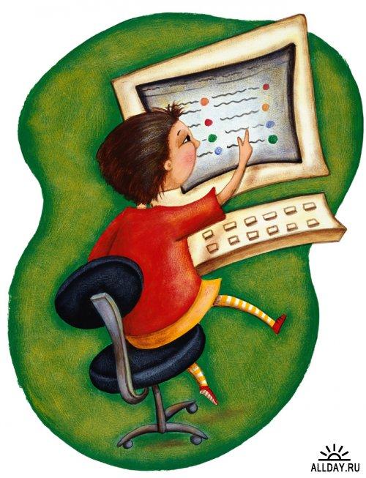
School
subjects

Slide 11
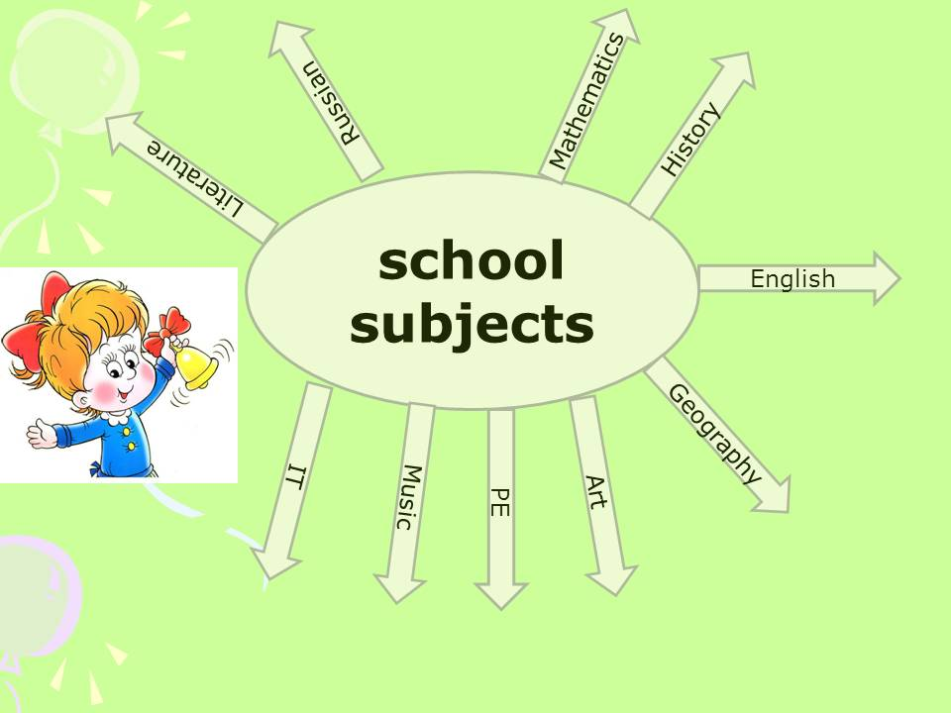

Slide 12
Test 1. Match the objects to the school subjects.
1.atlas a) English
2.paints b) IT
3.experiment c) Maths
4.sports shoes d) Geography
5.dictionary e) Music
6.calculator f) Science
7.PC g) PE
8.piano h) Art

Slide 13
Answer key: 1-d; 2-h; 3-f; 4-g; 5-a; 6-c; 7-b; 8-e.
Fill in your progress report cards…

Slide 14
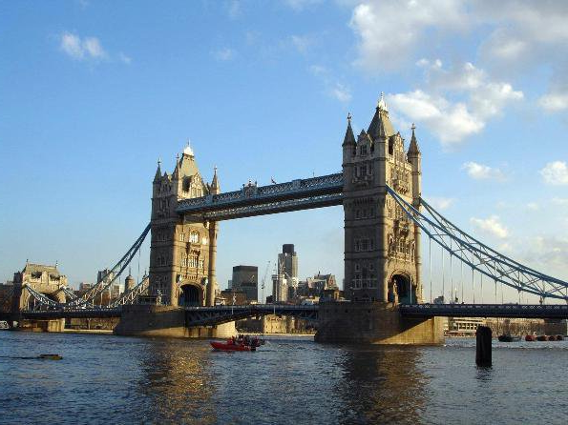

Do you Know English Well?
Do you Know English -Speaking Countries Well?

Slide 15
Test 2 «Guess English-speaking countries»
1). L E R I N A D
2). E W N E Z D A N A L
3). D A A N A C
4). N A L C S T O D
5). G E L N A N D 6). A T R U S A A L I
7). S U A 8). L E S A W

Slide 16
Answer key
1. Ireland
2. New Zealand
3. Canada
4.Scotland
5.England
6. Australia
7.the USA 8. Wales
Fill in your progress report cards…

Slide 17
FLAGS & COUNTRIES & NATIONALITIES
Name country and nationality!

Slide 18

FRANCE
French

Slide 19

JAPAN
Japanese

Slide 20

NEW ZEALAND
New Zealander

Slide 21

RUSSIA
Russian

Slide 22

GREAT BRITAIN
(The UK).
British

Slide 23

CANADA
Canadian

Slide 24

the United States
of America (the USA)
American

Slide 25
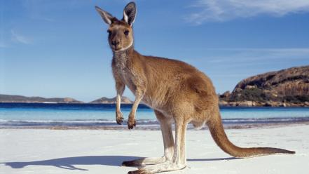
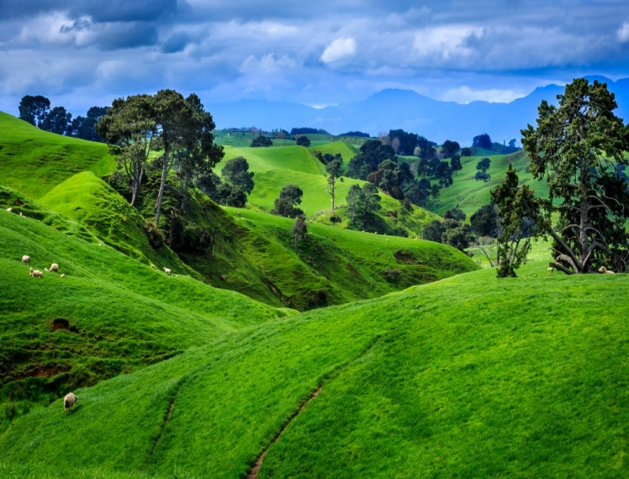
AUSTRALIA
Australian

Slide 26
Song “Time For School”
Bring your notepad, bring your pens
Bring your schoolbag, too
Bring your books, call your friends
Bring them all with you!
It’s time for school, hooray, hooray
Hurry up, it’s my first day
It’s time for school, it’s lots of fun
School is great for everyone!
English, Maths and History
Art and science, too
Music and Geography
Are fun for me and you!

Slide 27
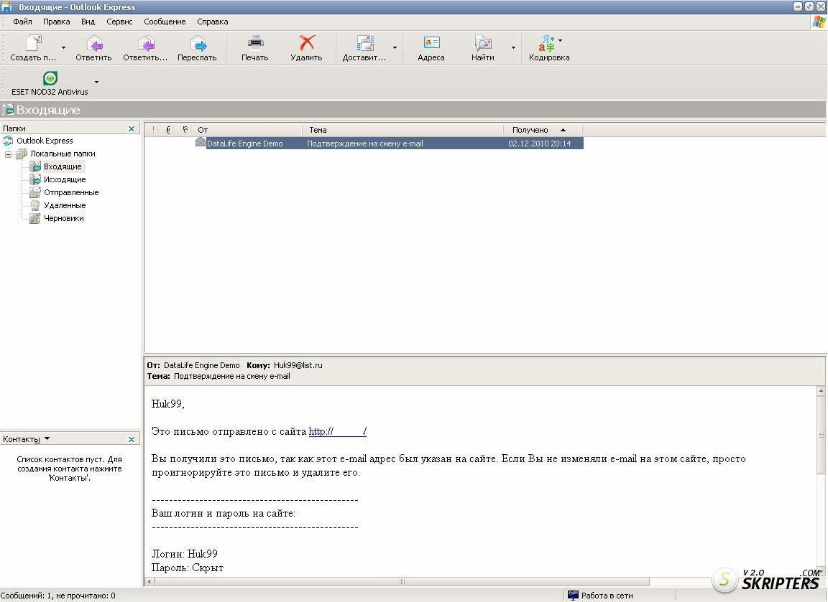
a guest
Dear friends,
I’m Andrew Jones. I’m 10 years old,
from Liverpool in the UK.
I’ve got some questions about
Russian schools…

Slide 28

Spotlight on Russia. Andrew’s questions:
1.How old are Russian schoolchildren in Year 1?
2.How many lessons a day do you have?
3. Do you have breaks?
4.What about lessons time and holidays?
5.Do children in Russian schools wear a uniform?
6. What are your favourite subjects?

Slide 29
Suggested answer key
1. They are 6 (or 7) years old.
2. We have 5 (or 6) lessons a day.
3. Yes, we do. We have 10 minutes breaks and a long lunch break.
4. Each lesson lasts 40 minutes. We have autumn, winter, spring and summer holidays.
5. Yes, we do. Look at us! But not all of us wear school uniform every day.
6. My favourite subject(s) is (are)…

Slide 30
Questions to the guest:
1.How old are you?
2.Where are you from?
3.How many countries are there in the UK?
What are they?
4.What is the symbol of England?
5.What Form are you in?
6.How many lessons a day do you have?
7.Have you got a sister or a brother?
8.Do you like your school?...

Slide 31
Questions to the guest:
9. Do you play computer games?
10. What is your favourite game?
11. Do you copy the homework from your classmates’ exercise books?
12. Have you seen the queen?
13. How old is the queen?

Slide 32
Suggested answer key
1.I am 10 years old.
2. I am from Liverpool, the UK.
3. There are 4 countries in the UK. They are: Scotland, England, Wales and Northern Ireland.
4. The symbol of England is a red rose.
5. I’m in the 5-th Form (Year)
6. We usually have 6 or 7 lessons a day.
7. I have got a brother
8. Yes, I do. I’m proud of it.

Slide 33
Suggested answer key
9. Yes, I do.
10. My favourite computer game is…
11. No, I don’t. I do it myself.
12. No, I haven’t. Only on TV.
13. She is about 90, I think.

Slide 34
Work in groups
1. Listen and Read the text (SB p 41)and find out where the souvenirs are from
For example,
The hat is Northern Irish. You can buy a hat with shamrocks on it in Northern Ireland.

Slide 35
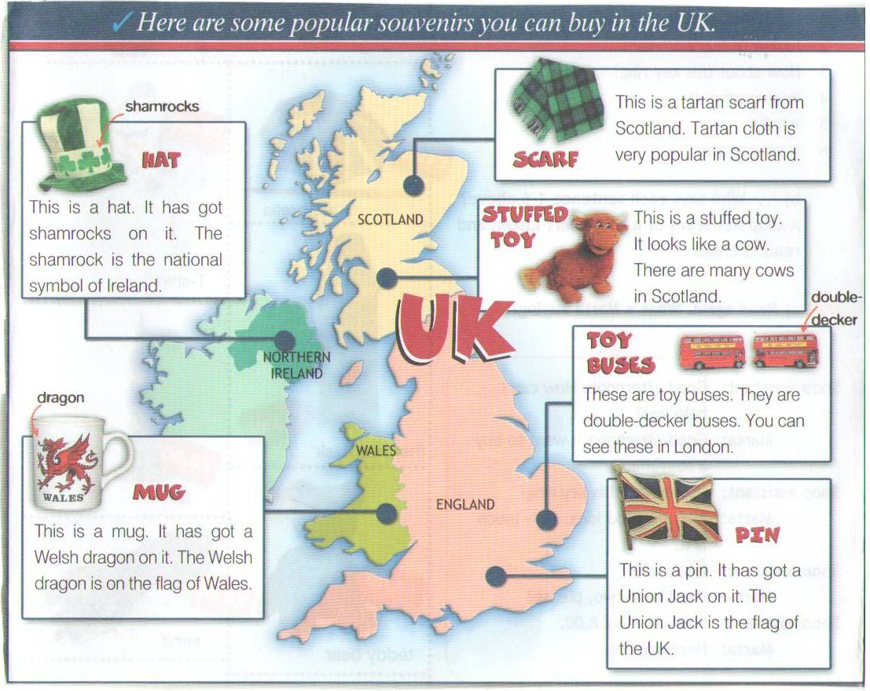

Slide 36
Answer Key
The scarf is Scottish. You can buy a tartan scarf in Scotland.
The stuffed toy is Scottish. You can buy a stuffed toy (like this) in Scotland.
The toy buses are English. You can buy toy buses in England.
The mug is Welsh. You can buy a mug (like this) in Wales.
The pin is British. You can buy a(Union Jack) pin in England.

Slide 37
Homework
SB ex 4, p 41
(a project on popular Russian souvenirs)

Slide 38


