Slide 1
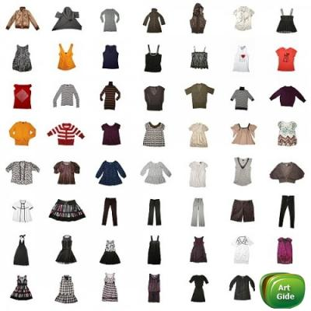
APPEARANCE, CLOTHES

Slide 2
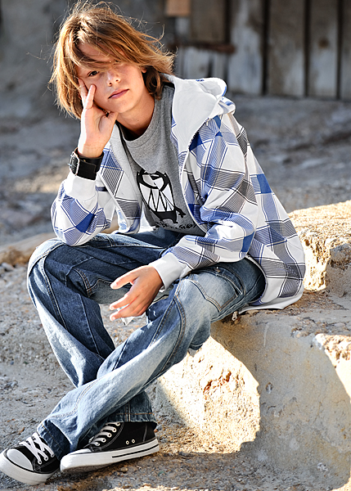
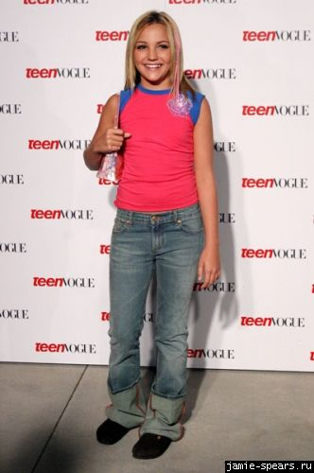
What are they wearing?

Slide 3
Present Simple Present Progressive
+ V/Vs
- DON’T/DOESN’T + V
? DO…/DOES… V…?
+ AM, IS, ARE + Ving
- AM NOT, ISN’T,
AREN’T + Ving
? AM/IS/ARE….Ving…?

