Slide 1
The Invention of Airplanes
Выполнила:
Хаддис Елизавета

Slide 2
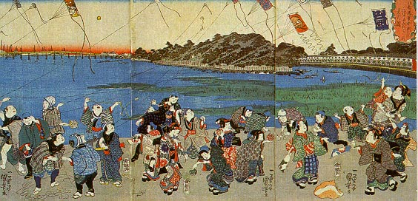
Paper kites used by the Chinese in religious ceremonies , for merriment and checking the weather conditions.

Slide 3
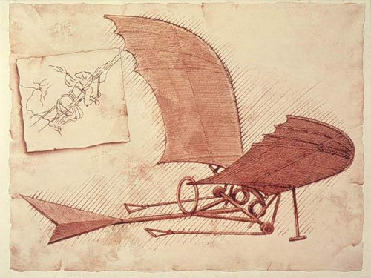
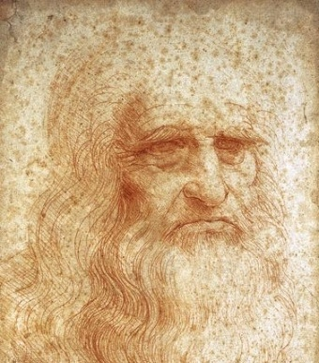
Leonardo da Vinci made the first real study of the flight. Later his theory was applied in practice in the 19 century.

Slide 4
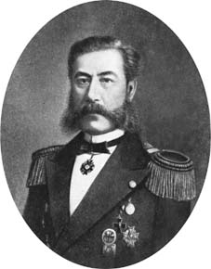
The first plane , built in natural size, made in Russia by Alexander Mozhaysky , but it was not able to rise into the air.

Slide 5
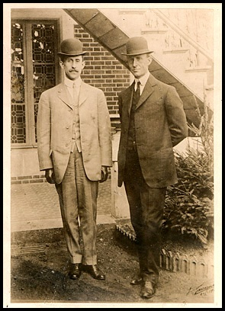
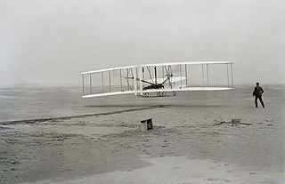
The first flight of the powered plane was on 17 December , 1903.It was built by the Wright brothers.

Slide 6
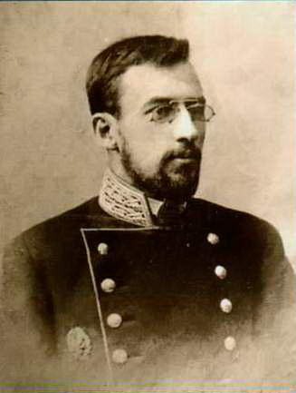
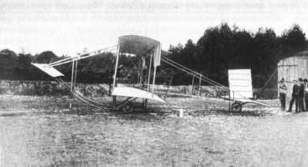
The first successes of the Russian aviation date back to the 1910 , when on 4 June the prince Alexander Kudashev flew on his own designed plane.

Slide 7
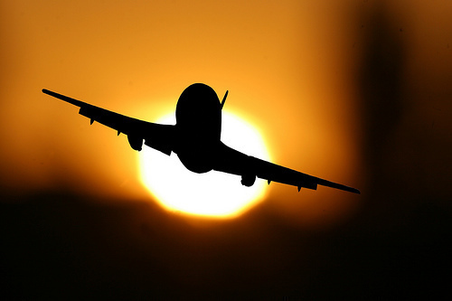
Now the mankind could fly! Over the 20 century were created new aircrafts and engines.

Slide 8
Test.
Where was a paper kite invented?
Russia
China
US
Who made the first study of the flight?
Leonardo da Vinci
Igor Sicorsky
Alexander Mozhaysky?
China
Leonardo da Vinci

Slide 9
The first plane, built in real size made by:
Alexander Kudashev
Alexander Mozhaysky
Yakov Gakkel
The first powered aircraft was made by:
Brothers Wright
Otto Lilienthal
Ader Clement
When was the first flight of the plane?
4 June 1910
16 June 1910
17 December 1903
Alexander Mozhaysky
Brothers Wright
17 December 1903

Slide 10
Links
http://www.izobreteno.ru/2.php
http://en.wikipedia.org/wiki/Fixed-wing_aircraft
http://eco-driving.ru/blog/post/364
http://zapravdu.ru/content/view/18/
http://ru.wikipedia.org/wiki/%D0%A4%D0%B0%D0%B9%D0%BB:Kudashev.jpg
http://upload.wikimedia.org/wikipedia/commons/thumb/8/86/First_flight2.jpg/320px-First_flight2.jpg
http://fotki.yandex.ru/users/promanergo/view/376469/?page=92
http://www.interfax.by/mosaic/1047543
http://images.yandex.ru/yandsearch?rpt=simage&ed=1&text=%D0%B1%D1%80%D0%B0%D1%82%D1%8C%D1%8F%20%D1%80%D0%B0%D0%B9%D1%82&p=37&img_url=www.fi.edu%2Fflights%2Ffirst%2Finline%2Fpairbig.jpg
http://ru.wikipedia.org/wiki/%D0%9B%D0%B5%D0%BE%D0%BD%D0%B0%D1%80%D0%B4%D0%BE_%D0%B4%D0%B0_%D0%92%D0%B8%D0%BD%D1%87%D0%B8
http://lib.rus.ec/b/313591/read

