Slide 1
Operating systems

Slide 2
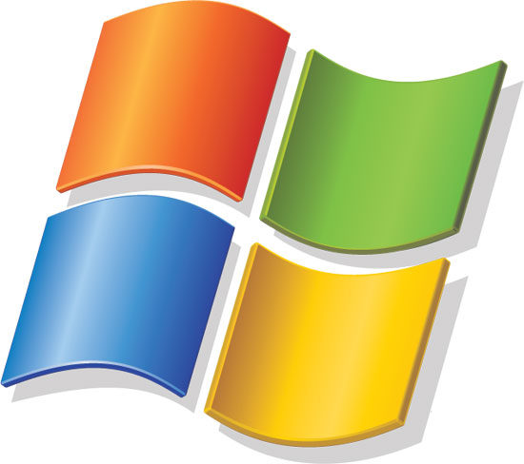
Windows

Slide 3
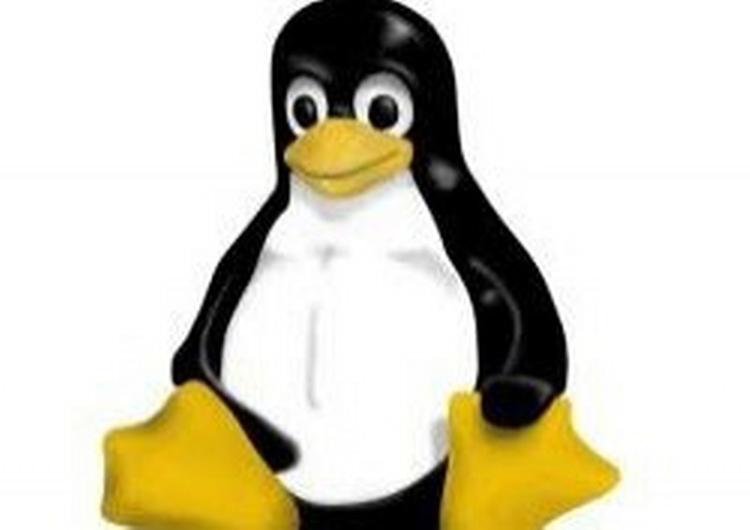
Linux

Slide 4
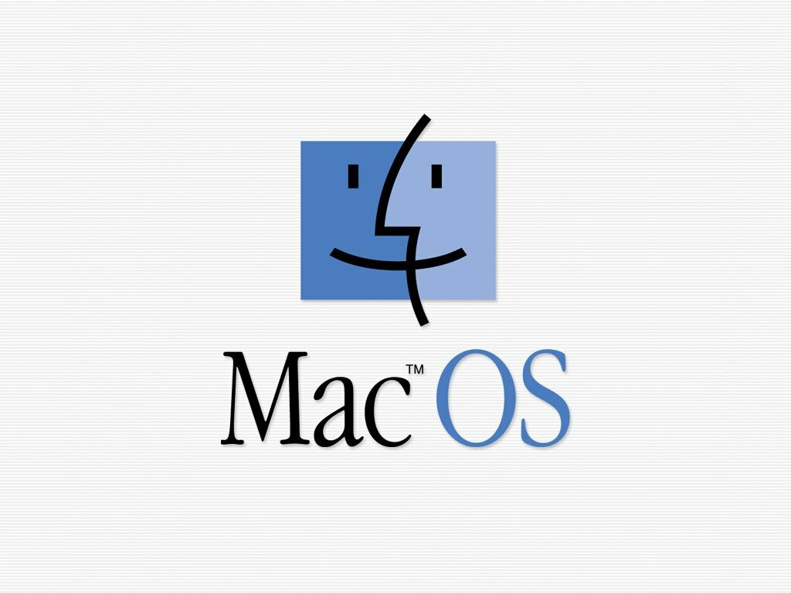

Slide 5
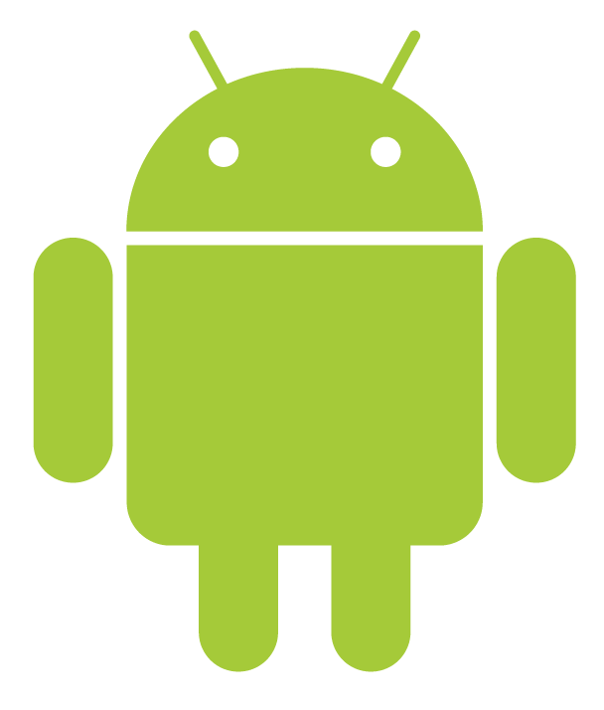
Android

Slide 6
Лексика
Operating system
Interface
Applications program
Word processor
Spreadsheet
Supervisor program
Resident program
Nonresident program
Command driven

Slide 7
Лексика
Multi – user
Multi – tasking
Graphically – oriented
Kernel
Source code
Open source
Free Software Foundation
Modify
Fix bugs
Add new features

Slide 8
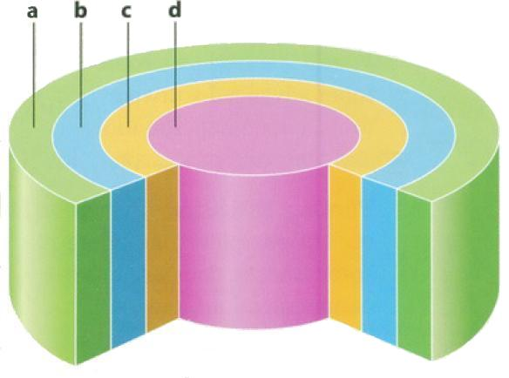
A conceptual diagram of an operating system
Match the labels to the four layers of this diagram with the help of the diagram caption
Applications programs
User
Hardware
Operating system

Slide 9
Test
This OS is used on Apple Macintosh microcomputers
Windows 7
NetWare
MacOS

Slide 10
Test
This OS is used on Apple Macintosh microcomputers
Windows 7
NetWare
MacOS

Slide 11
Test
Linux is a related to
Windows
Unix
Android

Slide 12
Test
Linux is a related to
Windows
Unix
Android

Slide 13
Test
Linux was created by
Free Software Foundation
A university student
Bill Gates

Slide 14
Test
Linux was created by
Free Software Foundation
A university student
Bill Gates

Slide 15
Test
The latest version of windows is
Windows Vista
Windows NT
Windows 7

Slide 16
Test
The latest version of windows is
Windows Vista
Windows NT
Windows 7

Slide 17
Test
This Operating system is distributed as freeware
Unix
Linux
Mac OS

Slide 18
Test
This Operating system is distributed as freeware
Unix
Linux
Mac OS

Slide 19
Test
The source code of this operating system is freely available
Windows 7
Linux
Mac OS

Slide 20
Test
The source code of this operating system is freely available
Windows 7
Linux
Mac OS

Slide 21
Test
An operating system lies
Between the user and the hardware
Between the applications program and the hardware
Between two computers

Slide 22
Test
An operating system lies
Between the user and the hardware
Between the applications program and the hardware
Between two computers

Slide 23
Test
If the operating system has an open source you can
Develop or fix bugs in the software
Input data by voice
Close it

Slide 24
Test
If the operating system has an open source you can
Develop or fix bugs in the software
Input data by voice
Close it

