Slide 1
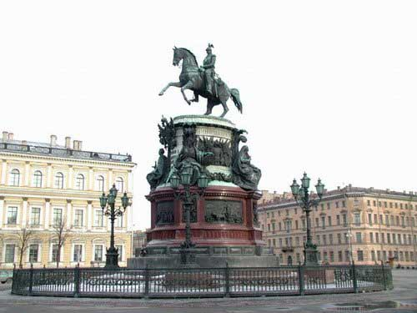
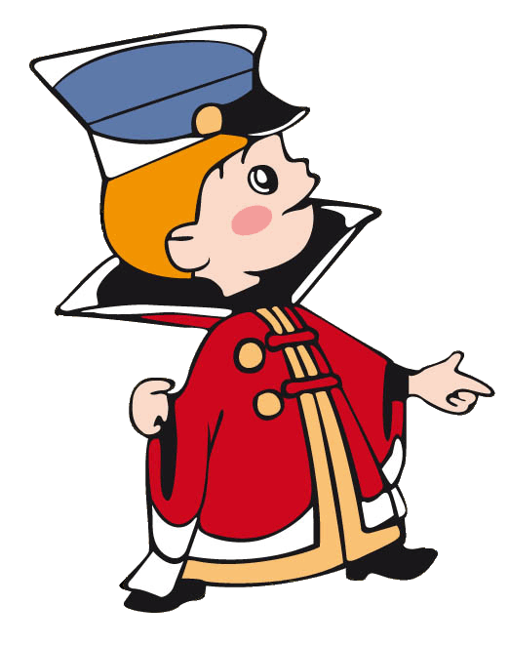
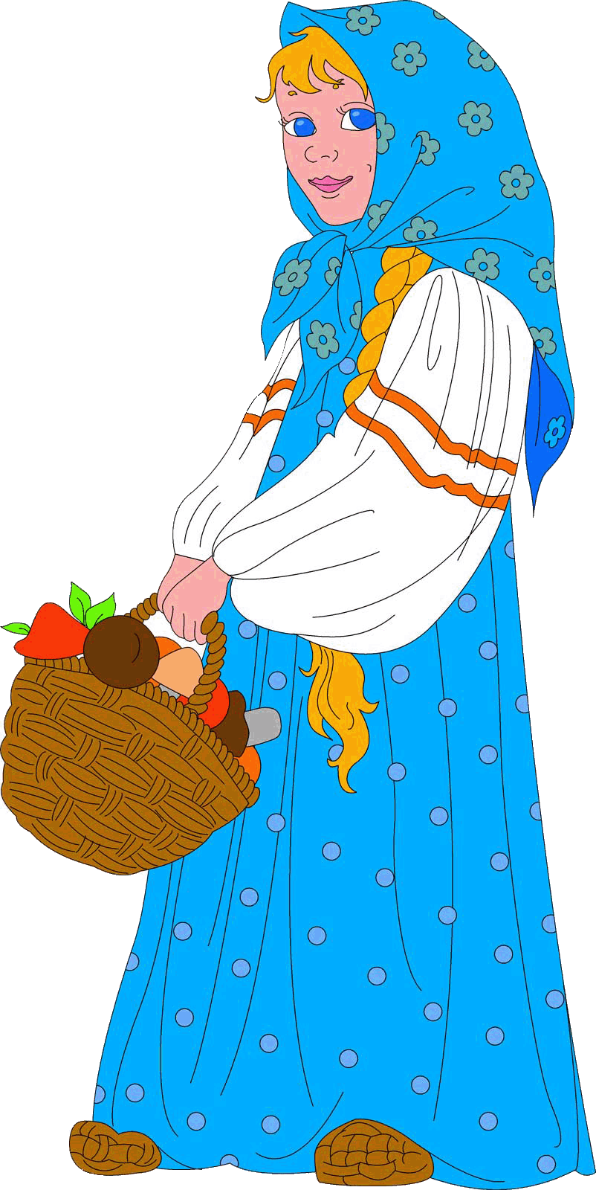
It’s our first day in St. Petersburg, and we don’t know our ways. Where are we now?
Yes?
Excuse me!

Slide 2
You are at the corner of Nevsky Prospect and the Griboyedov Chanel. There’s the Kazan Cathedral across the street.
Ah, yes, of course! I know the Kazan Cathedral: I have seen it on a postcard. What a beautiful building, isn’t it.
Yes, it has a world-wide fame.

Slide 3
That’s right. Just walk along the embankment and take the first turning to the right.
Yes? And then?
Look here, and how do we get to the Russian Museum from here? I think it’s somewhere near.

Slide 4
Oh , thank you very much. It was most kind of you.
Then walk as far as the corner, and you will see the Russian Museum on your left.
It was pleasure.

