Slide 1
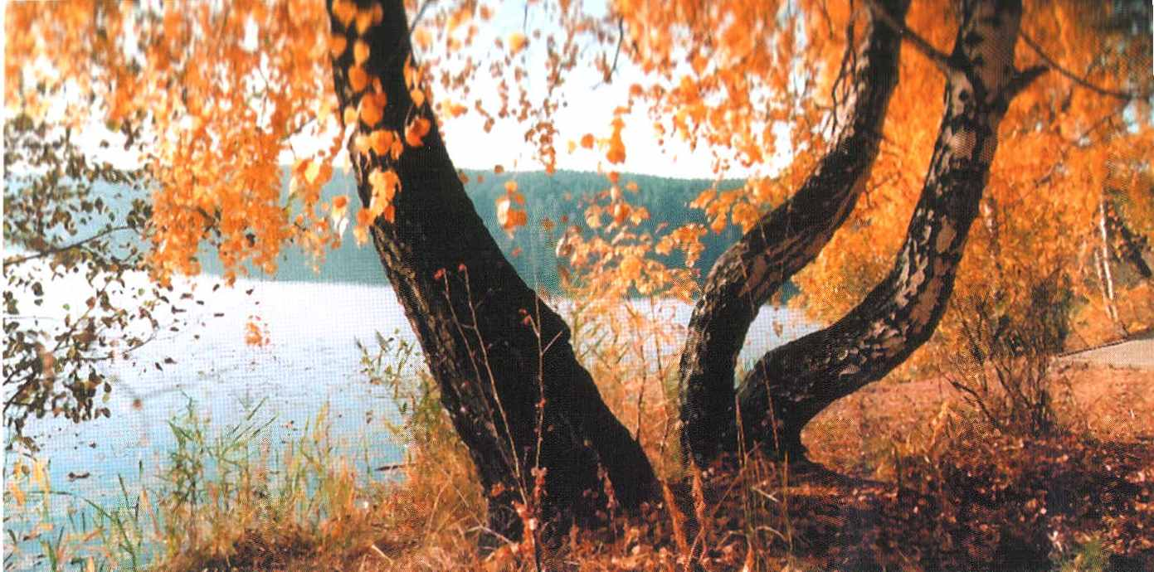
Trees of my country
Chudakova Svetlana
Form 7

Slide 2
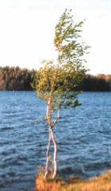
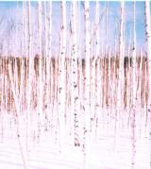
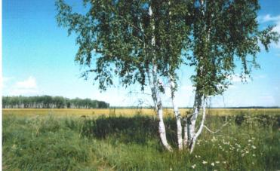
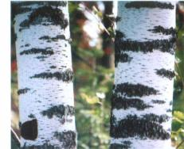

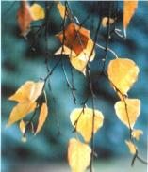
Birch
Birch is average. But it is white. It elegant winter and summer. Russian man close connected with birch. It gives firewood, planks and even medicine. Again birch is very beautiful.

Slide 3
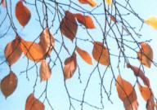
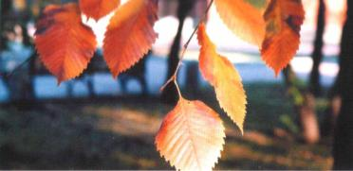
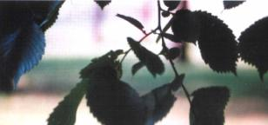
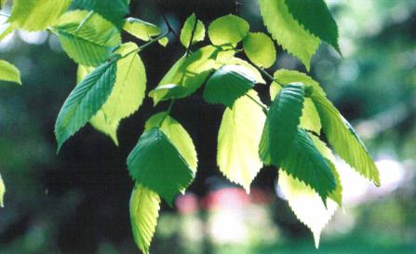
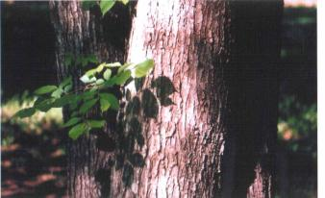
Elm
Leaf of elm is rather big. Its form resemble egg. Autumn leafs of elm are very beautiful. They are yellow as yolk reds as beet. Border of leaf is saw. Plate of leaf isn’t even but ribbed.

Slide 4
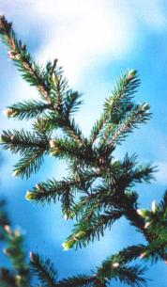
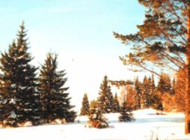
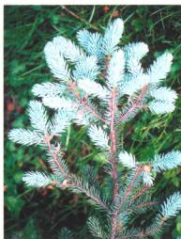
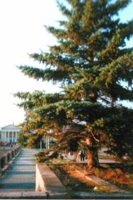
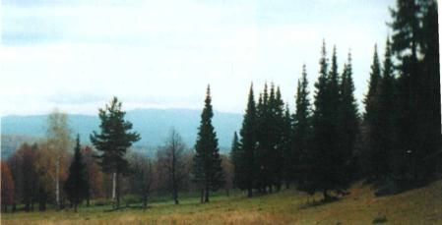
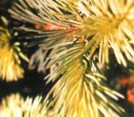
Fir
Fir is evergreen tree. «At soul» fir is tree earthly but celestial. Fir, perhaps, is the rightest tree in terms of form. Stem is even. Crown is perfect.

Slide 5
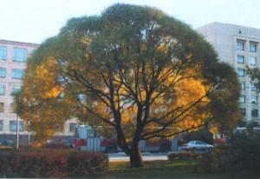
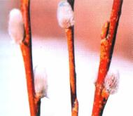
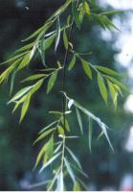
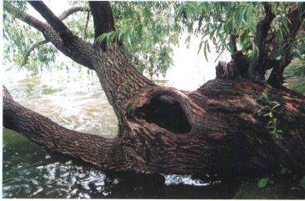
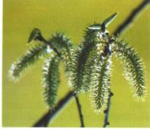
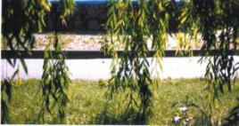
Willow
At love willow it is impatient. Water is better rhyme to willow. It is bloom earlier then other trees.Water willow on water table is image that occurs often. Willow isn’t fanciful. It is able to resurrection.

Slide 6
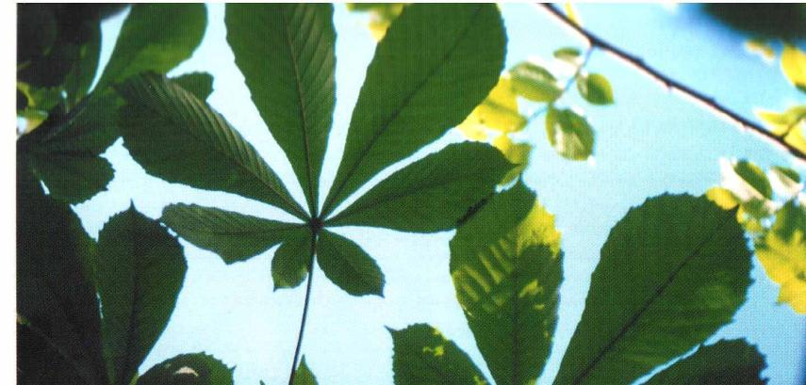
Chestnut
Chestnut is amazing tree. It grows nobly and don’t ail.It achieve four meters and bloom beautifully. Leaf of chestnut has five fingers.

Slide 7
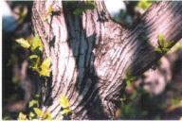
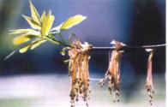
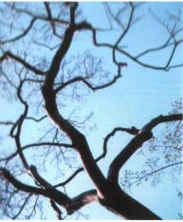
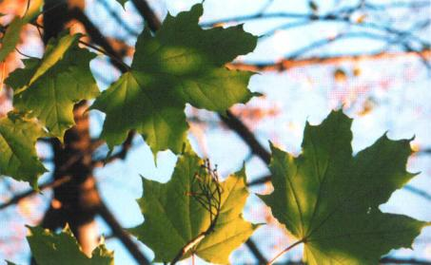
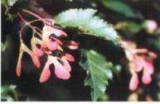
Maple
Maple of leaf is like image of gold autumn. Generous gold of maple autumn is like compensation sadness fading, deceit us by beauty of departure.

Slide 8
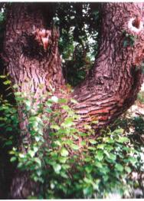
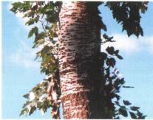
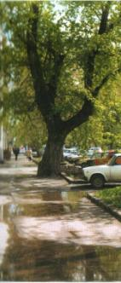
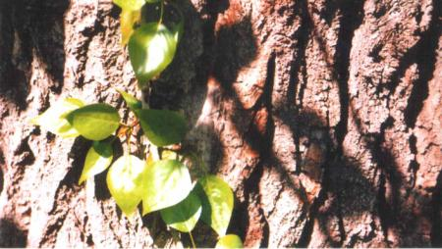
Poplar
Poplar is true citizen. Poplar is good among others trees. Poplar loves people, strains after them. And people must reply musicality its. Poplar grow everywhere . It is tenacious of life and fecund.

Slide 9
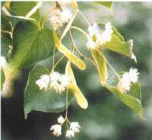
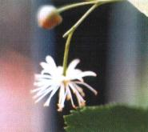
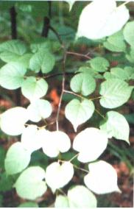
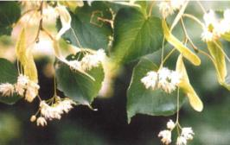
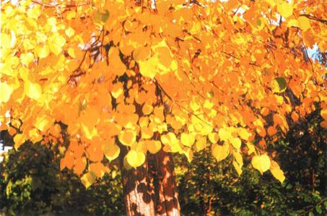
LIME
Flower of lime “sees” below. Sweet honey of lime was called “lipec” before. That is flower as if awaits meeting with bee.

Slide 10
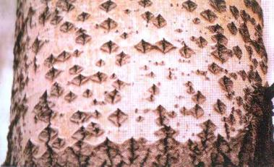
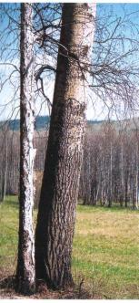
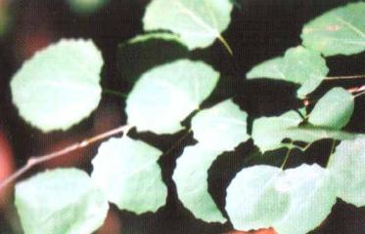
Aspen
Aspen is perfectly tree. Aspen is perhaps, not for people, but for beasts. Young, it is green with grey,or grey with green. Colour is not catched, and see it pleasantly.

Slide 11
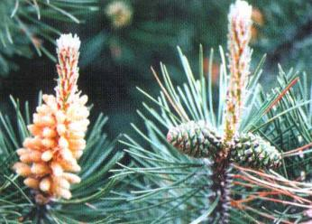
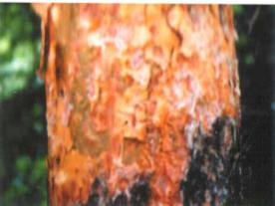
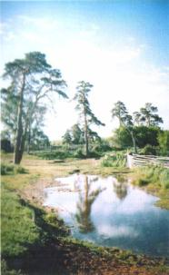
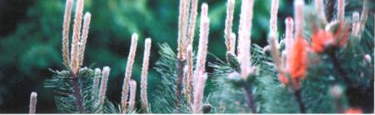
Pine
Pine is very interesting tree. Such tree begins from tiny mote. Cone ripens in autumn. It will open in winter or following spring. Seed fly out from cone, each is on its own flaps.

Slide 12


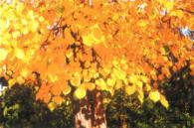
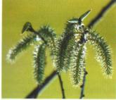




crossword

Slide 13

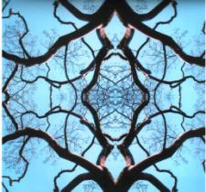


Answers
l
i
m
e
w
i
I
l | m
f
i
a
p
l
e
o | p | l | a | r
b
o
w
p | i | n
r
a
c
h | e | s | t | n | u | t
h
p
e
n

Slide 14
Quiz соотнесите названия деревьев, переставив буквы и найдите перевод
l e m poplar каштан
i l e m maple ива
l e p a m willow тополь
l a p r o p chestnut осина
n i p e aspen сосна
r i f lime клен
l o l w i w elm ель
tuntcseh pine береза
n e p a s fir липа
c h i b r birch вяз

