Slide 1
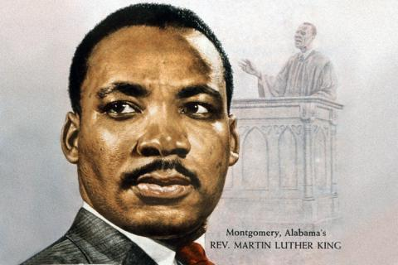
Martin Luther King
I have a dream
Дикая Н.А. , учитель английского языка,
ГОУСОШ № 347 с углубленным изучением английского языка
Санкт-Петербург

Slide 2
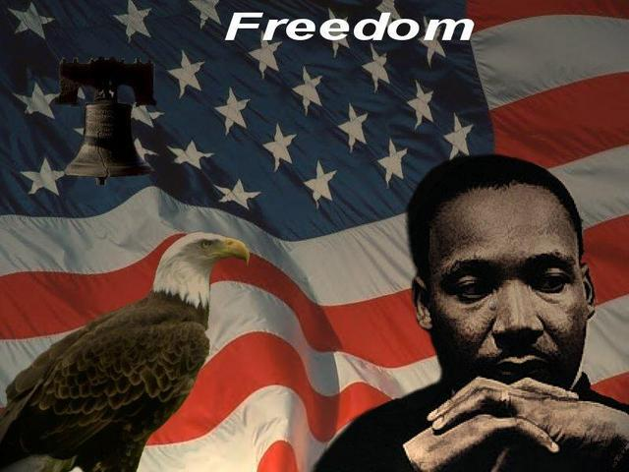
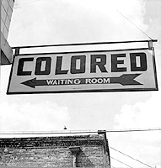

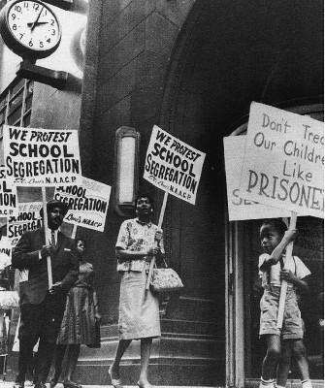
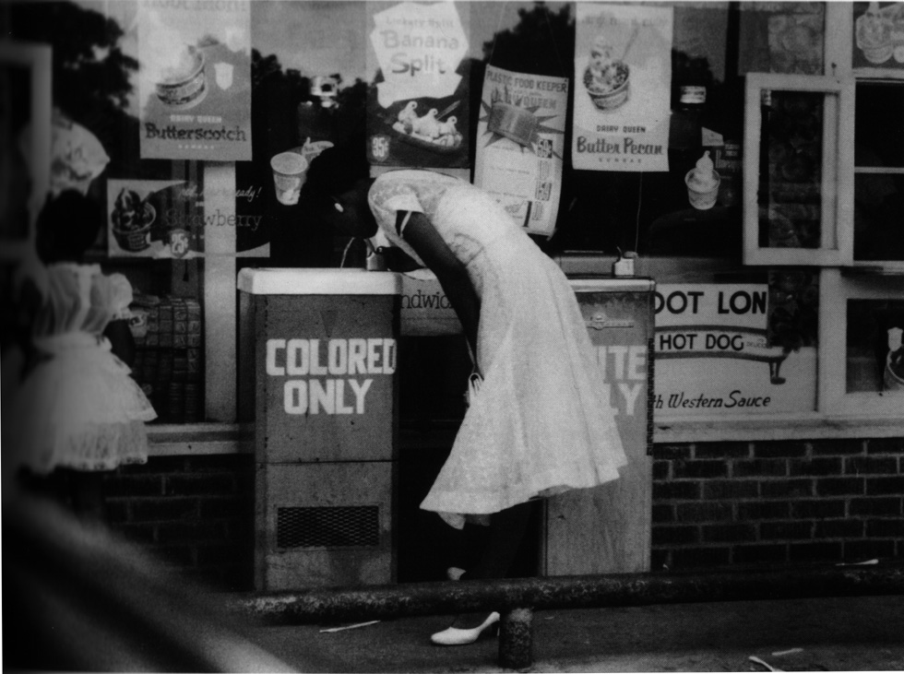

Slide 3
human rights
freedom
strike
preach
justice
organize
fight
for
persuade
independence
struggle
peace
protest
activity
war
slavery
support
help
racism
Hero
against
admire
unemployment
award
remember
poverty
child labour
violence
positive
brave
consequences
qualities
respect
trust
honest
arrest
negative
reliable
modest
exile
suffer
patient
helpful
loneliness
sacrifice
wise
deprive
assassinate
threaten

Slide 4
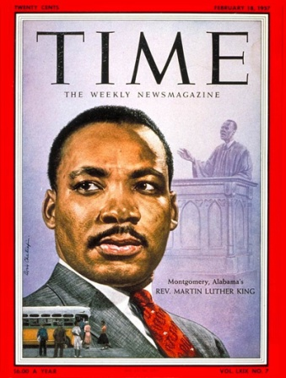
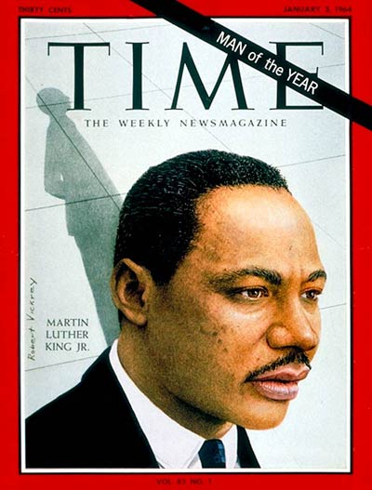
Do you believe that…
The third Monday in January is a federal legal holiday commemorating Martin Luther King’s birthday.
Time magazine chose him as Man of the year in 1963.
He wasn’t an educated person.
He was named Michel but late his name was changed to Martin Luther
He was against the war in Vietnam
He was 35 years old when he won The Nobel Peace Prize in
1964-the youngest man to ever receive this high honour.
He didn’t have any children.
The person who influenced him most was Nelson Mandela.

Slide 5
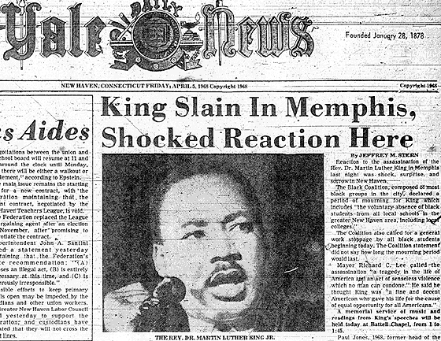
This technique is called INSERT
“”
information is known
“”
new information
“-”
you don’t think so
“?”
you don’t understand, or have further questions
I- interactive
N- noting
S- system
E- effective
R- reading
T- thinking

Slide 6

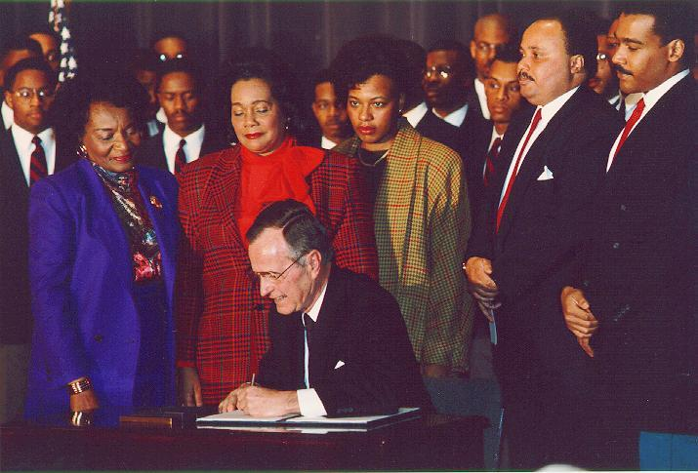
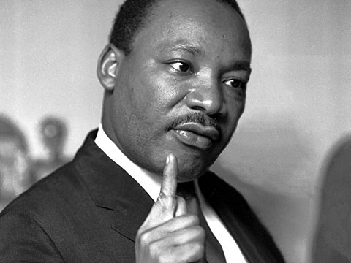
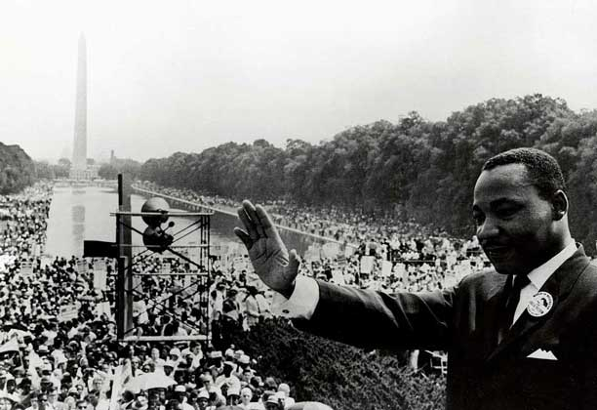
Text.

Slide 7
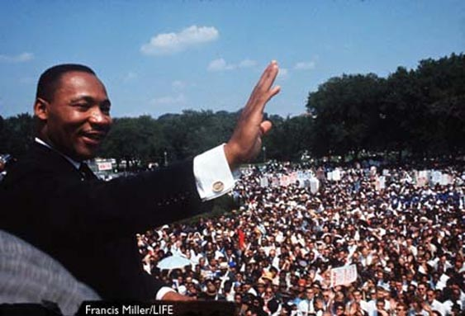



Slide 8


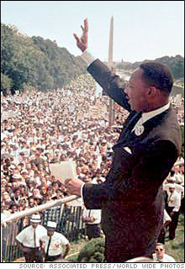
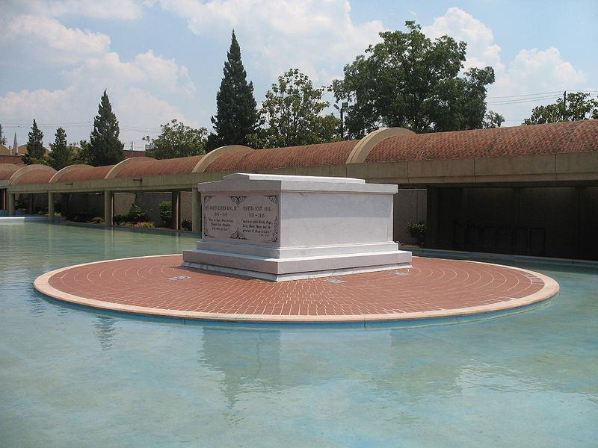
advantages | disadvantages

Slide 9
human rights
freedom
strike
preach
justice
organize
fight
for
persuade
independence
struggle
peace
protest
activity
war
slavery
support
help
racism
Hero
against
admire
unemployment
award
remember
poverty
child labour
violence
positive
brave
consequences
qualities
respect
trust
honest
arrest
negative
reliable
modest
exile
suffer
patient
helpful
loneliness
sacrifice
wise
deprive
assassinate
threaten

Slide 10
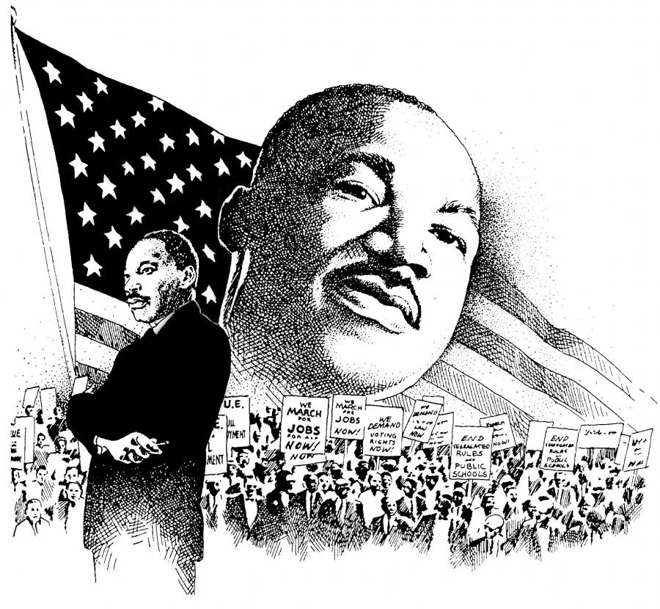

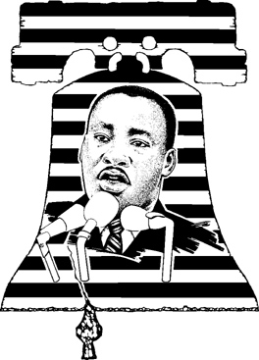
Cinquains
1. Martin Luther King
2. honest, brave
3. to fight, to help, to protest
4. He was against racism
5. hero

Slide 11
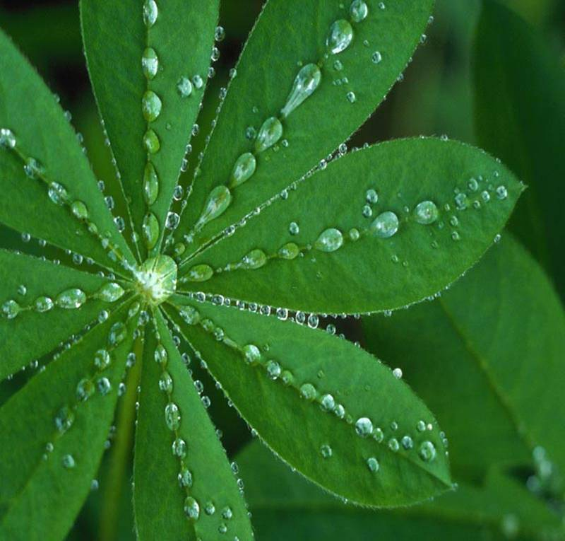
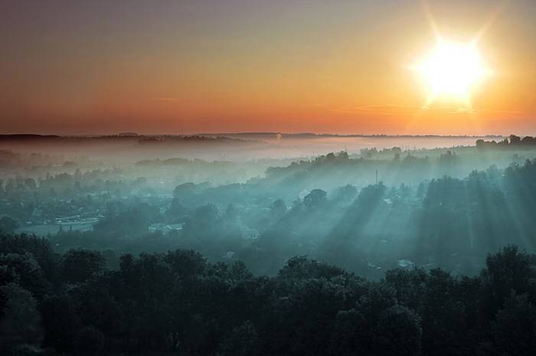
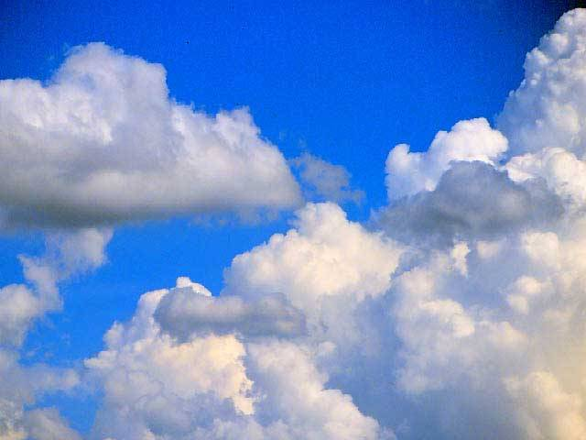
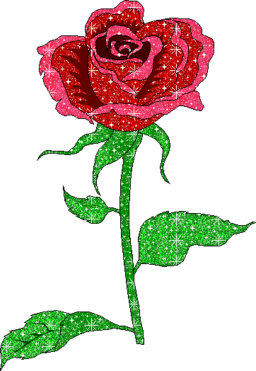
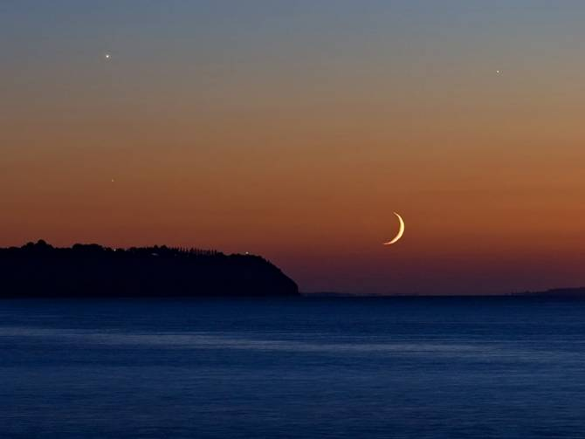
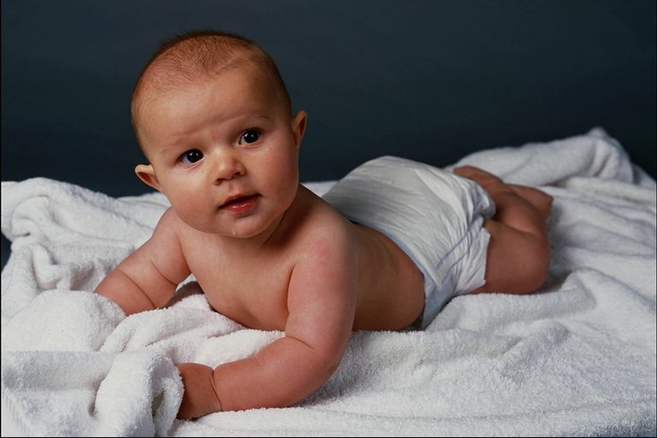
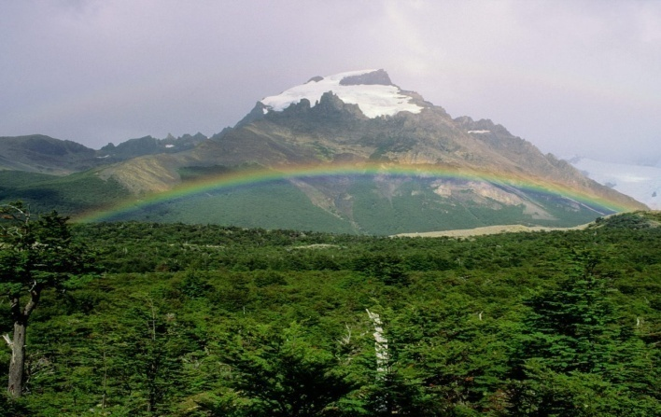

What wonderful world

Slide 12
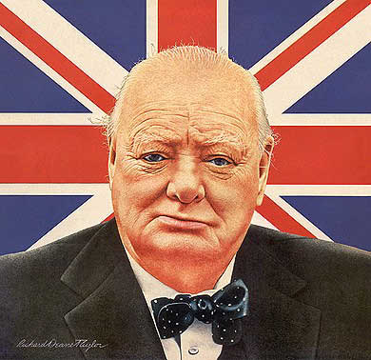
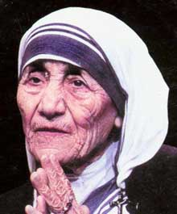
Home work
Epigraph
All the great things are simple,
and many can be expressed in a single word:
freedom, justice, honour, duty, mercy, hope.
Winston Churchill .
We can do not great things-only small things with great love.
Mother Teresa.

