Slide 1
“WELCOME TO AMERICA”
“Добро пожаловать в Америку”
Names of America
Nickname of America
Discovery of America
Symbols of America
American holidays
Tradition of American clothes

Slide 2
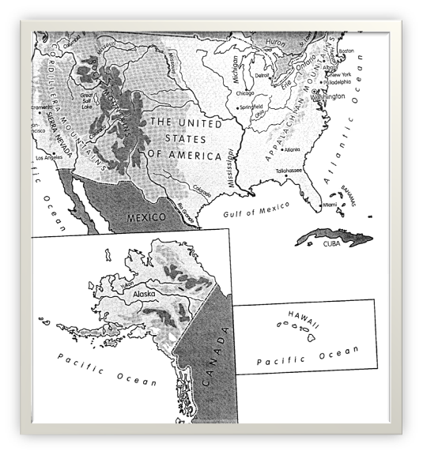
America is a great country. In our days everybody knows what the word “America” means. It is the name of the country – the United States of America. And it is the name of the two continents – North America and South America.

Slide 3
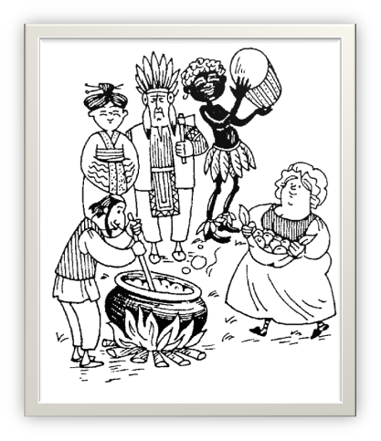
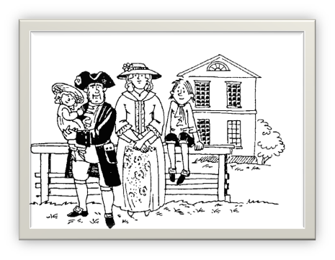
The country is usually called “melting pot”, “salad bowl”, “vegetable soup” because there are many immigrants of different nationalities from different countries in America.

Slide 4
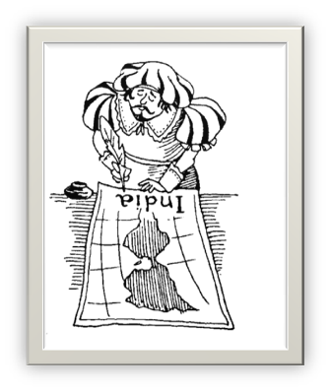
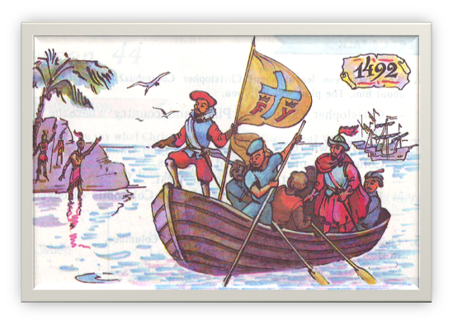
Christopher Columbus discovered America in 1492. It was a new continent, “the New World”.

Slide 5
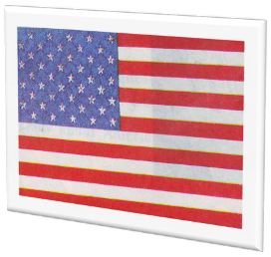
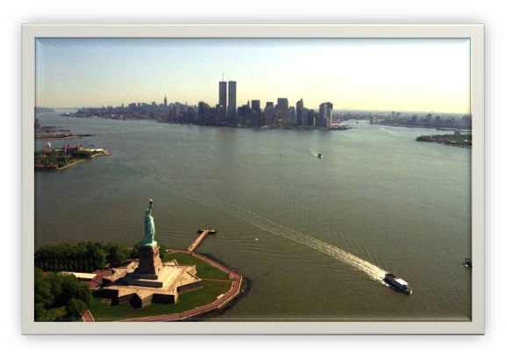
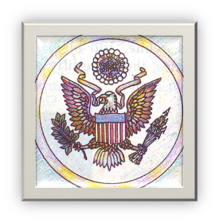
These are three national American symbols: the Statue of Liberty, the American flag, the eagle.

Slide 6
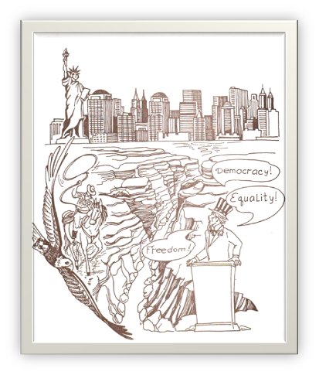
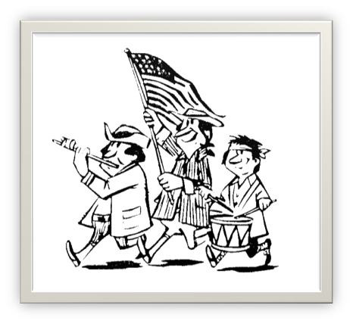
Independence Day is the greatest national holiday. It is the birthday of the American nation. It is celebrated on July 4th. George Washington was the first president of free states.

Slide 7
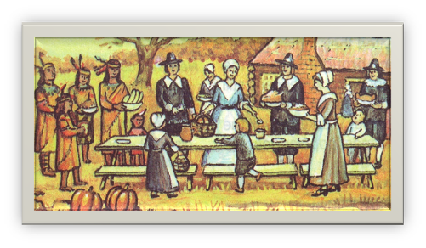

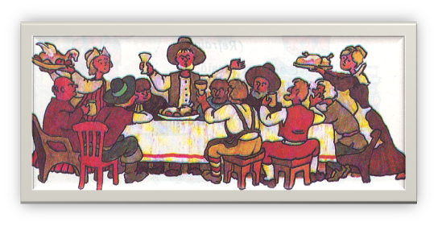

In the autumn of 1621, the pilgrims celebrated their first harvest festival in America and called it Thanksgiving Day.

Slide 8
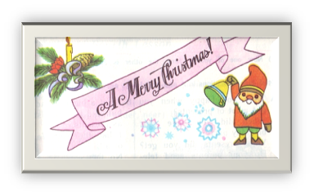
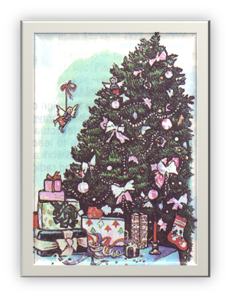
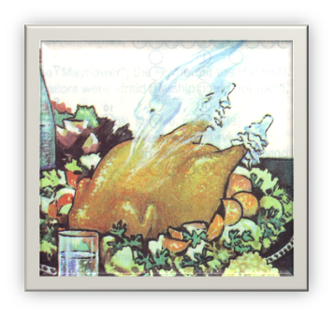
Christmas is a religious holiday. It is an old Christmas tradition to prepare special food for Christmas lunch: turkey, pudding.

Slide 9
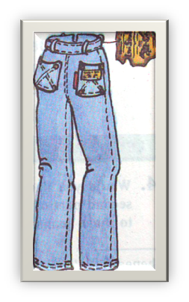
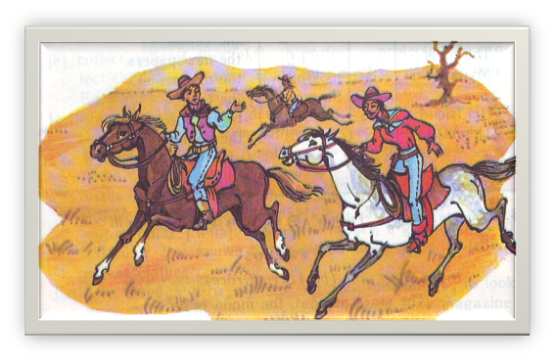
A cowboy was the best job in the West. Cowboys are really one of America’s most popular symbols of independence and bravery.

Slide 10

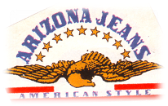
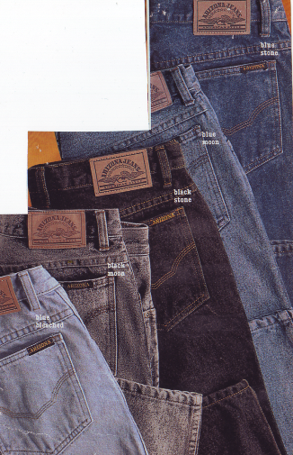
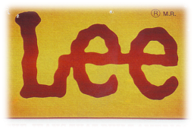
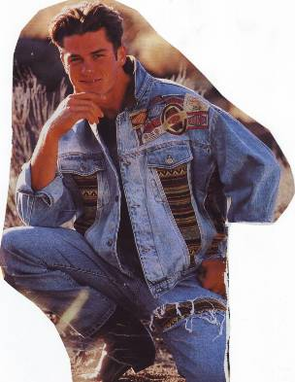

JEANS THAT BUILT AMERICA

Slide 11
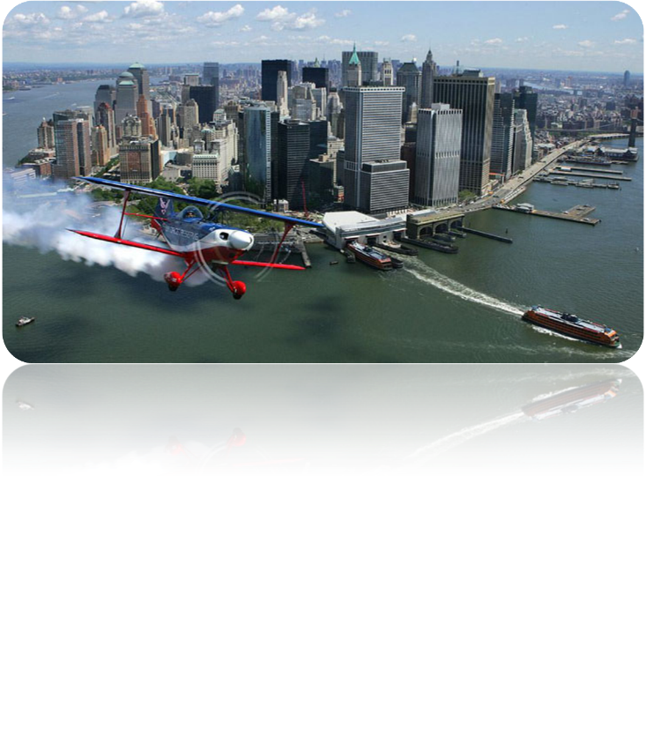
There are many interesting things in America. Welcome to America!

