Slide 1


Overview of the Electronic Waste Problem
Electronic waste is the fastest-growing waste stream, posing complex global challenges.
Преподаватель иностранного языка Горяинова В.В.
РТУ МИРЭА Колледж программирования и кибербезопасности

Slide 2



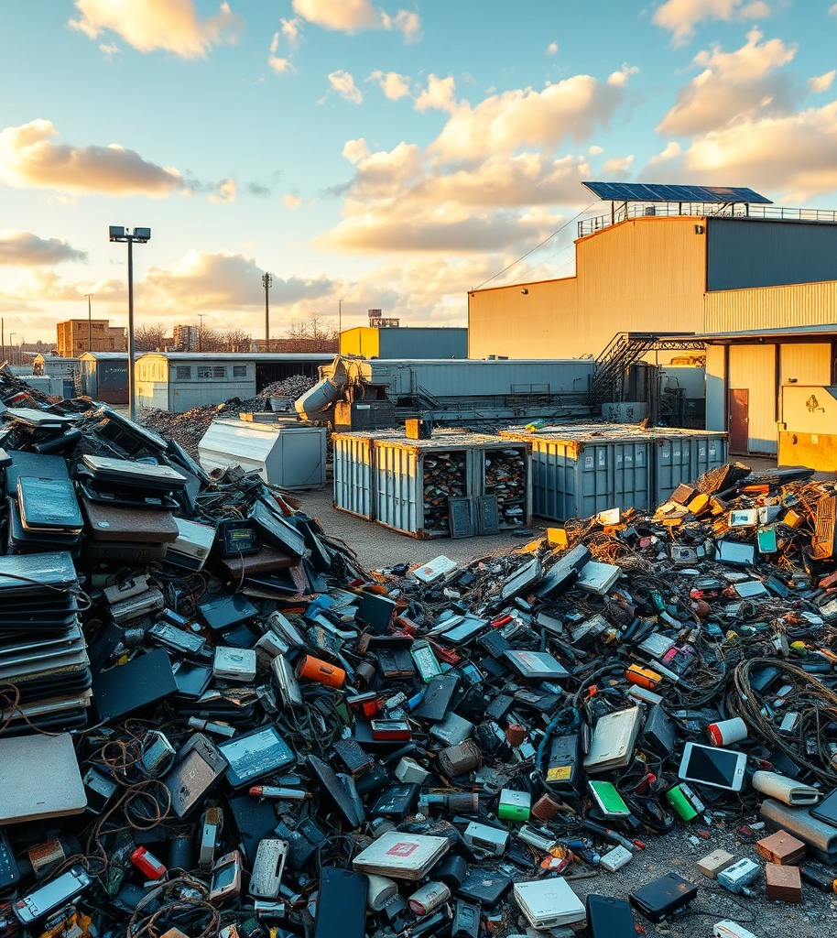
Understanding the Scale and Risks of E-Waste
In 2021, global electronic waste topped 57 million metric tons, fueled by growing consumption. While rich in valuable metals, e-waste also contains toxic substances harmful to health and the environment, especially where recycling is informal and unsafe.
2

Slide 3







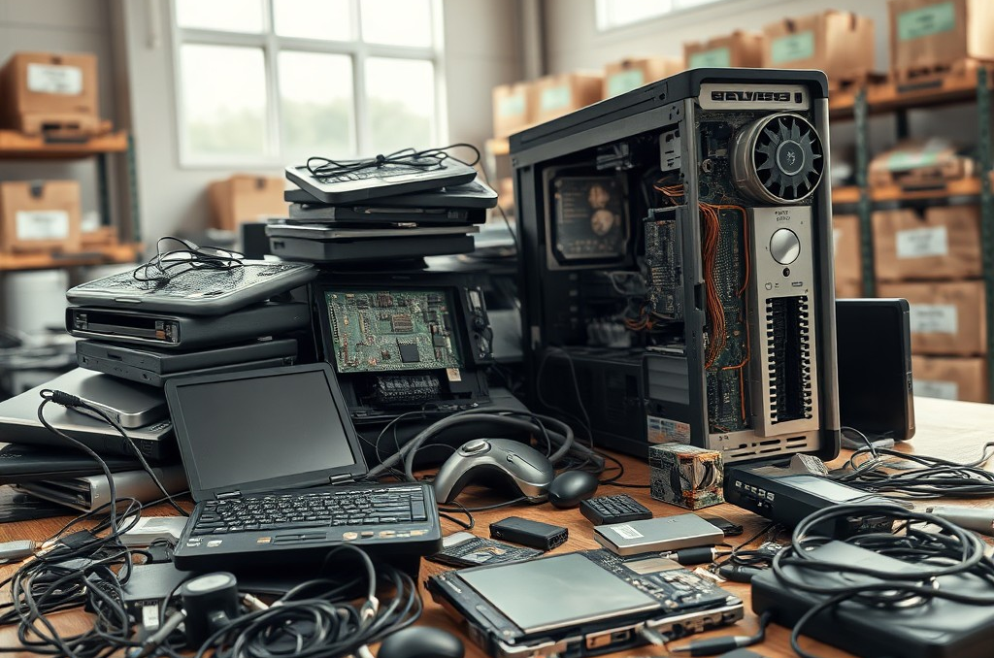
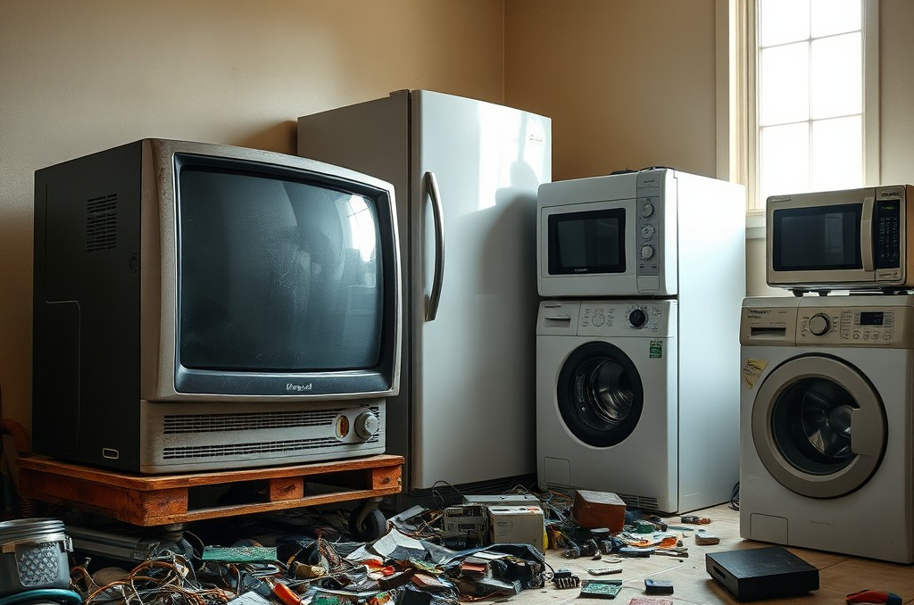
Common Sources and Types of E-Waste
Smartphones: Ubiquitous and Frequently Replaced
Smartphones contribute heavily to e-waste due to rapid technology cycles and consumer upgrades. Their batteries and components contain both precious and hazardous materials requiring careful handling.
Computers and IT Equipment
Discarded desktops, laptops, and peripherals form significant e-waste volumes. These devices contain metals like gold and copper but also toxic elements demanding specialized recycling.
Household Appliances and Television Sets
Old TVs, refrigerators, and microwaves comprise another major category. Their diverse materials and chemicals pose unique challenges for disposal and material recovery.
3

Slide 4

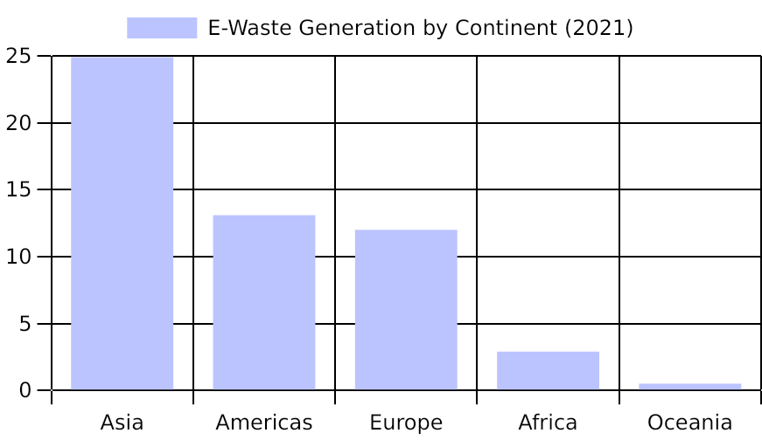
Global E-Waste Generation by Region (2021)
Asia's rapid industrialization and population growth drive its leading e-waste volumes, complicating management efforts.
Disparities highlight the need for tailored regional strategies addressing diverse recycling capacities and waste streams.
Global E-waste Monitor 2022
4

Slide 5






Environmental and Health Consequences of E-Waste
Exposure in Informal Recycling
Workers handling e-waste without protection face toxic metal poisoning and respiratory illnesses from smoke and dust.
Public Health Burdens Increase
Communities near disposal sites experience higher rates of chronic diseases linked to environmental contamination.
Toxic Leaching into Ecosystems
Hazardous substances from e-waste contaminate soil and waterways, threatening biodiversity and food safety.
Long-Term Ecosystem Degradation
Persistent pollutants accumulate in environments, causing gradual but irreversible ecological damage over decades.
5

Slide 6


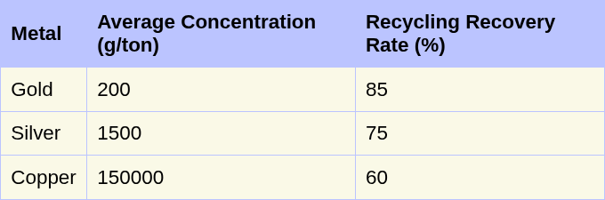
Material Composition and Recovery Potential in E-Waste
Metals such as gold, silver, and copper are found in e-waste at recoverable concentrations, reducing the need for mining when recycled effectively.
High recovery rates of precious metals from e-waste can significantly lower environmental mining impacts.
UNEP Global E-waste Report 2020
6

Slide 7

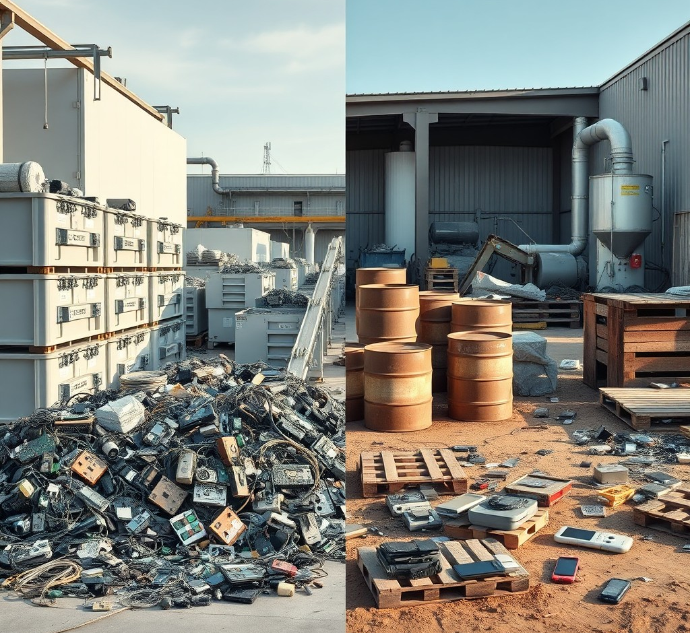
E-Waste Recycling Processes and Challenges
Formal Recycling Systems
Formal recycling involves structured collection, dismantling, and advanced material recovery techniques ensuring safety and efficiency.
Informal Sector and Associated Risks
Informal methods rely on unsafe manual dismantling, exposing workers to toxins and resulting in material loss and environmental pollution.
7

Slide 8
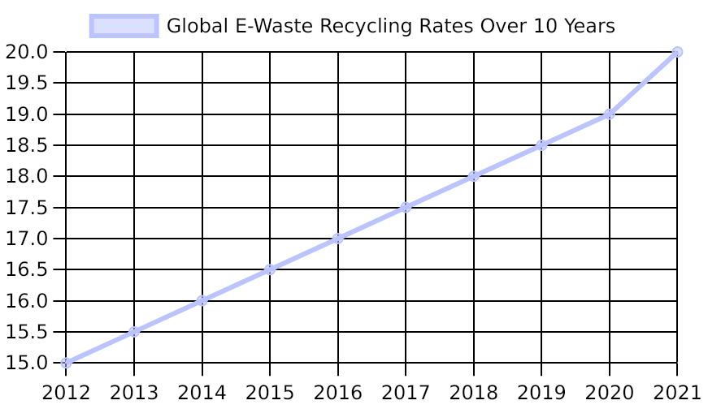
Trends in E-Waste Recycling Rates Globally
Developed countries maintain higher recycling rates, reflecting better infrastructure and regulations.
Despite improvements, most e-waste still escapes recycling, necessitating stronger policies and technologies.
Global E-waste Monitor 2022
8

Slide 9








Key Strategies and Innovations in E-Waste Management
Extended Producer Responsibility (EPR)
Consumer Awareness and Participation
Manufacturers are increasingly held accountable for their products’ end-of-life, promoting sustainable design and take-back programs.
Educating consumers on proper e-waste disposal encourages recycling and reduces landfill dumping.
Advanced Recycling Technologies
International Cooperation
Urban mining and automated sorting improve material recovery, enhancing efficiency and environmental safety.
Global partnerships facilitate knowledge sharing and harmonized policies, addressing cross-border e-waste challenges.
9

Slide 10

Shaping the Future of E-Waste Management
Addressing e-waste requires coordinated policy, innovative technology, and education to foster sustainable consumption and circular economy growth globally.

