Slide 1
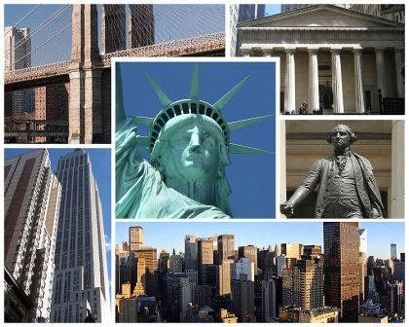

New York, New York.
Агапова Н. А. МОУ «СОШ №6» г.Новомосковска Тульской области.

Slide 2
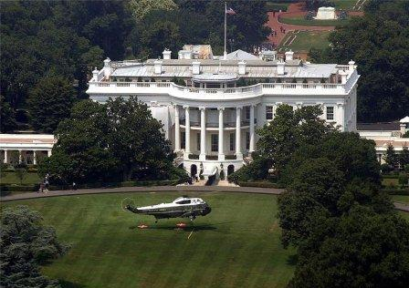
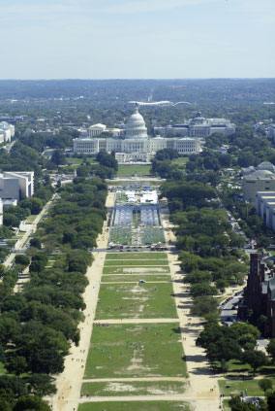
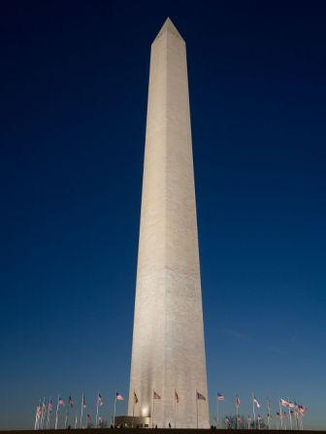
Washington D.C.
Агапова Н. А.

Slide 3
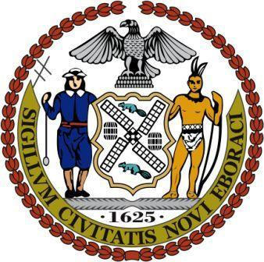
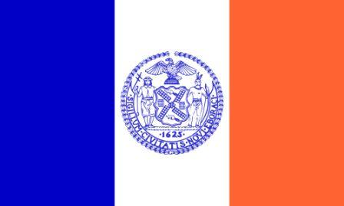
The flag and the
national emblem of
New York
Агапова Н. А.

Slide 4
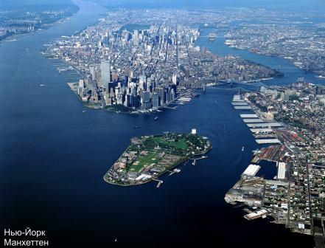
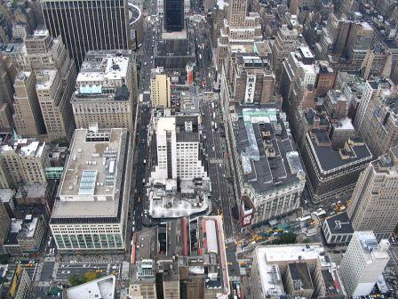
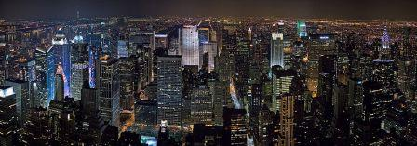
The Statue of Liberty, New York Harbor, the Empire State Building, Rockefeller Center , the United Nation Organization, the Chrysler building, the Metropolitan Opera, the Philharmonic Hall, the Bronx, Brooklyn, Queens, Richmond, Manhattan, the Jewish quarter, the Metropolitan Museum of Arts, The Solomon Guggenheim Museum, The Whitney Museum of Arts, the Brooklyn bridge, the Manhattan bridge, the Robert А Kennedy bridge, the George Washington Bridge.
Агапова Н. А.

Slide 5
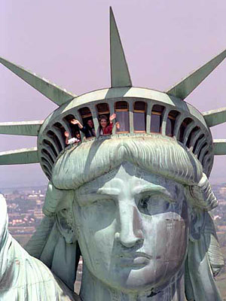
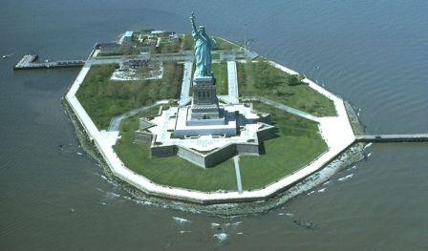
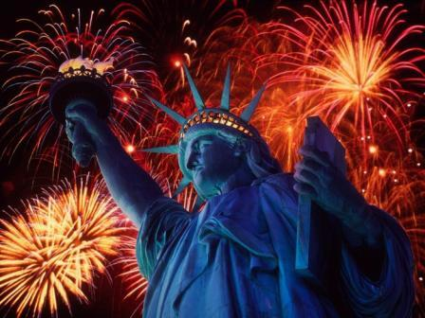
The Statue of Liberty
Агапова Н. А.

Slide 6
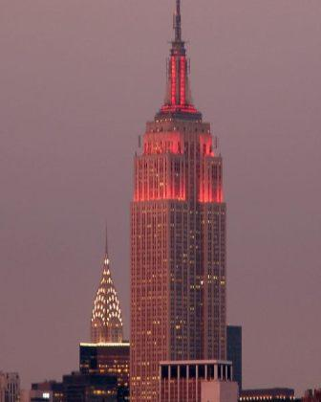
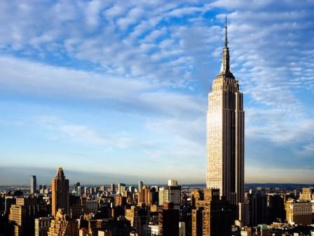
The Empire State Building
Агапова Н. А.

Slide 7
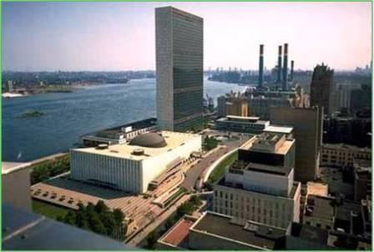
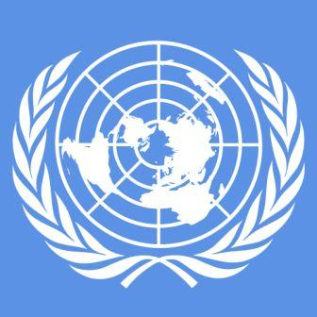
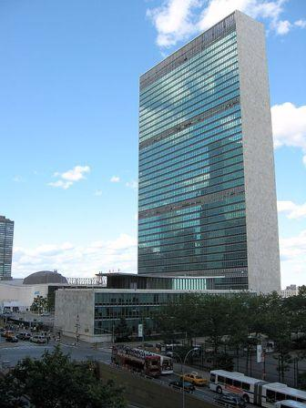
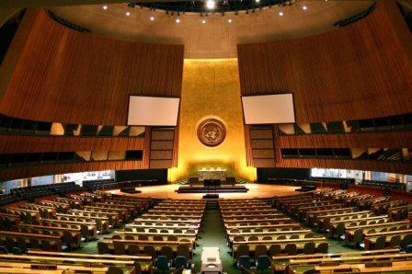
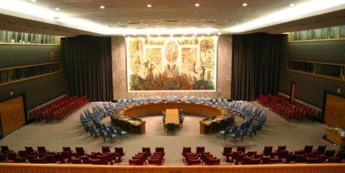
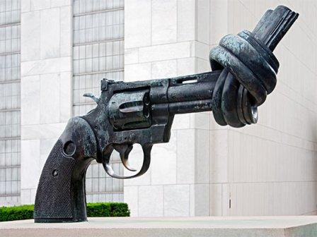
The United Nations headquarter
Агапова Н. А.

Slide 8
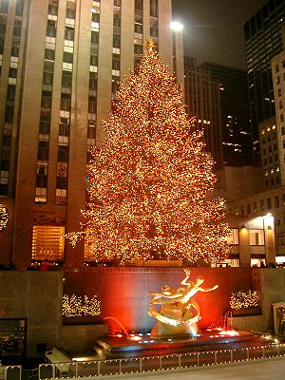
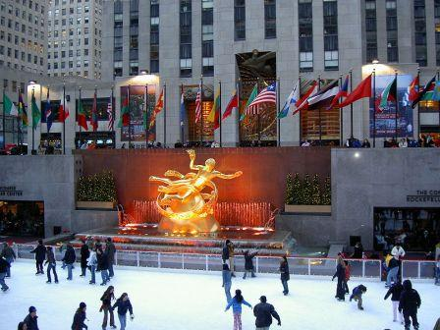
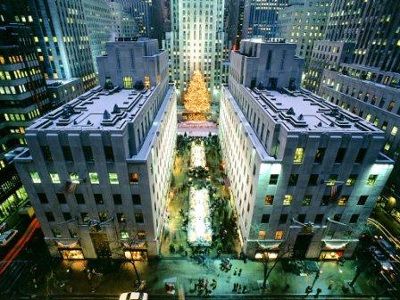
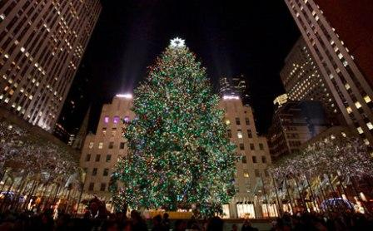
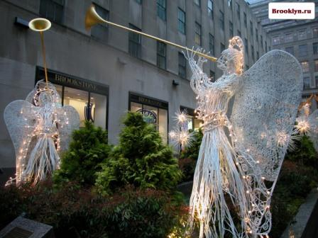
The Rockefeller Center
Агапова Н. А.

Slide 9
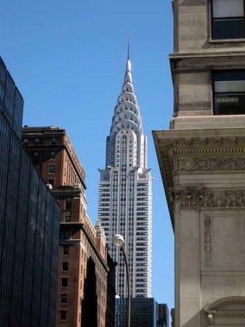
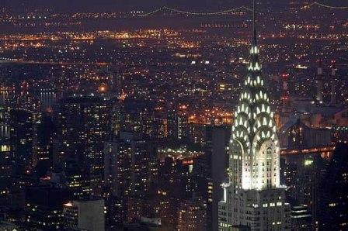
The Chrysler Building
Агапова Н. А.

Slide 10
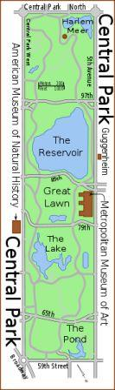
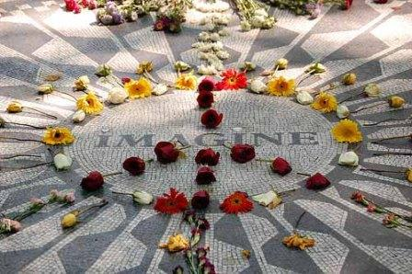
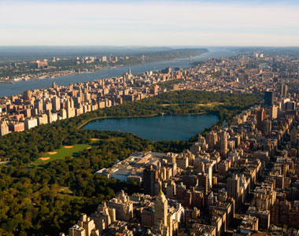
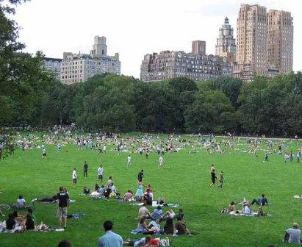
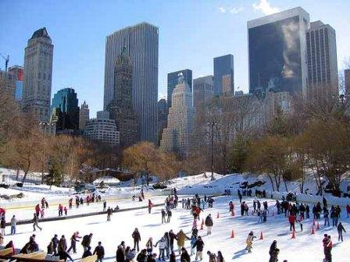
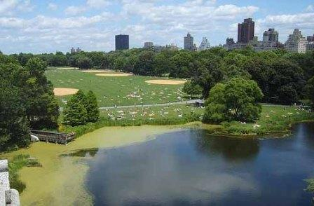
The Central Park
Агапова Н. А.

Slide 11
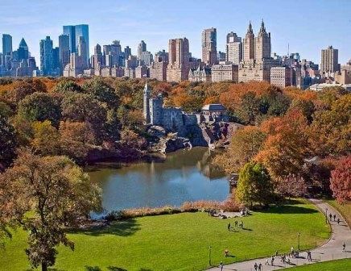
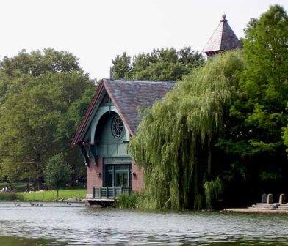
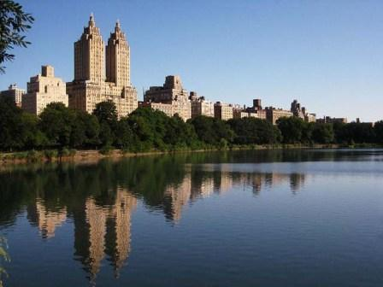
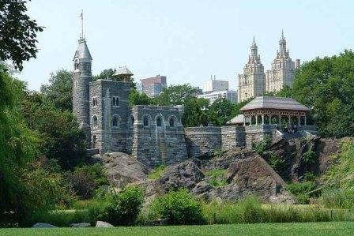
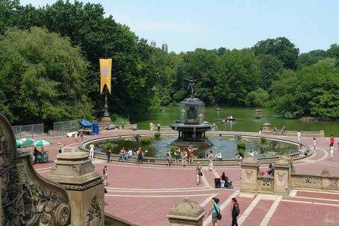
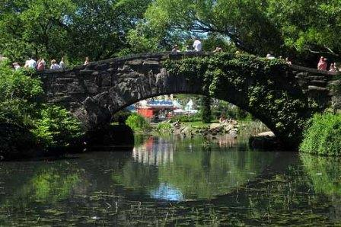
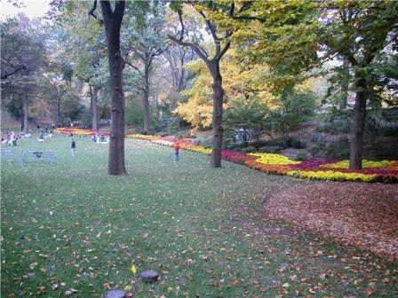
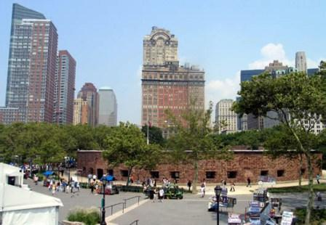
Агапова Н. А.

Slide 12
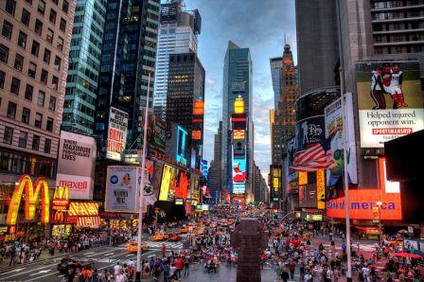
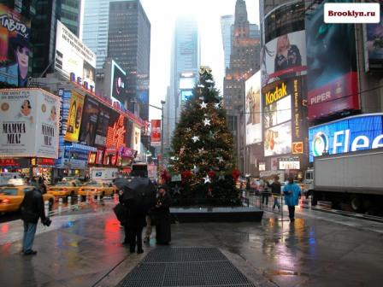
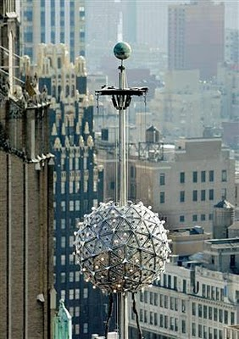
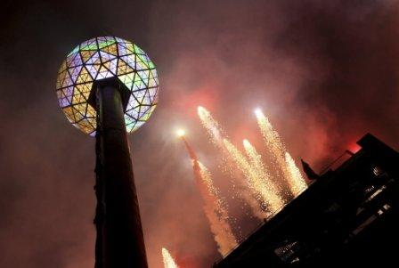
Times Square
and New Year’s
Eve ball
Агапова Н. А.

Slide 13
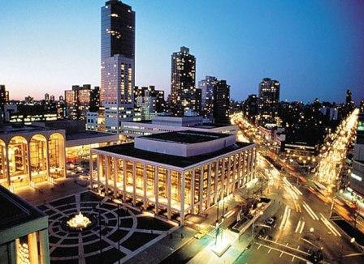
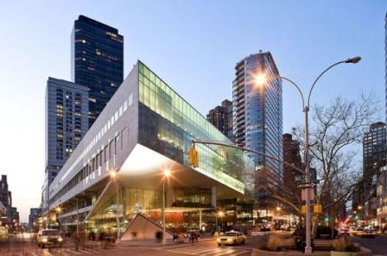
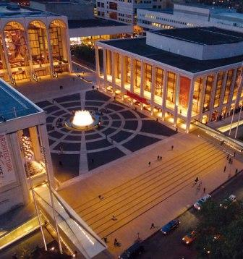
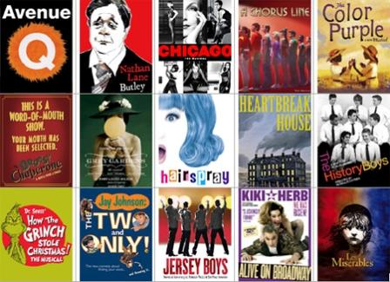
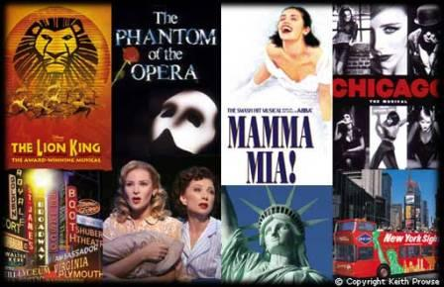


The Lincoln Center
Агапова Н. А.

Slide 14





Broadway and
the Fifth Avenue
Агапова Н. А.

Slide 15



The islands of New York:
Manhattan, Long Island
and Staten Island
Агапова Н. А.

Slide 16


The boroughs of New York
The city may be described as a collection of many neighbourhoods, each with its own character and life-style. Manhattan is the economic and cultural heart of the city. Only Brooklyn of the other boroughs has a similar range of social life. Queens is mainly residential and middle class, and Staten Island is partly suburban but still rural in some areas. In the Bronx luxurious residences and solid middle-class apartments prevail in some sections. Агапова Н. А.

Slide 17





Manhattan
The Bronx
Staten Island
Brooklyn
Queens
Агапова Н. А.

Slide 18





Ethnic pockets abound throughout Manhattan, from black and Spanish Harlem in the north, to the various enclaves of the Lower East Side such as Little Italy and Chinatown. New York City also has large numbers of Irish, Puerto Ricans, and West Indians, as well as the largest Jewish population of any city in the world.
Harlem
Chinatown
Агапова Н. А.
Little Italy
The Jewish quarter

Slide 19



Wall street and The New
York Stock Exchange
Wall Street in Manhattan is home to the nation's largest stock exchange and is the headquarters of the country's largest brokerage firms.
Агапова Н. А.

Slide 20




The Solomon Guggenheim Museum
The Whitney Museum of Arts
Most famous among the city's many museums are the Metropolitan Museum of Art, the Solomon R. Guggenheim Museum, the Whitney Museum of American Art, and the American Museum of Natural History.
The Metropolitan Museum of Arts
The American Museum of Natural History
Агапова Н. А.

Slide 21




The Brooklyn bridge
The Manhattan bridge
Агапова Н. А.

Slide 22




The George Washington Bridge
The Robert А Kennedy bridge
Агапова Н. А.

