Slide 1
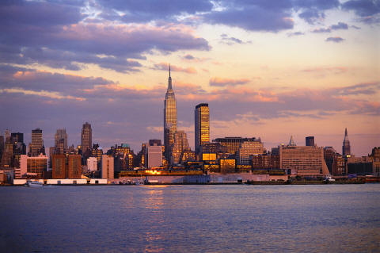
New York City!

Slide 2
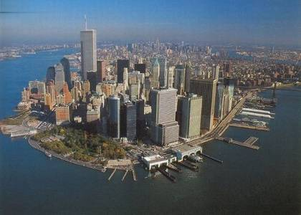
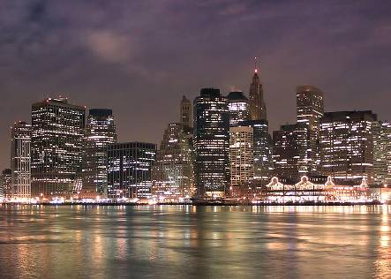
Manhattan is the main island of New York.

Slide 3
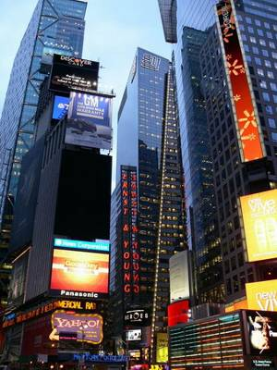
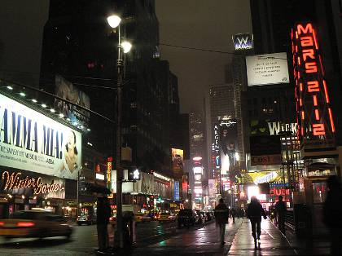
This is Broadway.
There are more than thirty theaters here!

Slide 4
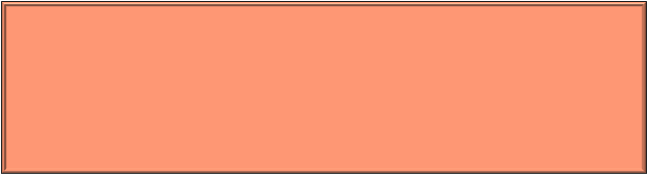
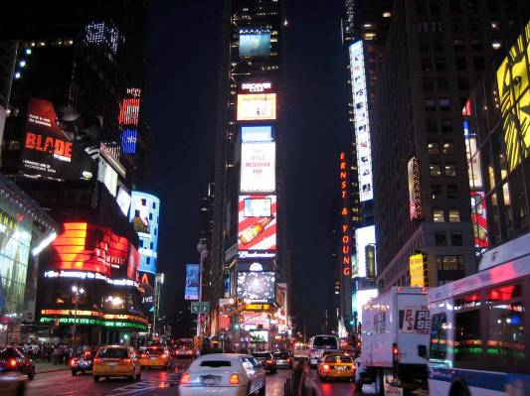
Times Square is the center of the theater district. The lights from all the theaters and advertisements are very bright.

Slide 5
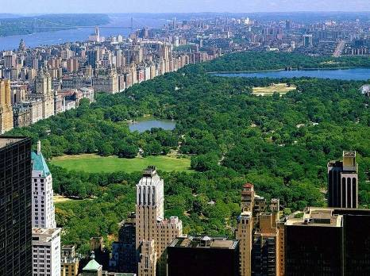
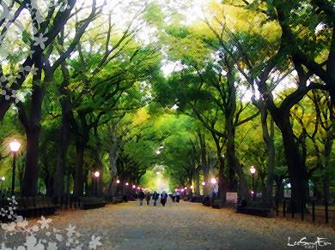
Central Park is used by thousands of New Yorkers and visitors every day. Here you will see families walking their dogs and young people riding their bikes and roller – skating.

Slide 6
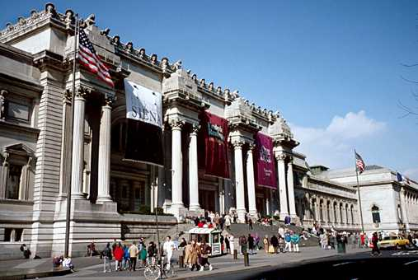
The Metropolitan Museum of Art is the famous art museum in New York. It has great art collections from all over the world. It’s located in Central Park.

Slide 7
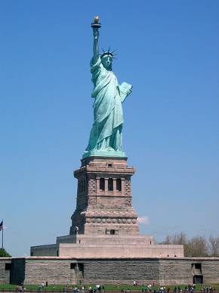
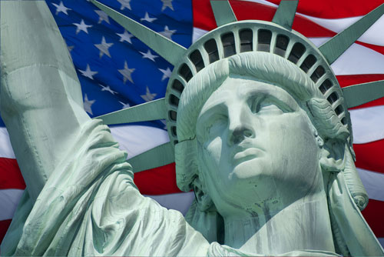
The Statue of Liberty is a symbol of freedom. It was built in New York Harbor in 1886. It was a gift from the people of France.

Slide 8


