Slide 1


Урок-дискуссия в 10 классе учитель английского языка
ГОУ СОШ № 853 г.Зеленоград
Семенова О.В.

Slide 2
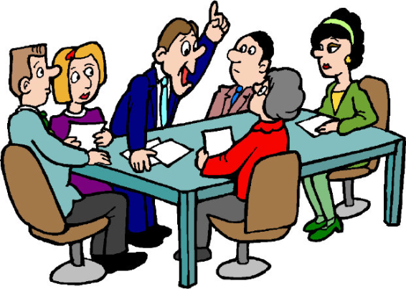
Дискуссии как средство подготовки старшеклассников к устной части ЕГЭ по английскому языку.

Slide 3

Дискуссии
Дискуссии развивают:
Логическое и критическое мышление.
Навыки устной речи.
Навык в организации своих мыслей.
Терпимость к различным взглядам.
Уверенность в себе.
Способность работать в команде.
Способность концентрироваться на сути проблемы.

Slide 4
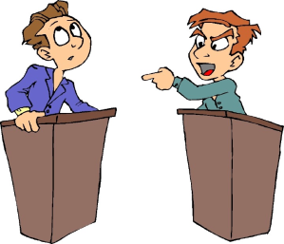
Этапы работы при подготовке к дебатам:
Развитие у учащихся умения слушать собеседника – «мозговой штурм».
Выработка ряда ключевых клише.
Отработка навыка реагирования на слова оппонента.
Формирование умения задать вопрос.
Развитие речевого этикета.

Slide 5
языковые клише
we suppose; we suggest;
we believe; the thing is; the fact is;
we wonder; the point is; in our opinion;
there is something in what you are saying but…
we appreciate;
thank you for your attention;
thank you for the questions …

Slide 6
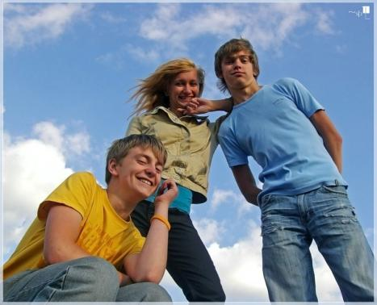
Тема урока :
Some teenagers think that nobody can help with their problems , but the others are sure that adults (parents and teachers) could understand them and help . What is your opinion?

Slide 7
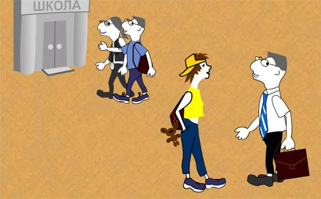
Teen`s problems

Slide 8
Метод «мозгового штурма»
The more you put your opinions across, the more your confidence grows and more people respect you.
At 14, you feel really grown up. You want to go clubbing but they say you are too young...
I wish I`d told the bullies to shut up, because as soon as you stick up for yourself, bullies often back off.
When I was being bulled my “friends” had joined in, but then later on, act like nothing had happened.
I was angry when my parents didn`t give me money to go…
I remember feeling shy around the popular kids at school because they made anyone not in their clique feel really small.

Slide 9
Мыслительный набор «Кайдзер»
Be grateful for
what you`ve got
Be confident!
Don`t put up with bullies!
Control your temper.
Know who your friends are.
The “cool”
crowd is not so cool!
Be different!
Respect your parents!

Slide 10
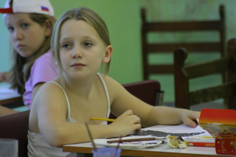
One of the worst teenagers` problems is schooling.

Slide 11
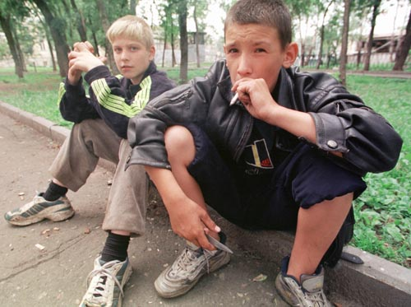
  A lot of teens like to look older, that's why they obtain
  bad habits like smoking, drinking, taking drugs.

Slide 12
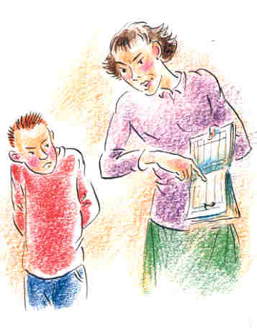
Parents press their child, they think he is “iron”
and he doesn't feel soul ache.
Parents want us to study very well;
they don't understand that we do everything as good as we can.

Slide 13
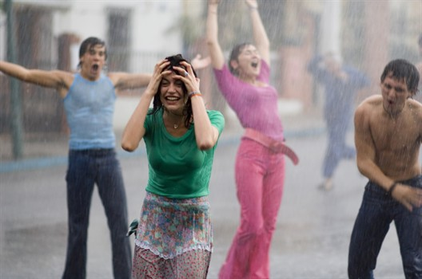
But no one should become a fan, because we can
kill our individuality and become clones.

Slide 14
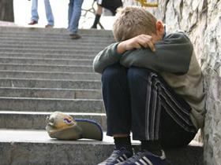
Only teen can understand people, who are the same age as he is. It is really difficult to be a teenager!

Slide 15
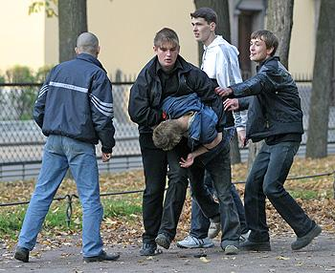
Bullying often starts when people pick on something that's different.

Slide 16
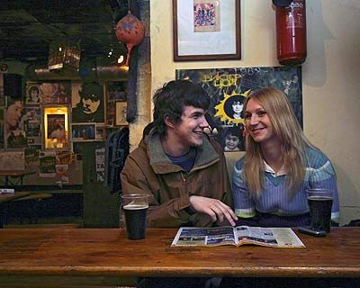
Certainly today there is a problem connected
to the dialogue between girls and boys.

Slide 17
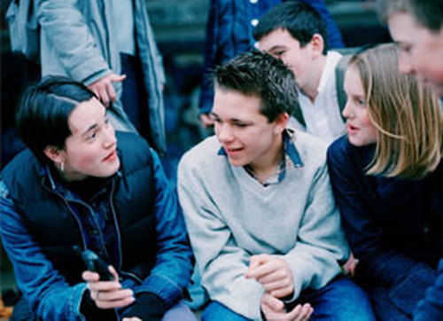
We have some certain groups of students in
our class who communicate only inside their group.

Slide 18

Unfortunately we have
several «white crows».
This is the person who
doesn’t have any friends
among the classmates.

Slide 19
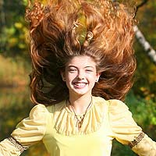
Love yourself. Remember that you are you and you are unique.

Slide 20
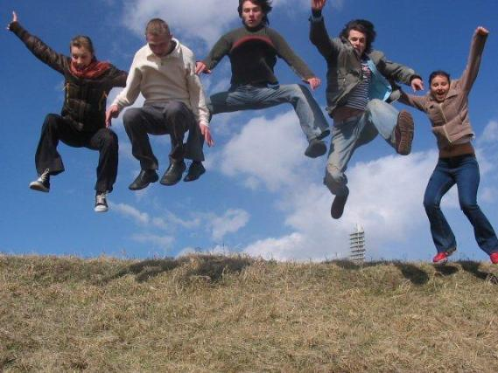
Be yourself. You cannot be 'cool' all the time.

Slide 21
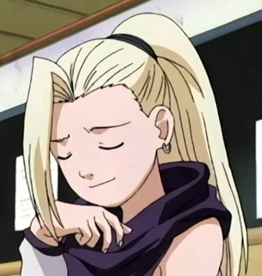
Believe in yourself — if you don't, how can you expect others to?

Slide 22


Домашнее задание: написать сочинение и выразить свое мнение по теме:
Some teenagers think that nobody can help with their problems , but the others are sure that adults (parents and teachers) could understand them and help .

