Slide 1
“Shops, shops, shops…”
Учебник: «Enjoy English» 3 класс
Авторы: М.З. Бибалетова, О.А. Денисенко
Unit 1
Материал подготовлен учителем английского языка ГБОУ СОШ НО № 410 г. Москвы СВАО
Куликовой Татьяной Владимировной

Slide 2
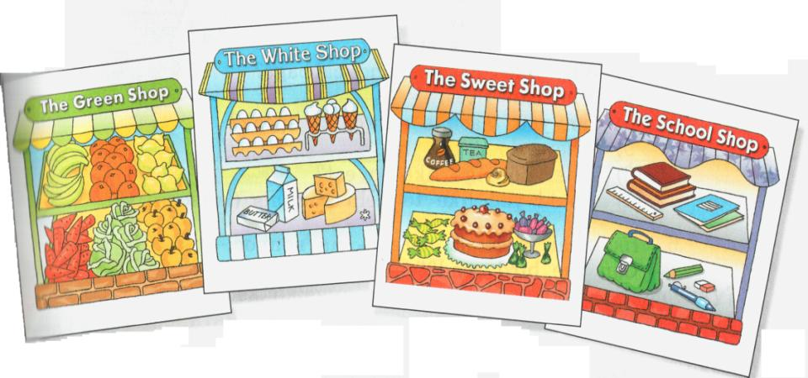
Look and try to remember!

Slide 3
What is there?
Green shop
1
2
3
4
5
6
White shop
1
2
3
4
5
Sweet shop
1
2
3
4
5
School shop
1
2
3
4
5
6
7

Slide 4
Here they are!

Slide 5

I would like to buy…

Slide 6
We would like to buy…

Slide 7
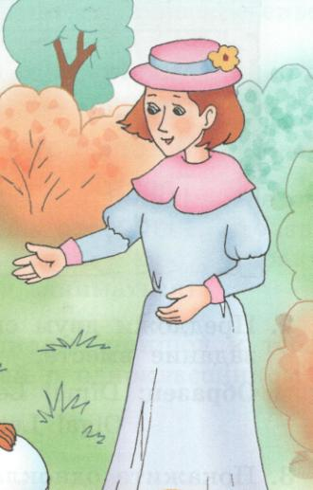
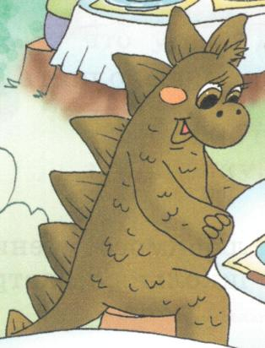

We would like to buy…

Slide 8
Would they like to buy…?
+ Yes, they would.
- No, they would not.

Slide 9
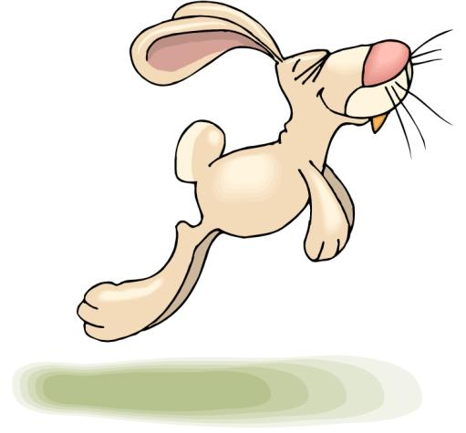
A RABIT

Slide 10
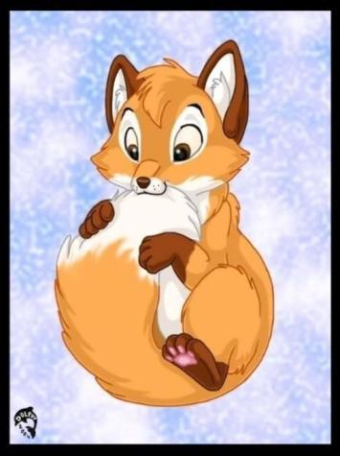
A FOX

Slide 11

A FISH

Slide 12
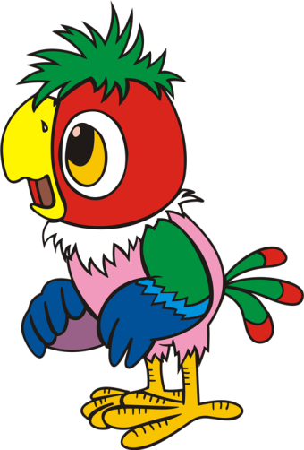
A PARROT

Slide 13

A HORSE

Slide 14
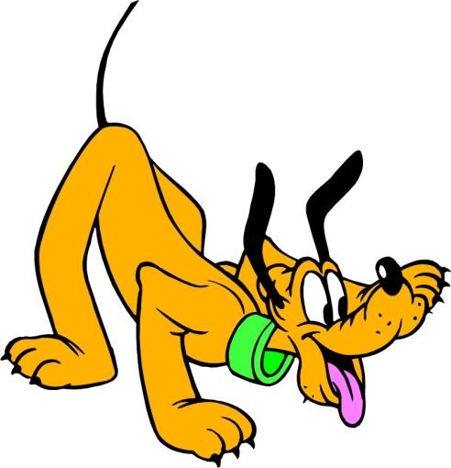
A DOG

Slide 15
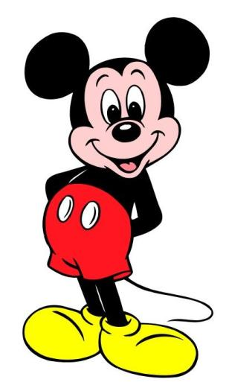
A MOUSE

Slide 16





Colours
Blue
Green
Black
Red
Grey

Slide 17
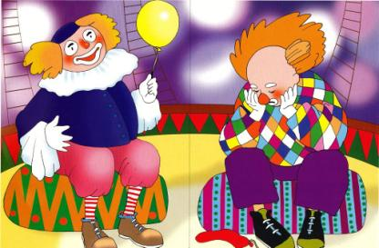


Antonyms
Fat - Slim
Happy - Sad
Big - Little

Slide 18
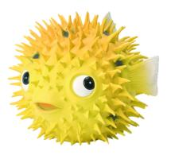
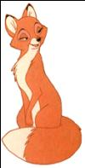
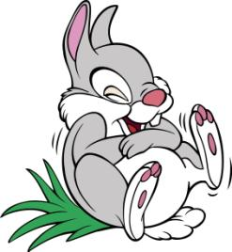
+
Smart
Clean
Smart
Good
Brave

Slide 19

Colours
Fish
Horse
Red
Parrot
Happy
Rabit
Brave
Fat
Dog
Big
Good
Mouse
Funny
Fox

Slide 20
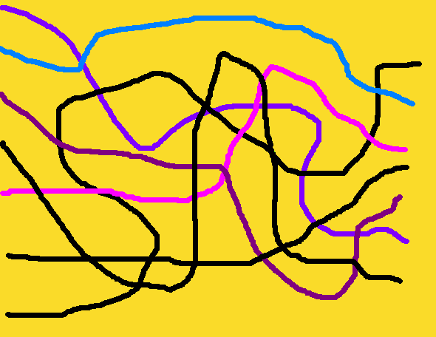
Colours
Fish
Horse
Red
Parrot
Happy
Rabit
Brave
Fat
Dog
Big
Good
Mouse
Funny
Fox

Slide 21
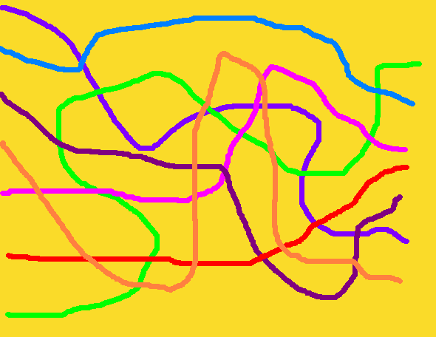
Colours
Fish
Horse
Red
Parrot
Happy
Rabit
Brave
Fat
Dog
Big
Good
Mouse
Funny
Fox

