Slide 1

Welcome, Christmas!
Разработка внеклассного мероприятия
по страноведению США
учителя английского языка
ГОУСОШ №882 г. Москвы
Марудиной С. В.

Slide 2

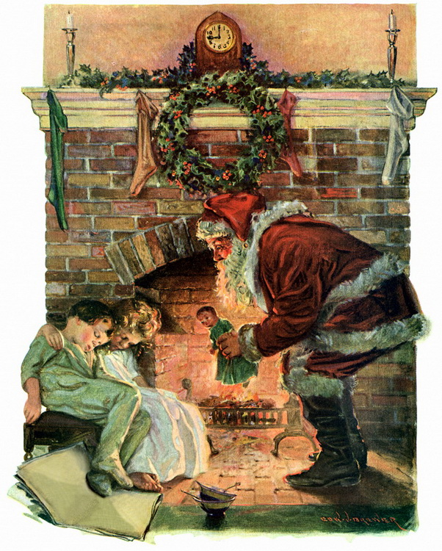
Santa Claus is coming to town.
In the USA people celebrate Xmas on December 25. It is the most important and popular holiday.

Slide 3

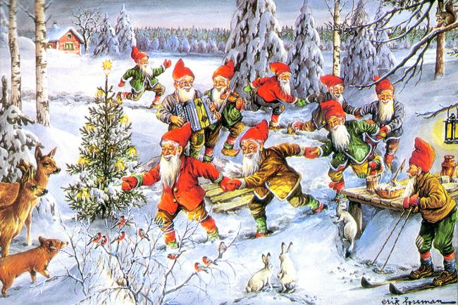
Christmas elves
Christmas elves were introduced into the tale of Santa Claus during the 19th century in the United States.

Slide 4

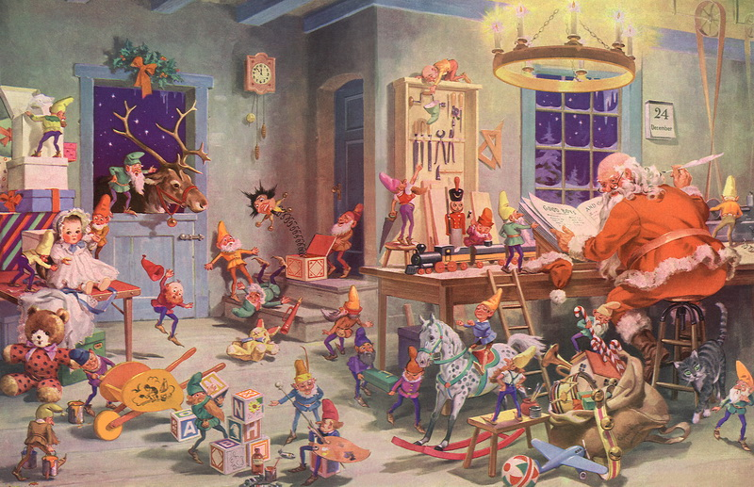
The night before Christmas
According to the tale Christmas elves live with Santa in the North Pole and act as his helpers.

Slide 5

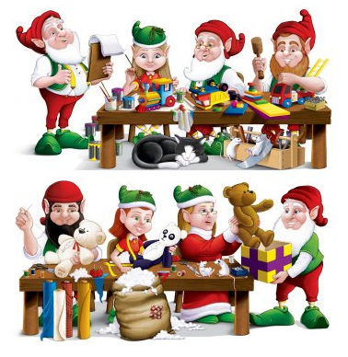
Santa’s workshop
They say Santa’s elves make the toys in Santa’s workshop and take care of his reindeer.

Slide 6
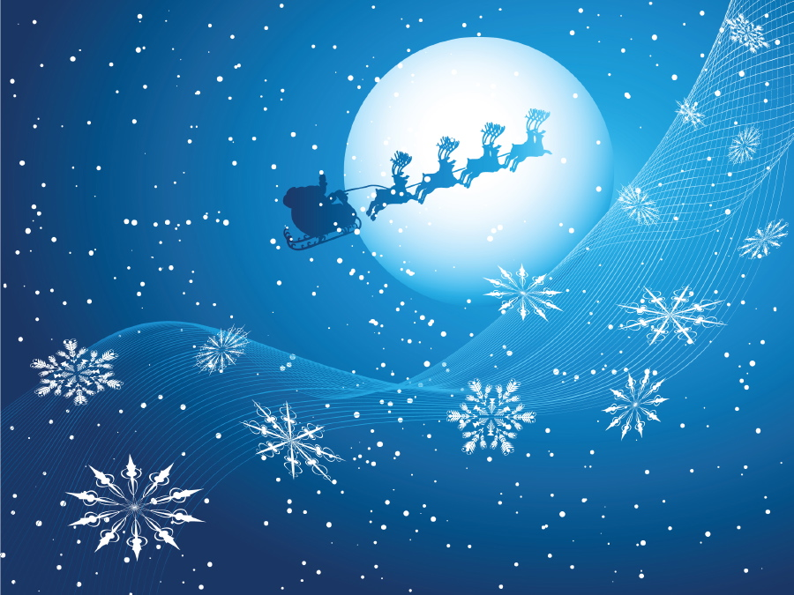
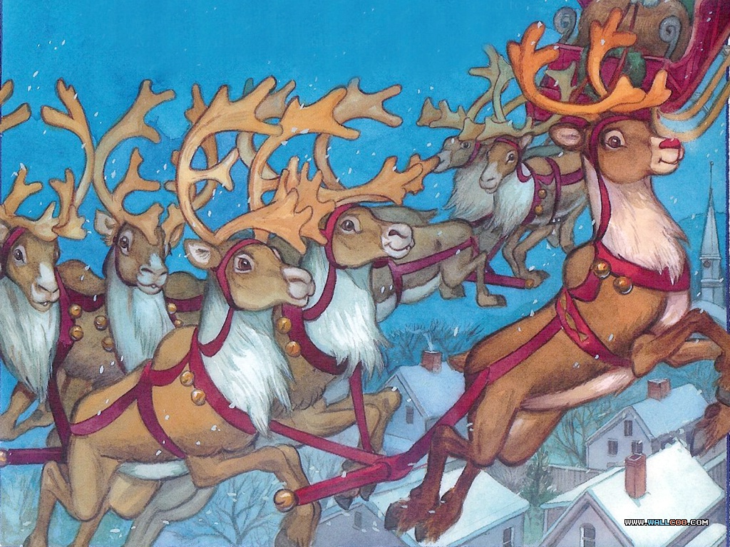
Santa Claus’s reindeer
Santa Claus’s reindeer first appeared in the poem by Clement C. Moore “A visit from St. Nicholas” in 1823.

Slide 7

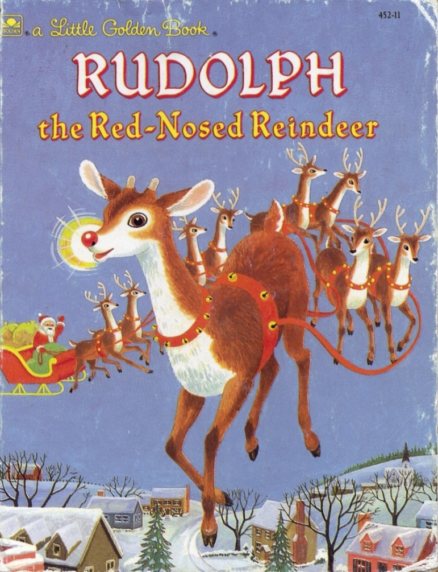
Rudolph the Red-Nosed Reindeer
Rudolph first appeared in 1939. The book was written by Robert L. May and published by Montgomery Ward in the United States.

Slide 8

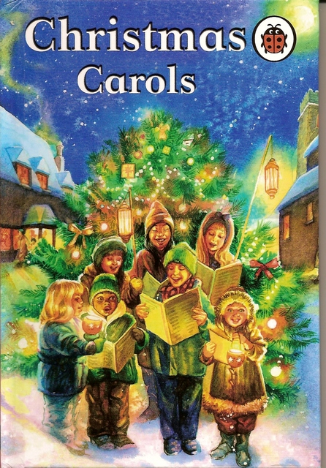
The choir of children
“We wish you a merry Christmas” is a popular secular sixteenth-century English carol from the West Country of England. In the 17th century the Pilgrims brought this carol in America.

