Slide 1
Alice visits Belgorod
Подготовила
педагог дополнительного образования,
учитель английского языка
МДОУ д/с №23 г.Белгорода
Вергун Татьяна Юрьевна
239-218-789

Slide 2
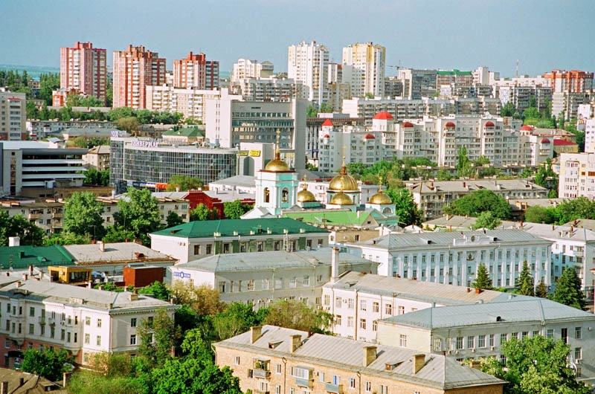
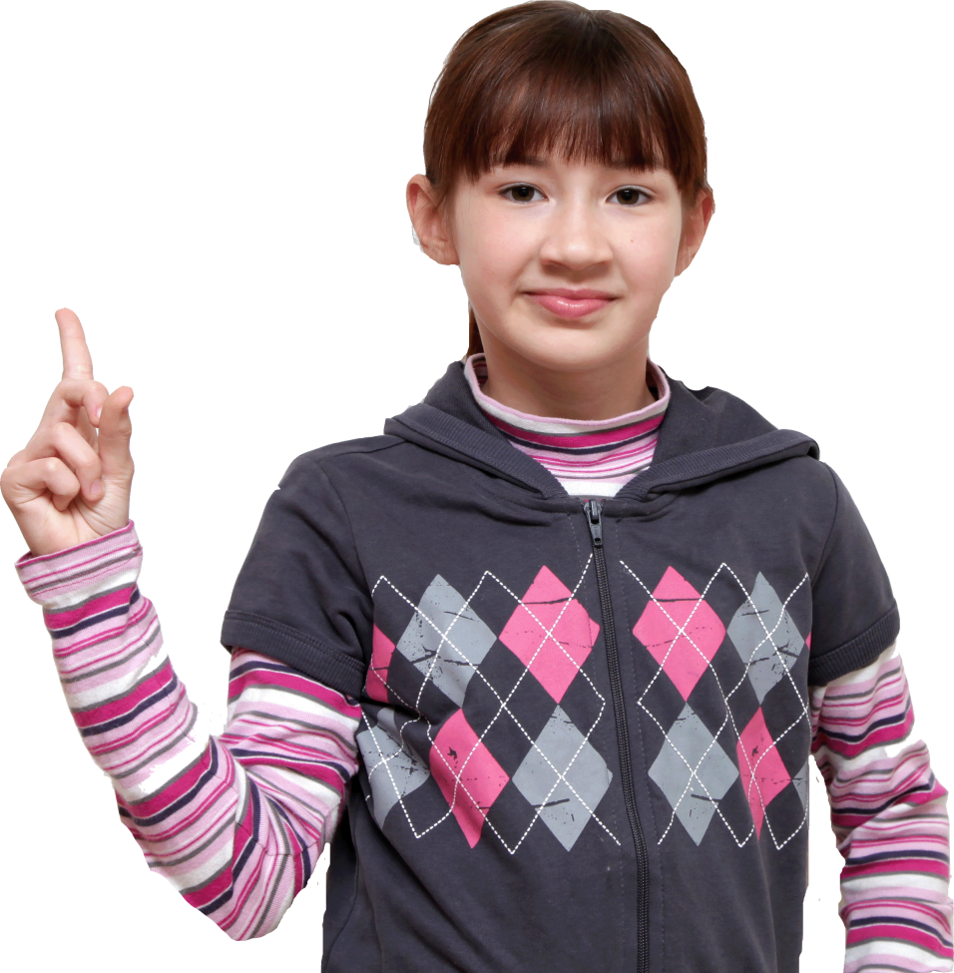
Alice visits Belgorod

Slide 3
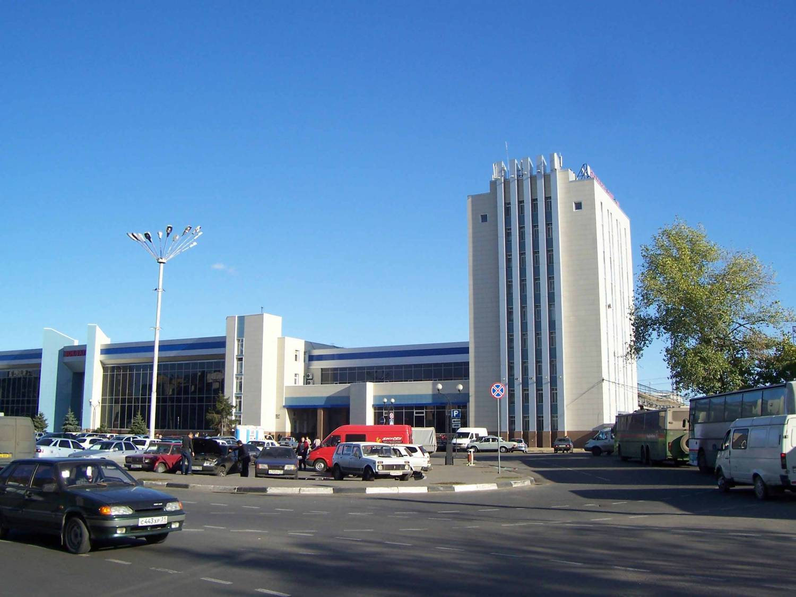
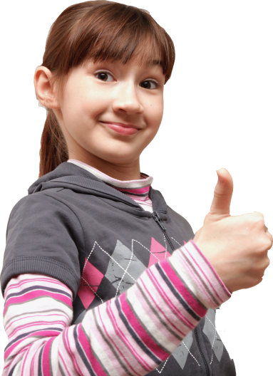
Alice and her mother come to the railway station of Belgorod by train. Alice is very happy!
Do you like to travel by train?

Slide 4
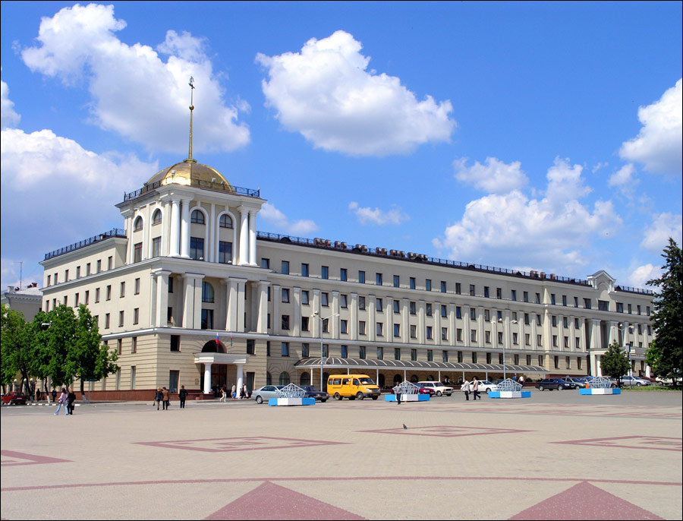
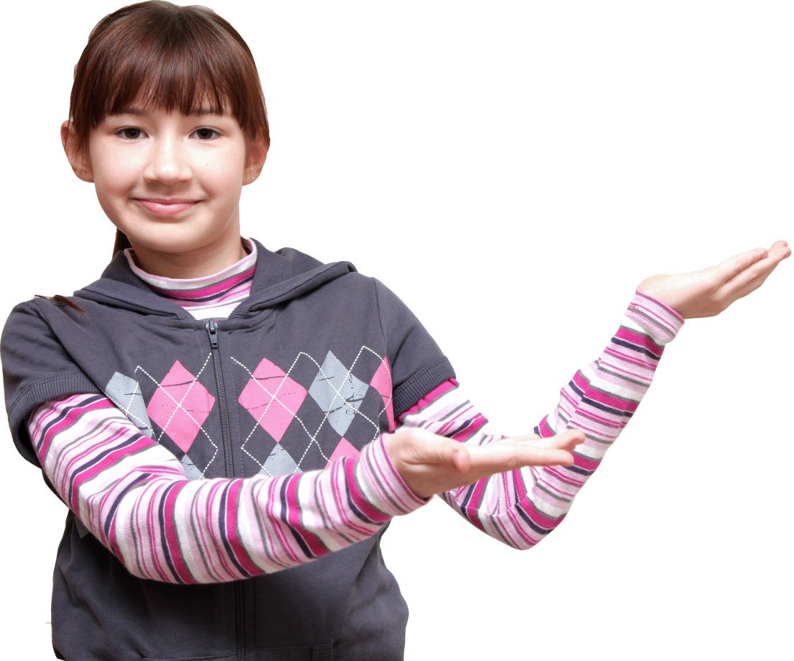
Alice and her mother take a taxi and go
to the best hotel in the town.
They see a very beautiful square near the hotel.
The hotel’s name is Belgorod.
Is the hotel beautiful, too?

Slide 5
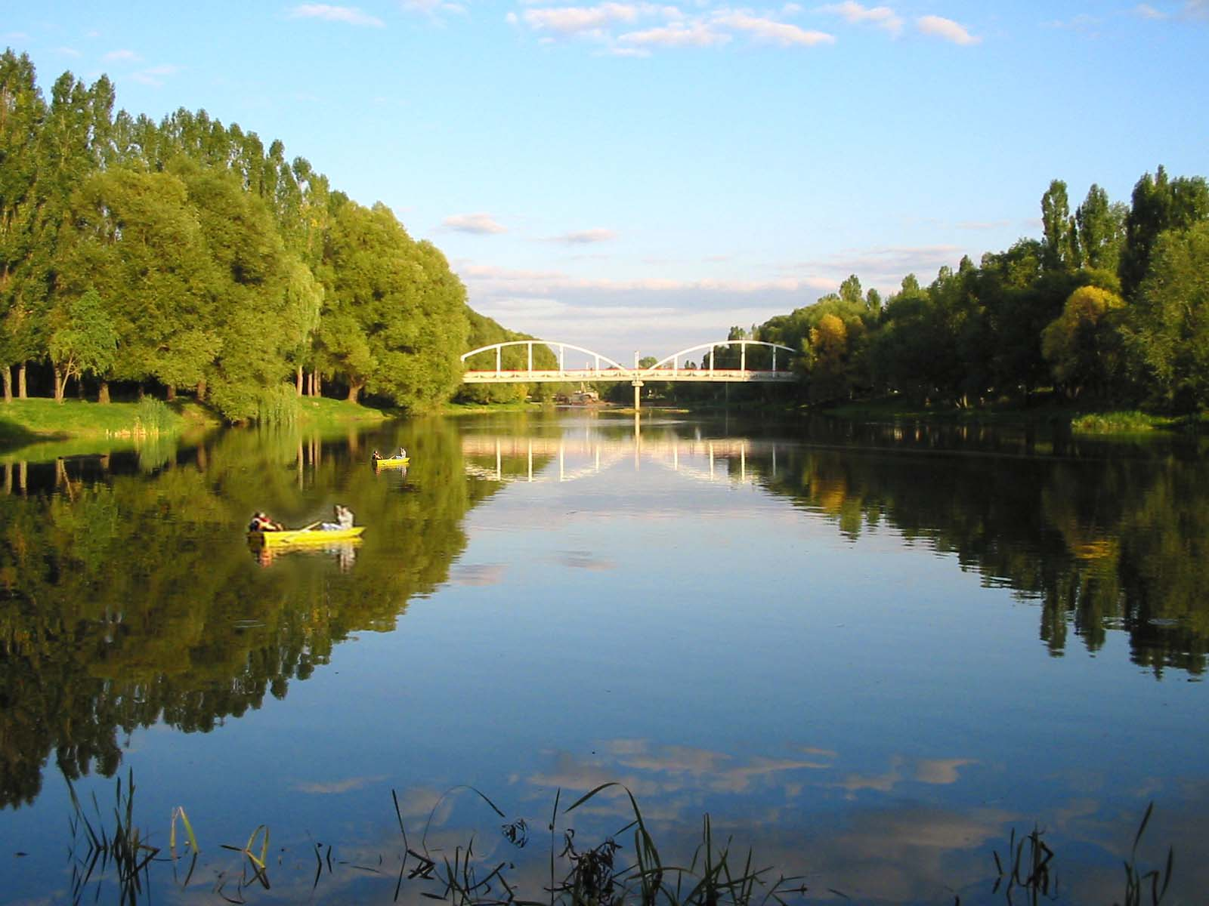
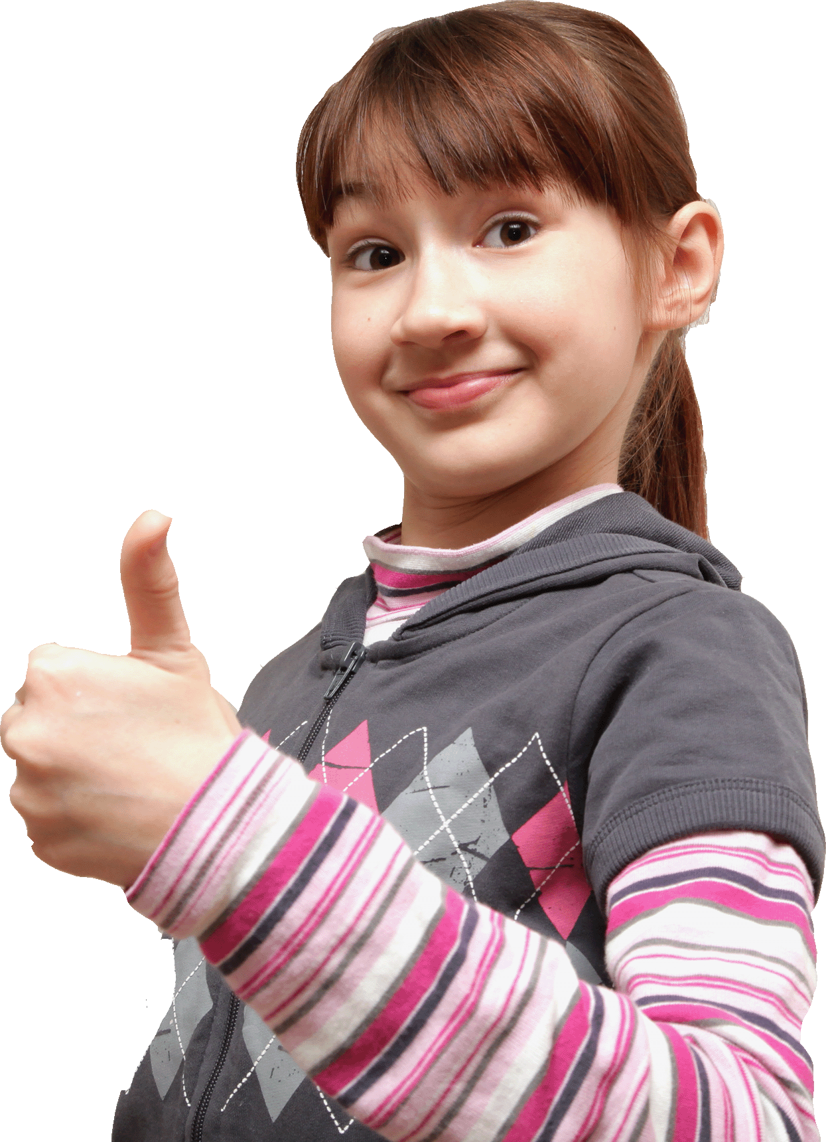
Let’s go to the park! – says Alice’s mother.
There are many things to see.
There is a river and there are boats on the river. Wow!
What about a ride on the boat?

Slide 6
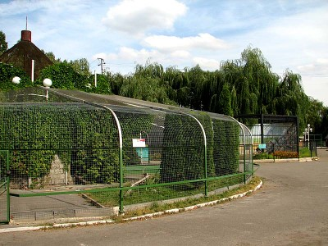
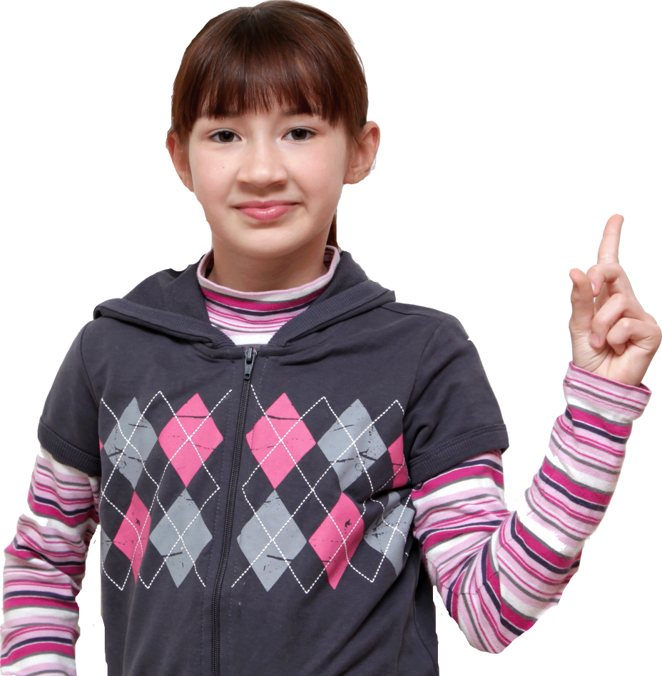
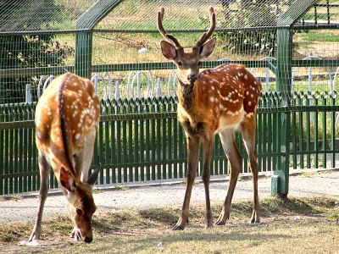
There’s a zoo in the park. Alice likes deer.
…And you?

Slide 7
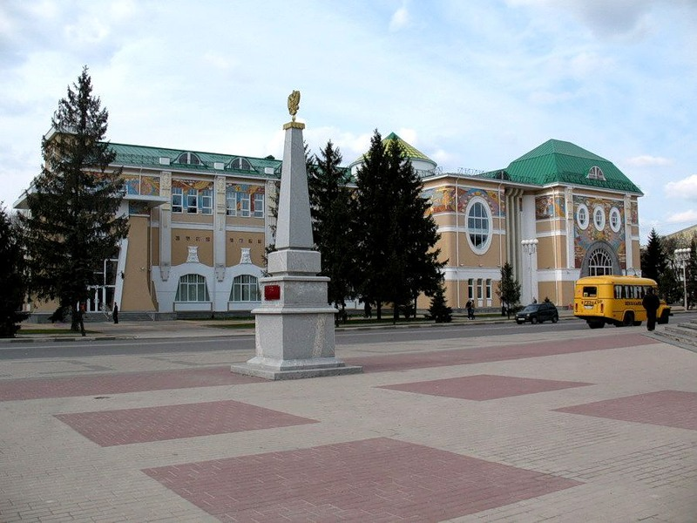
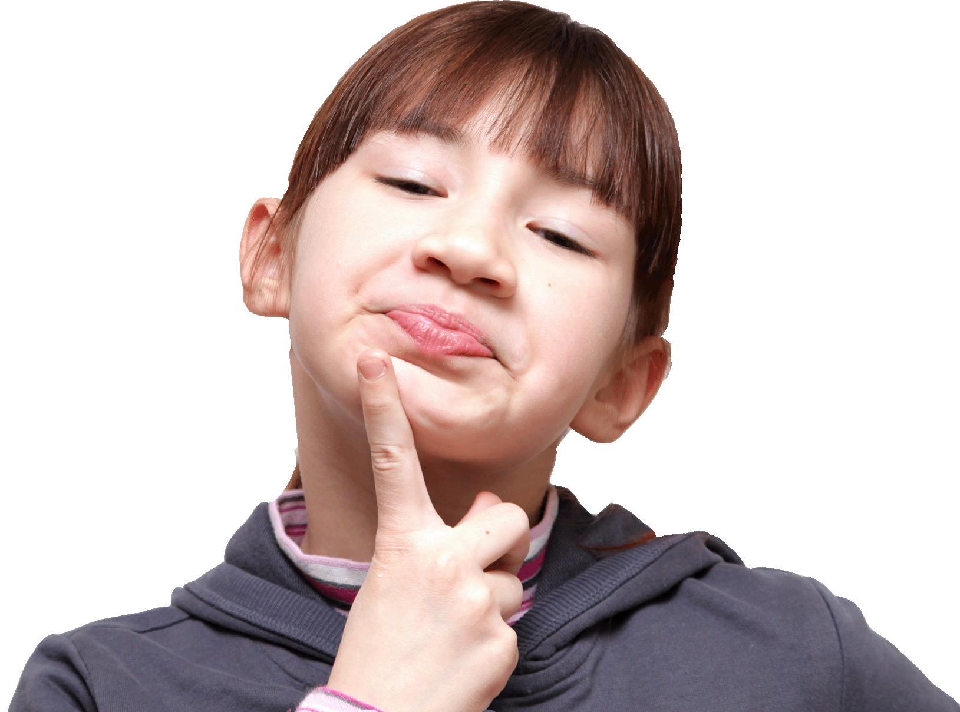
Alice likes to draw pictures and look at the pictures.
In Belgorod she goes to the Art Museum.
Do you like to draw pictures?

Slide 8
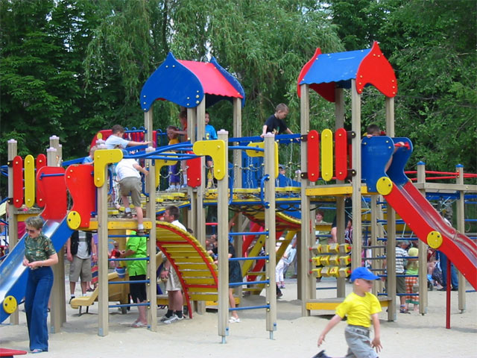
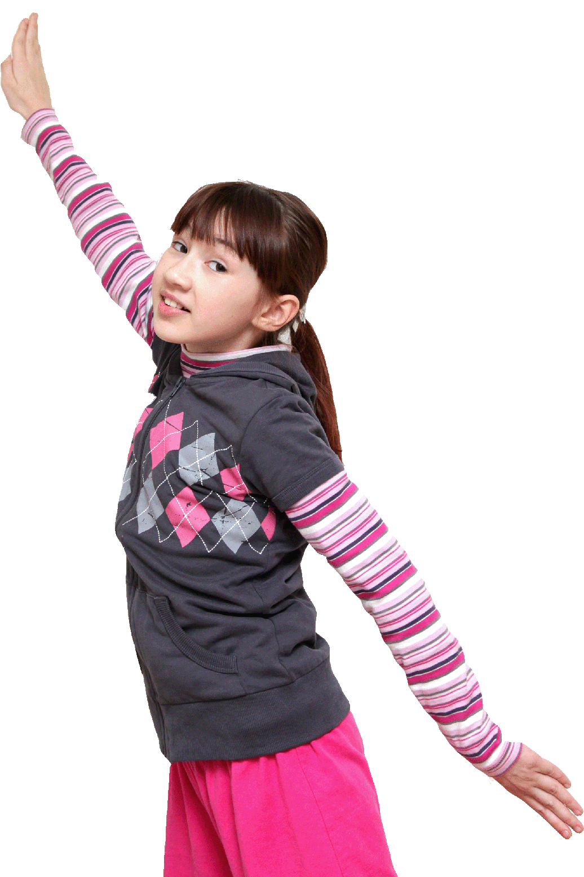
Hurray! Hurray! I like to play. What a nice playground!
Do you know this place?

Slide 9
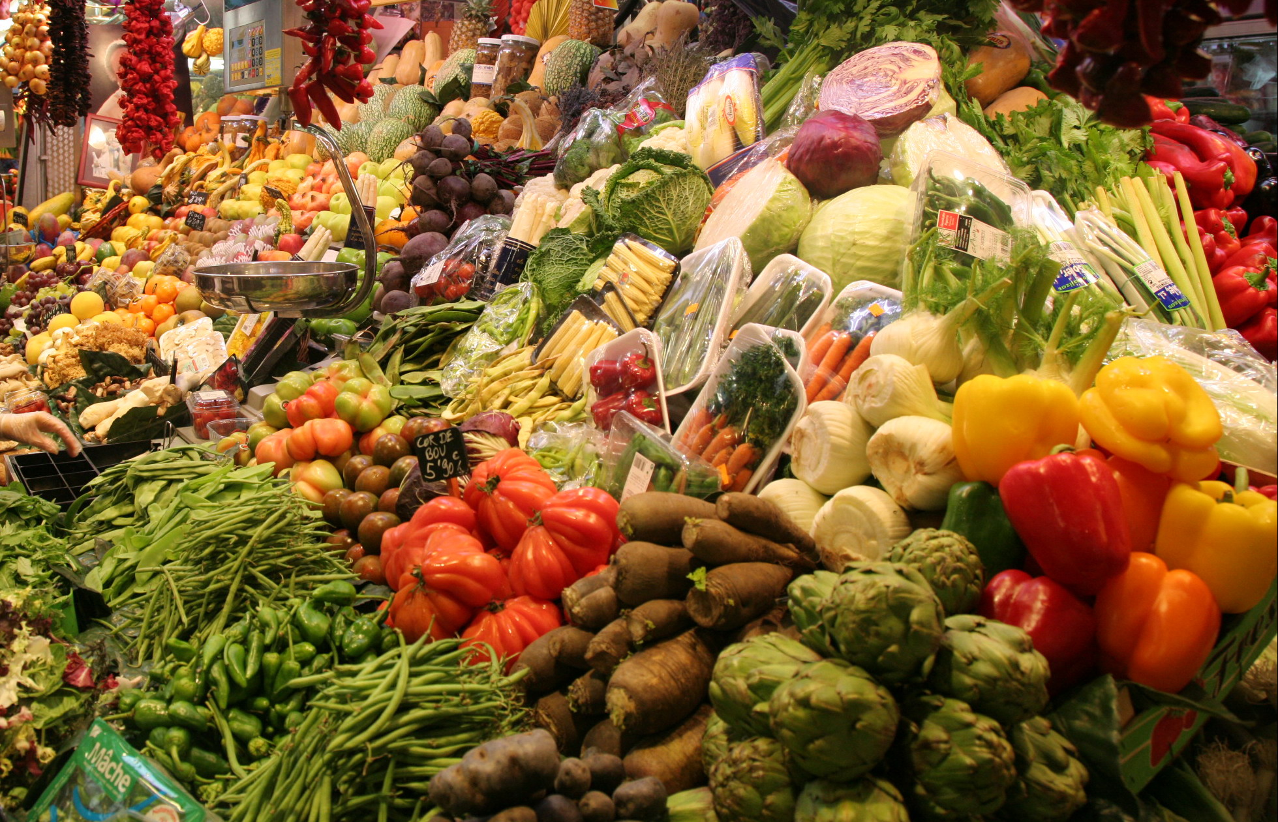
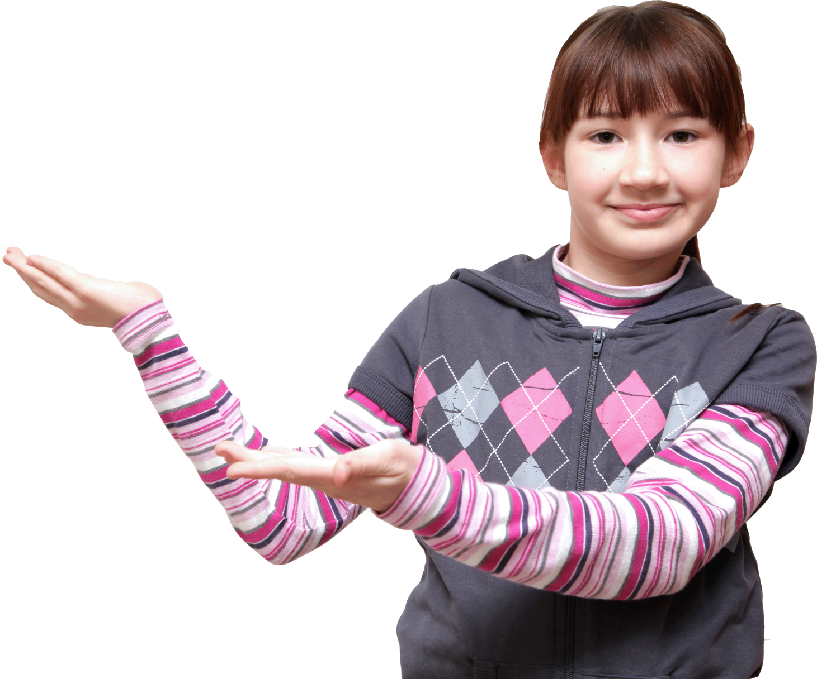
I am hungry! – says Alice. Let’s go to the market.
Look at all this fruit and vegetables! Many of them grow in Belgorod Region.
What do you like to eat?

Slide 10
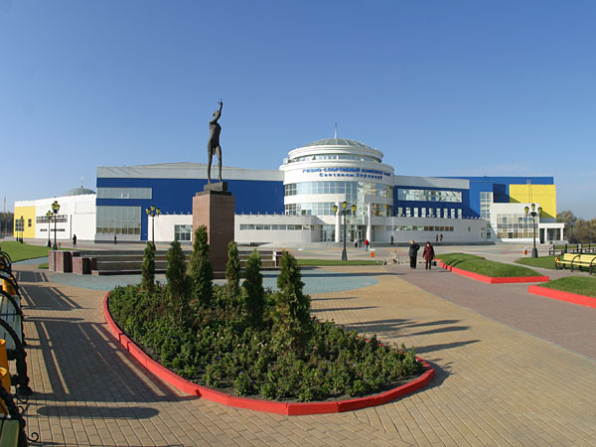
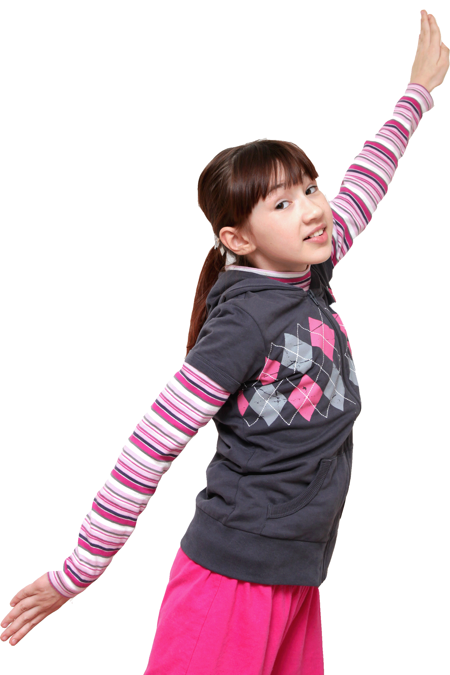
Alice wants to be a famous gymnast like Svetlana Khorkina.
She is very excited to be here.
Whom do you want to be?

Slide 11
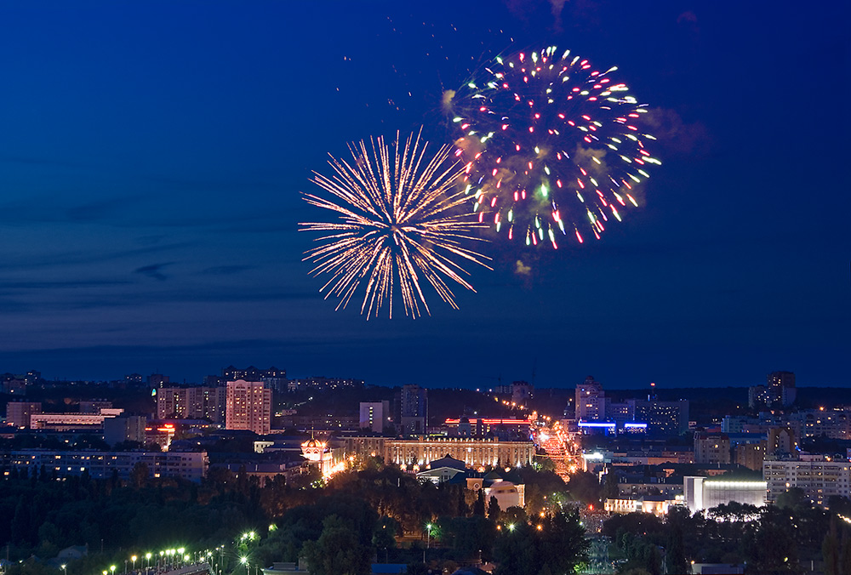
In the evening Alice and her mother goes to see a firework.
It is really great!
When can you see a firework in Belgorod?

Slide 12
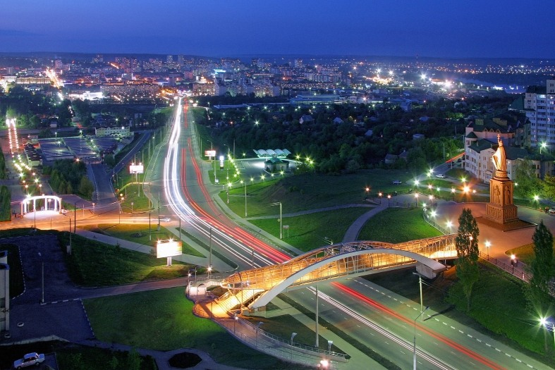
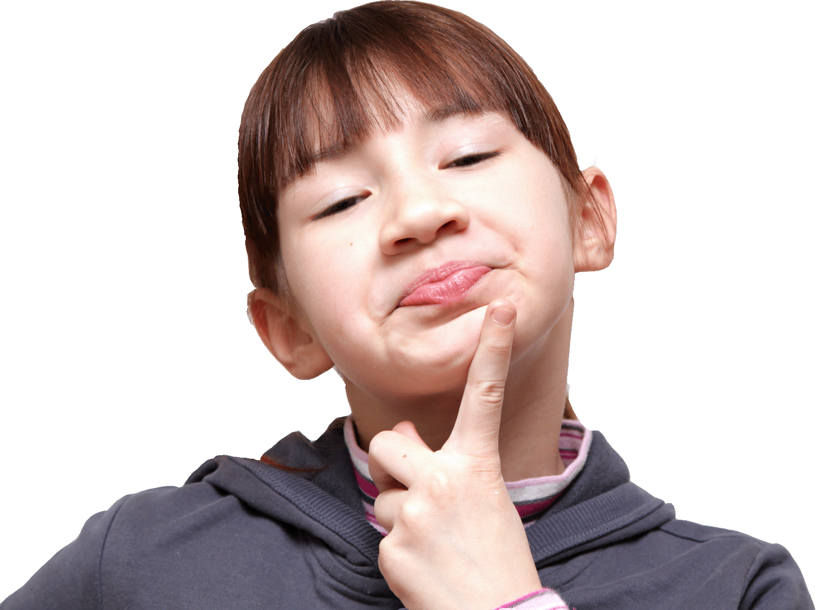
Mamma, I’ve had a wonderful holiday in this beautiful town!
Good-bye, Belgorod!
Are you proud to be Belgorodian?

