Slide 1
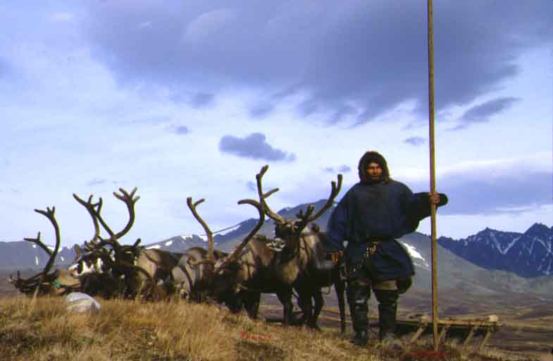
The Nenets.
General information.
Daily life.

Slide 2
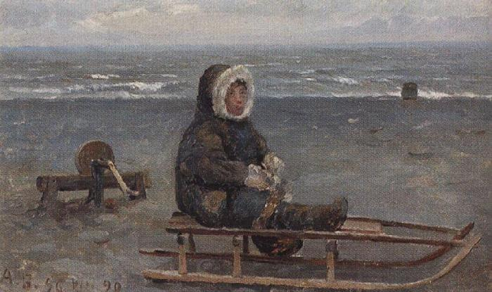
The Nenets are one of the largest of the ____ groups in Northern Si . . ria.

Slide 3
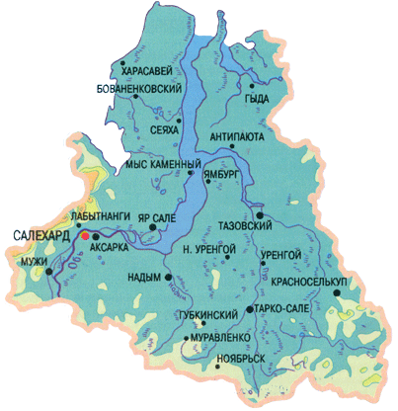
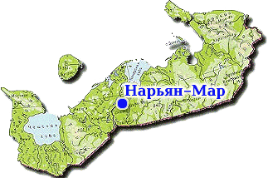
Nowadays most Nenets live in northern areas of the Yamal-Nenets _____ District and the Nenets Autonomous District.

Slide 4
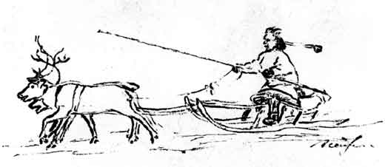
The ____ of the Nenets se..led in the Russian North about 1000 years ago.

Slide 5
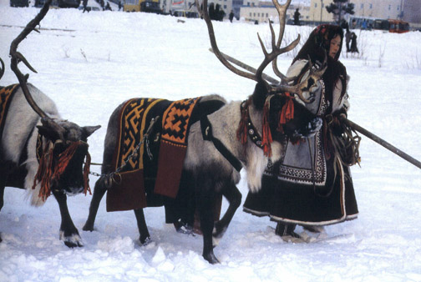
Traditionally the Nenets are ____ breeders, who also hunt, trap and fish.

Slide 6
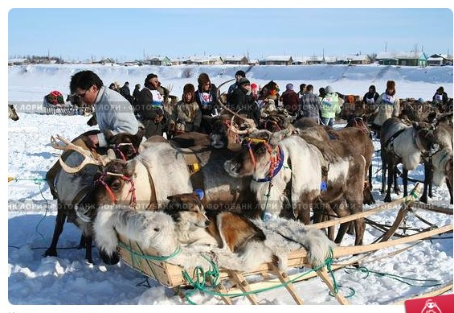
Reindeer is the basis of their culture providing food, cl…ing, sh..ter and tra…..t.

Slide 7
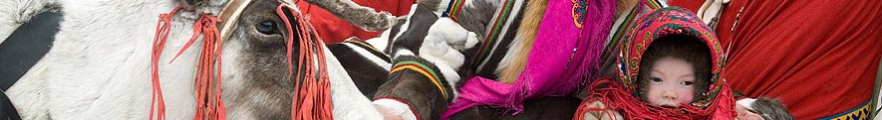
Today the Nenets have educational o…rtunities at all levels and many follow modern careers.
Despite this, r…deer breeding remains important, both eco…ically and culturally.

Slide 8
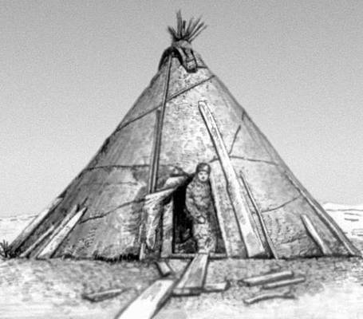
Nenets herders live in tepee style tents which are made from ____ ___for use in winter and _____in the summer.

