Slide 1
Traditional beliefs of the Nenets

Slide 2
wellbeing – благополучие to be dependant on – быть зависимым от to make sacrefice – приносить жертву sacred sites – святые места disease – болезнь in return – взамен predicting - предсказание the dead – мертвые underground world – загробный мир

Slide 3
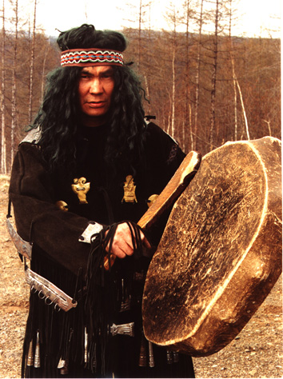
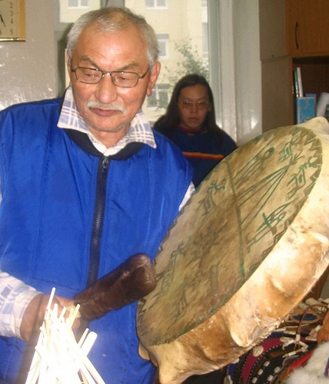
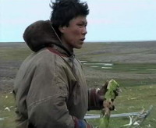
The Nenets traditional religious beliefs are animistic.

Slide 4
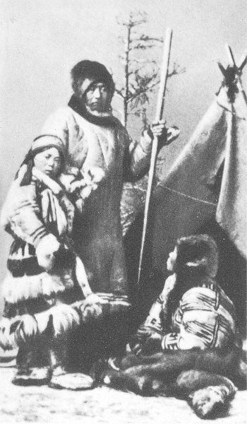
They believe that every part of the natural world has spirits, and animals, plants, rivers, lakes and hills… all have their own ‘spirit masters.’

Slide 5
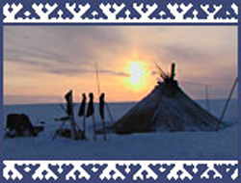
The earth and all living things were created by the god ‘Num’ and people’s wellbeing is entirely dependant on him.

Slide 6
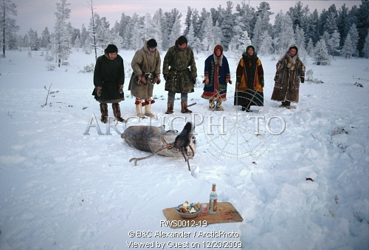
Num protects people if they ask for help and make the appropriate sacrifices and offerings.

Slide 7
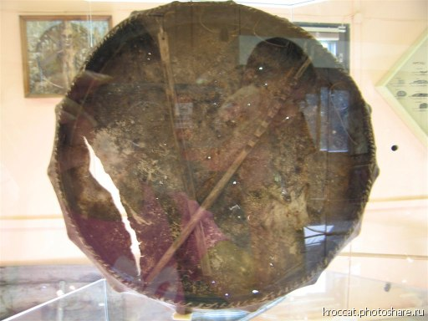
Only shamans can talk to the sky spirits.
During the rituals shamans wears a special costume decorated with metal ornaments and they also use a drum.

Slide 8
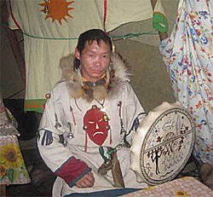
The role of Shamans includes treating sickness, predicting the future and delivering the souls of the dead to the underground world.

Slide 9
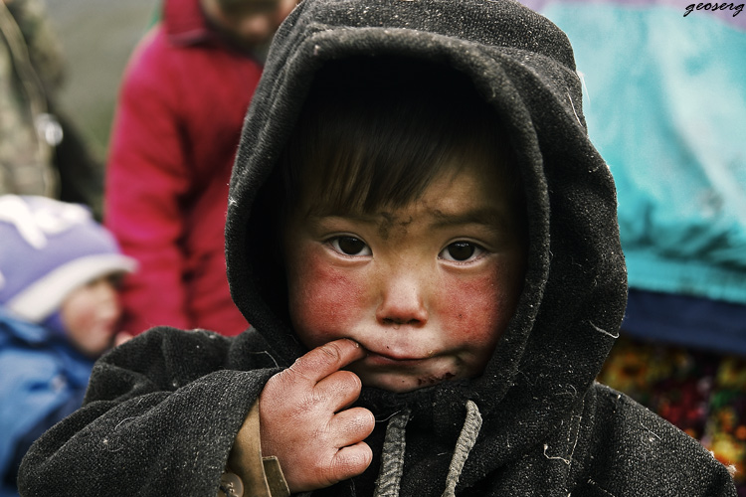
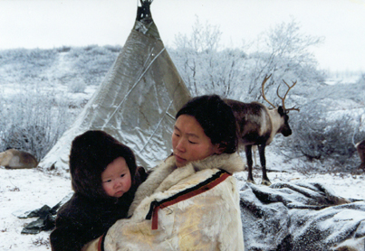
The benign spirit called ‘Ya-nebya’ (Mother Earth) protects women and aids in childbirth.

Slide 10
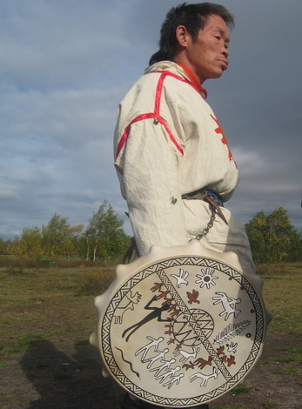
Evil comes mainly from ‘Nga,’
Num’s son, a malevolent god of diseases and death.

Slide 11
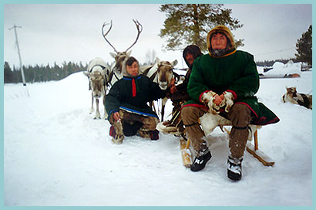
There are sacred sites all over the
Nenets’ territory where reindeer are sacrificed and people leave gifts for the spirits.
In return they ask for things like safe travel, good health and luck with hunting and fishing.

Slide 12

The most of the Nenets wear amulets, often bear's teeth on the belt.
Many families have a sacred sled on which they transport their idols.

Slide 13
Questions

Slide 14
What are Nenets' traditional beliefs?

Slide 15
What gods do they have?

Slide 16
What is the role of shamans in their life?

