Slide 1
My favourite holiday

Slide 2
Learn the poem
I have six honest serving men.
They taught me all I knew.
Their names are: what and why and
when
And how and where and who

Slide 3
Try to find wh-words
n | o | w | e | l
e | w | h | a | w
w | h | e | w | h
h | o | r | h | e
y | w | e | o | n
w | h | a | t | h

Slide 4
Check up
n | o | w | e | l
e | w | h | a | w
w | h | e | w | h
h | o | r | h | e
y | w | e | o | n
w | h | a | t | h

Slide 5
Make up questions
Do, like, you, fairy tales?
your, is, birthday, When?
old, How, you, are?
you, What season, do, like?
funny, Can, pictures, you, draw?

Slide 6
Check up
Do you like fairy tales?
When is your birthday?
How old are you?
What season do you like?
Can you draw funny pictures?

Slide 7

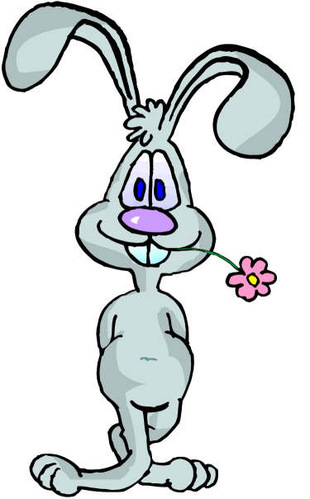

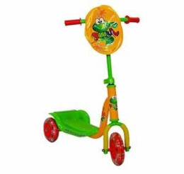
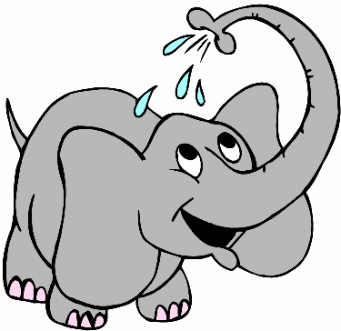



Do the crossword puzzle
 |  |  |  |  |  |  |  | 1
 |  |  |  | 2
 | 3
 |  |  |  | 4
 |  |  |  | 5
 |  |  |  |  |  |  |  | 6
 |  |  |  |  |  |  | 7
 |  |  |  |  | 8

Slide 8
Check up
 |  |  |  |  |  |  |  | b | e | a | r
 |  |  |  | r | a | b | b | i | t
 | c | o | m | p | u | t | e | r
 |  |  |  | s | c | o | o | t | e | r
 |  |  |  | e | l | e | p | h | a | n | t
 |  |  |  |  |  |  |  | d | o | l | l
 |  |  |  |  |  |  | b | a | l | l
 |  |  |  |  | b | i | c | y | c | l | e

Slide 9







What presents can Andrew get?

Slide 10

Listening key
a player

Slide 11
Do or Does?
… your friend like summer?
What season … you like?
Where … you skate in winter?
What sport … his mother like?
What … they have for breakfast?
Why … he like to draw?

Slide 12
Check up
does
do
do
does
do
does

Slide 13
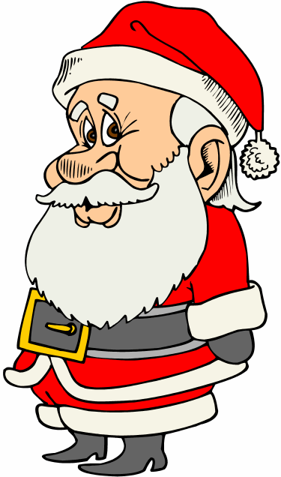
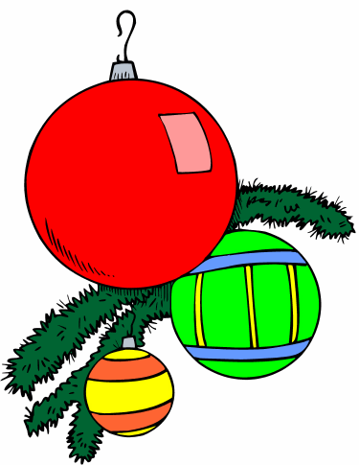
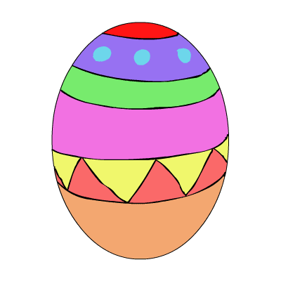
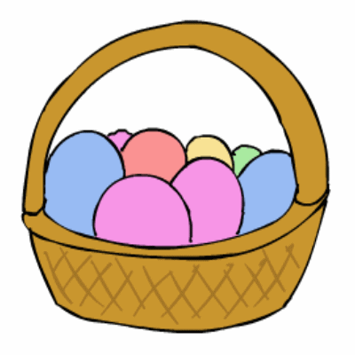





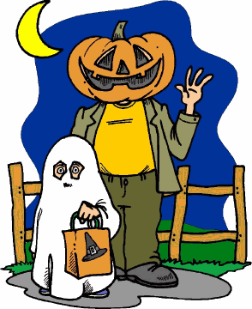
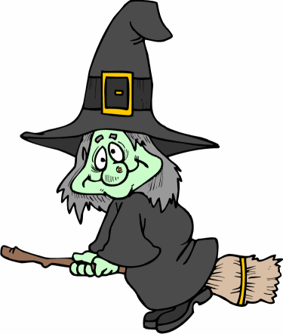
What holidays do we celebrate?
Christmas Easter
New Year
Halloween Valentine’s

Slide 14
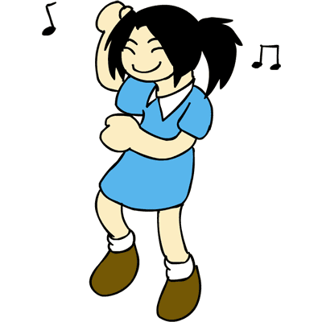

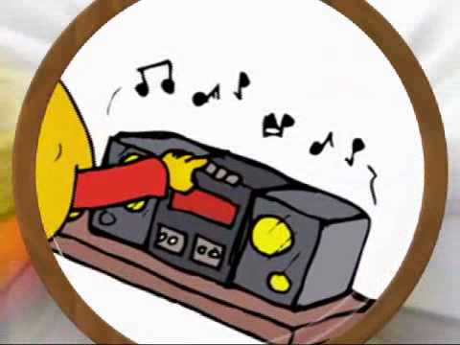
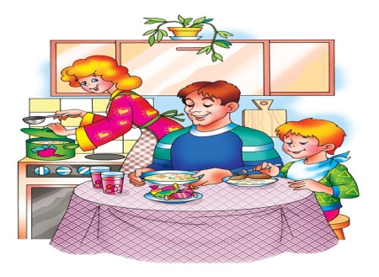
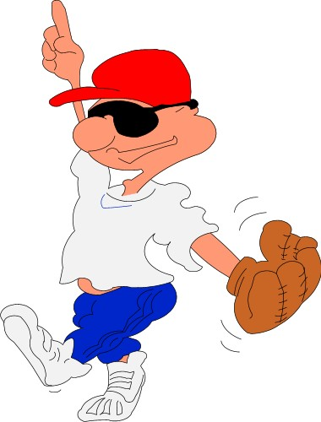
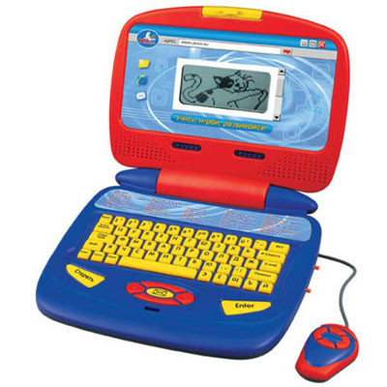
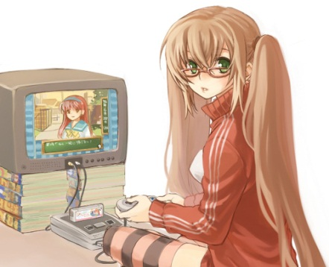
What can we do on holidays?
dance watch TV listen to music
have family dinner play

Slide 15
Tell about your favourite holiday
Hello! My name is …
I am from …
I am … years old.
My favourite holiday is …
It is in … (время года)
It is on the … of …
I can … on … (название праздника)
I like to …

Slide 16
Your hometask
Ex. 4, p. 56 in your workbook.

Slide 17


Slide 18
Resources
Biboletova M.Z. «Enjoy English»3
www.esl-kids.com
http://images.yandex.ru

