Slide 1
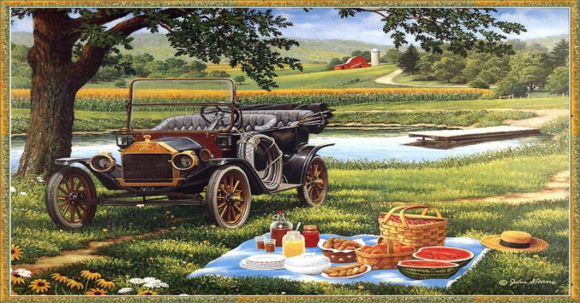
Plans for the weekend
Составила: учитель английского языка
Стуколова Елена Александровна
МОУ «Гимназия №1» г. Астрахань

Slide 2

Match the words that rhyme
Red
Hat
Kissed
Green
Laugh
Whose
Short
List
Mean
Shoes
Said
That
Bought
Half

Slide 3
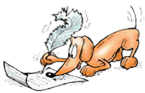
Match the words that rhyme
Red-said
Hat- that
Kissed-list
Green-mean
Laugh-half
Whose-shoes
Short-bought

Slide 4

What do you usually do at the weekends?
to play tennis
to visit friends
to watch TV
to go to the zoo
to play the computer
to read books
to do homework
to arrange a picnic
I usually …at the weekends

Slide 5

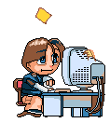


What do they usually do?

Slide 6
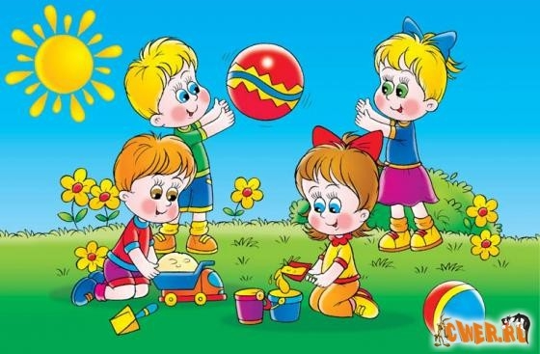
The children/play
The children usually play.

Slide 7
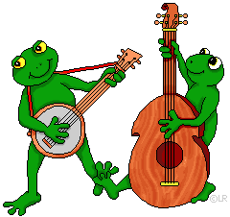
The frogs/play musical instruments
The frogs usually play musical instruments.

Slide 8
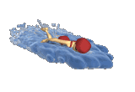
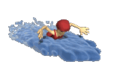
The girls/swim
The girls usually swim.

Slide 9
What are they going to do?

Slide 10
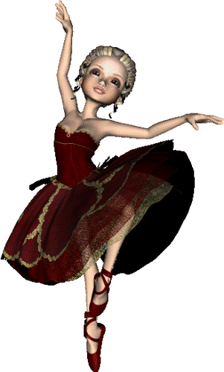
The girl/dance
The girl is going to dance.

Slide 11
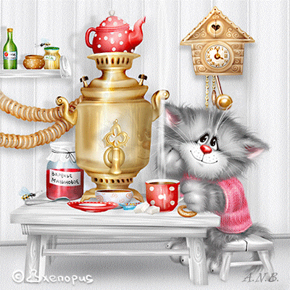
The cat/drink tea
The cat is going to drink tea.

Slide 12
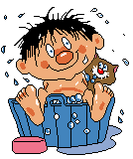
The boy/wash
The boy is going to wash.

Slide 13


Bad weather / Good weather
to play tennis
to visit friends
to swim
to go to the Zoo
to take pictures
to listen to music
to travel
to do homework
to watch TV
to arrange a picnic
to play the computer
to read books
I am going to …in bad weather.
I am going to …in good weather.

Slide 14
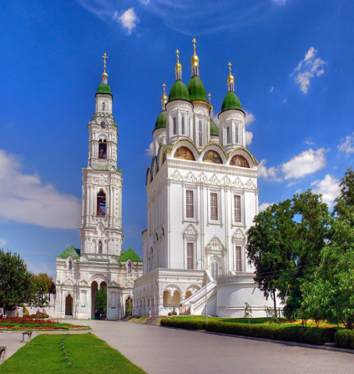
The weather forecast
ASTRAKHAN
Saturday: fine weather, mainly sunny, few clouds late
Sunday: comfortably warm, light winds, lots of sunshine.

Slide 15
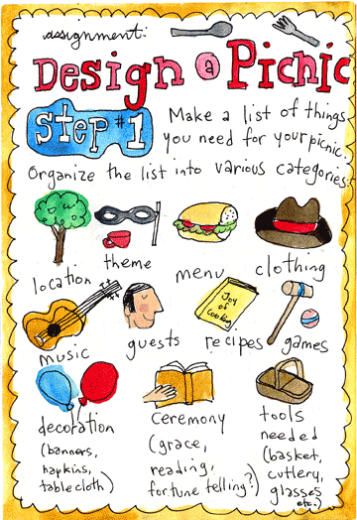
We have a lot of things to do!
We are:
1. to arrange a date and time
We are to decide:
2. who will be responsible for the social programme
3. who will be responsible for sandwiches and drinks
4. who will be responsible for the music

Slide 16
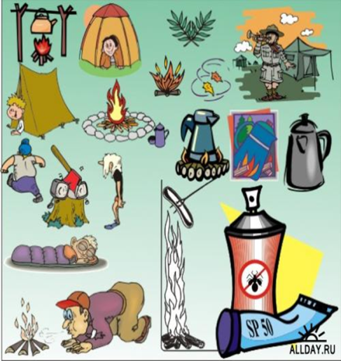
The Opinion Polls
1. Let’s meet at … o’clock.
2. … will be responsible for the social programme.
3. … will be responsible for sandwiches and drinks.
4. … will be responsible for the music.

Slide 17
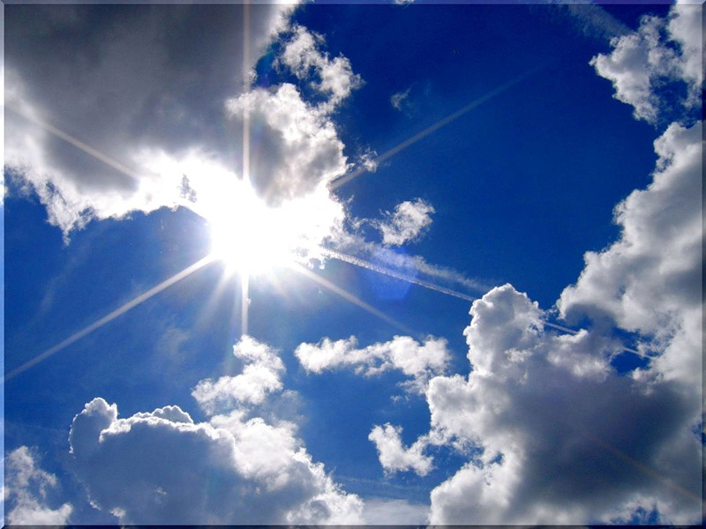


Leaving
1. I’m going to catch a train.
I’m going to find
a better place
2. I don’t want to see another
Dinosaurs or whale
3. I’m going to leave this job.
I’m leaving tonight.
4. I’m going to be free.
I’m going to be me
I don’t want to see
this museum again
5. I’m going to leave this job.
I’m leaving tonight.

Slide 18
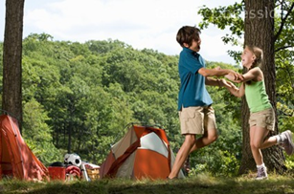
What are you going to do at the picnic?

Slide 19
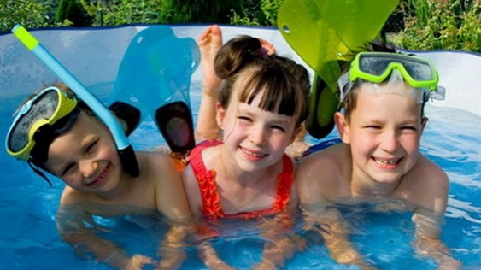
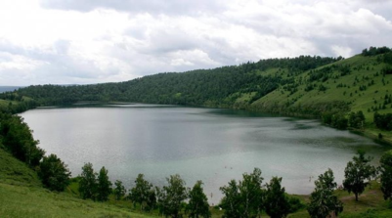
There is a lake. (to swim)
We are going to…

Slide 20

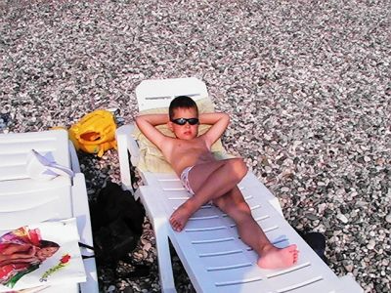
The sun shines brightly.
(to sunbathe )
We are going to …

Slide 21
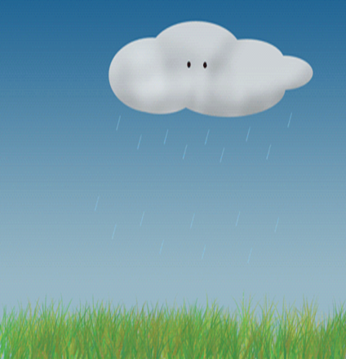
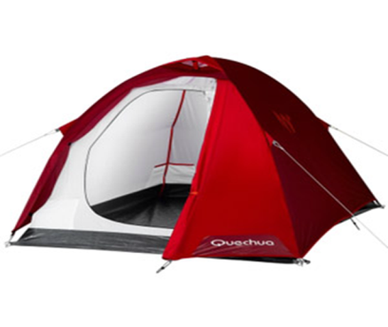
It is raining. ( to put up a tent)
We are going to…

Slide 22

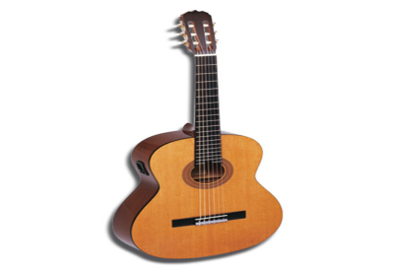
We’ll take a guitar. (to sing songs)
We are going to…

Slide 23
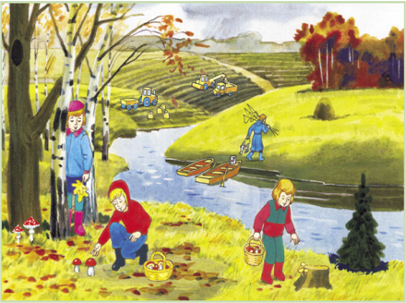
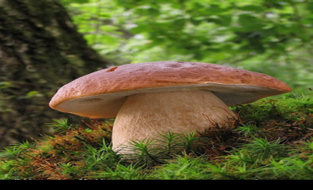
There are a lot of mushrooms.
( to gather mushrooms)
We are going to …

Slide 24
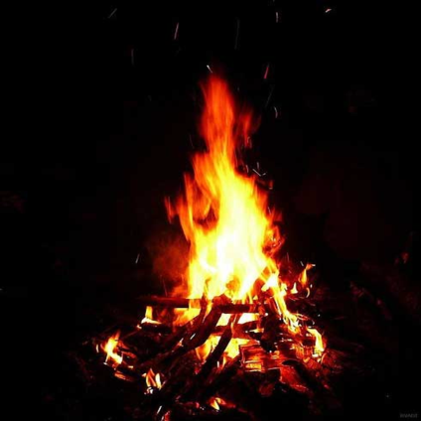
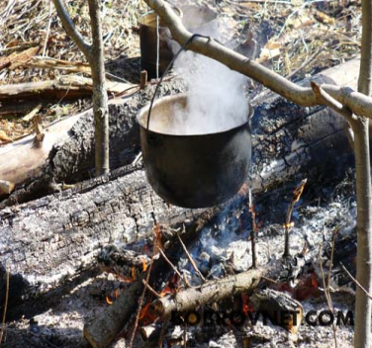
We make a campfire.
(to cook dinner)
We are going to…

Slide 25
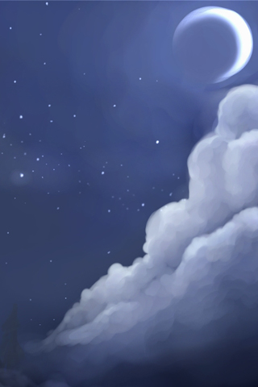
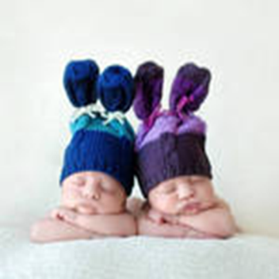
It is dark already. (to sleep)
We are going to…

Slide 26
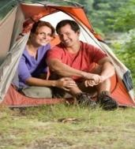
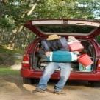

To sing songs
To take pictures
To swim
To sunbathe
To play the guitar
We are going
to have a picnic
To gather mushrooms
To pick berries
To cook dinner
To put up a tent
To make a campfire

Slide 27

An invitation letter
Dear …,
We would like … you to visit us. We are going ….
We … that you come for the weekends. We’ll … the accommodations and … programme.
We hope we’ll….
Yours sincerely,
…
(to have a good time, to have a picnic, to be responsible for ,to invite, to propose, social)

Slide 28

An invitation letter
Dear …,
We would like to invite you to visit us. We are going to have a picnic.
We propose that you come for the weekends. We’ll be responsible for the accommodations and social programme.
We hope we’ll have a good time.
Yours sincerely,
…

Slide 29

Dialogue

Slide 30
Dialogue
Catherine: - It’s Frank’s birthday next Saturday, isn’t it? What presents are we going to give him? Any ideas, Steve?
Steve: - Let’s have a surprise party for him. We can organize a picnic.
Julia: - That’s a great idea: a birthday picnic.
Catherine: - Let’s arrange the date now.
Steve: - Well, I think next Saturday. The 4th of September is the best day. Is that OK with you, Catherine?
Catherine: - Yes, it is. I’ll be responsible for sandwiches and drinks then.
And what about you, Julia?
Julia: - Why don’t I make a special birthday cake for Frank?
Steve: - Great! I’ll be responsible for the music. I’ve got a lot of new CD’s.
Catherine: - I hope Frank would like his picnic.
Julia: - I’m sure he will.

Slide 31
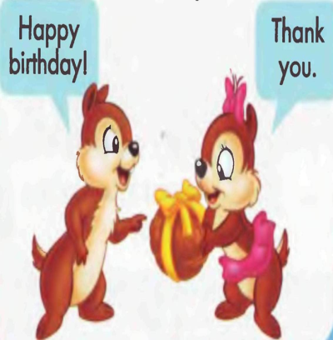
Answer the questions:
1. When will the picnic start?
2. What is Steve responsible for?
3. What is Catherine responsible for?
4. What is Julia going to do?

Slide 32

Home task:
listen to the dialogue (ex.26 p.34)
make up your own dialogue, using cards.

