Slide 1
Victory Day (9 May)
Санникова Татьяна Викторовна,
педагог доп.образования,
МОУ ДОД «Центр детского творчества»
г.Междуреченск

Slide 2

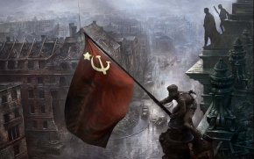
Victory Day (9 May)

Slide 3
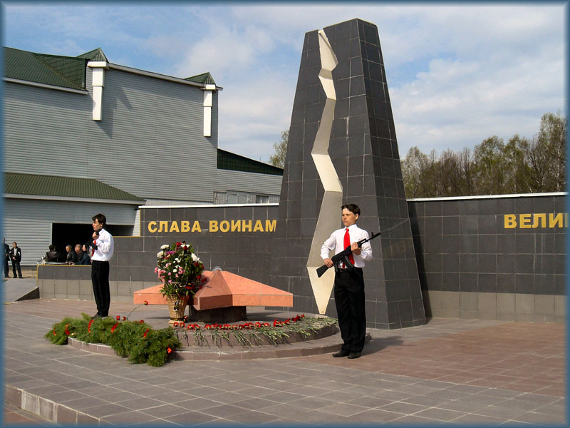

In Russia and other countries Victory Day , or 9th May, is one of the great holidays of the year. It is a holiday of all people.

Slide 4
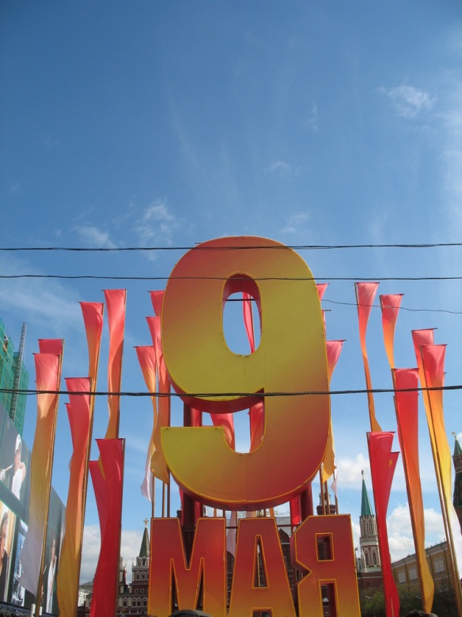
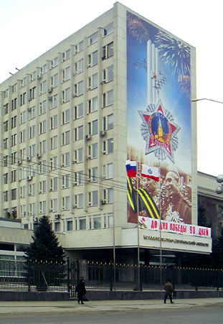
In all towns there are decorations, flags and placards in the streets, in the shop windows and on the front of large buildings.

Slide 5

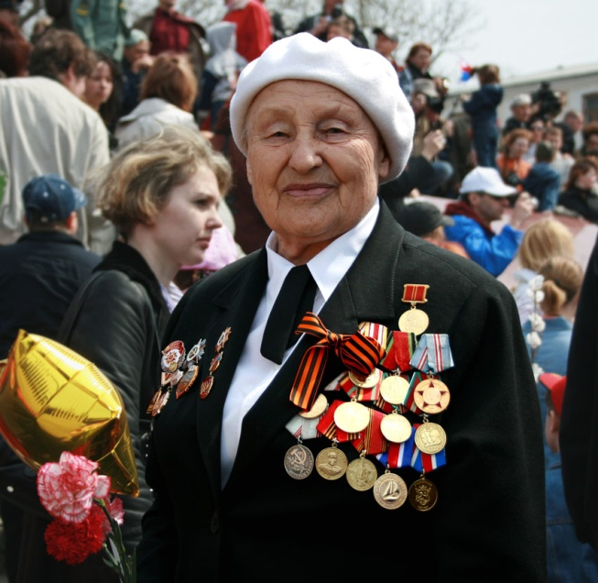
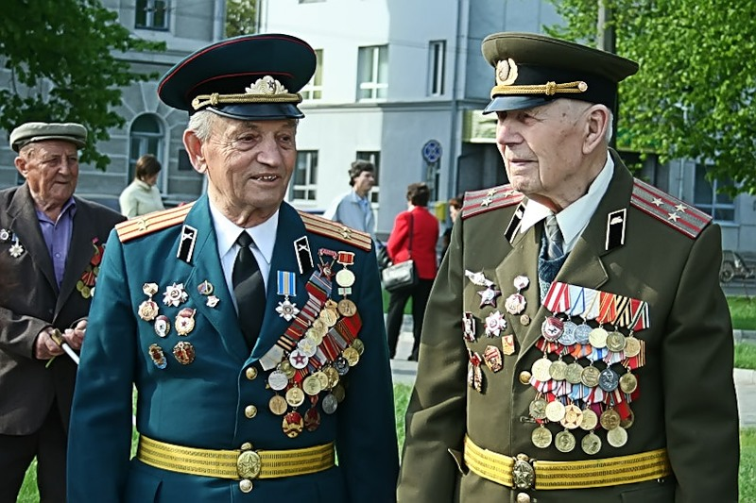
On Victory Day morning there are meetings and demonstrations of the veterans who fought in the Great Patriotic War.

Slide 6
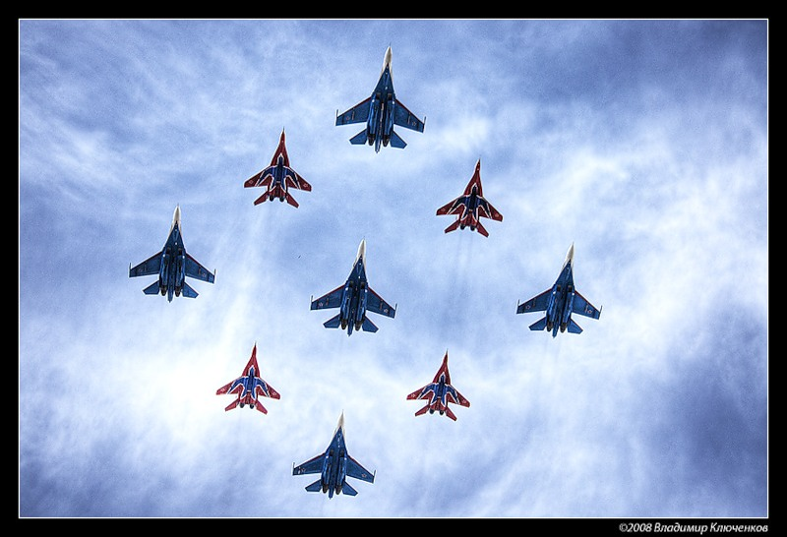
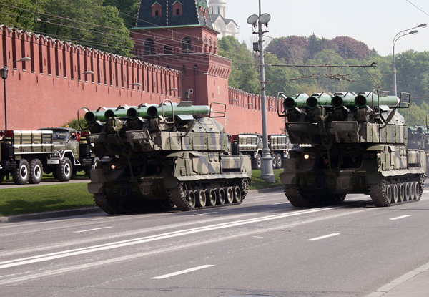
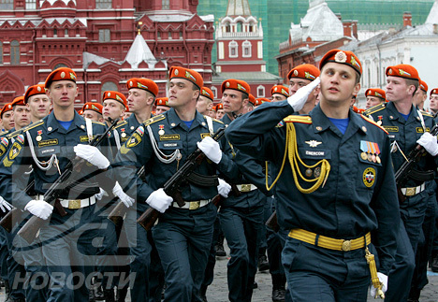
On that day there is military parade in all big cities of our country.

Slide 7
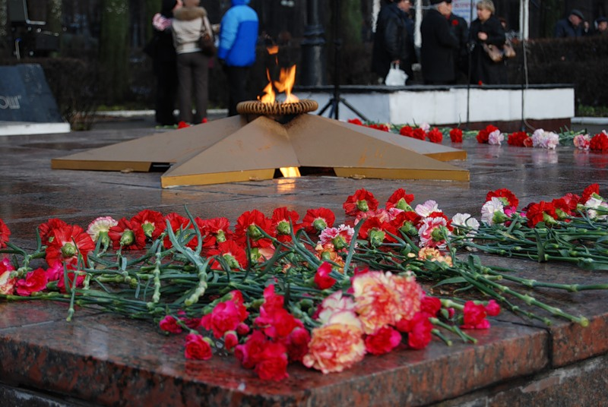
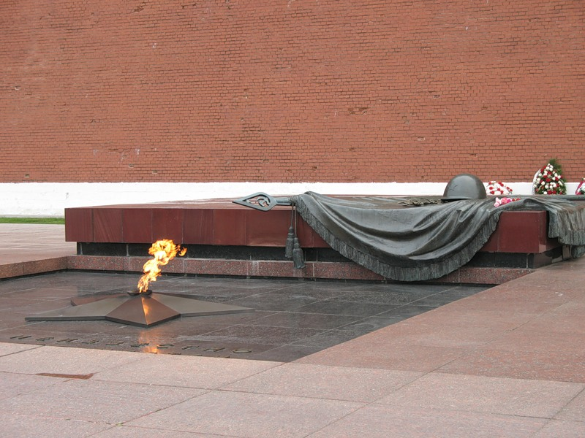
Flowers and souvenirs are given to those who took part in the Great Patriotic War.

Slide 8
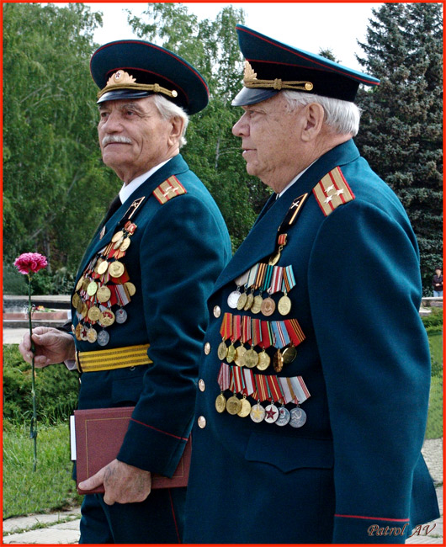
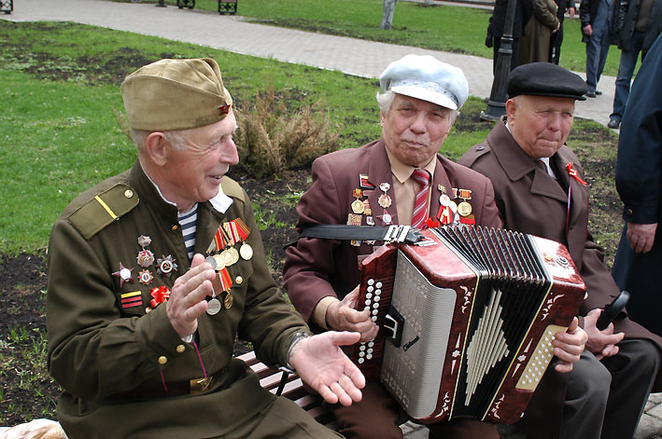
There are a lot of people in the streets and squares, at theatres, cinemas and concert halls. They are all celebrating their holiday. Many people go to see their friends or go for walks in the parks.

Slide 9
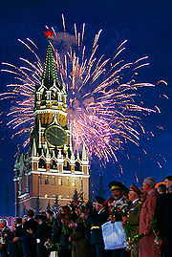
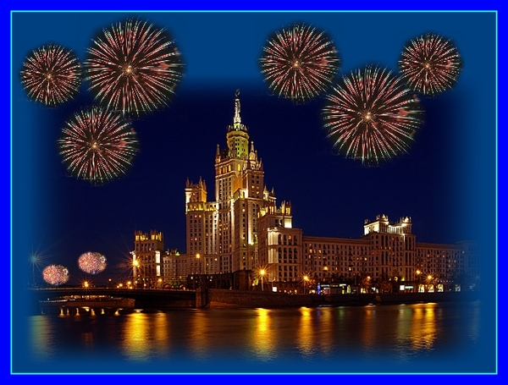
In the evening there is a holiday salute and a minute of silence to remember all those who did not come back from the war.

Slide 10
Используемые источники:
1. Старков А.П., Диксон Р.Р. Английский язык. Учебник для 6 класса.
2. http://ru.wikipedia.org/wiki/RSS
3. http://en.wikipedia.org/wiki/Main_Page
4. http://go.mail.ru/search_images

