Slide 1
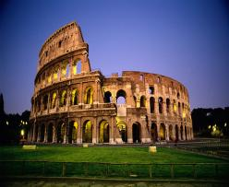
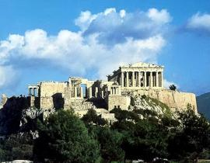
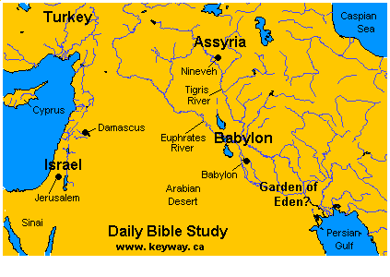
The Presentation for Review Lesson “HISTORY and CIVILIZATIONS” level – 9 teachers: Polyatykina I.
Kershengolts N. school № 1242
Moscow
2010 - 2011

Slide 2

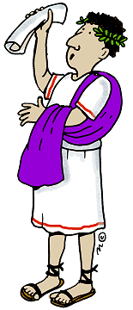
Agenda:
1. Why is history taught in schools?
2. How well do you know ancient civilizations?
3. The most important inventions.
4. Every minute of our life is history in the making.

Slide 3
Match the words with their definitions:
1. mankind a. to begin to create, to start to happen;
2. to achieve b. modern or relating to the present time;
3. contemporary c. all humans;
4. generation d. to succeed in doing what you planned to do
5. to establish e. belonging to the same time

Slide 4
Why is history taught in schools?
to understand today’s events?
to understand the past?
to avoid making mistakes?
other ideas?
to contribute to our cultural identity?

Slide 5

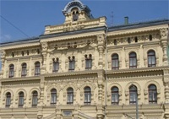
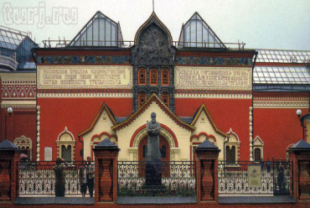
You and your friend want to go to a museum. Discuss and choose the most attractive option: a) The History Museum b) The Museum of Science and Technology c) The Russian Army Museum d) The City Picture Gallery

Slide 6
Before civilizations.
Watch the episode from the film “The Flintstones” and tick the modern gadgets represented in a humorous way.
A CAR | A VAN | A TRAIN
THEATRE | CIRCUS | DRIVE-IN-MOVIE
A MOTORBIKE | A TWO-WHEELED BICYCLE | A THREE-WHEELED BICYCLE
A HELICOPTER | A PLANE | A SPACESHIP

Slide 7
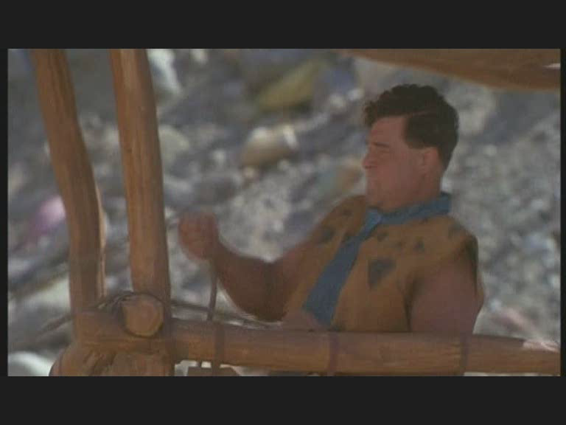


Slide 8
Fill in the gaps with the words: art, advanced, political, religion
Civilization is an ________________(1) stage of human development marked by a high level of ____________ (2), ___________(3), science and social and _______________(4)organization.
“Dictionary of English Language and Culture”

Slide 9
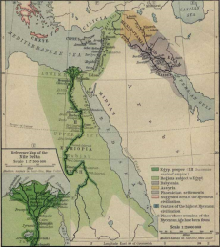
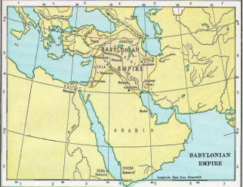
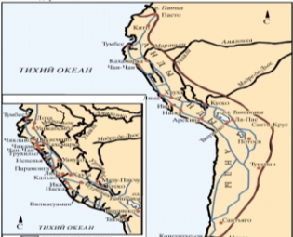
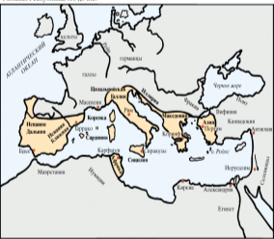
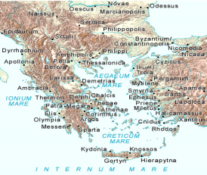
Where were the ancient civilizations? Match the maps with their names: the Babylonians the Egyptians the Romans the Greeks the Incas
1.
33.
xxxxxx
5
22.
44.

Slide 10
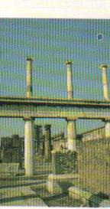
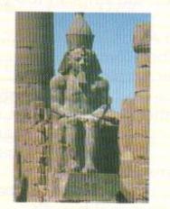
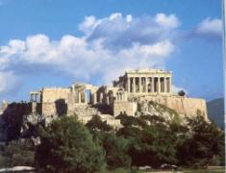
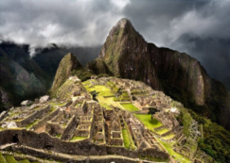
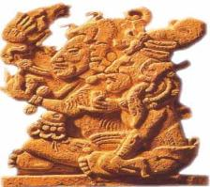
How well do you know the greatest achievements of ancient civilizations? Describe civilizations without giving their names and let the others guess.
Artistic and intellectual
material
Social and administrative
Ancient Rome
Ancient Egypt
Ancient Maya
Ancient Incas
Ancient Greece

Slide 11
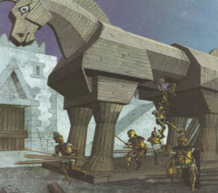
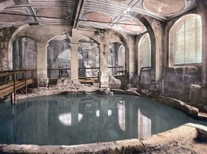
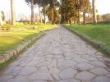
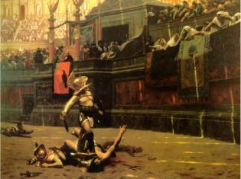
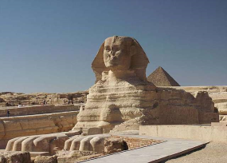
Egyptian? Greek? Roman?
1. The Trojan horse
2. Public baths
3. Excellent roads
5. The Sphinx
4. gladiator

Slide 12
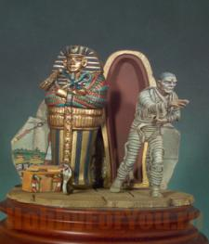
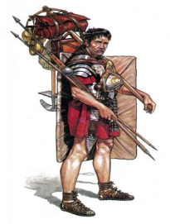
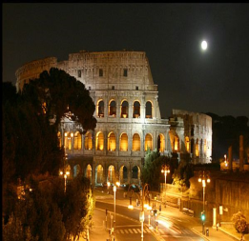
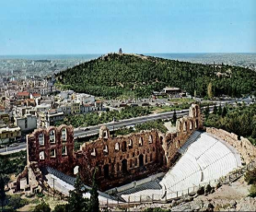
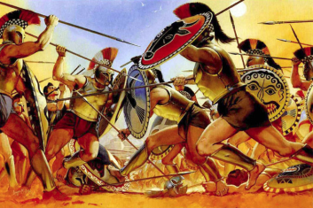
Greek? Egyptian? Roman?
7. mummy
6. legionary
8. Coliseum
10. Spartan warriors
9. the first theatre

Slide 13
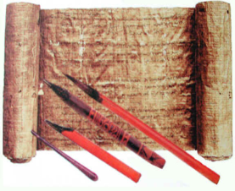
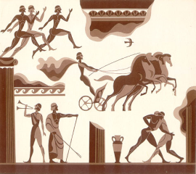
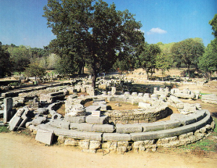
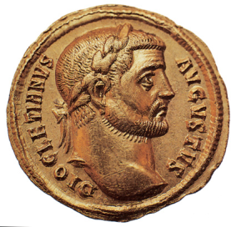
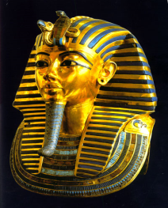
Egyptian? Greek? Roman?
13. Mount Olympus
11. papyrus
12. sport games
15. emperor
14. pharaoh

Slide 14
Watch the film and tick seven wonders of Ancient Greece:
The first city of Maya | The lost city of Atlantis
Minotaur | Dinosaur
The Highland Games | The Olympic Games
Delphi Oracle | Speaker in the senate
The first movies | The first theatre
The Nelson’s Column | The Colossus of Rhodes
The Parthenon | The Coliseum

Slide 15


Slide 16
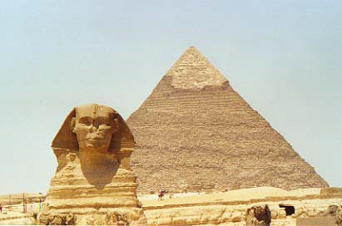
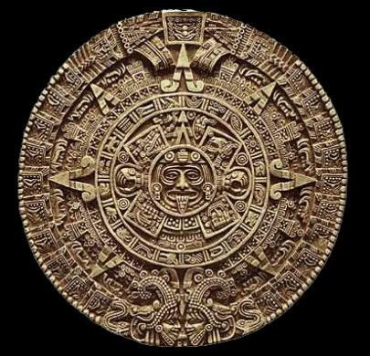
Compare early civilizations.
Which ancient civilizations do you admire most of all?
The Egyptians
The Maya

Slide 17
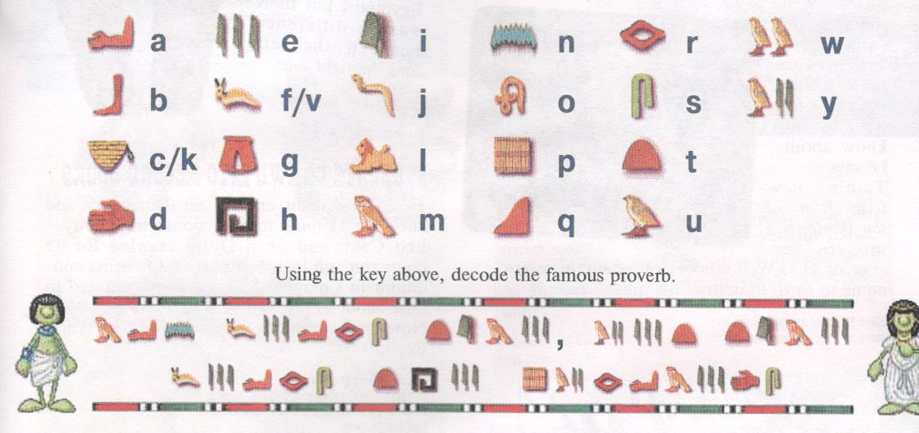
Can You Read in Ancient Egyptian?

Slide 18


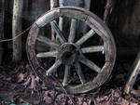
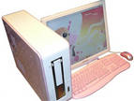
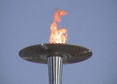
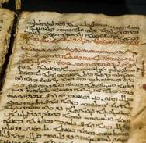
What is the most important invention of the humankind in your opinion?
Now comment on the statement “Necessity is the Mother of Invention”

Slide 19
Conclusion:
* ancient civilizations contributed a lot into the modern society;
* knowledge of history gives us cultural identity;
* every minute of our life is history in the making.

Slide 20
Which team is the best?
 | 1 team | 2 team
1. Matching the words and definitions
2. Mini-talk “Why is history taught in schools?”
3. Dialogue “Visiting Museums”
4. Listening 1 (Video “The Flintstones”)
5. Filling the gaps in the definition of a civilization
6. Matching the maps to the ancient civilizations
7. Mini-talks (riddles) about civilizations/ guessing the names
8. Which belongs to Egyptian, Greek or Roman civilization?
9. Listening 2 (Video “Seven Wonders of The Greek World”)
10. Dialogue-comparison of ancient civilizations
11. Decoding of the proverb
12. Mini-talk “The Most Important Invention”
13. Mini-talk “Necessity is the Mother of Invention”
TOTAL

Slide 21

HOMEWORK: prepare a two-minute talk on one of the themes:
“The History Repeats Itself” or
“Without the Past there Is No Future”

Slide 22
1. lived in the north of Africa on the banks of the Nile
2. located in the south of Balkan peninsula.
3. controlled lands from Persia to Libya
4. the civilization appeared in the southwest Europe on the Italian Peninsula or Apennine Peninsula
5. developed in the Andes of present-day Peru

