Slide 1
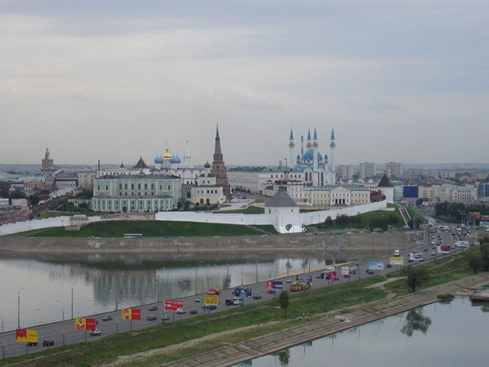
Famous people of Tatarstan

Slide 2

Oh, Kazan! Spirited Kazan!
Melodious Kazan! Radiant Kazan!
Here are all the solemn places
and deeds of our ancestors,
Here are all the beauties and
the paradise of the yearning soul!
Gabdullah Tukay

Slide 3
paint
write
compose
dance
invent
act
direct
win
produce
- er
- or

Slide 4
COSMONAUT
ASTRONAUT
SPORTSMAN
POLITICIAN
MUSICIAN
SCIENTIST
PLAYWRIGHT
ARCHITECT

Slide 5
№ | Сфера деятельности | Выбор
1 | a TV programme | manager
2 | a school | president
3 | a shop | head teacher
4 | the governing party | conductor
5 | an orchestra | captain
6 | a republic | Prime Minister
7 | a hospital | producer
8 | a football team | doctor
9 | a cinema | actor

Slide 6
№ | Сфера деятельности | Выбор
1 | a TV programme | producer
2 | a school | head teacher
3 | a shop | manager
4 | the governing party | Prime Minister
5 | an orchestra | conductor
6 | a republic | president
7 | a hospital | doctor
8 | a football team | captain
9 | a cinema | actor

Slide 7
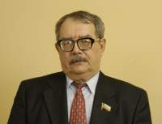
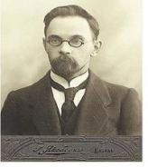
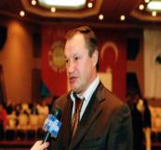
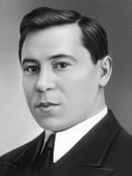
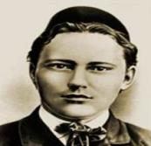
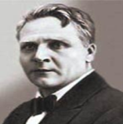
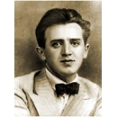
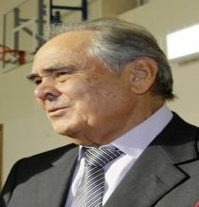
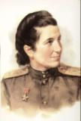
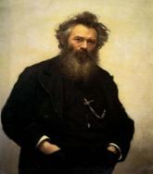
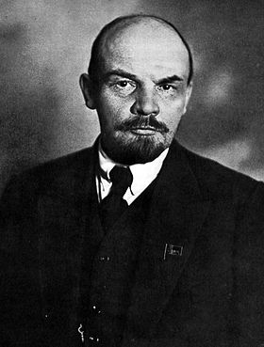
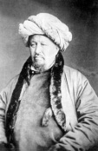
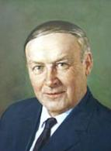
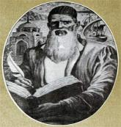
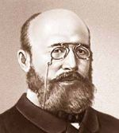
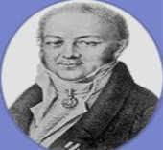
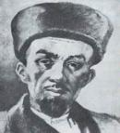
We are proud of them

Slide 8
Why do people respect them?
People admire/respect them for their …….
ideas
actions
deeds
achievements

Slide 9

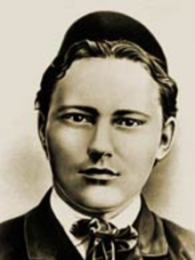

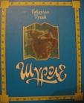
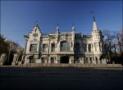
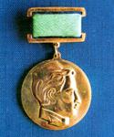
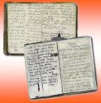
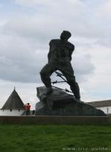
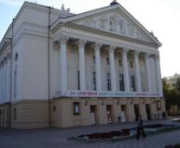
Gabdulla Tukay
Musa Jalil

Slide 10
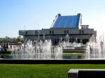
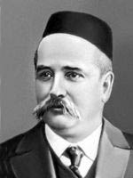

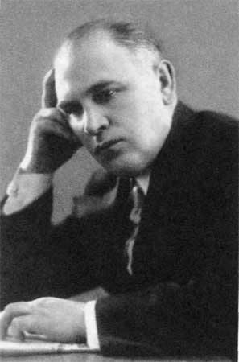
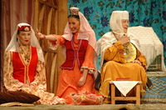
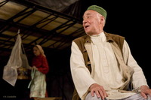
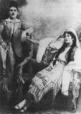
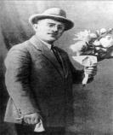
The playwrights

Slide 11
The list of the Kazan theatres below is not complete. Can you complete it?
?
?
?
?
?
?
?

Slide 12
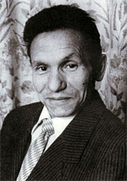
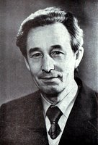
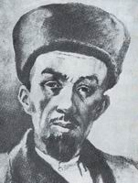
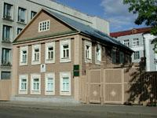
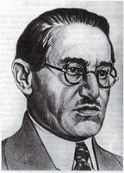
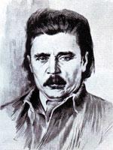
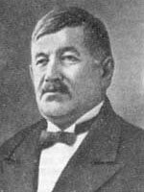

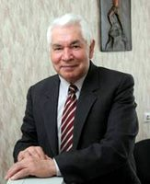


Slide 13
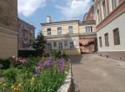
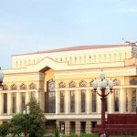
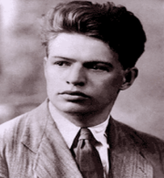
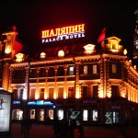
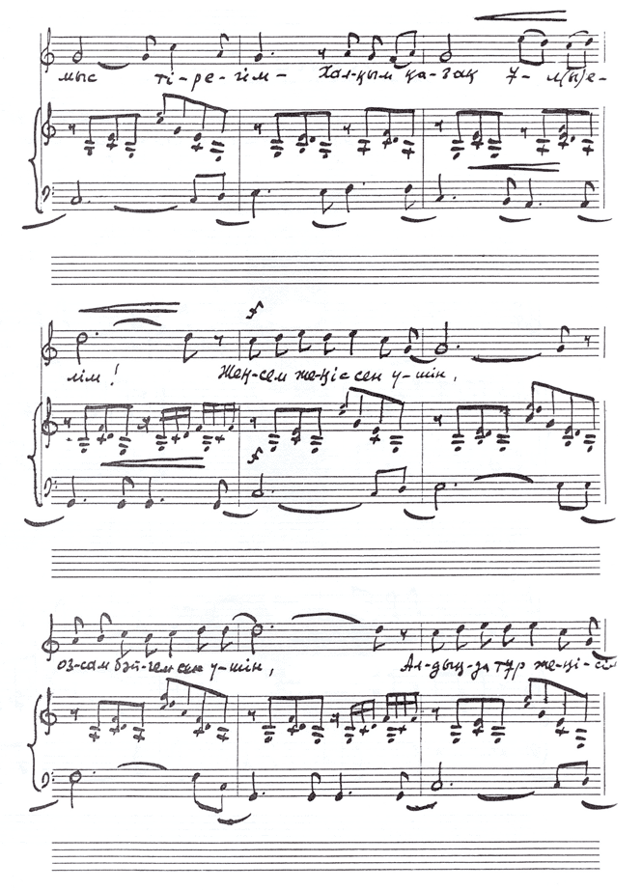


.
Farid Yarullin
Salikh Saidashev
ballet "Shurale"
Fyodor Shalyapin

Slide 14
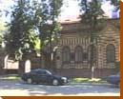

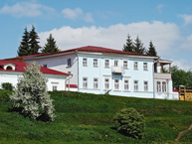
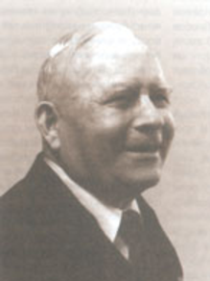
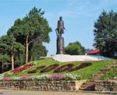

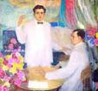



I. Shishkin
Baky Urmanche

Slide 15

1
2
3
People mentioned in this slide played an important role in the cultural development of Tatarstan, Russia and even the world.

Slide 16







Nikolay Lobachevsky
Alexander Arbuzov
Karl Fuks
Aleksandr Butlerov

Slide 17





Yevgeny Zavoisky

Slide 18








"Only two know the mystery of brain structure and organization: God and Bekhterev"- Bekhterev
Vladimir Behterev

Slide 19








“Kazan is the capital of champions!”
Wrestling
FC "Rubin"
HC "Ak Bars"

Slide 20
G. Tukai
M. Shaimiev
S. Saidashev
M. Sirtlanova
N. Isanbet
K. Nasyri
B. Urmanche
F. Muhametshin
Y. Zavoisky
Kurban Berdiev
F. Yarullin
V. Behterev
composer
scientist
writer
poet
trainer
w. cosmonaut
playwright
politician
sculptor
President of Tatarstan
educator
doctor
a
an
the
was
is

Slide 21
HOW DID PEOPLE HONOUR THEM?
People…
establish a medal
build monuments
establish a stamp
name some places
…in honour of them.

Slide 22





WHAT PLACES ARE THESE NAMES CONNECTED WITH?
Yevgeny Zavoisky
Gabdulla Tukay
Salikh Saidashev
Musa Jalil
Vladimir Ilyich Lenin
… is connected with…

Slide 23
Complete the dialogue using the words and word combinations below.
Tourist: ___1_. I’d like some information about museums in Yelabuga, _____2_.
Guide: There are four museums and many mysterious places in Yelabuga, you know! What do you want to see?
Tourist: Well, I’m ____3_ painting.
Guide: OK, you can go to the Shishkin museum. That’s a _____4_ . There are really interesting things to see.
Tourist: Right. And when is it ___5_ ?
Guide: From 10 am till 6 pm.
Tourist: How much are the ____6_?
Guide: Entrance is free!
Tourist: That’s great! And ___7_ do I get there?
Guide: Well, you can get a bus. The bus station is in front of the museum.
Tourist: Where can I get a map? I don’t want to get lost.
Guide: Here you are.
Tourist: _______8_.
how, Good morning, great day out, interested in, open, please, Thank you very much, tickets

