Slide 1
FILM TERMS: SHOTS; CAMERA MOVEMENTS

Slide 2
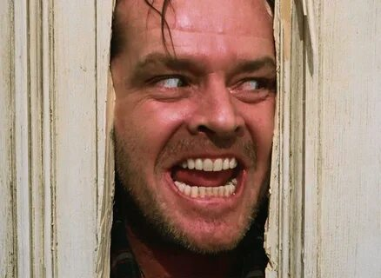
CLOSE-UP (CU)
A SHOT THAT SHOWS A SUBJECT FROM THE TOP OF THE HEAD TO THE UPPER CHEST LEVEL

Slide 3
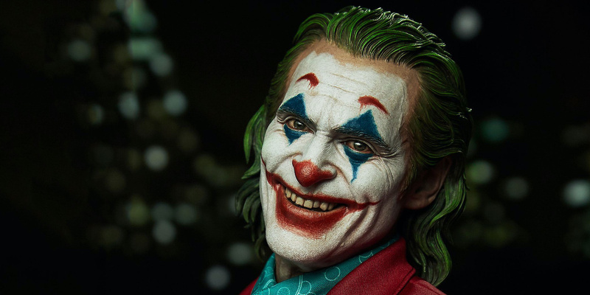
CHOKER
A CLOSE-UP SHOT THAT SHOWS A PERSON’S FACE FROM THE NECK TO ABOVE THE HEAD

Slide 4
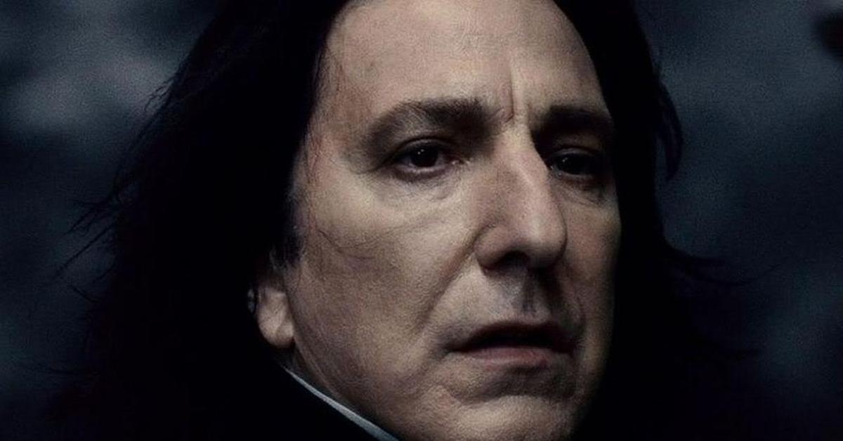
BIG HEAD CU
A CLOSE-UP SHOT THAT SHOWS A PERSON’S FACE FROM JUST BELOW THE CHIN AND CUTS OFF THE TOP OF THE HEAD

Slide 5
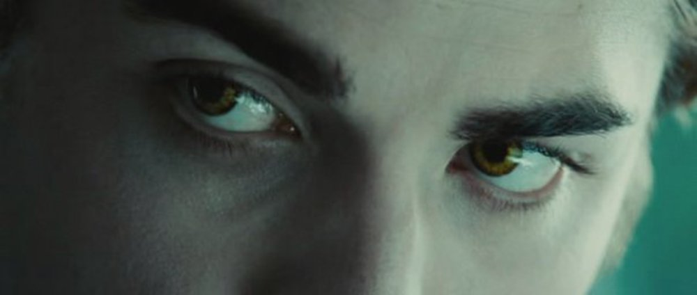
EXTREME CLOSE-UP (ECU)
A CLOSE-UP SHOT THAT SHOWS A VERY LIMITED SUBJECT OR A PART OF A SUBJECT, SUCH AS A PERSON’S EYES

Slide 6
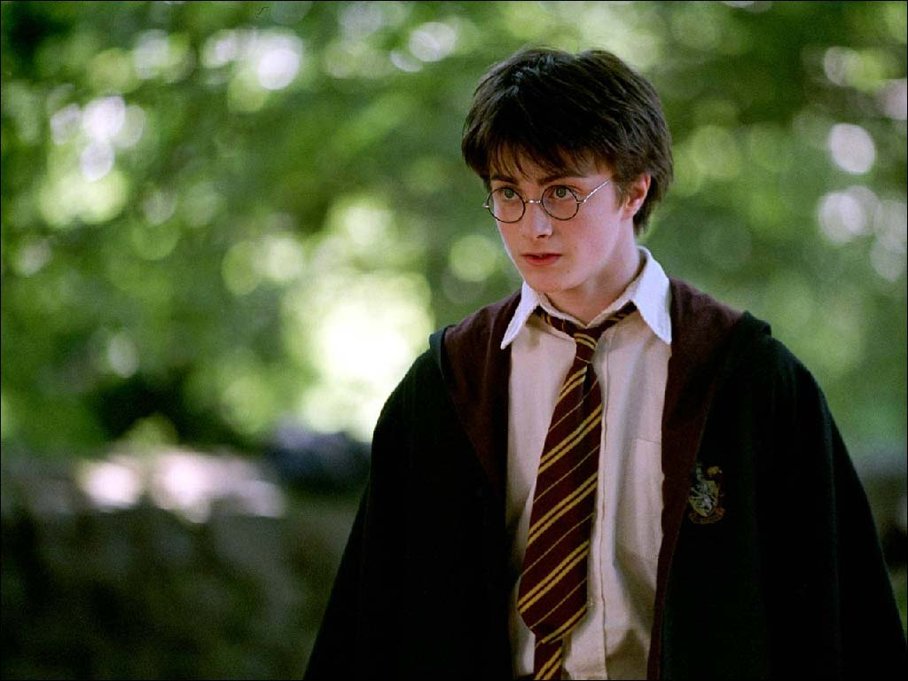
MEDIUM SHOT/MID SHOT (MS)
A SHOT THAT IS FILMED AT A MODERATE DISTANCE FROM THE SUBJECT, OFTEN SHOWING A PERSON’S HEAD AND UPPER BODY (WAIST UP)

Slide 7
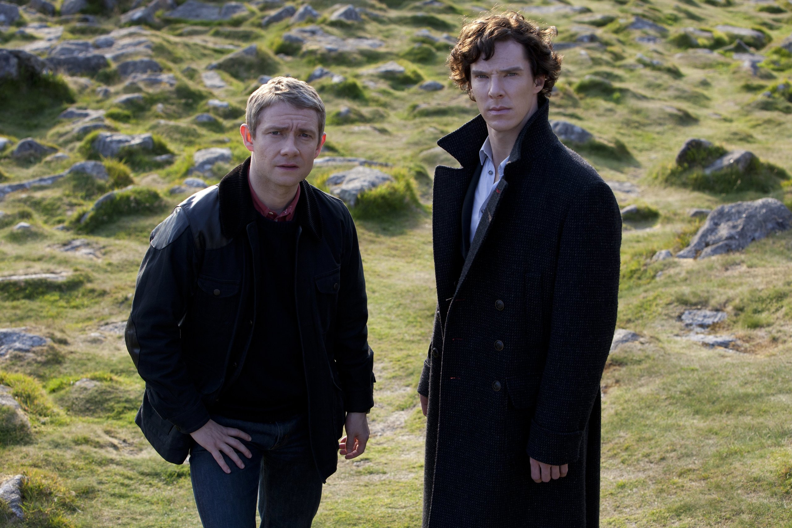
COWBOY SHOT
A SHOT THAT SHOWS A PERSON FROM THE HEAD TO THE UPPER LEG (MIDTHIGH)

Slide 8
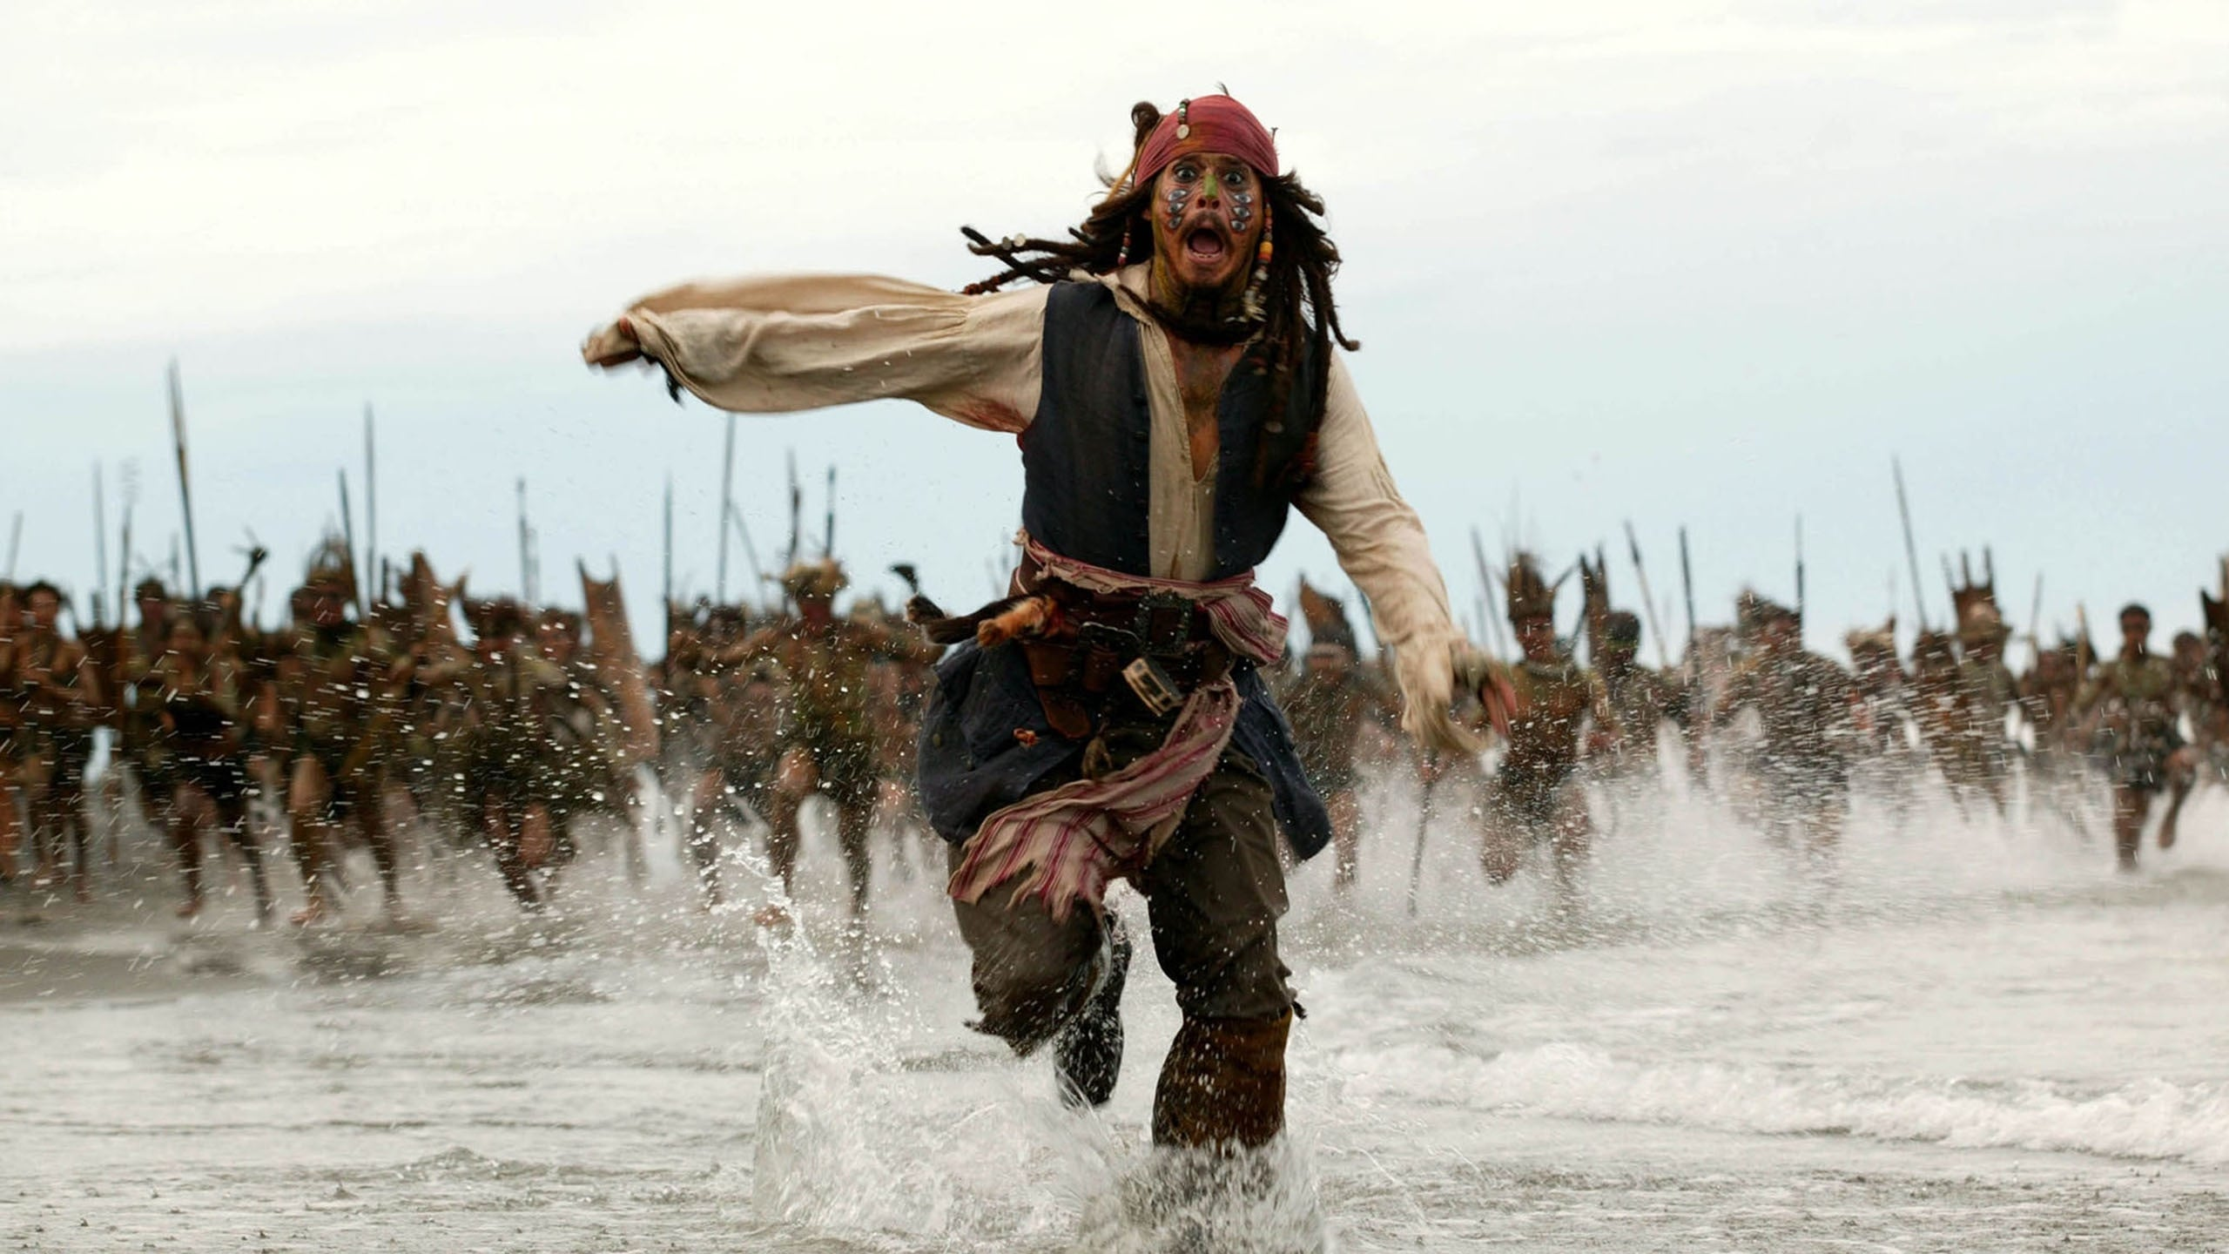
FULL SHOT
A SHOT THAT SHOWS AN ENTIRE PERSON OR OBJECT

Slide 9
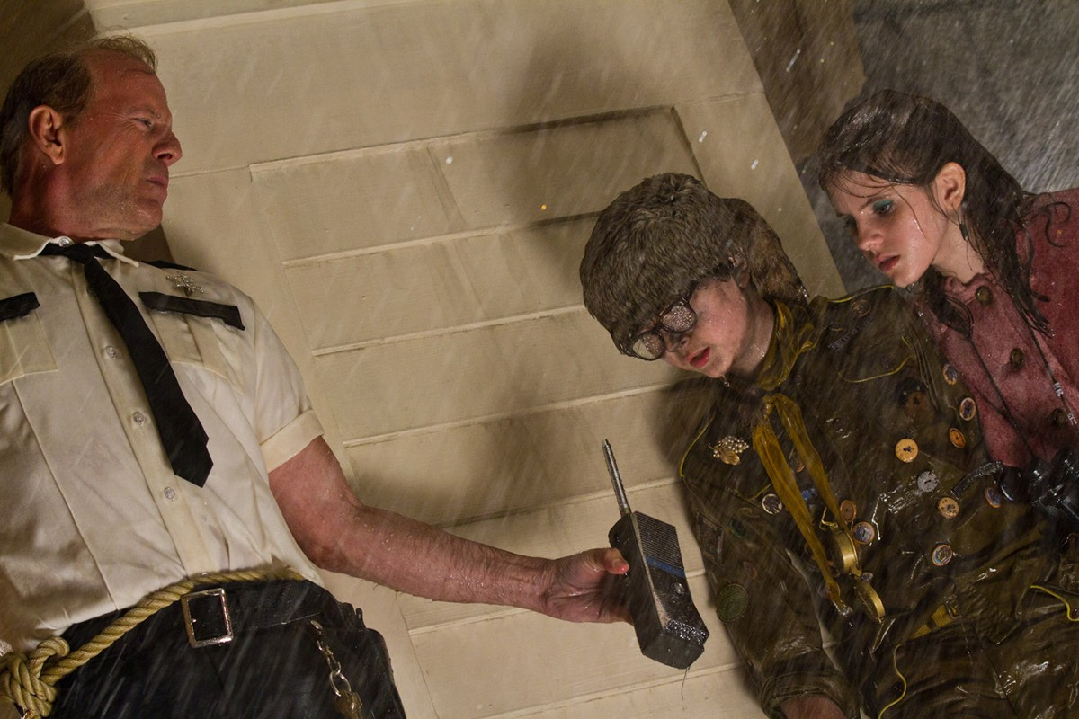
DUTCH ANGLE
A TECHNIQUE IN WHICH THE CAMERA IS NOT LEVEL WITH THE GROUND BUT TILTED ON THE LEFT OR RIGHT MAKING VERTICAL OBJECTS APPEAR TO BE LEANING

Slide 10
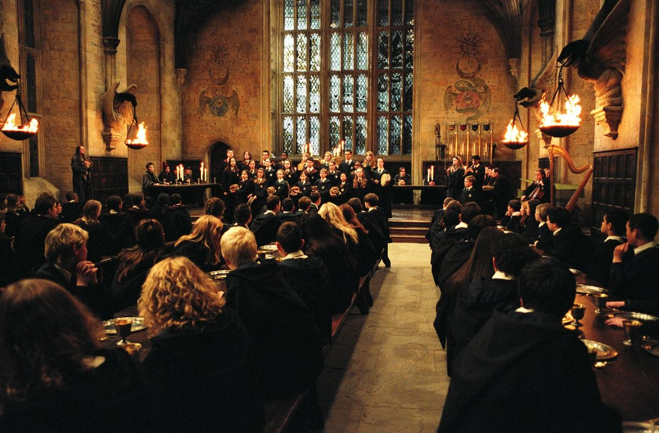
WIDE SHOT (WS)/LONG SHOT (LS)
A SHOT THAT SHOWS MOST OR ALL OF A SETTING

Slide 11
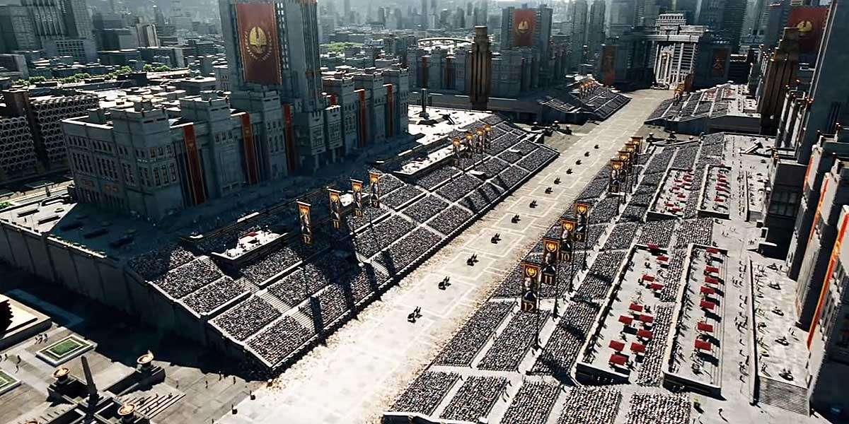
BIRD’S EYE ANGLE/GOD’S EYE VIEW
AN OVERHEAD SHOT IN WHICH THE CAMERA IS PLACED AT A VERY HIGH ANGLE, GENERALLY TO SUGGEST A PERSPECTIVE THAT SEES EVERYTHING IN A SCENE AND TO GIVE A SYMBOLIC MEANING TO IT

Slide 12
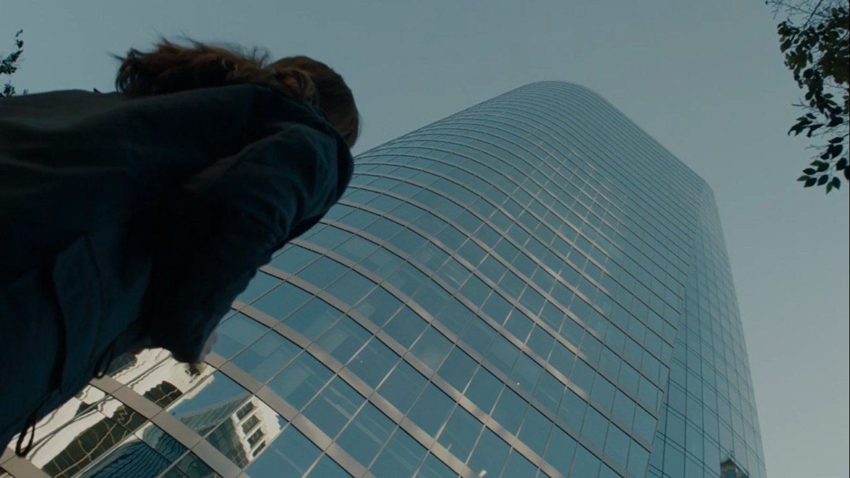
WORM’S EYE ANGLE
THE VIEW OF A SCENE FROM BELOW THAT A WORM MIGHT HAVE IF IT COULD SEE

Slide 13
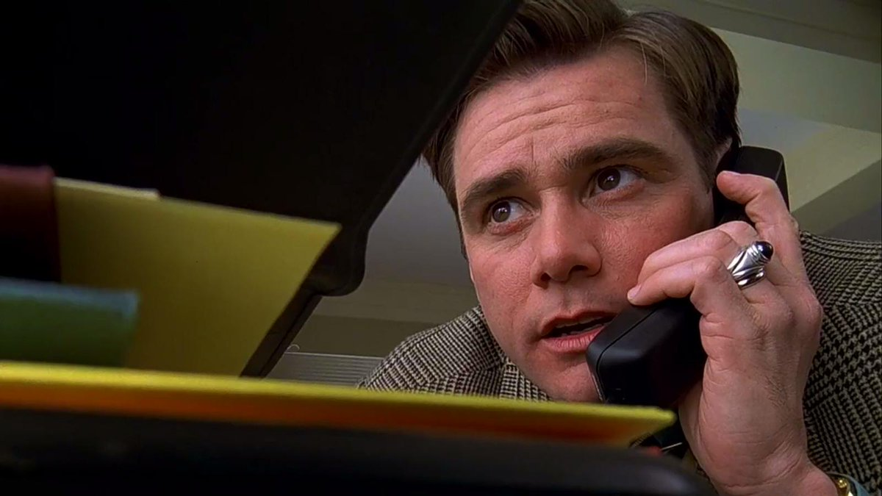
LOW ANGLE
THE CAMERA IS PLACED BELOW EYE LEVEL, LOOKING UP AT THE SCENE

Slide 14
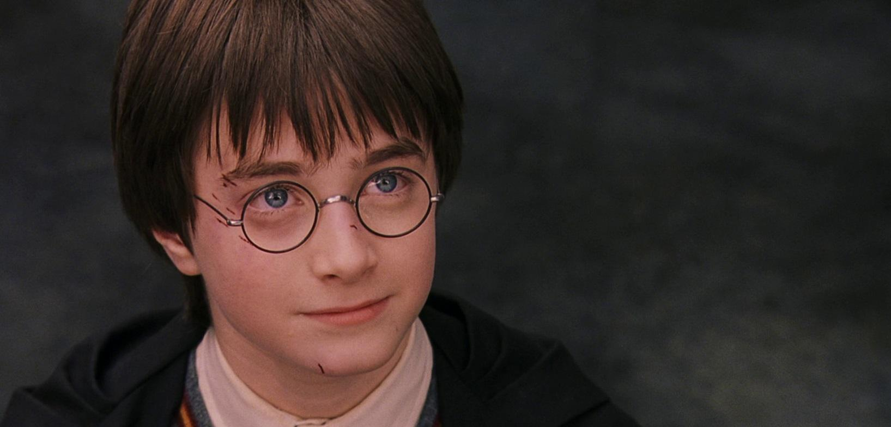
HIGH ANGLE
THE CAMERA IS PLACED ABOVE EYE LEVEL, LOOKING DOWN AT THE SCENE

Slide 15
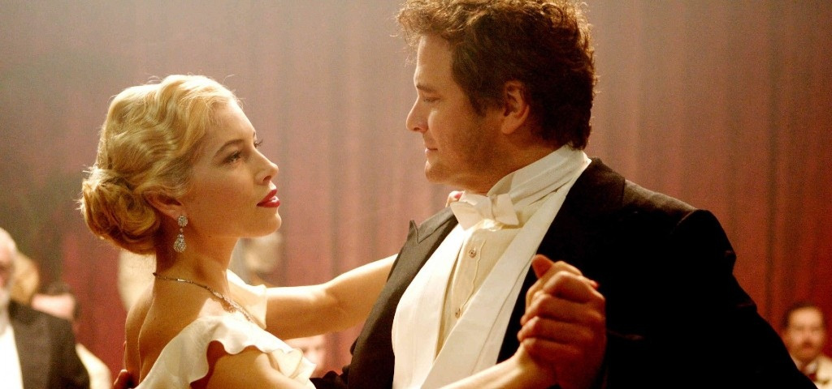
50/50
A SHOT THAT SHOWS TWO PEOPLE FROM THE SIDE AS THEY FACE EACH OTHER

Slide 16
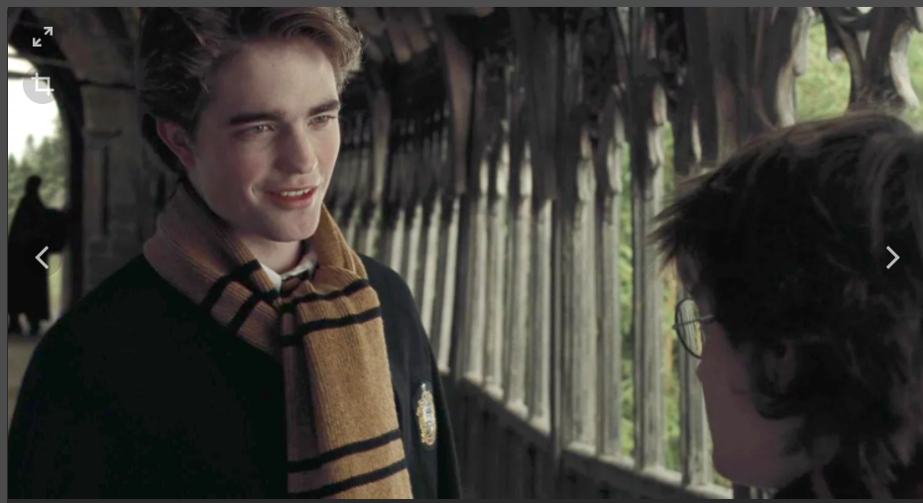
OVER-THE-SHOULDER-SHOT (OSS)
A SHOT OF A PERSON FROM BEHIND ANOTHER PERSON, IN WHICH A SIGNIFICANT PART OF THE SECOND PERSON IS VISIBLE

Slide 17
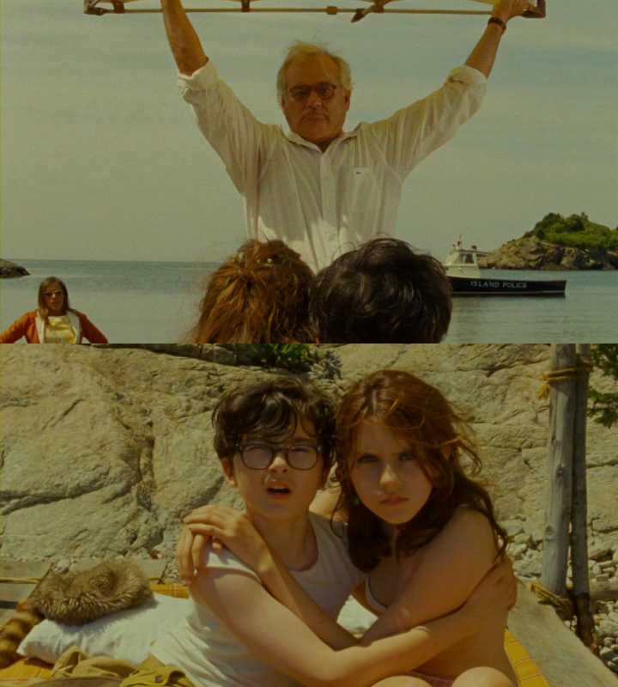
SHOT-REVERSE-SHOT
TWO SHOTS EDITED TOGETHER THAT ALTERNATE THE CHARACTERS, TYPICALLY IN A CONVERSATIONAL SITUATION

Slide 18
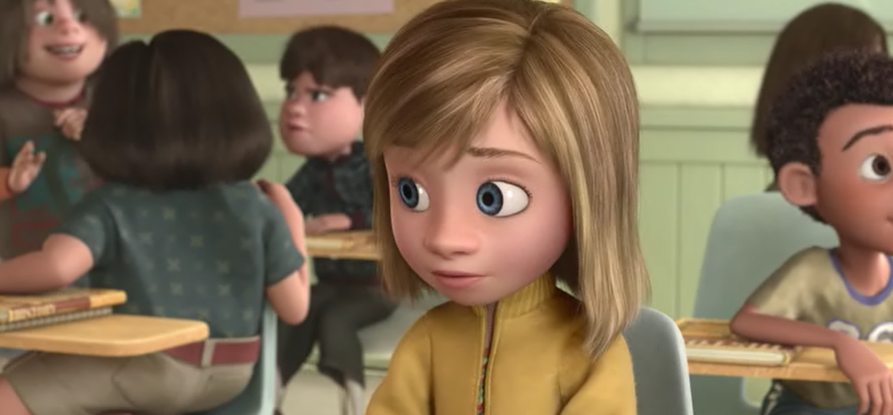
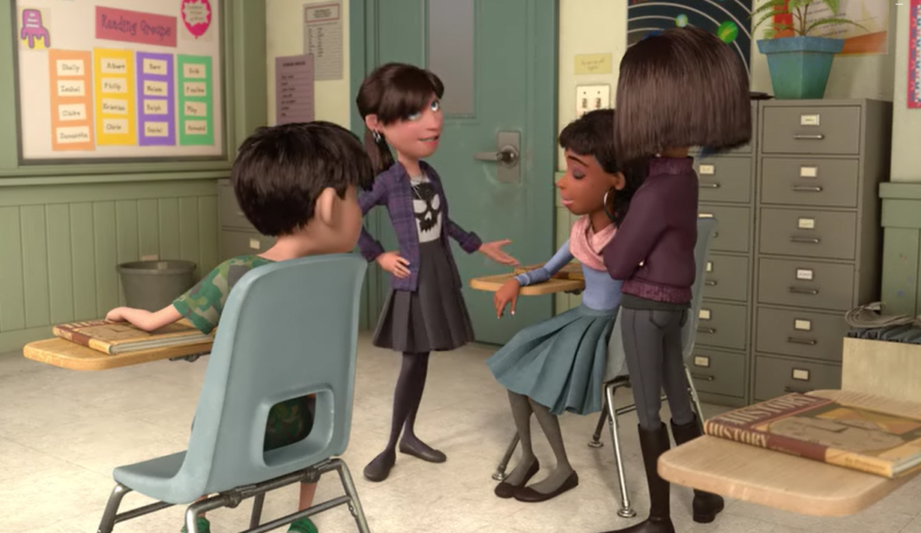
REVERSE SHOT
A SHOT TAKEN AT A 180-DEGREE ANGLE FROM THE PROCEDING SHOT

Slide 19
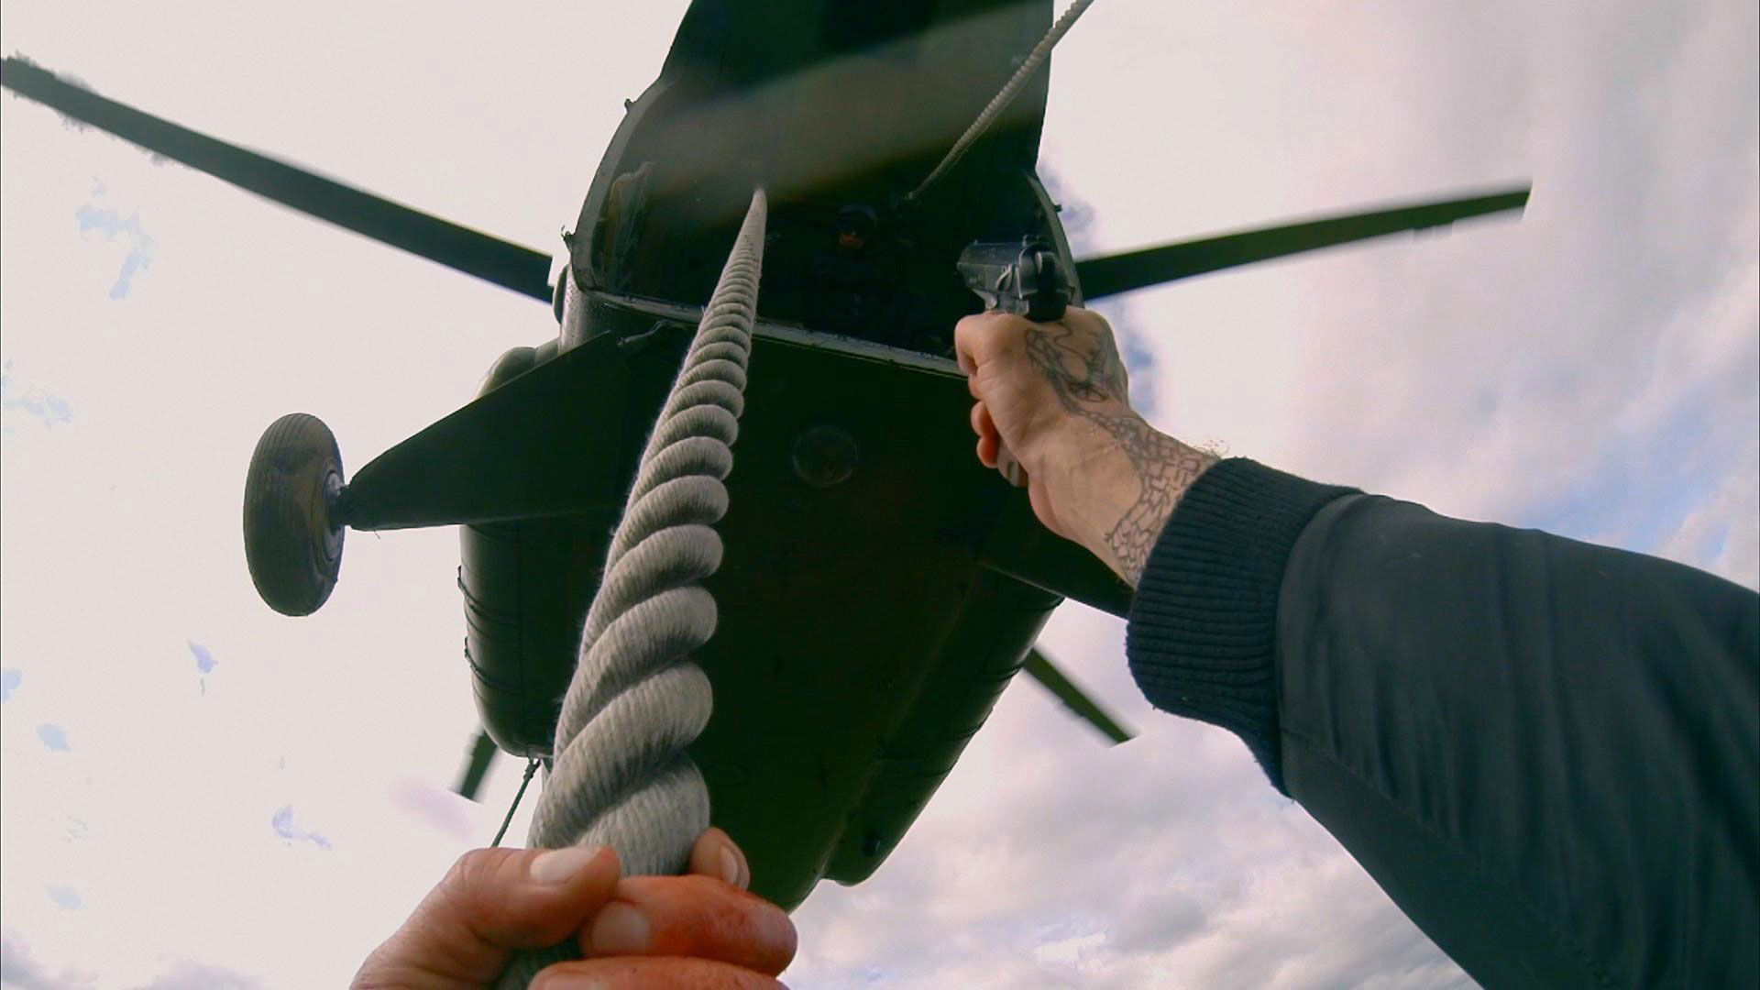
POINT-OF-VIEW (POV CUT)
A CUT THAT IS USED WHEN A CHARACTER LOOKS OFF-SCREEN IN ONE SHOT, AND THE DIRECTION OF HIS OR HER GAZE DETERMINES THE POINT OF VIEW IN THE NEXT SHOT

Slide 20
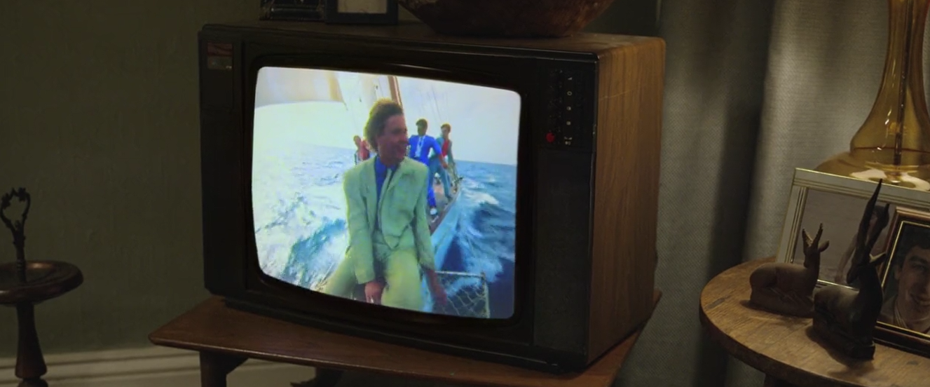
FRAME WITHIN A FRAME
AN IMAGE THAT HAS ITS OWN BORDERS SOMEWHERE INSIDE THE FRAME OF THE SHOT

Slide 21
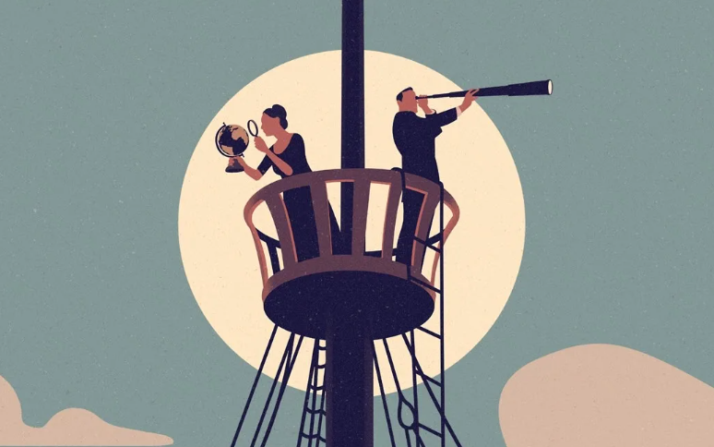
ZOOM IN/OUT:
TO SHIFT THE VIEW OF A CAMERA CLOSER TO OR FARTHER FROM A SUBJECT, WITHOUT CHANGING THE CAMERA’S LOCATION

Slide 22
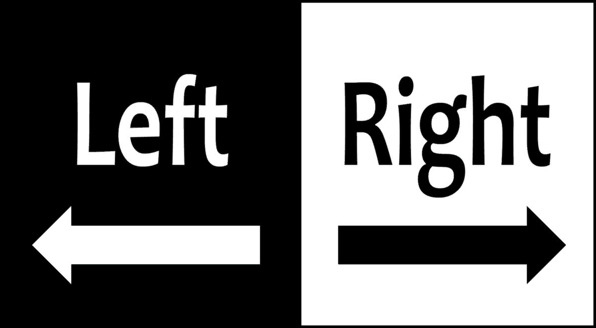
PAN LEFT/RIGHT:
TO SHIFT THE VIEW OF A CAMERA FROM SIDE TO SIDE, WITHOUT CHANGING THE CAMERA’S LOCATION

Slide 23
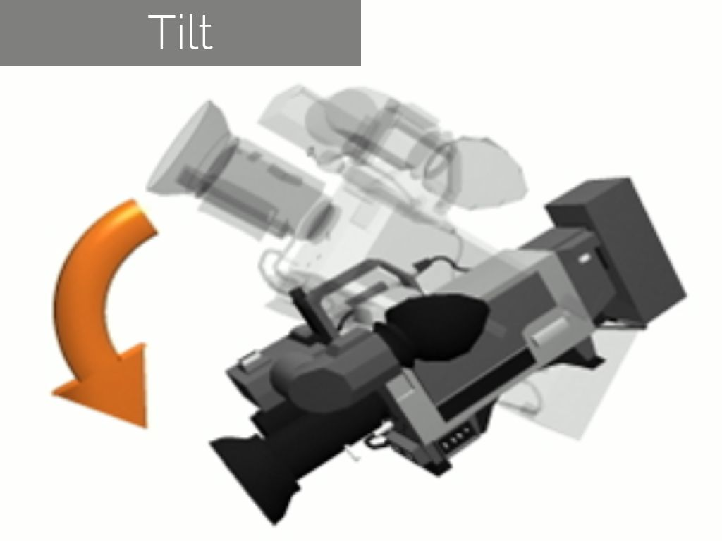
TILT UP/DOWN:
TO SHIFT THE VIEW OF A CAMERA UP OR DOWN, WITHOUT CHANGING THE CAMERA’S LOCATION

Slide 24
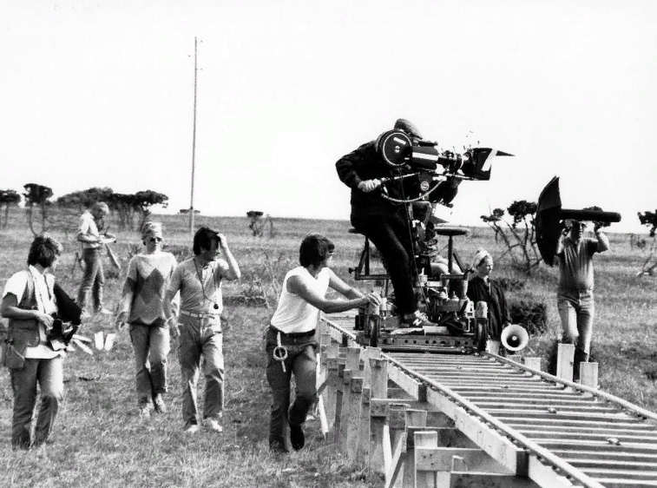
TRACKING:
THE PROCESS OF MOVING A CAMERA ALONGSIDE A SUBJECT, SO THE CAMERA MAINTAINS THE SAME VIEW OF THE SUBJECT AS THE SUBJECT MOVES

Slide 25
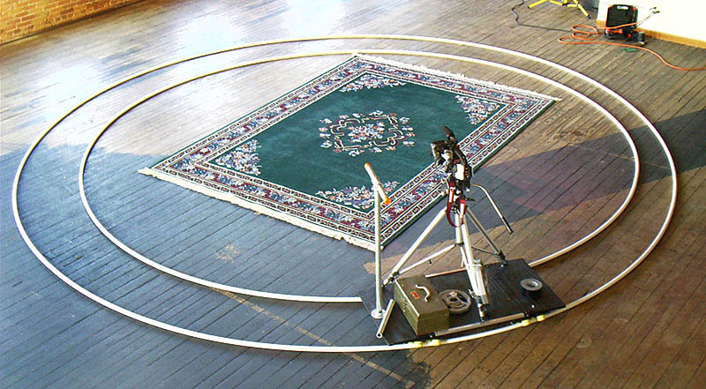
CIRCLE TRACK MOVE:
THE PROCESS OF MOVING A CAMERA AROUND A SUBJECT IN A CIRCLE OR PARTIAL CIRCLE

Slide 26
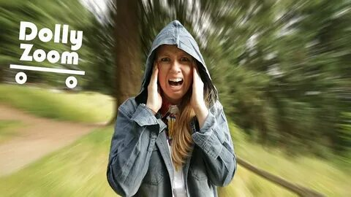
DOLLY ZOOM
AN IN-CAMERA EFFECT HERE YOU DOLLY TOWARDS OR AWAY FROM A SUBJECT WHILE ZOOMING IN THE OPPOSITE DIRECTION

Slide 27

FADE IN/FADE OUT
THE IMAGE APPEARS AND DISAPPEARS GRADUALLY, OFTEN USED AS A DIVISION BETWEEN SCENES

Slide 28
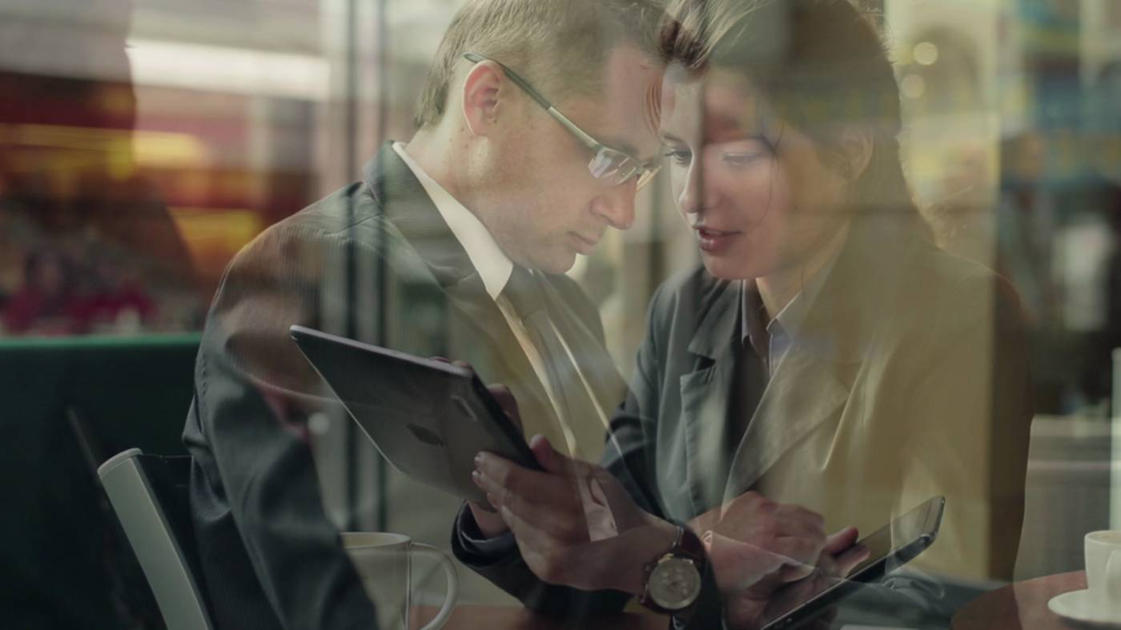
DISSOLVE
ONE IMAGE FADES IN WHILE ANOTHER FADES OUT SO THAT FOR A FEW SECONDS, THE TWO ARE SUPERIMPOSED

