Slide 1
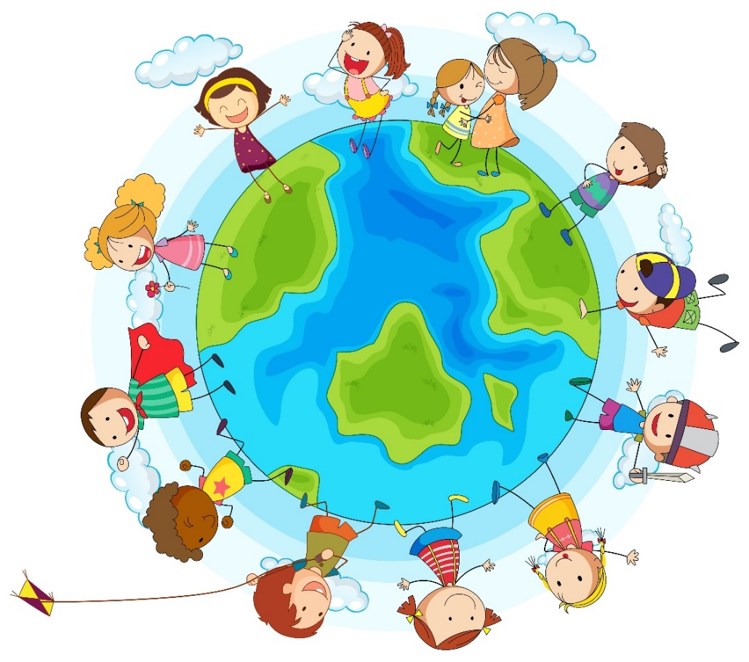
English – speaking countries and their capitals.

Slide 2
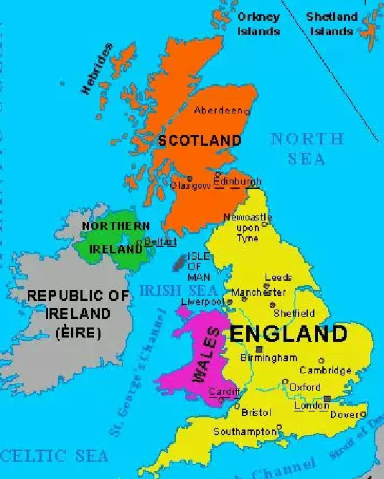
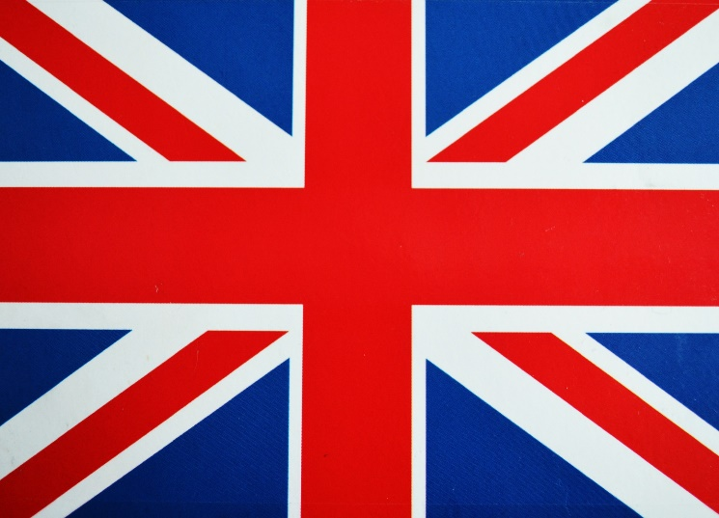
The United Kingdom of Great Britain
England
Scotland
Wales
Nothern Ireland

Slide 3
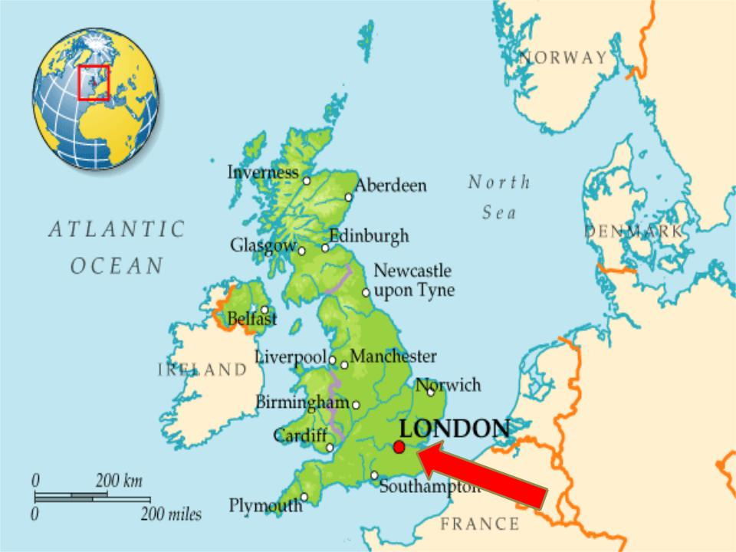
London is the capital of the UK.

Slide 4
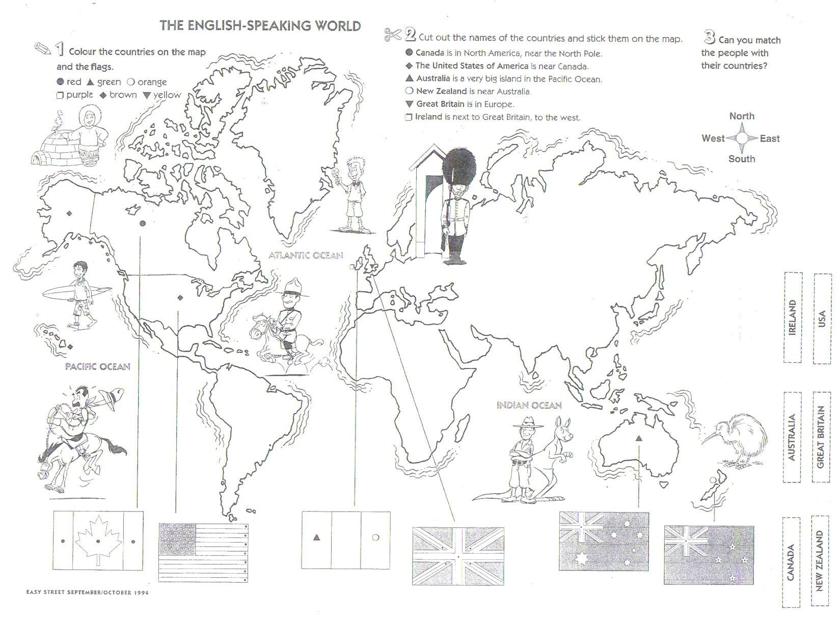
Find the UK. Colour this country and its flag.

Slide 5
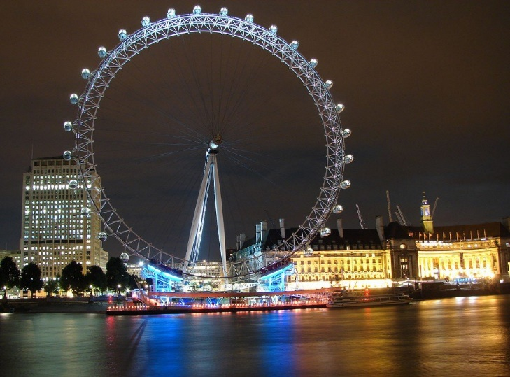
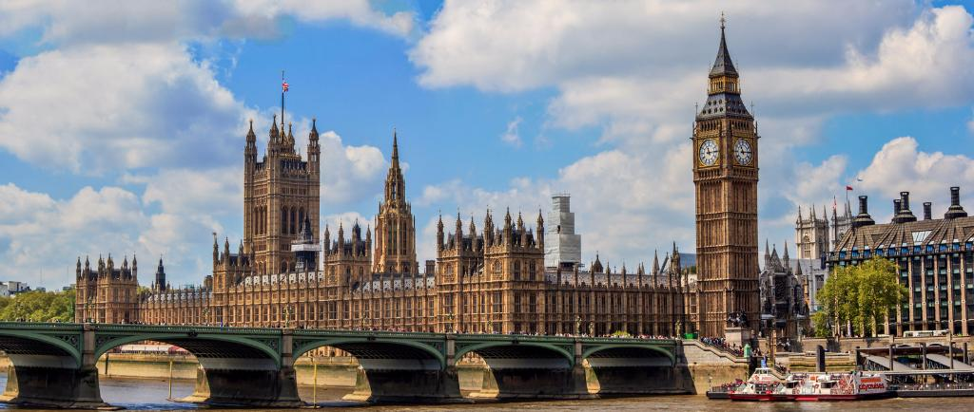
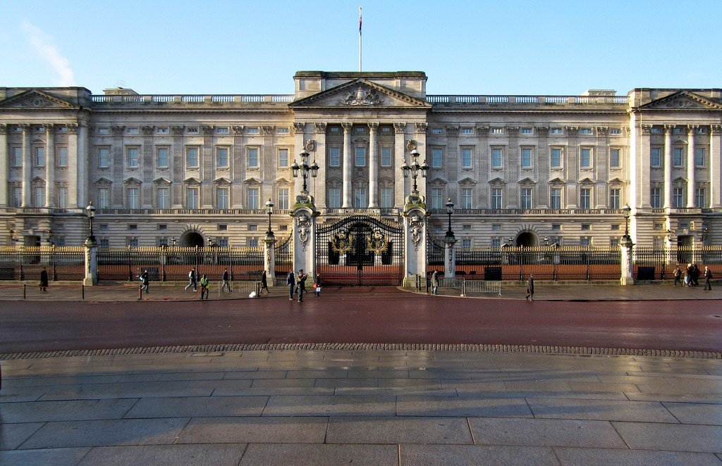
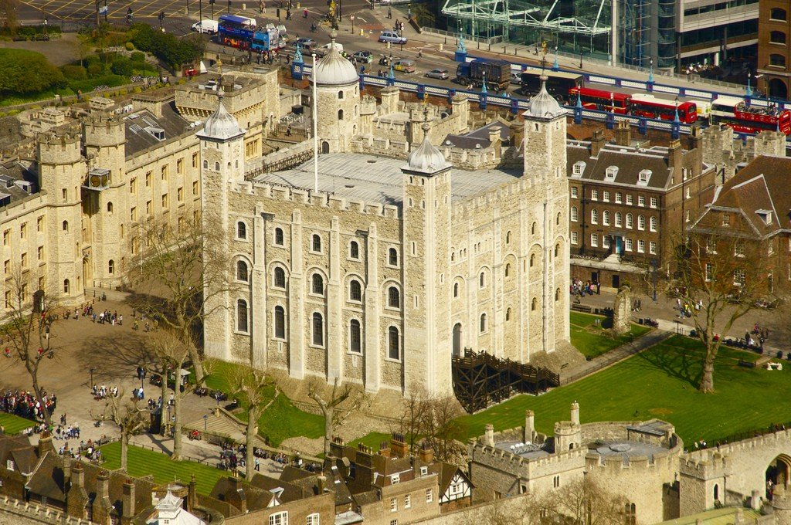
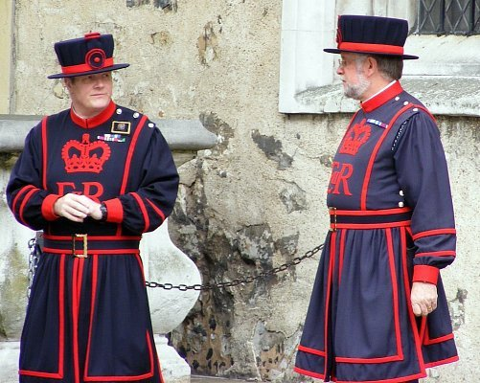
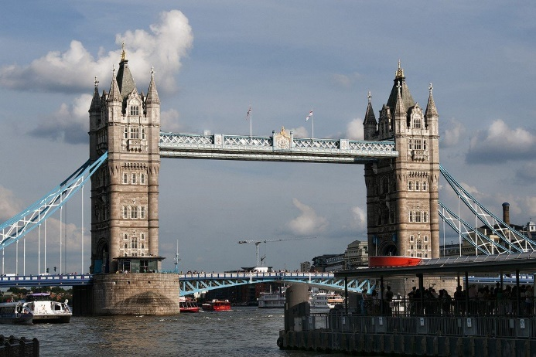
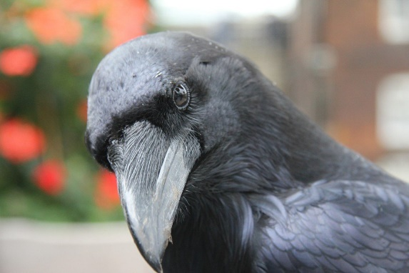
The sightseeings of the UK
Big Ben and Westminster Palace
London Eye
Buckingham Palace
Ravens
Tower of London
Beefeaters
Tower Bridge

Slide 6

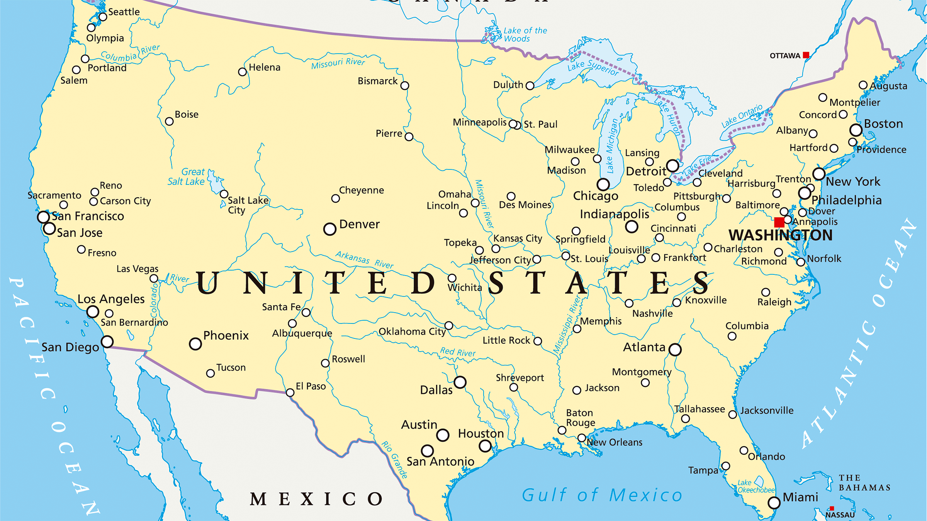
The United States of America
Washington is the capital of the USA.

Slide 7

Find the USA. Colour this country and its flag.

Slide 8
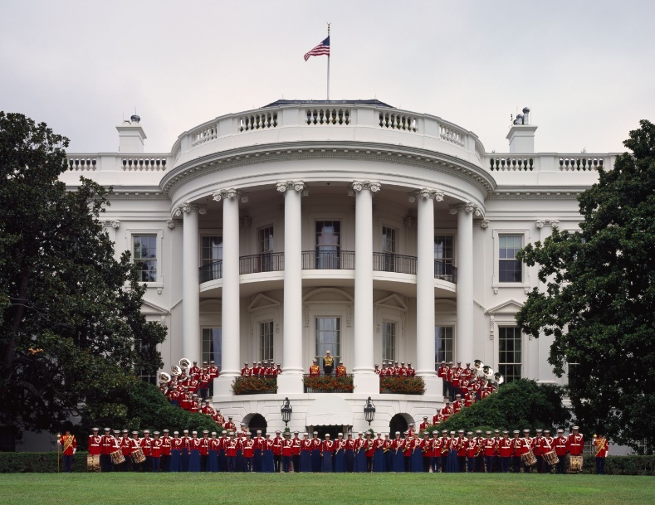
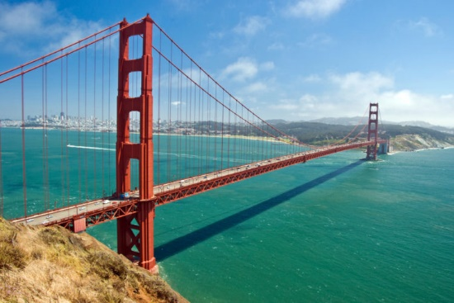
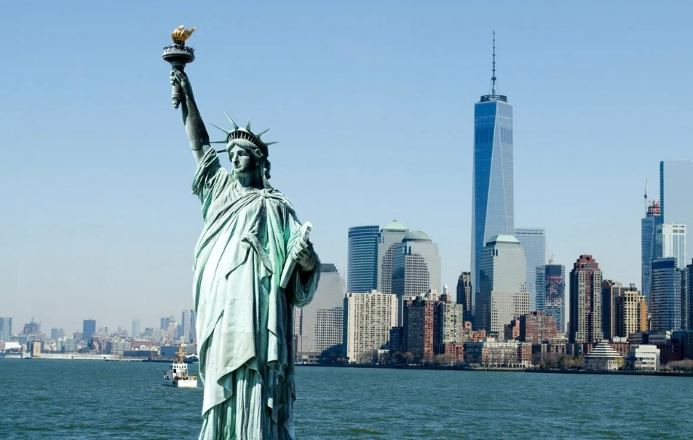
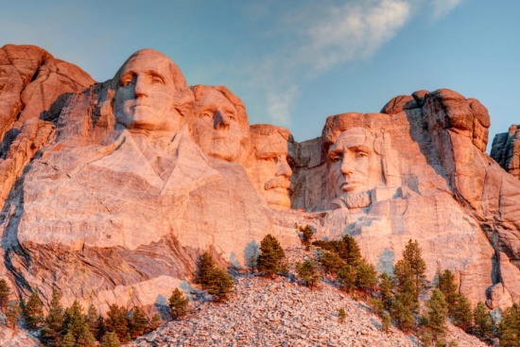
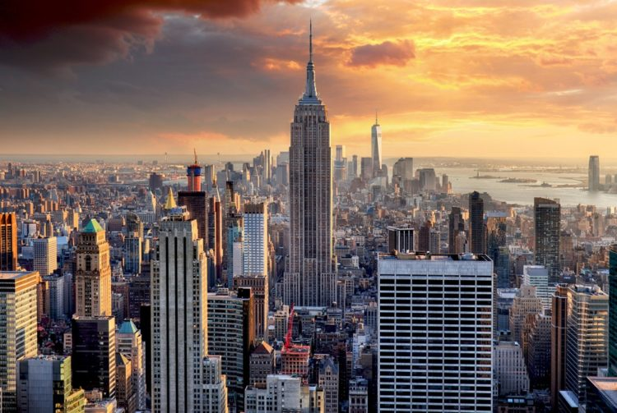
The sightseeings of the USA
The White House
The Golden Gate Bridge
The Statue of Liberty
Mount Rushmore
Empire State Building

Slide 9
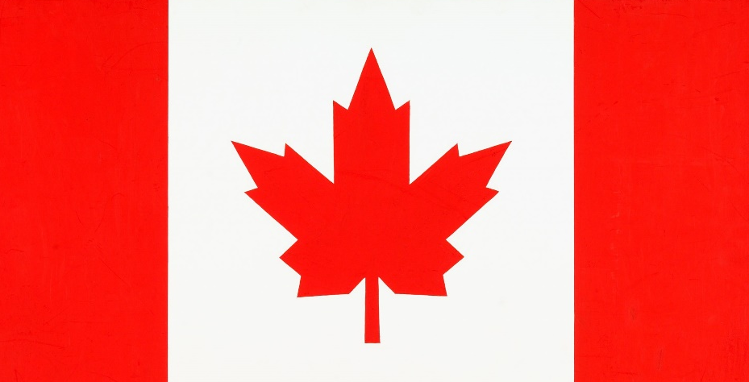
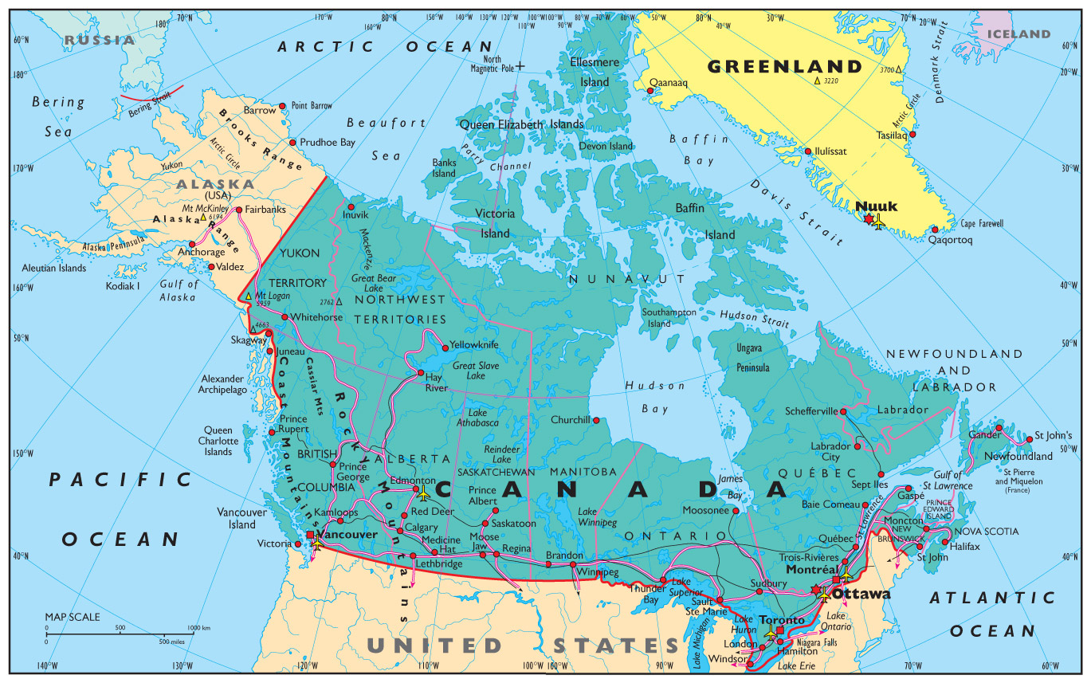
Canada
Ottawa is the capital of Canada.

Slide 10
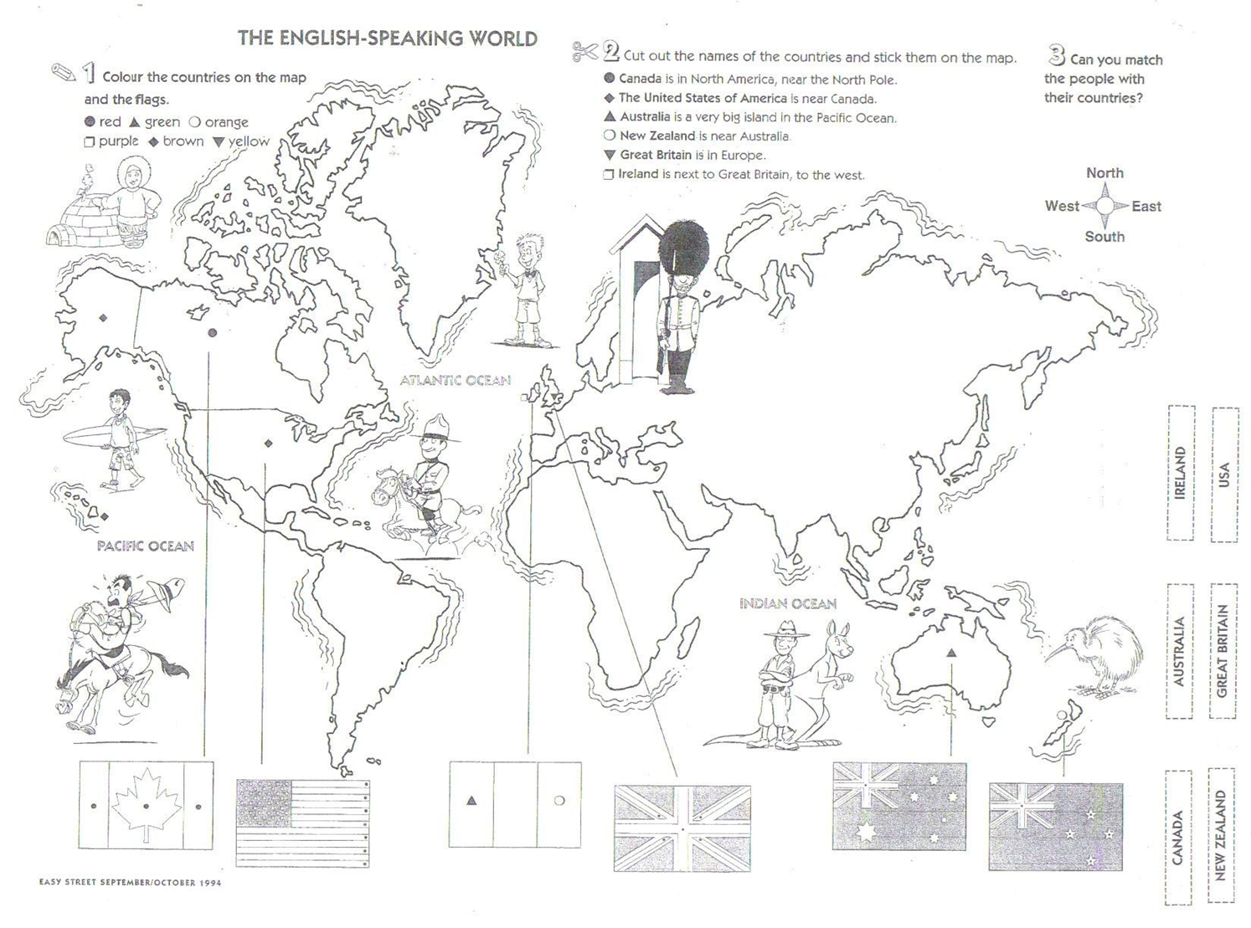
Find Canada. Colour this country and its flag.

Slide 11
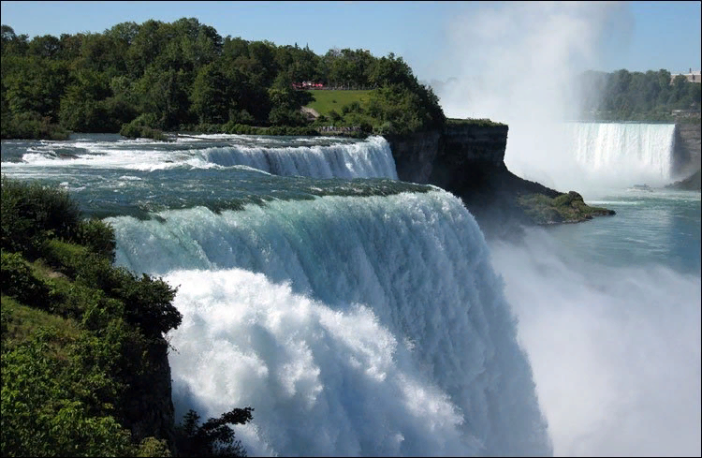
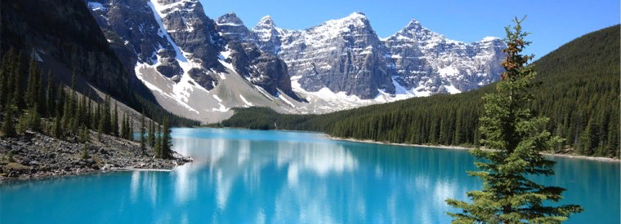
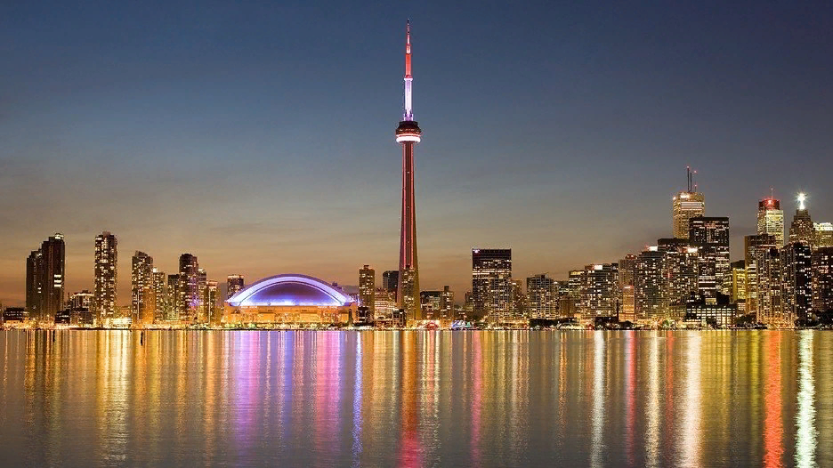
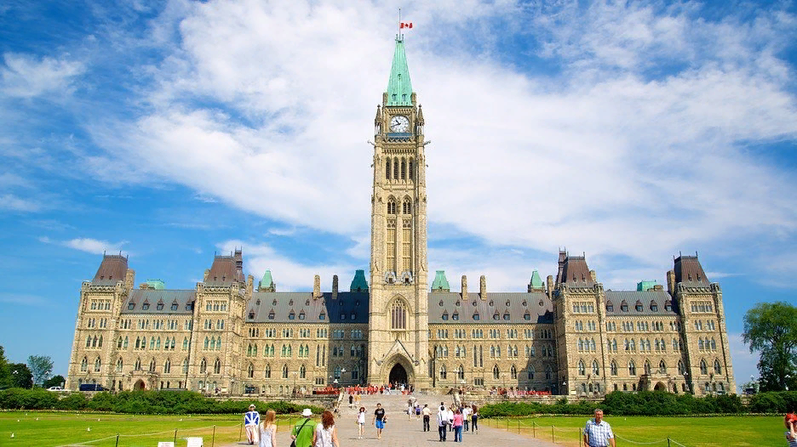
Banff and Rocky Mountains Nature Reserve
Niagara Falls
CN Tower in Toronto
Parliament Hill in Ottawa

Slide 12
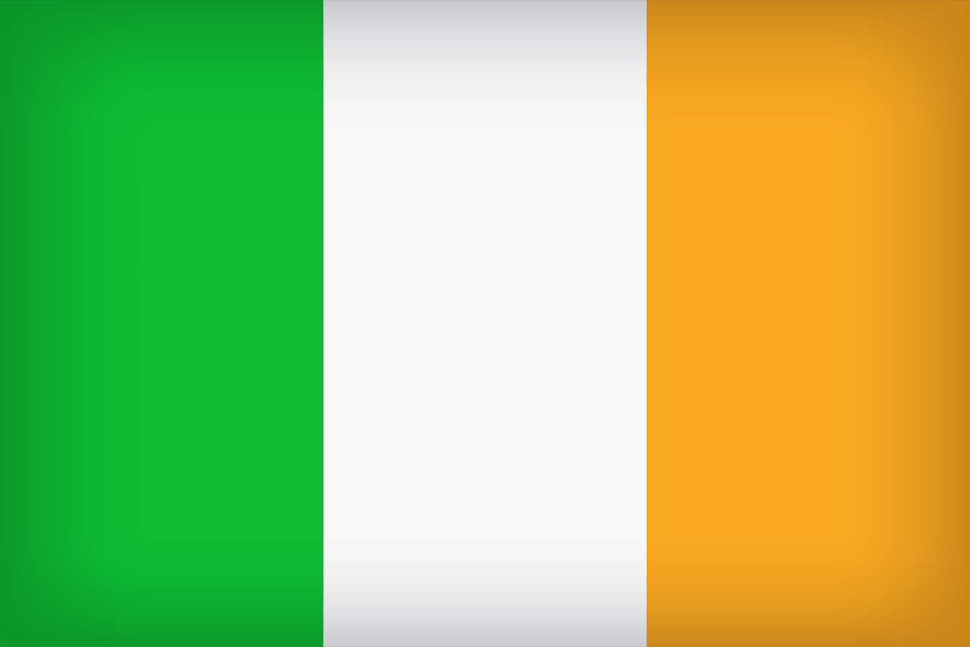
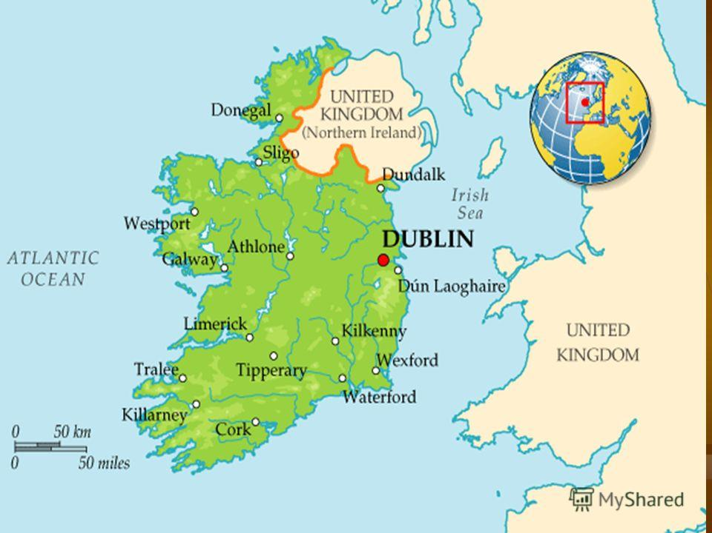
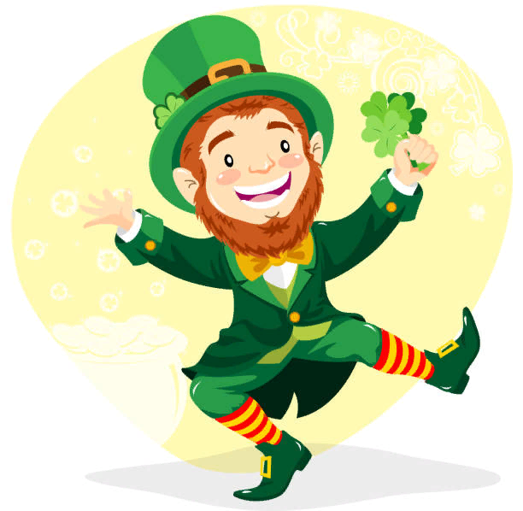

Ireland
Dublin is the capital of Ireland.

Slide 13

Find Ireland. Colour this country and its flag.

Slide 14
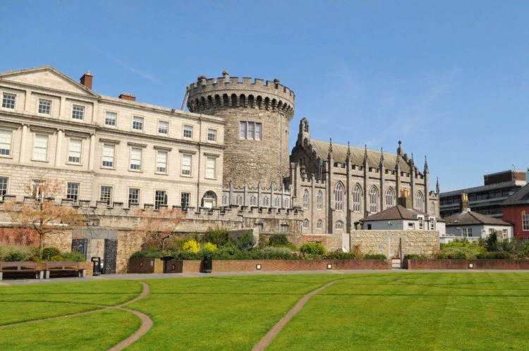
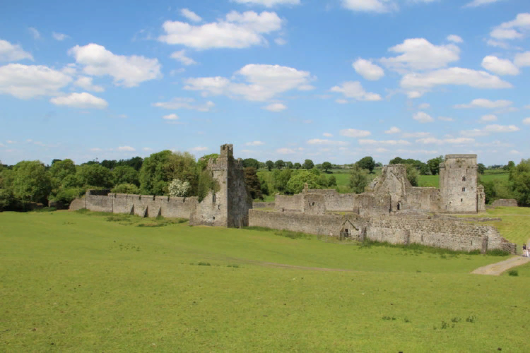
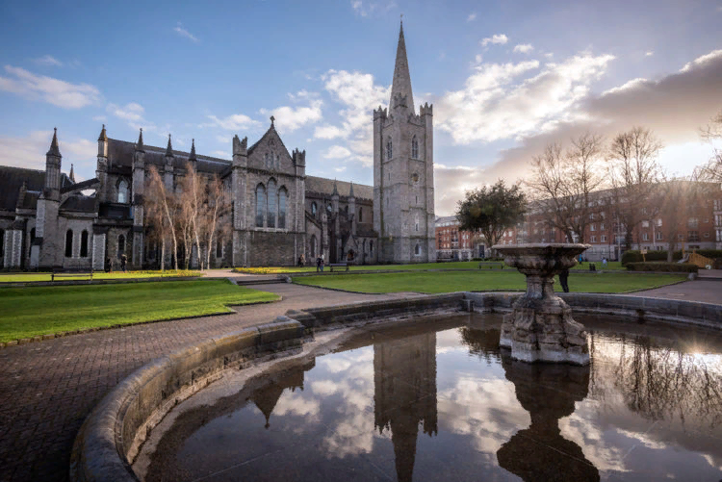
Dublin Castle
The Abbey of Kells
St. Patrick's Cathedral

Slide 15
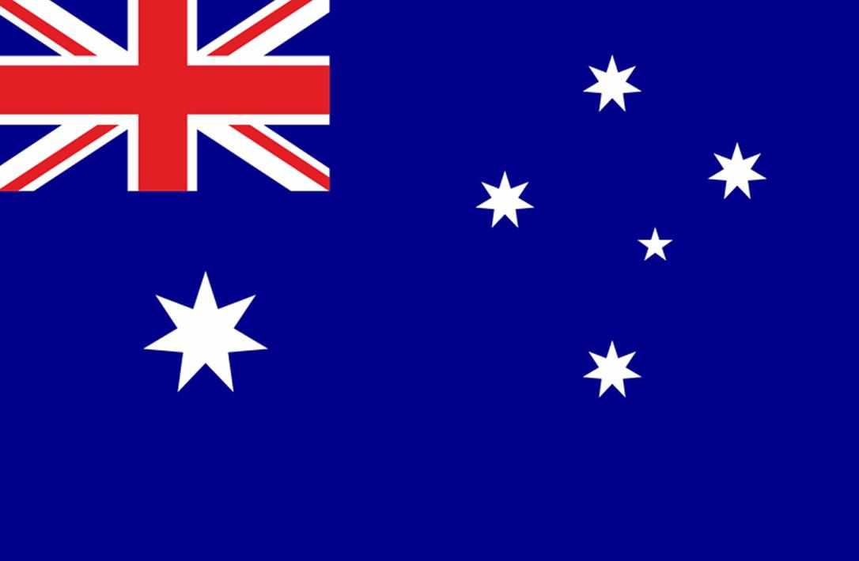
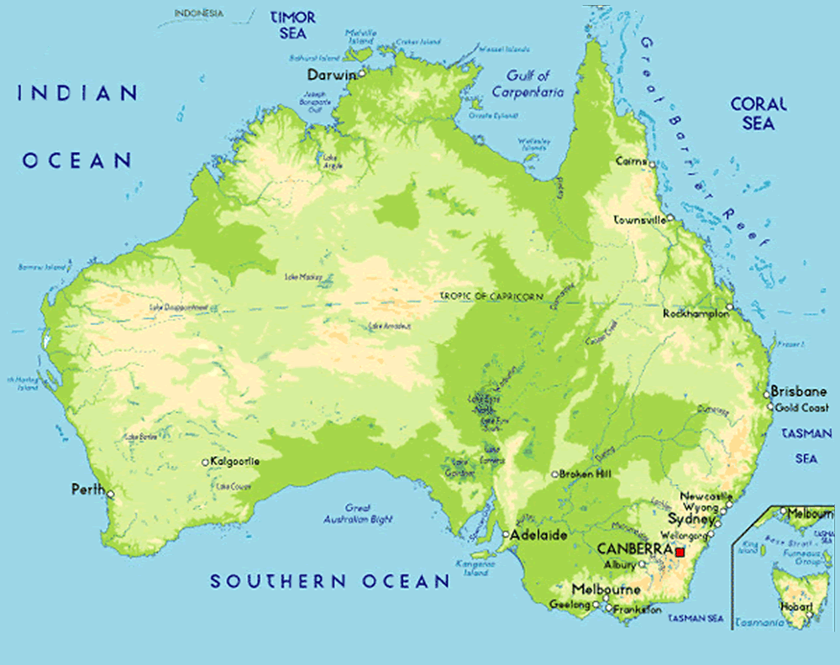
Australia
Canberra is the capital of Australia.

Slide 16

Find Australia. Colour this country and its flag.

Slide 17
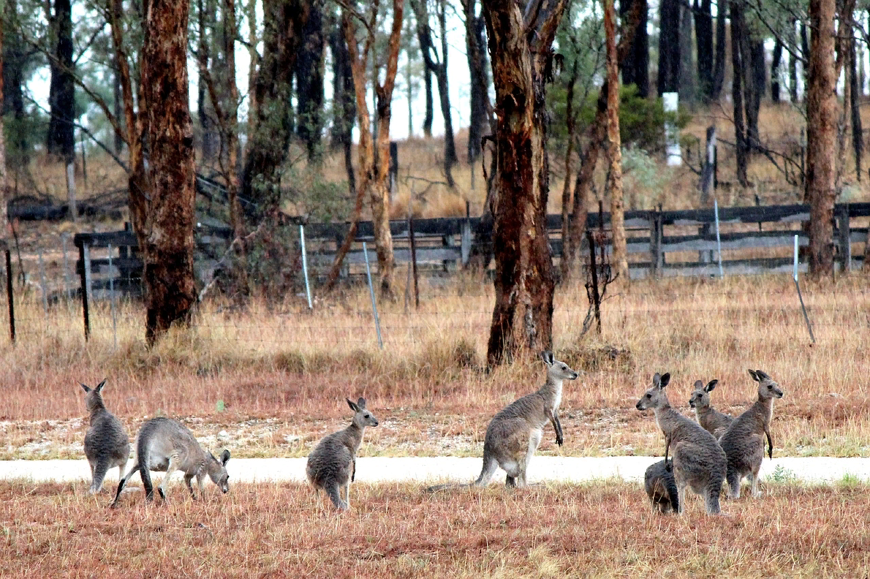
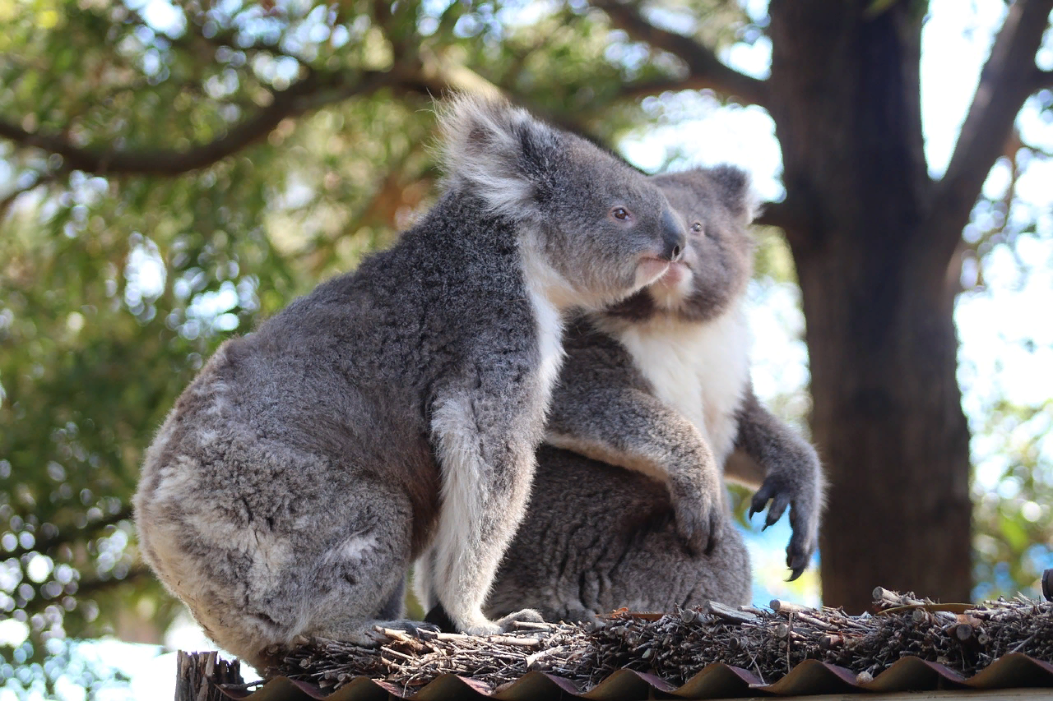
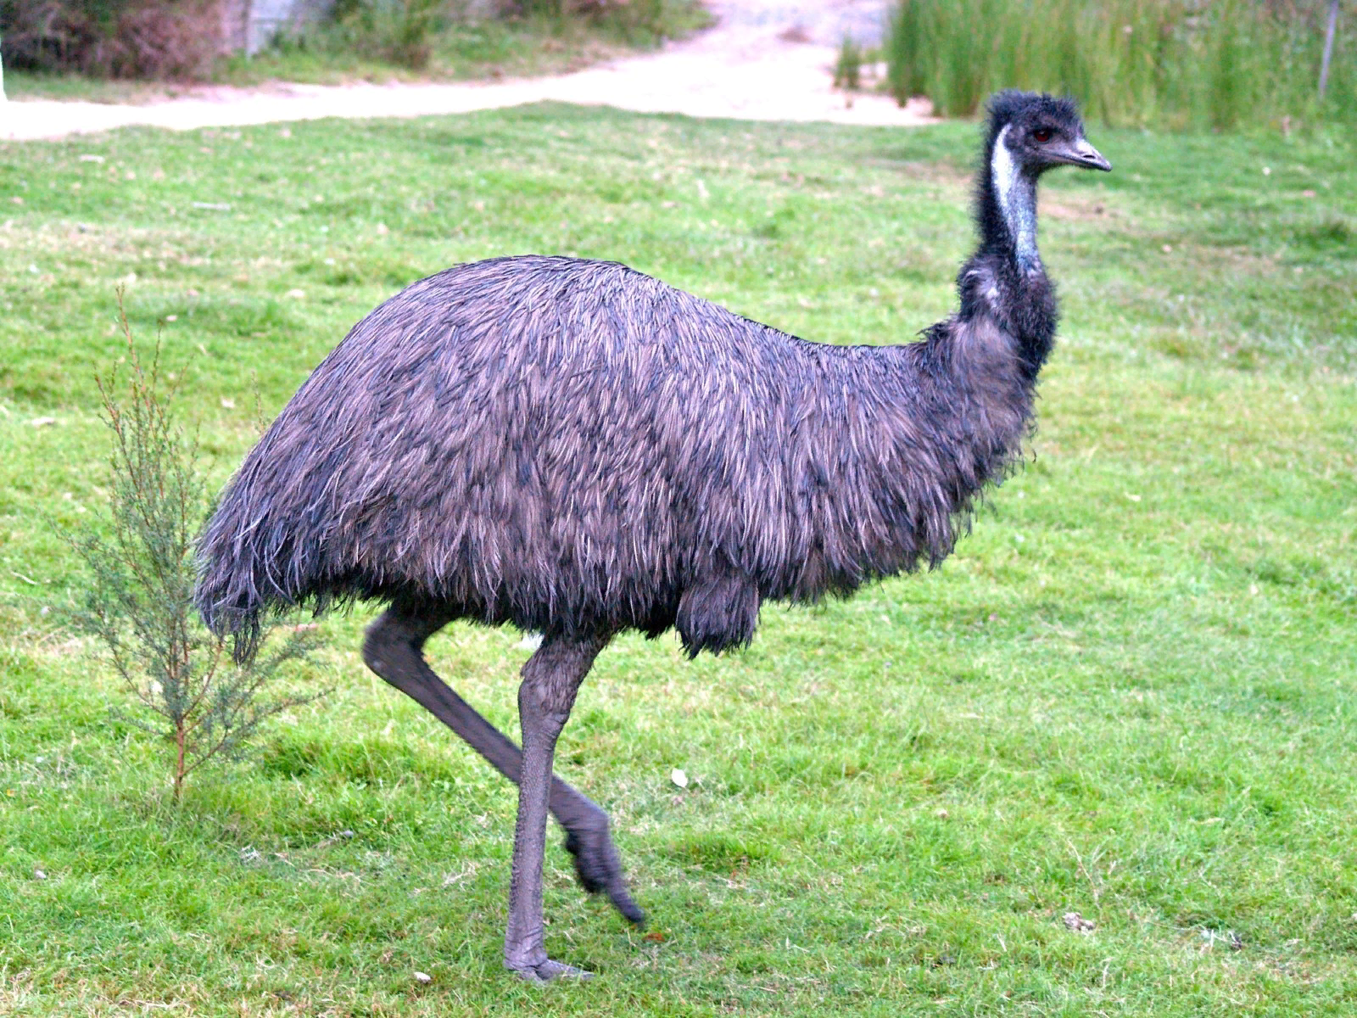
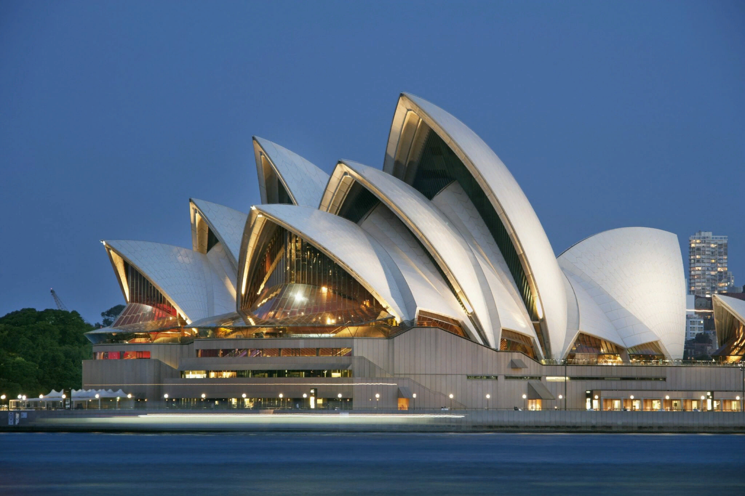
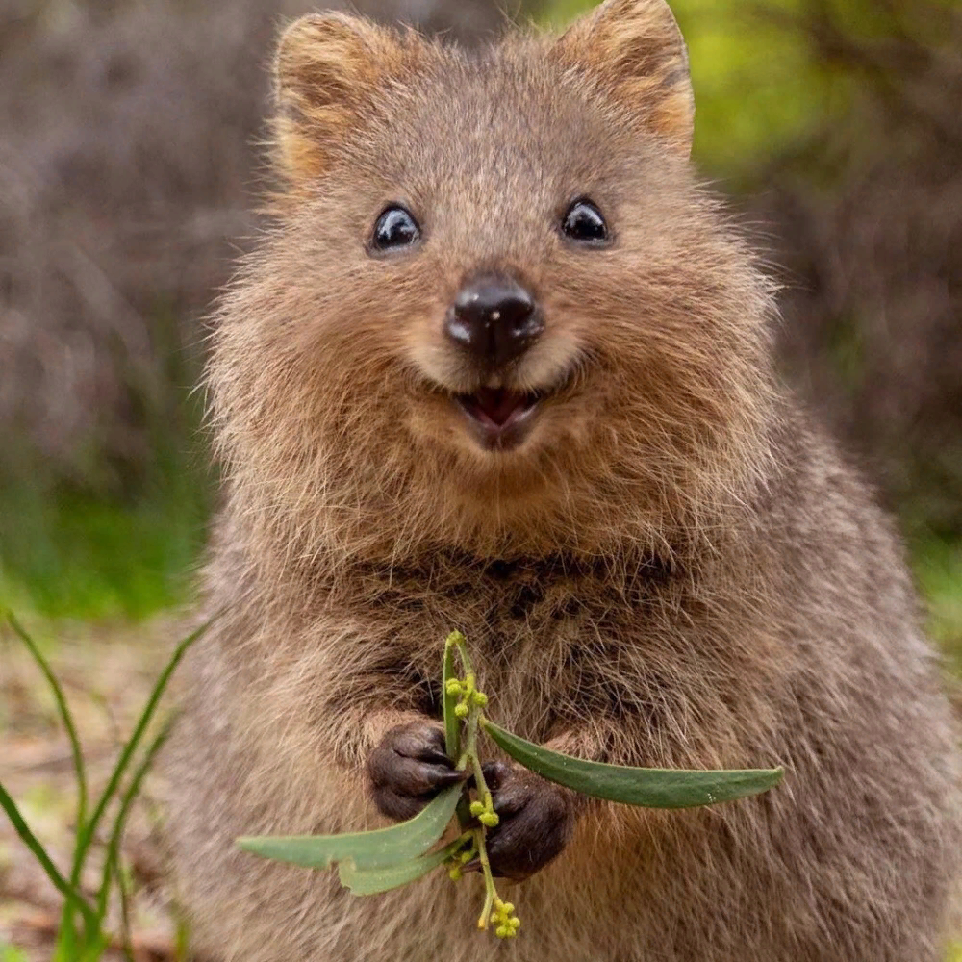
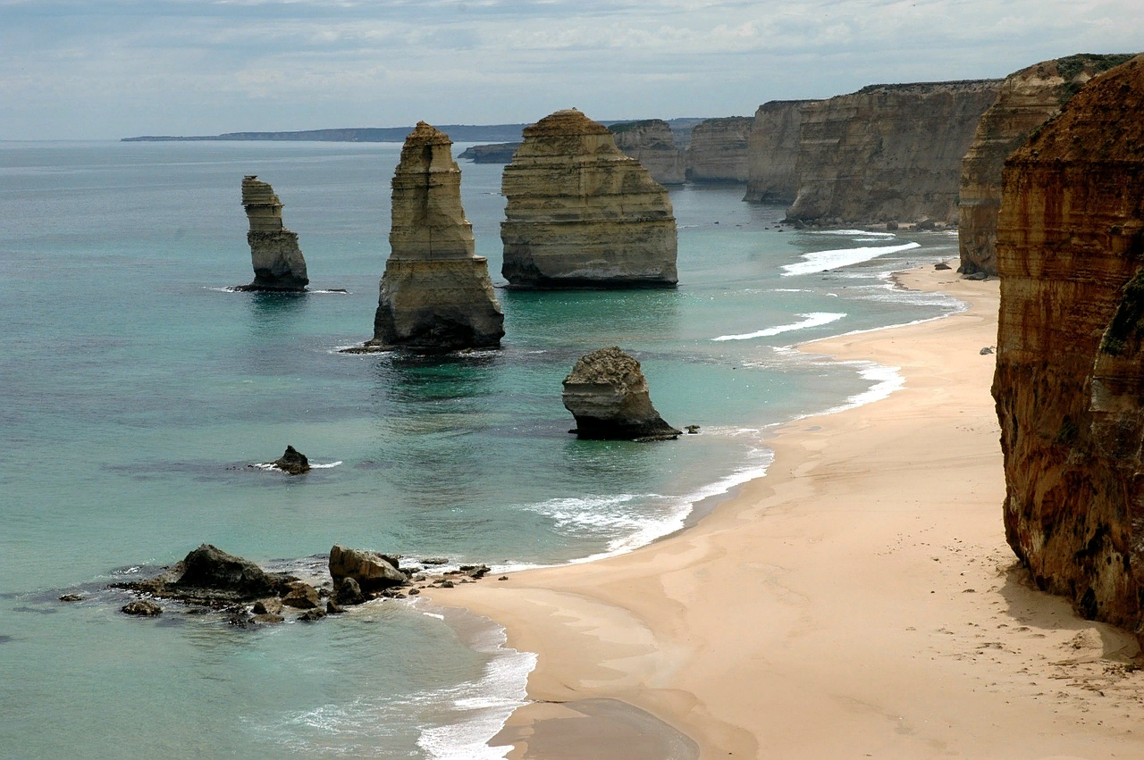

Slide 18
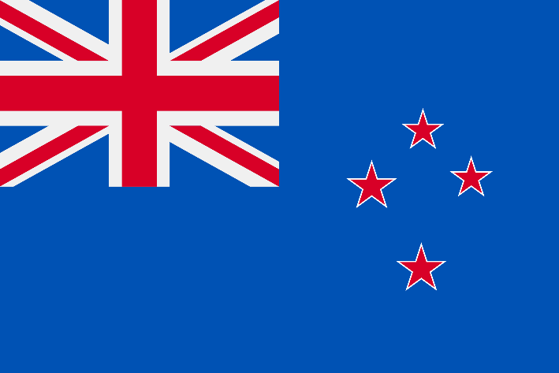
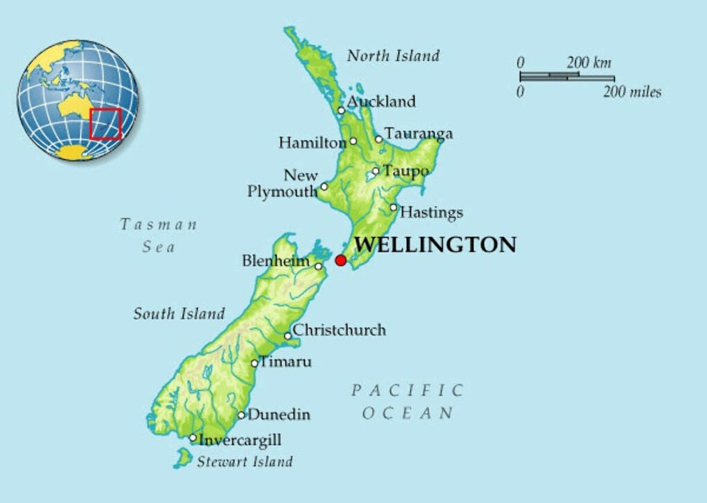
New Zealand
Wellington is the capital of New Zealand.

Slide 19
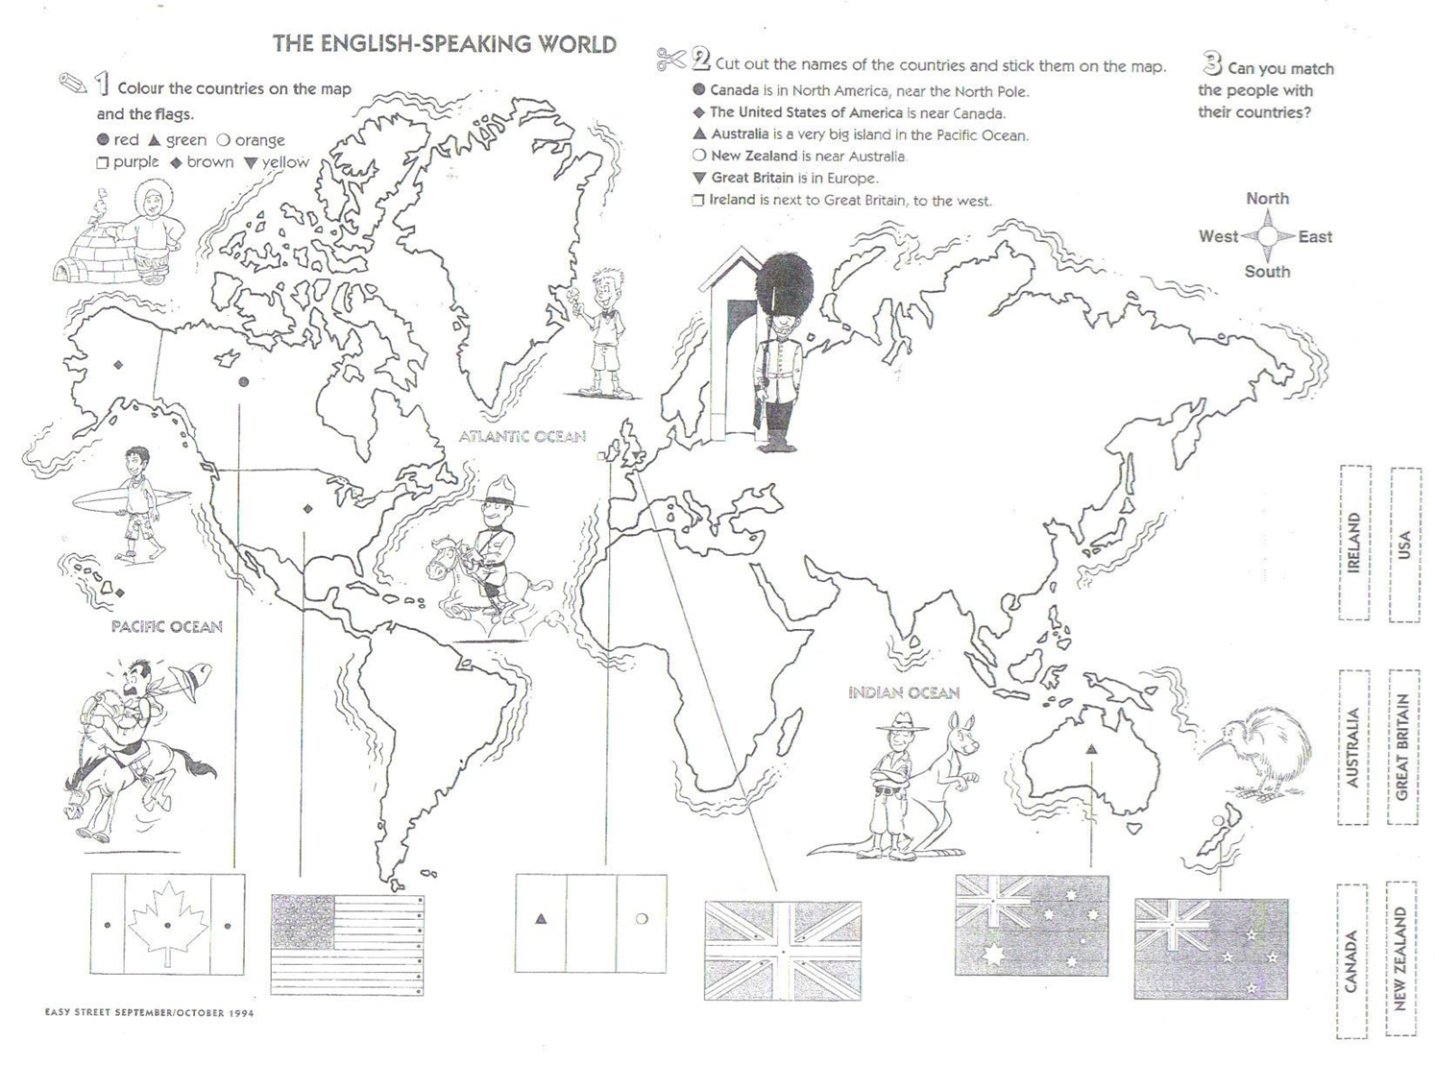
Find New Zealand. Colour this country and its flag.

Slide 20
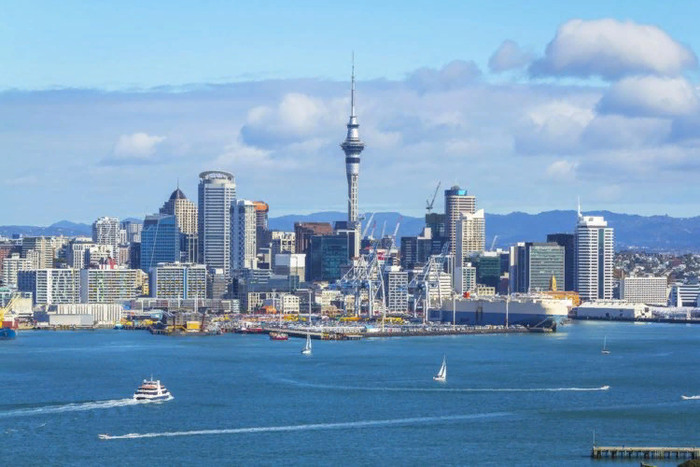
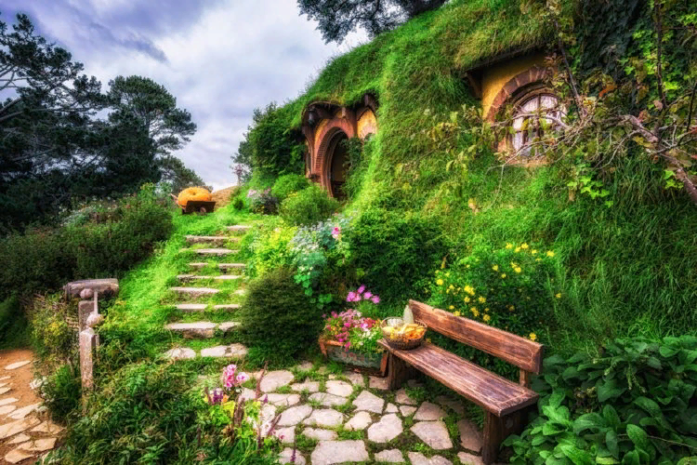
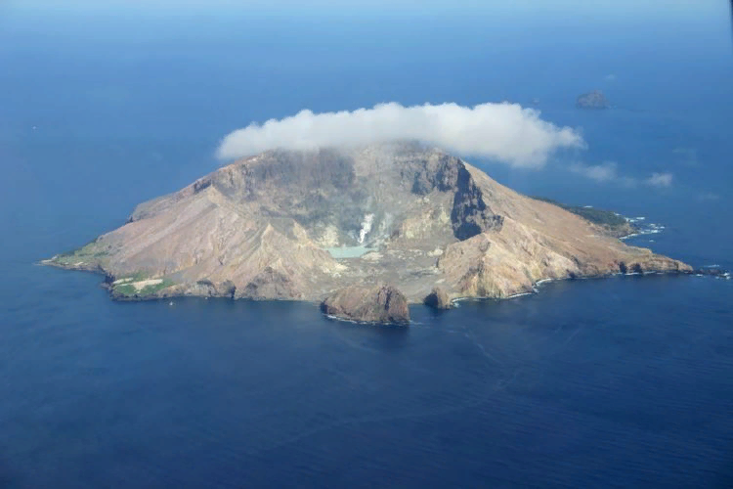
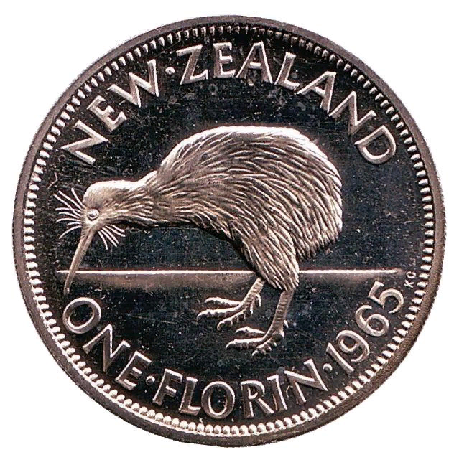
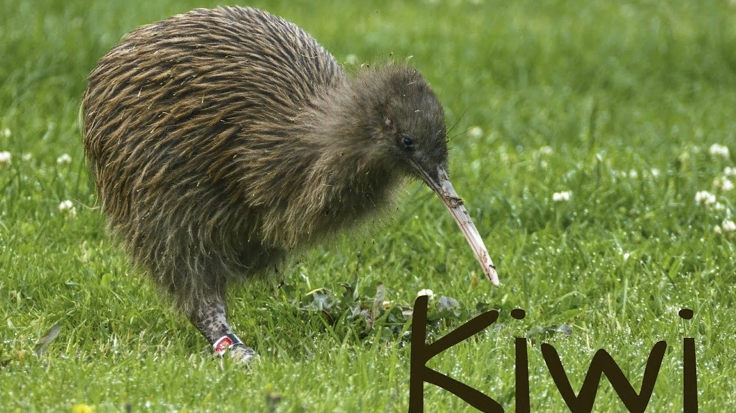

Sky Tower
Hobbiton
White Island

Slide 21
Quiz
How much do you know about English – speaking countries?

Slide 22
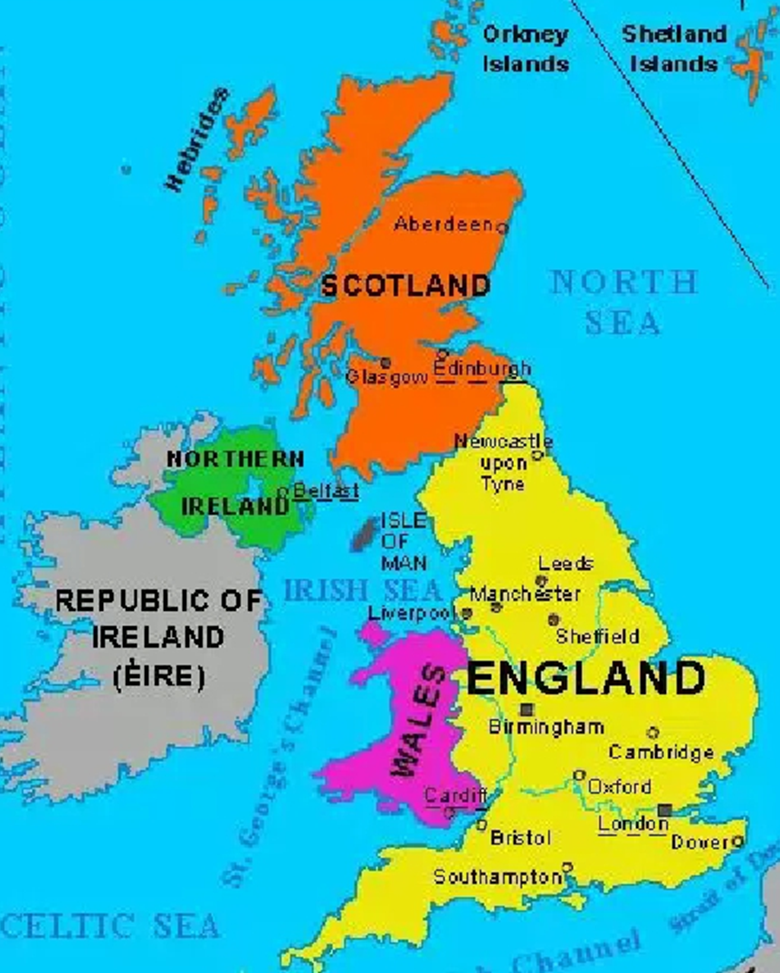
1. Which country doesn’t belong to the UK?
A. Ireland
B. Scotland
C. Wales

Slide 23


2. Montreal, Toronto and Vancouver are cities in
A. Canada
B. Ireland
C. the USA

Slide 24

3. Sidney, Melbourne and Adelaide are cities in
A. Canada
B. Australia
C. Britain

Slide 25
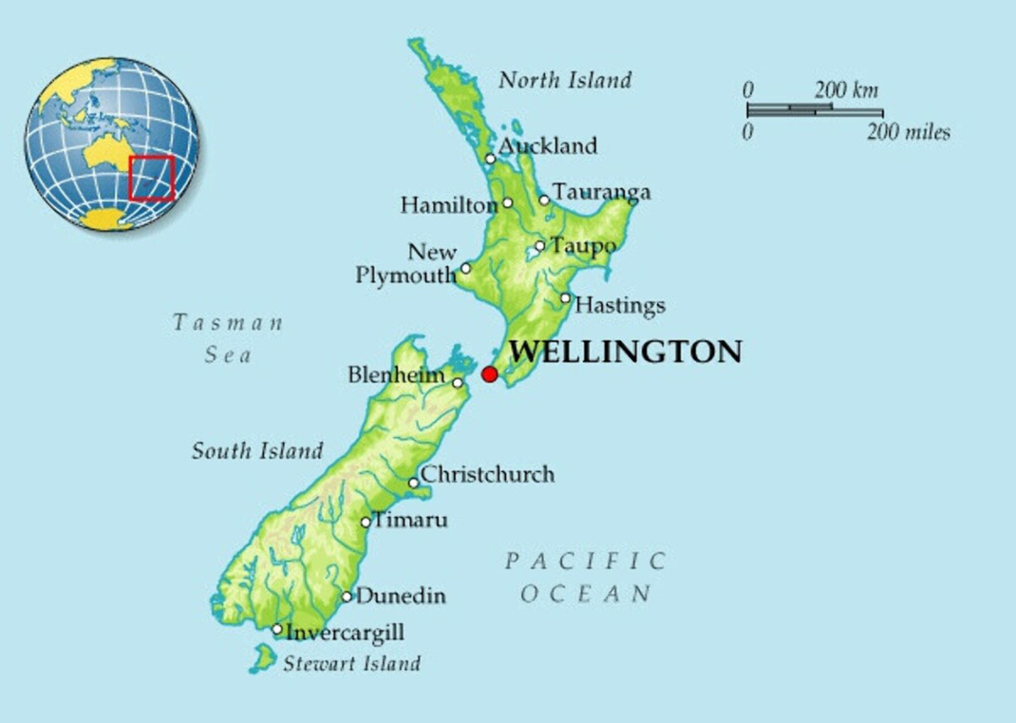

4. Auckland, the City of Sails, is in
A. Australia
B. Ireland
C. New Zealand

Slide 26
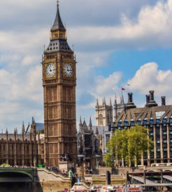

5. Where is Big Ben?
A. Oxford
B. Cambridge
C. London

Slide 27
Well done!

Slide 28
Список литературы
1. Easy Street, Berman S., September/ October, 1994.

