Slide 1
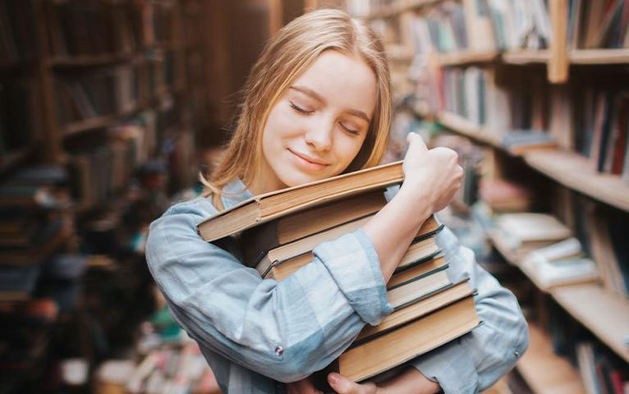

Bookworms
Which meaning does the unit
title have?
a) insects that eat books;
b) people who like reading very much.
Spotlight 7, Module 2a

Slide 2







Literary genres
Biography- биография
Comedy- комедия
Detective – детектив
Drama – драма
Fairy tale – сказка
Novel - роман
Humorous story – юмористический рассказ

Slide 3


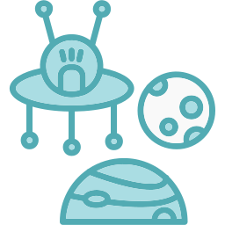

Literary genres
Legend- легенда
History- история
Mystery – детективный рассказ
Myth – миф
Science fiction – научная фантастика
Suspense story – захватывающий приключенческий рассказ

Slide 4
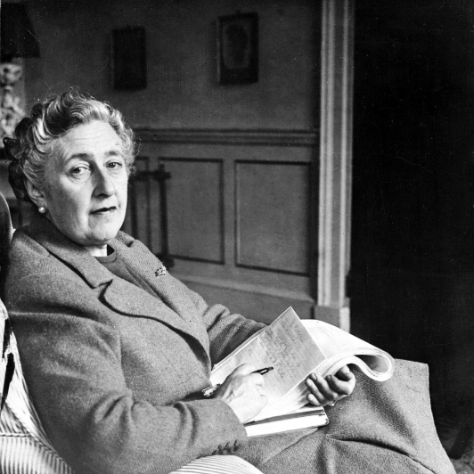
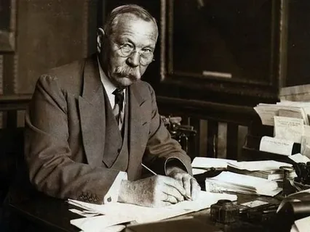
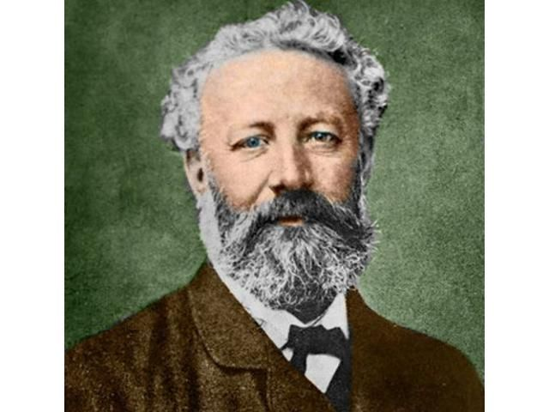
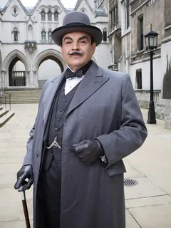
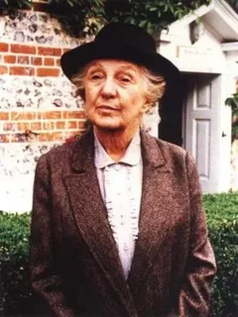
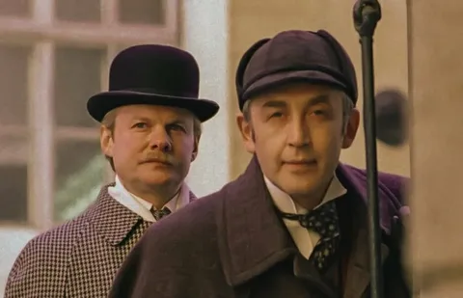
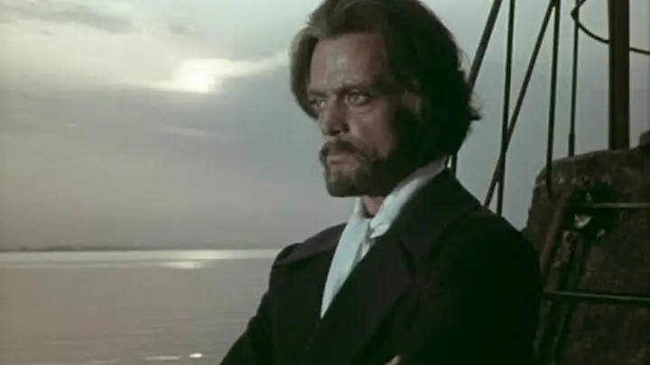
Famous authors and characters
Agatha Christie
Sir Arthur Conan Doyle
Jules Verne
Hercule Poirot Miss Marple
Sherlock Holmes and Dr Watson
Captain Nemo

Slide 5
Answer the questions. Who...
1
solves crimes with a partner?
2
always wants to be neat and tidy?
3
doesn’t look like a detective?
4
wrote adventure novels?
5
travels in a submarine?

Slide 6

Vocabulary
neat appearance
inspire
вдохновлять
опрятный вид
obsession
solve
расследовать
одержимость
investigations
mysterious cases
загадочные дела
расследования
imagination
at first glance
воображение
на первый взгляд

Slide 7
Match adjectives to their synonyms
Adjectives
Synonyms
well-known
typical
unusual
extraordinary
amazing
faithful
clever
intelligent
ordinary
strange
loyal
famous

Slide 8
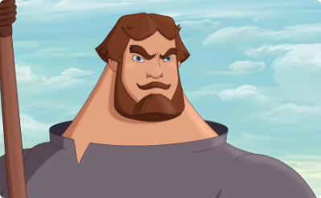
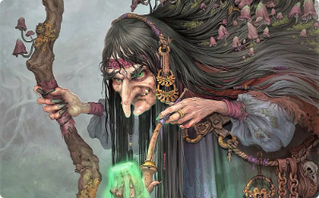
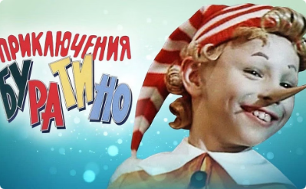
Describe the characters, using adjectives
Илья Муромец
Сильный и верный защитник..
Баба Яга
Необычная и загадочная старушка.
Буратино
Изобретательный и любопытный мальчик..

Slide 9
Regular/ Irregular verbs in Past Simple
V+ (e)d | V2
bake +d= baked walk+ ed = walked | go = went do = did

Slide 10
Past Simple
Positive | Negative | Question
I played. | I did not play. | Did I play?
He/She/It wrote. | He/She/It did not write. | Did he/she/it write?
We/You/They studied. | We/You/They did not study. | Did we/you/they study?

Slide 11






Past Simple: Complete the questions with the correct form of the verb and answer them.
1. (Arthur Conan Doyle/write) poems?
2. (Agatha Christie/be) a famous writer?
3. What (Arthur Conan Doyle/study)?
4. What (Jules Verne/do) when he was 12?
5. Which characters (Jules Verne/create)?
6. Where (Agatha Christie/be born)?

Slide 12
Home assignment
Write an article for your school newspaper about your favourite author.
Write:
where he/she was born
what he/she did before writing
what famous character(s) he/she wrote
what the famous character(s) are like

Slide 13
