Slide 1
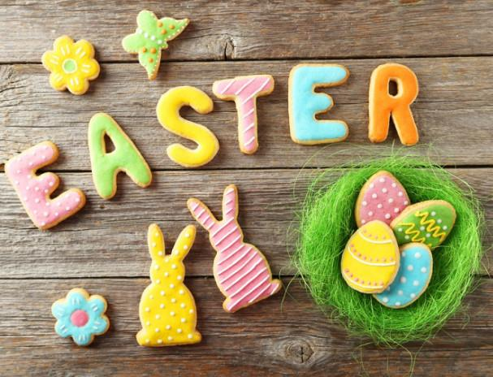
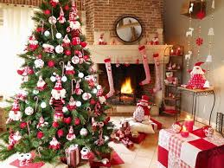

Holidays in Great Britain

Slide 2
Tongue twisters Say them as quickly as you can and translate.
A black cat sat on a mat and ate a fat rat.
A big black bug bit a big black dog on his big black nose!

Slide 3
Jumbled words Write them correctly
1) tyrap –
2) hron –
3) ftig –
4) dofo –
5) sumic –
6) stocume –
7) setug –
8) forkwire –
9) knippum –
10) vestalif –

Slide 4
keys:
1) tyrap – party
2) hron – horn
3) ftig – gift
4) dofo – food
5) sumic – music
6) stocume – costume
7) setug – guest
8) forkwire – firework
9) knippum – pumpkin
10) vestalif – festival

Slide 5
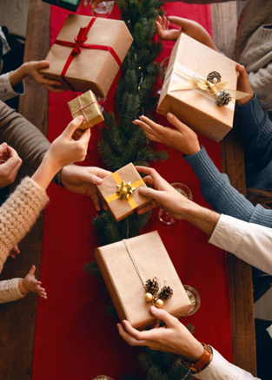
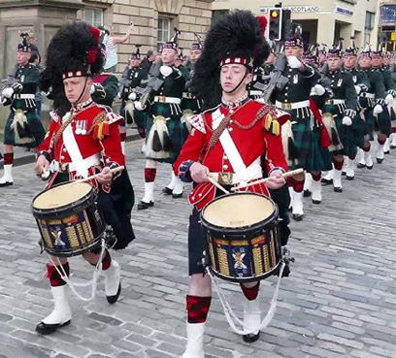
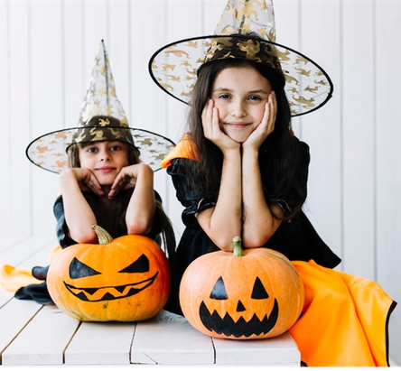
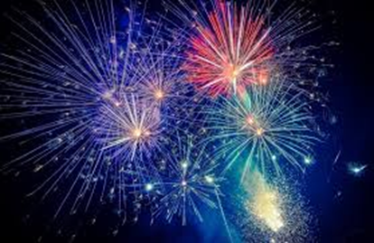
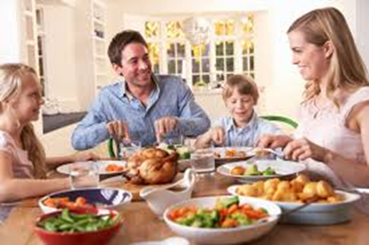
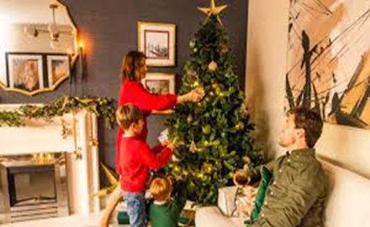
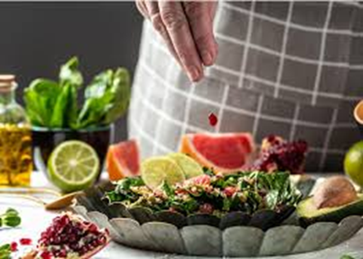
Match the phrases with the pictures
1) Dress up
2) Decorate the house
3) Exchange gifts
4) Cook special food
5) Set off fireworks
6) Have street parades
7) Have family dinner

Slide 6
Watch the video and answer the questions
What holidays are spoken about in this video?
When are these holidays celebrated?
What holidays are the most important in Britain?
How do people in Scotland call New Year’s Eve (the last day of the year)?

Slide 7


Slide 8
keys:
Guy Fawkes Day, Pancake Day, St. Valentine’s Day, Halloween, Christmas, Easter, New Year
5th November, February, 31st October, 14th February, 25th December, Spring, 31st December
Christmas and Easter
Hogmanay

Slide 9
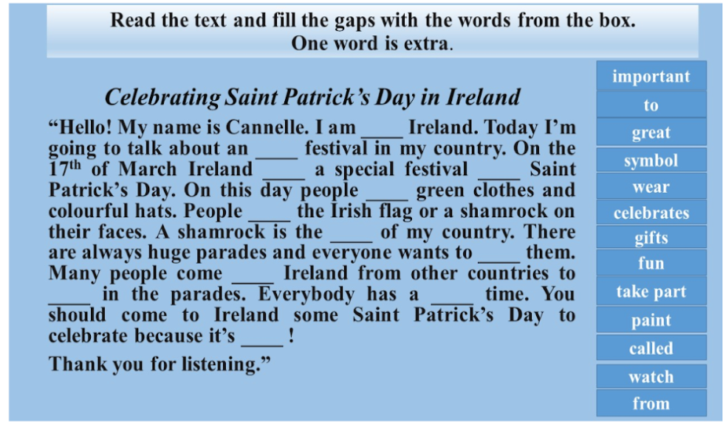

Slide 10
Keys:
1) from;
2) important;
3) celebrates;
4) called;
5) wear;
6) paint;
7) symbol;
8) watch;
9) to;
10) take part;
11) great;
12) Fun
Extra - gifts

Slide 11
Grammar task
Complete the sentences in Present Continuous.
• We can’t go climbing! It’s __________________. (rain)
• Why _______ you ________________ for your holiday photos? (look)
• What _______ you ________________ at? (laugh)
• ____ Steve ___________________ an invitation card? (write)
• OK, wait a minute, I ____ ____________ now (get up).
• “Where’s dad?” – “He ____ _____________ the last minute shopping.” (do)

Slide 12
keys:
• We can’t go climbing! It’s raining.
• Why are you looking for your holiday photos?
• What are you laughing at?
• Is Steve writing an invitation card?
• OK, wait a minute, I am getting up now.
• “Where’s dad?” – “He is doing the last minute shopping.”

Slide 13
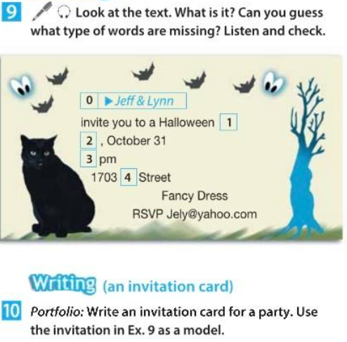

Slide 14
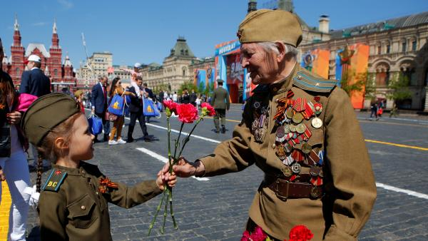
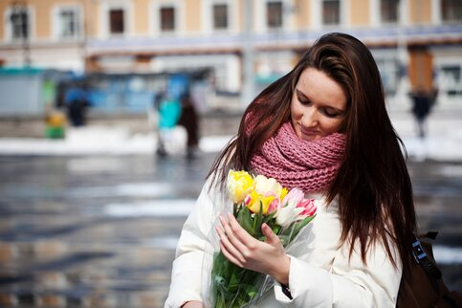
Make a speech about special days or holidays in Russia
Remember to say:
• what holiday it is
• why people like celebrating this holiday
• what you usually do on this day
• what presents people get on this holiday

Slide 15

How are you? Did you like the lesson?

