Slide 1
The 5th of February. Monday.
Theme: Stories from far away.
Plan:
Phonetic
Words revision
Grammar cards
Listening and reading
Acting out. ‘Stone soup’.
Home task: PB p71 №1; wb p70 №1

Slide 2
Tongue twister
[æ] [ e ] [ I ] [ Λ ]
Betty Botter bought some butter,
But she said, this butter’s bitter:
If I put it in my bitter,
It will make my batter bitter,
But a bit of better butter
Will make my batter better.

Slide 3
Find the odd word out
brakes wheel headache lock gears
earache doctor hospital school dentist
3. bring swing jump ring something
4. Italy London Spain Russia India
5. lake river ocean waterfall forest

Slide 4
Make your sentences
1. they/buy books 4. we/listen to the radio
2. she/ swim 5. she/sing songs
3. Tony/drink tea 6. Leila/talk to friends
every day, usually | now, at the moment | yesterday, last week

Slide 5
Group the words
cough laptop plumber toothache police officer charger temperature lawyer tablet engineer computer
mobile phone earache plumber
jobs
health
devices

Slide 6
Group the words
waterfall across cyclist through
light beautiful lock onto
breaks town island little
over wheel village
car friends
cycling
prepositions
nature

Slide 7
Using devices
1. What devices have you got?
2. What do use your computer for?
3. What do you use your mobile phone for?
4. What do you use your laptop for?

Slide 8
Remember irregular verbs
1. make | … | …
2. … | found | …
3. … | … | became
4. … | … | bought
5. … | drew | …
6. catch | … | …
7. … | brought | …

Slide 9
Remember irregular verbs
8. fly | … | …
9. … | forgot | …
10. … | … | got
11. … | … | given
12. … | grew | …
13. have | … | …
14. … | heard | …

Slide 10
find
catch
become
bring
see
go

Slide 11
Make up sentences
1. we/make cards 4. they/learn a poem
2. he/ read a book 5. she/listen to the radio
3. Tom/ride a horse 6. Ann/talk to friends
every day, usually | now, at the moment | yesterday, last week | yesterday at 6 o’clock

Slide 12
Make up sentences
1. they/write stories 4. we/talk to her sister
2. she/ walk in the park 5. Paul/listen to a radio
3. Ann/play the guitar 6. Jake/have breakfast
Present Simple | Present Continuous | Past Simple | Past Continuous

Slide 13
Dictation
make
see
write
buy
draw
take
put

Slide 14
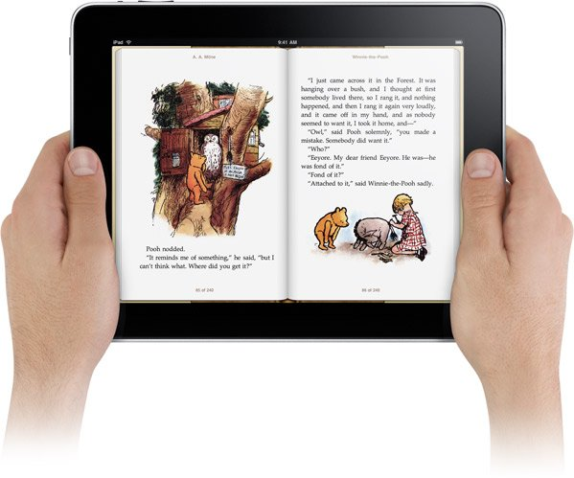
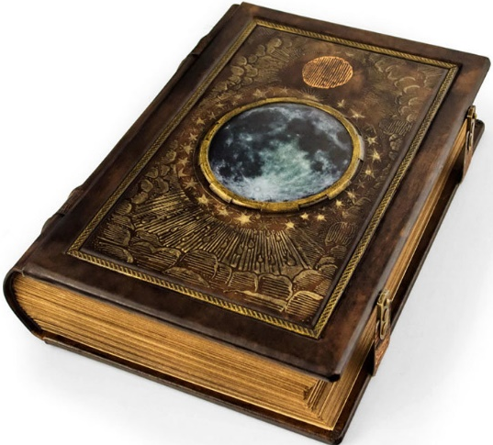
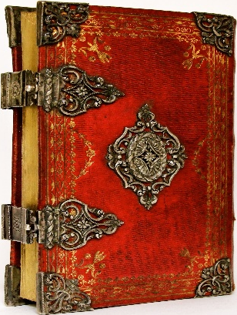

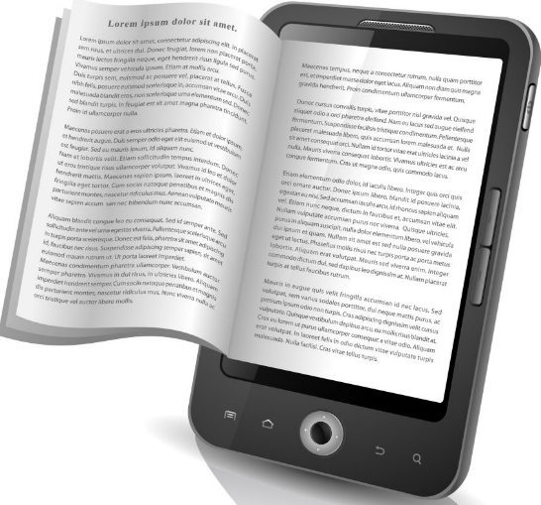
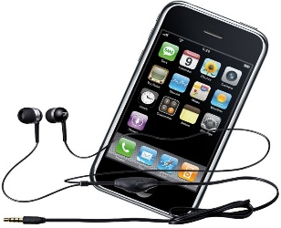
Books now and in the past

Slide 15
Read the sentences and tick:
Type of book | handmade | printed | audio | ebook
You can buy it in shops.
You read it on a digital device.
It is made using ink.
You can download it.
You can find it in the museum.
You can use earphones for it.

Slide 16
Result of the lesson
Now I know:
New words of the theme “Technology and inventions”
How to use irregular verbs.
Information about old and modern books.

Slide 17
Result of the lesson
Now I know:
New words of the theme “Technology and inventions”
How to use irregular verbs.
Information about old and modern books.

Slide 18



