Slide 1
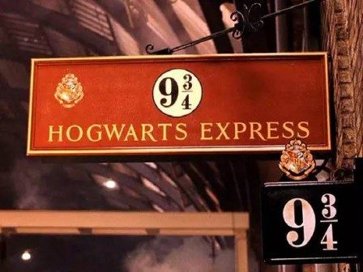

Slide 2
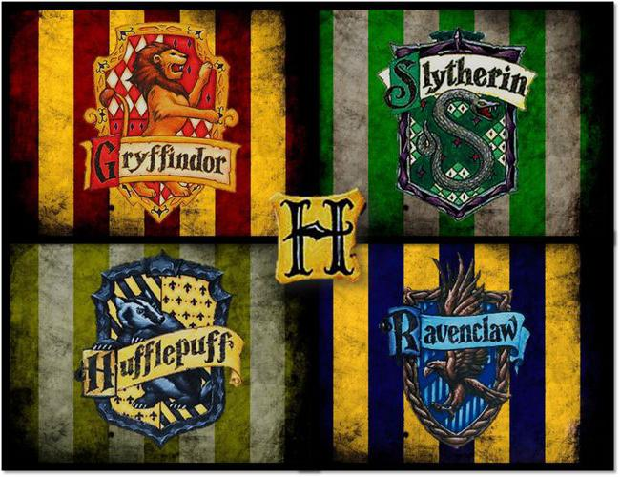

Slide 3
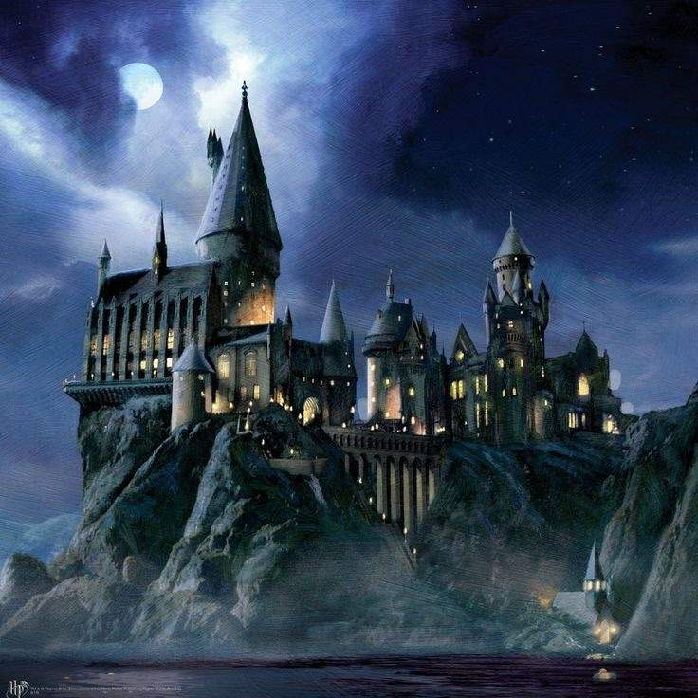

Slide 4
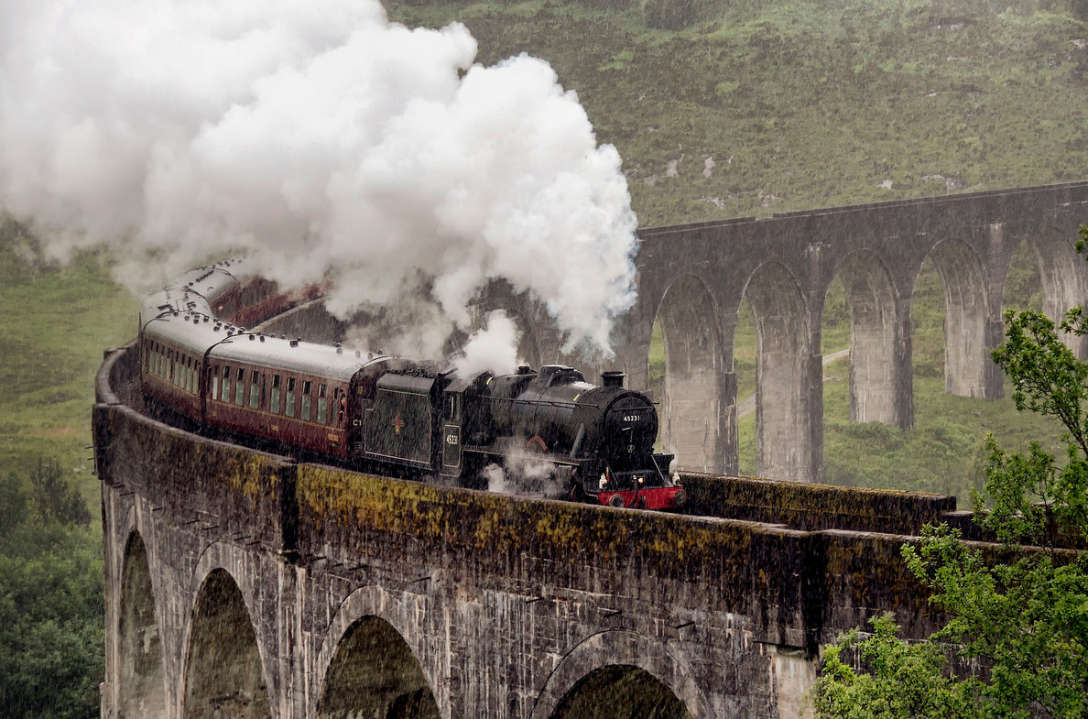

Slide 5
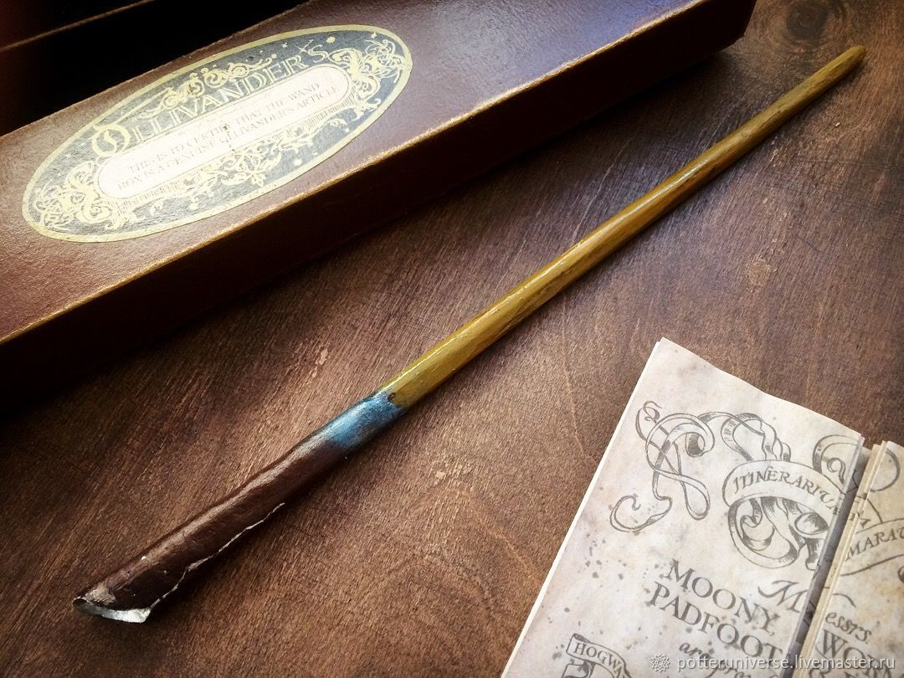

Slide 6
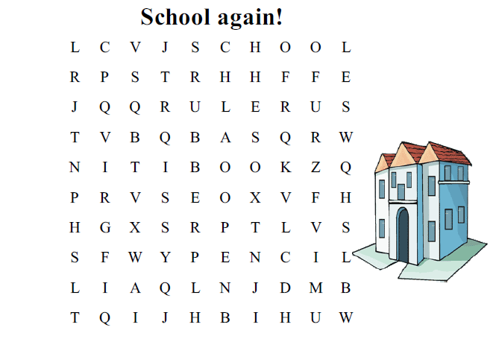

Slide 7
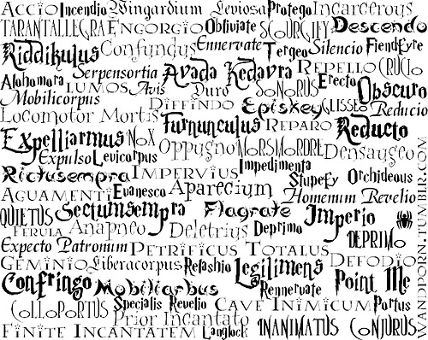

Slide 8
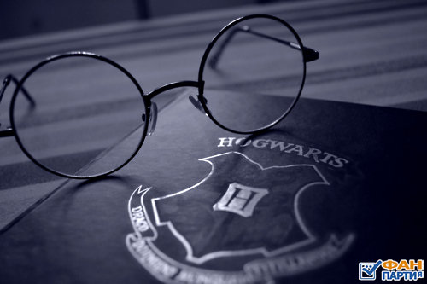
HISTORYSCIENCEGEOGRAPHYPEENGLISHMUSICART
HISTORYSCIENCEGEOGRAPHYPEENGLISHMUSICART
HISTORYSCIENCEGEOGRAPHYPEENGLISHMUSICART
HISTORYSCIENCEGEOGRAPHYPEENGLISHMUSICART
HISTORYSCIENCEGEOGRAPHYPEENGLISHMUSICART

Slide 9
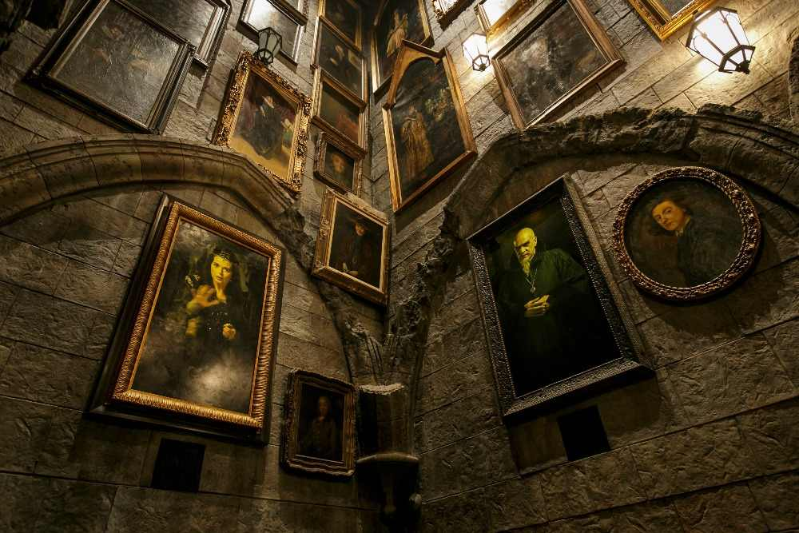
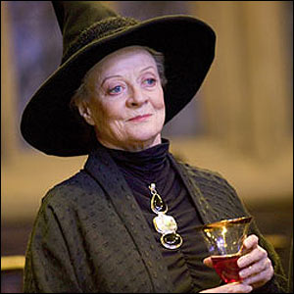
Minerva McGonagall is a teacher of transfiguration. She can transform into a cat. She is short with fair hair and blue eyes. Professor McGonagall is a strict, clever and kind woman.

Slide 10

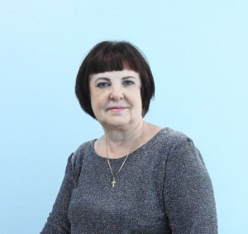
_______ is a _______of__________ ___________________. She can __________. She is ____ with ___hair and ______ eyes. _______is a ________ woman.

Slide 11
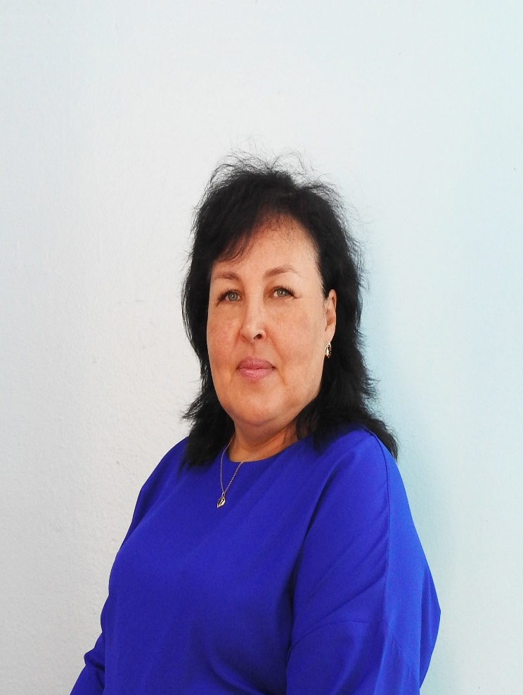
_______ is a teacher of ___________________. She can __________. She is ____ with ___hair and ______ eyes. _______is a ________ woman.

Slide 12
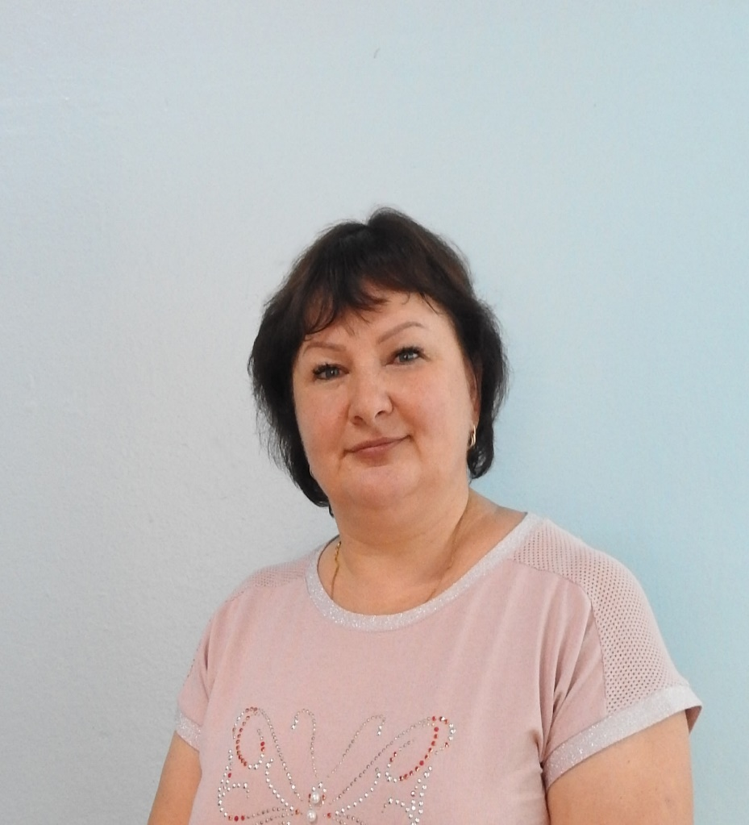
_______ is a teacher of ___________________. She can __________. She is ____ with ___hair and ______ eyes. _______is a ________ woman.

Slide 13
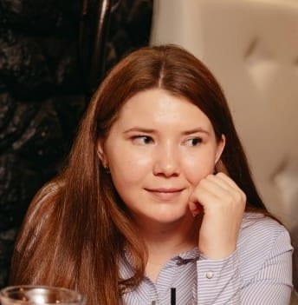
_______ is a teacher of ___________________. She can __________. She is ____ with ___hair and ______ eyes. _______is a ________ woman.

Slide 14
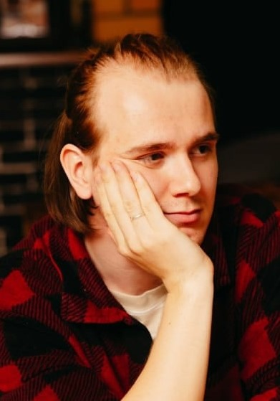
_______ is a teacher of ___________________. Нe can __________. She is ____ with ___hair and ______ eyes. _______is a ________ man.

Slide 15
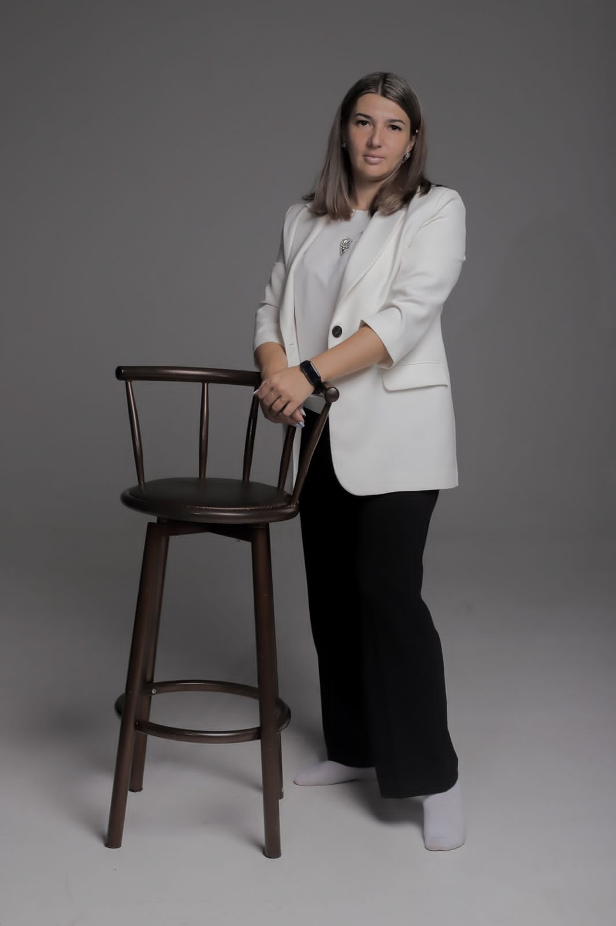
_______ is a teacher of ___________________. She can __________. She is ____ with ___hair and ______ eyes. _______is a ________ woman.

Slide 16
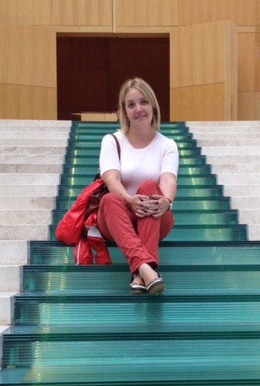
_______ is a teacher of ___________________. She can __________. She is ____ with ___hair and ______ eyes. _______is a ________ woman.

Slide 17
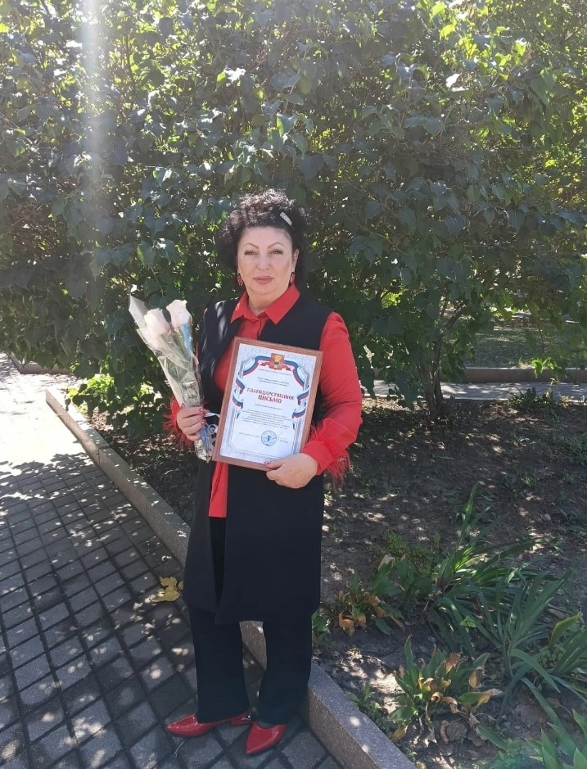
_______ is a teacher of ___________________. She can __________. She is ____ with ___hair and ______ eyes. _______is a ________ woman.

Slide 18
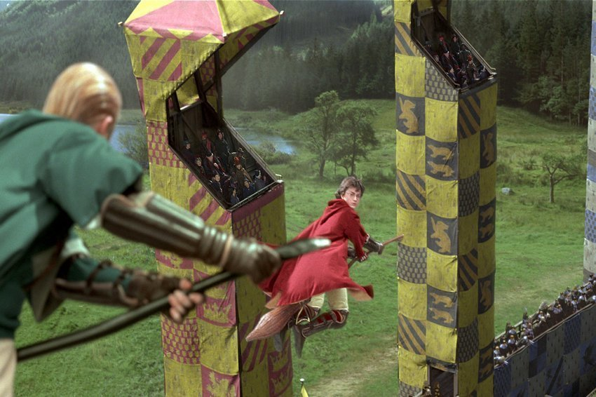
Let`s play Quidditch!
Up and down, up and down.
Which is the way
To London town?
Where? Where?
Up in the air.
Take the broom
And you are there.

Slide 19
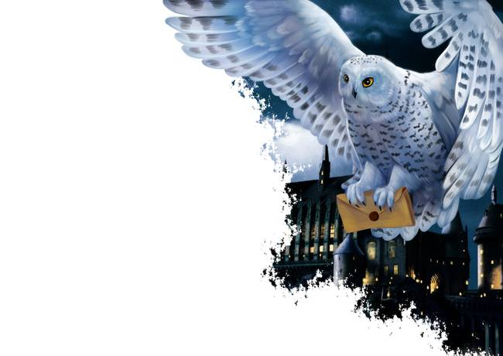
Dear friends,
I’m Harry Potter. I live in ____ . I go to _____.
My school starts_____. We study many interesting subjects.
We learn to fly. We speak to ____. We read _____ books.
My favourite subject is English of the future.
English is the subjects of the world.
I want to learn Russian. It ____me to find friends in Russia.
Bye,
Harry Potter.
1.Hogwarts School 2. at 9 o’clock 3. helps
4. London 5. magic 6. animals

Slide 20
Dear friends,
I’m Harry Potter. I live in London. I go to Hogwarts School .
My school starts at 9 o’clock. We study many interesting subjects.
We learn to fly. We speak to animals. We read magic books.
My favourite subject is English of the future.
English is the subjects of the world.
I want to learn Russian. It helps me to find friends in Russia.
Bye,
Harry Potter.

Slide 21
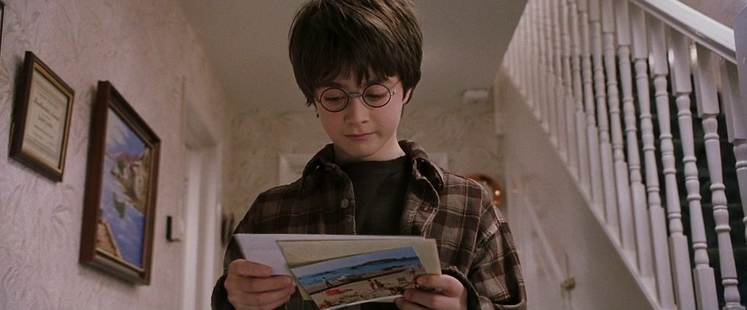

Slide 22

Dear Harry Potter,
Группа 1
We are pupils school №22.
We live in Ussuriysk.
We go to school 5 days a week.
School starts at 12.45.
Группа 2
My school is big and clean.
It has many classrooms.
I like to go to school because I like our teachers.
I think they are very clever and kind.
Группа 3
We have English.
English is the language of the world.
We speak English, read texts.
We like English. It’s interesting.
Группа 4
School finishes at 7 p.m.
In free time we like to play computer games, ski and skate.
We read books, listen to music.
Thank you for your letter.
Bye,
Pupils Form 7

Slide 23
