Slide 1
Illnesses & ailments
Have a headache
Have a stomach ache
Get a sunburn
Have a mouth ulcer
Have smelly feet
Have hay fever
Get a cold/the flu
Have a sore throat
Have a bad cough
Have an itchy rash
Have insomnia
Have bad breath
Have a minor cut
Have watery eyes
When was the last time you suffered from any of these? What do you do?

Slide 2
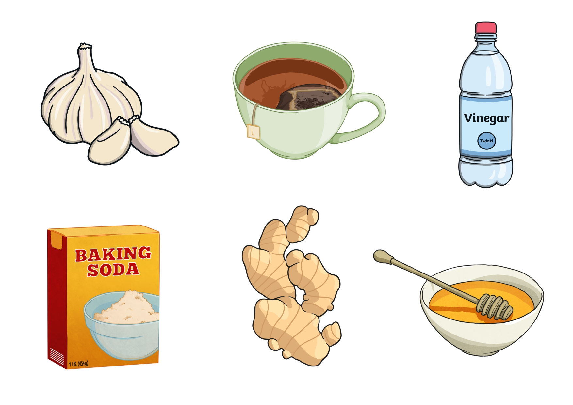
GARLIC
TEA
VINEGAR
BAKING SODA
GINGER
HONEY

Slide 3

Divide into groups
Read the text
Create a mindmap of you text (Ingredient/What can it treat?/How to use it)
Pretend you are doctors at a conference presenting “Natural Remedies”
Give a short talk based on your mindmap

Slide 4
TRUE OR FALSE?
T
Garlic is great for your immune system.
Vinegar is used to treat bad breath.
You can take a bath with honey to get rid of sunburn.
You should drink tea if you are experiencing a headache.
Baking soda is a great natural anti-perspirant.
Ginger may help if you have smelly feet.
F
F
T
T
F

Slide 5
ANSWER THE QUESTIONS
Which remedy (or remedies)…
1) … kills germs?
2) … is extremely old?
3) … helps you fight illness generally?
4) … must you keep in your mouth for a while?
5) … might make others around you feel better?

Slide 6
HW: SB ex. 9, p. 65
Do some research on the Internet and make notes on more home remedies. Present your findings to the class.

