Slide 1
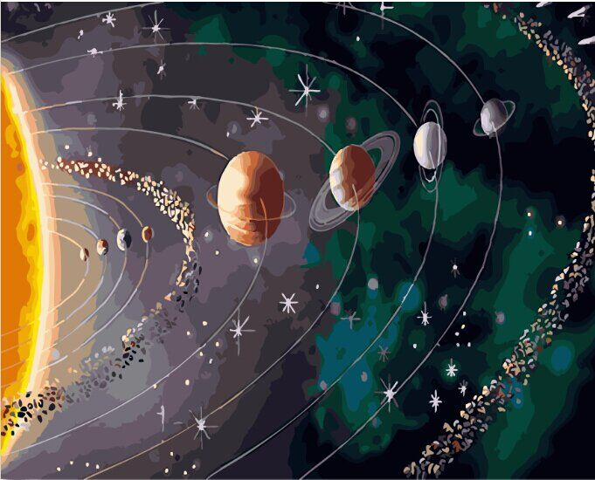
Solar System
By elena nikolaeva
School 1411
moscow

Slide 2
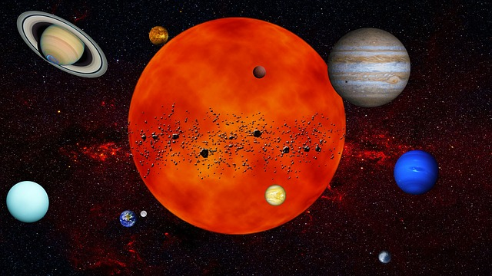
Our Solar System is made up of the sun, eight planets and their moons along with some asteroids, meteoroids, and comets.
The sun is at the center of our solar system and all the planets move around it in their own Orbits.

Slide 3
solar system quick facts Age: 4.6 Billion Years Total Planets: 8 Dwarf Planets: 5 Total Number of Moons: 181 Number of Asteroids: 552,894 Number of Comets: 3,083 Diameter: 18.75 trillion kilometers (11.65 trillion miles)

Slide 4
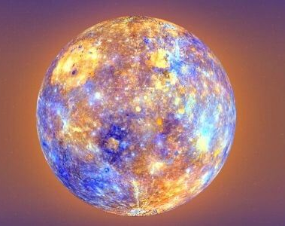
Mercury
Mercury is the Closest Planet to the sun in the solar system, still, it is the second hottest planet. Venus is the hottest. It is also the Smallest Planet among all eight planets. It is just a little bigger than Earth’s moon. The distance from the sun to mercury is over 35 million miles.

Slide 5
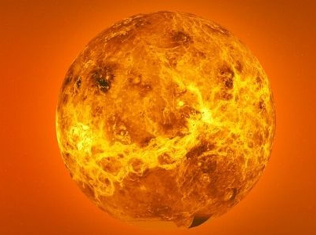
Venus
The planet Venus is the second from the sun and the third brmoon. This planet is named after the Roman goddess of love and beauty.
Venus is the hottest planet in our solar system and the second-largest terrestrial planet.
ightest object in the sky after the sun and the

Slide 6
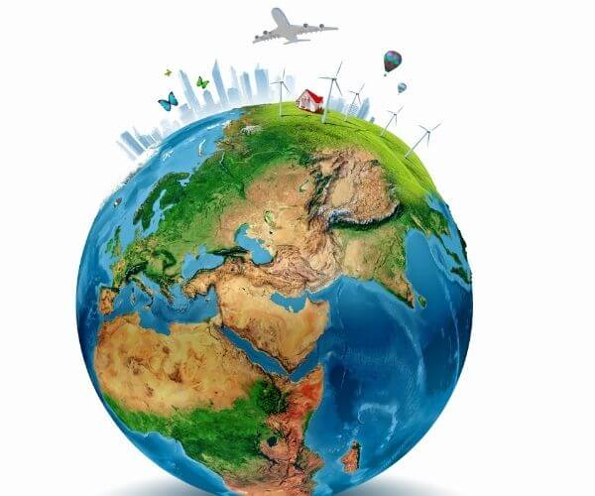
Earth
Earth, our home planet, the third planet from the sun, is the only place in the known universe inhabited by living things.
Planet Earth is also known as the ‘Blue Planet’ because of the two-thirds of its surface is covered by saltwater oceans.
It is the fifth-largest planet in the solar system with a radius of 3,959 miles. It is the only planet in our solar system with liquid water on the surface.

Slide 7
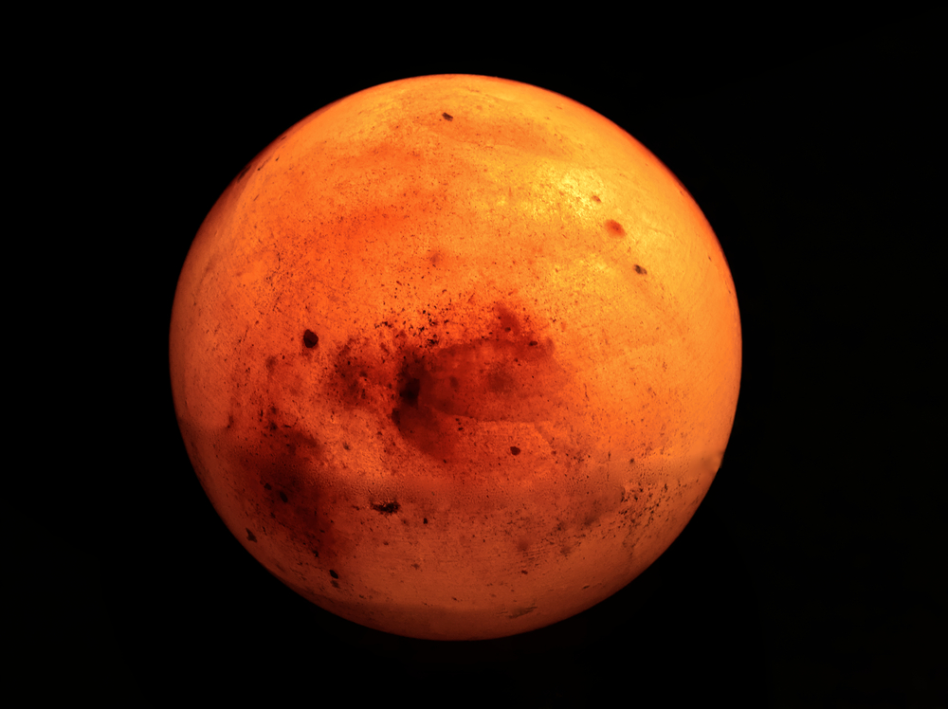
Mars
Mars is the second smallest planet (Mercury is the smallest) and fourth planet from the Sun. This planet is named after Mars, the Roman god of war.
The planet is named after Mars, the Roman god of war. It is also known by the name of “Red Planet” due to its red color.

Slide 8
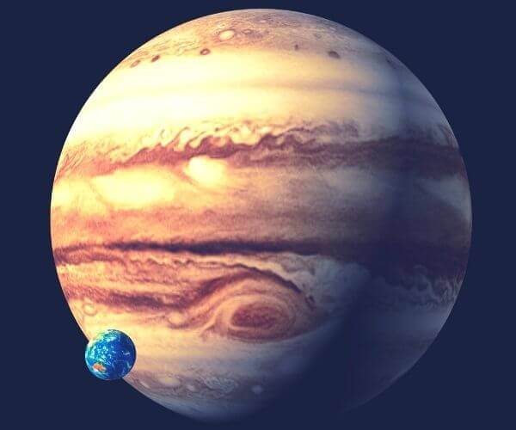
Jupiter
Jupiter is the 5th closest planet from the sun. It is the biggest planet and also called the Gas Giants.
Jupiter is named after the Roman king of the gods. It was the first Planet created in the Solar System.. Jupiter has 67 moons which are separated into groups. Jupiter is so big that the Earth would fit into Jupiter more than 1,300 times.

Slide 9
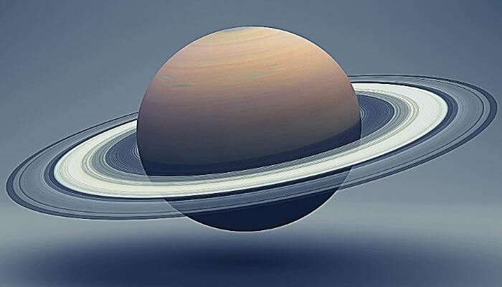
Saturn
Saturn, a gas giant is the second-largest planet in our solar system after Jupiter. Saturn is the 6th planet from the sun.
As Saturn is made mostly of gases i.e Helium and hydrogen; so if we drop it in a big enough ocean it will float. Saturn is also the lightest planet in the solar system. Saturn has 53 known moons. rings are made from billions of pieces of ice, dust, and rock. Some pieces are as tiny as a speck of dust. A few pieces are as big as mountains.

Slide 10
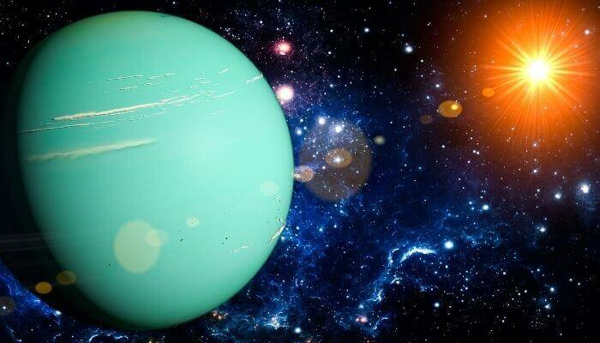
Uranus
Uranus is the seventh planet from the Sun, as well as the third largest . The name comes from the ancient Greek god Osanos who was the lord of the sky and husband of the earth. Uranus has the coldest temperature -224°C. Uranus rotates in the opposite direction as Earth and most other planets. Uranus has 27 known moons.

Slide 11
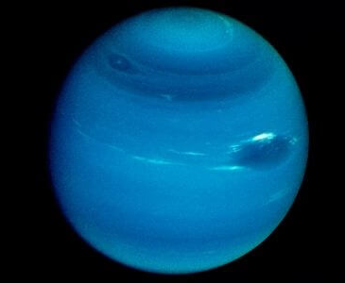
Neptune
Neptune is the eighth and farthest-known Solar planet from the Sun. Due to its beautiful blue color, Neptune was named after the Roman god of the Sea, PoseidonNeptune is the Coldest and windiest Planet in the Solar System. The average temperature on Neptune is about -221.45 degrees Celsius.

Slide 12
THANK YOU!

