Slide 1
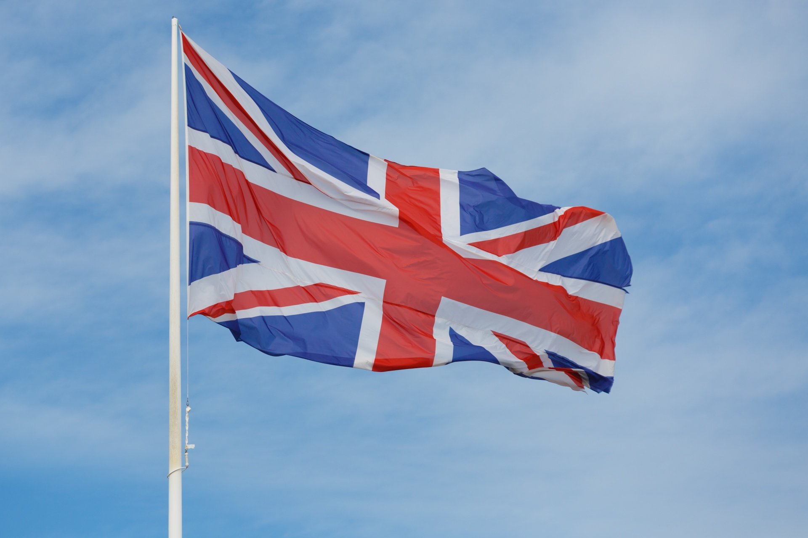
The Influential Female
Monarchs

Slide 2

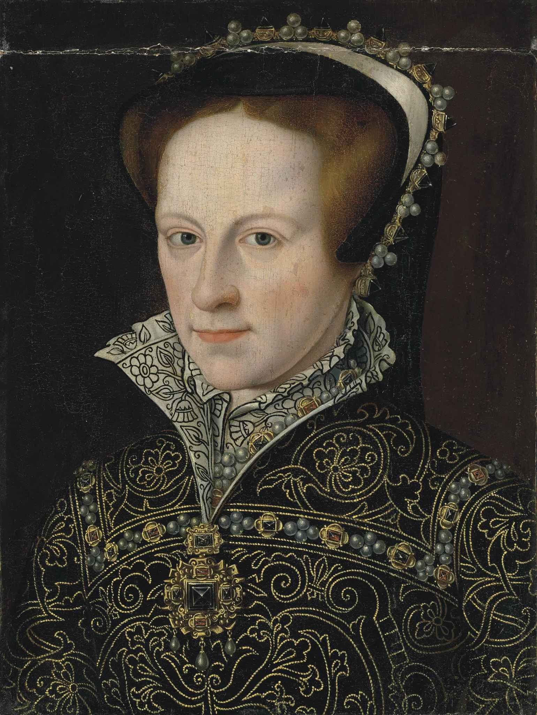
The influential female monarchs made an impressive contribution to the British history.
The name of the first crowned Queen of the England, Bloody Mary is associated with the multiple burning at the stakes the people, who was connected with the religious reforms.

Slide 3
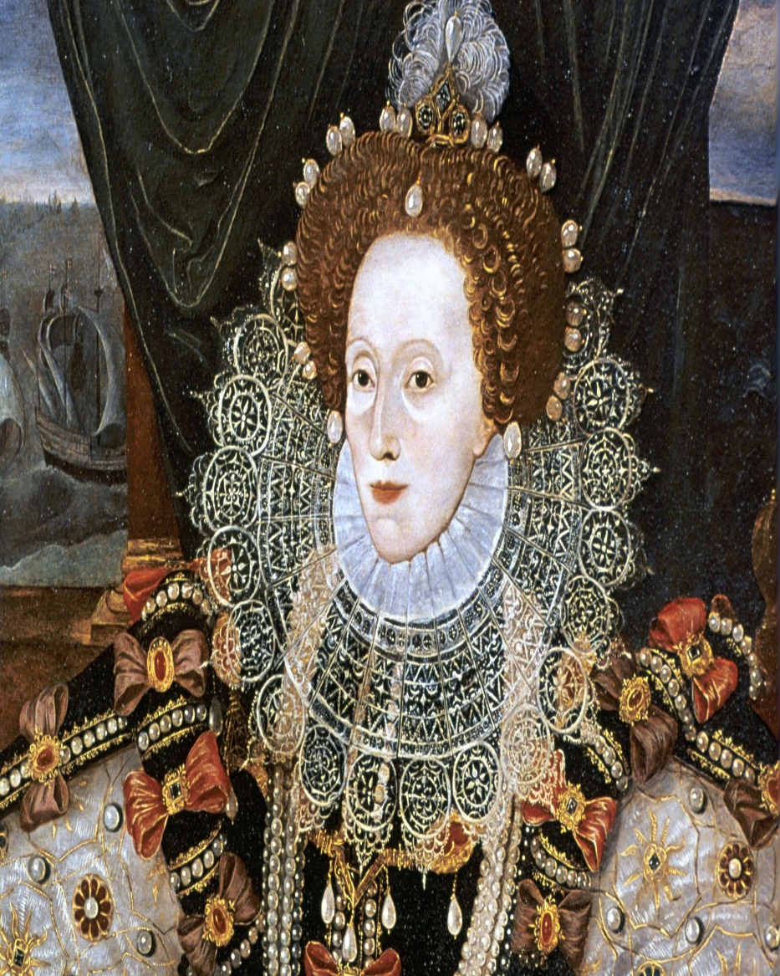
The last monarch of the House of Tudor, Elizabeth I became one of the most powerful and respected figure of the England and Ireland.

Slide 4
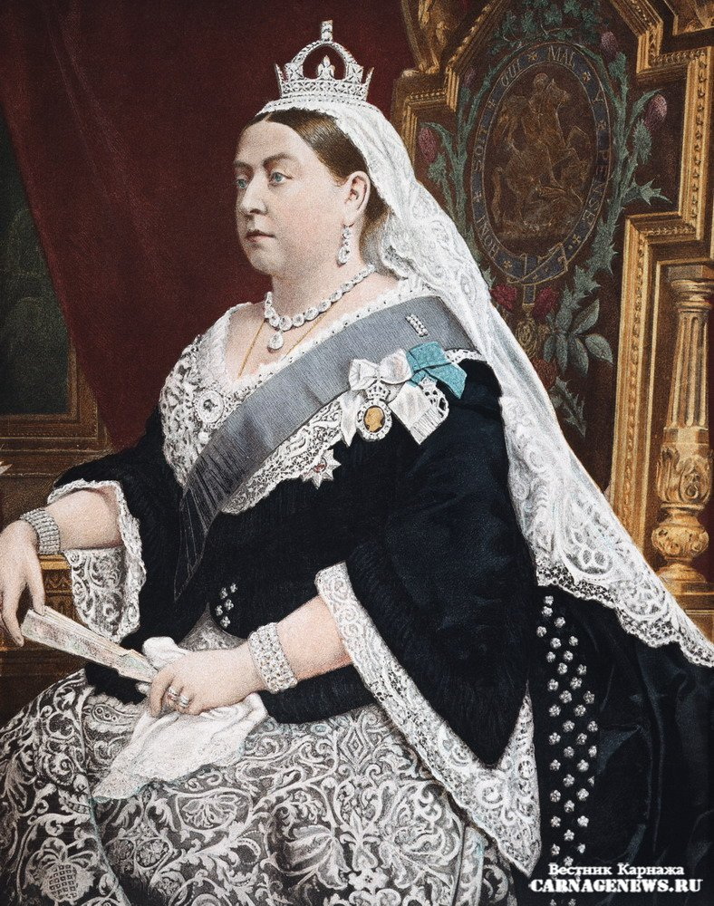
The longest reigning British monarch before acting Queen of the United Kingdom Elisabeth ll was Queen Victoria, who owned the quarter of the world. The Queen Victoria had an image of the Mother of British nation.

Slide 5
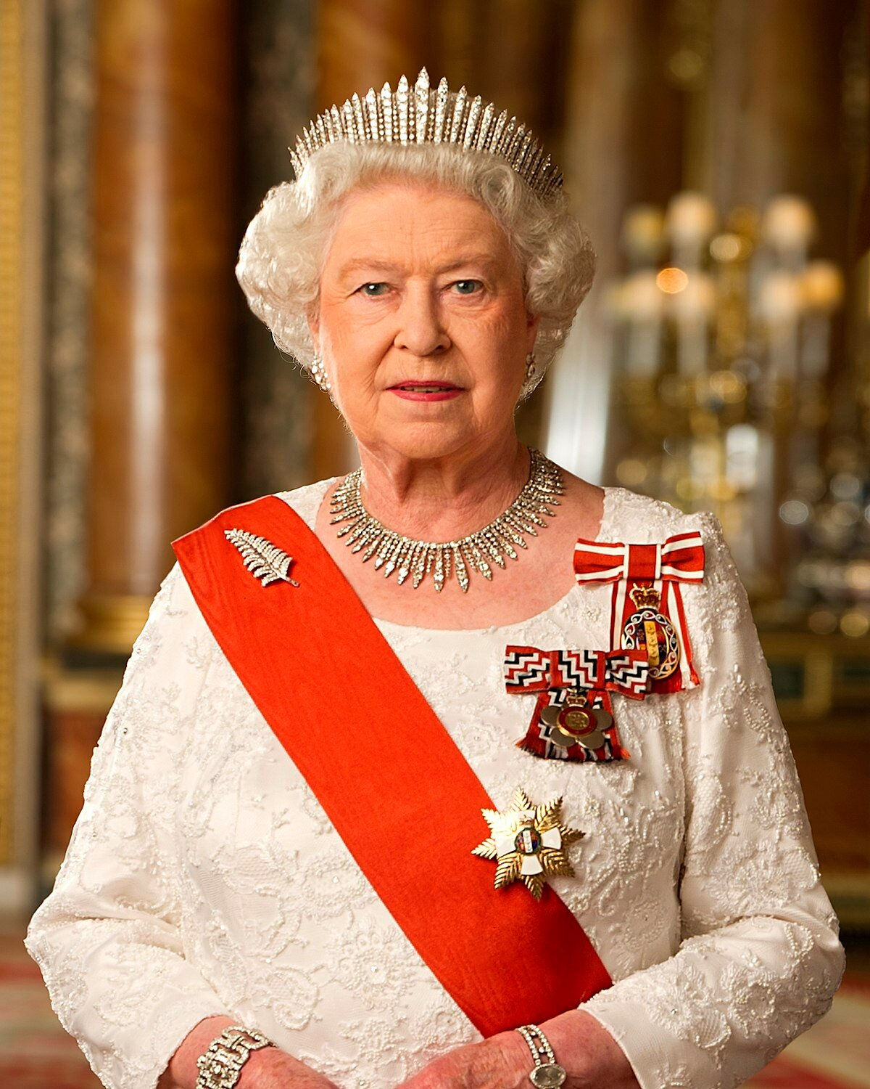
One of the most significant figure of the modern political stage is Elizabeth ll. She came to the throne in 1952 year, when she was 25 years old. The Queen of the United Kingdom is not only the longest monarch, but the oldest one.

Slide 6
Презентация составлена учащимися МБОУ «школа № 110» г.Ростов-на-Дону
Трушик София,
Редькина Ксения
2021г.

