Slide 1
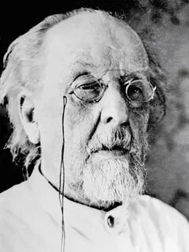
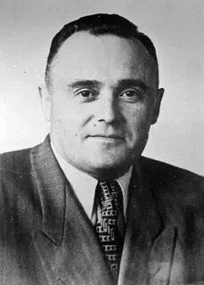
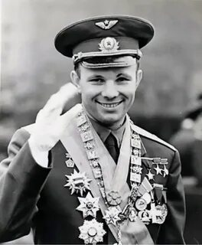
How are these people connected to each other? What theme are they related to?
Konstantin Tsiolkovsky
Sergei Korolyov
Yuri Gagarin

Slide 2
GREAT MINDS. Space Exploration Heroes.
Spotlight 8
Spotlight on Russia. Module 3 “Great Minds”, p.5

Slide 3
By the end of the lesson you will be able to…
a) find out more about Russian space exploration and its heroes
b) find out about the Milky Way

Slide 4




The plan of the lesson
LISTENING.
History of space exploration in Russia.
8 balls
READING AND SPEAKING.
Russian space exploration heroes.
5+5 balls
VIDEO INTERVIEW.
Quiz “Yuri Gagarin, the ambassador for Russia”.
7 balls
WEBSITE.
The Yuri Gagarin Cosmonaut Training Center: requirements for a cosmonaut.
5 balls

Slide 5
Before listening learn new words
the Cosmonautics Day
объявлять
запускать
День космонавтики
to declare
to launch
доказывать
сообщать
докладывать
Всем. день авиации и космонавтики
to prove
to report
the World Aviation and Astronautics Day
на борту
основывать
on board
the Nation Organization
to establish
Организация объединенных наций
Международный день полета человека в космос
отправиться в путешествие
the International Day of Human Space Flight
Общество изучения межпланетных сообщений
to set off on a journey
the Society for Studies of Interplanetary Travel
safe and sound
летать
целый и невредимый
to fly – flew – flown
искусственный
artificial
полет
the Earth was filmed
a flight
спутник
Землю снимали
a satellite

Slide 6
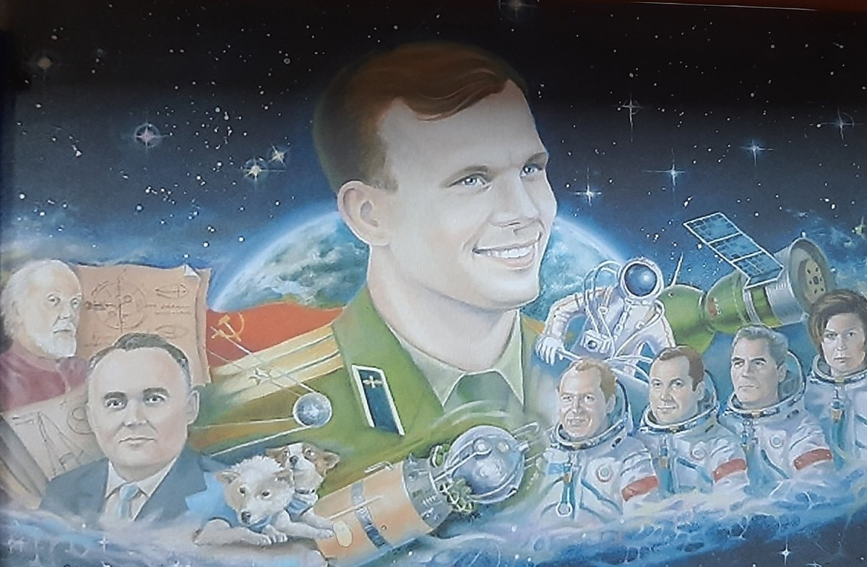

History of space in Russia
Listen to the text and put the events in the right order.

Slide 7
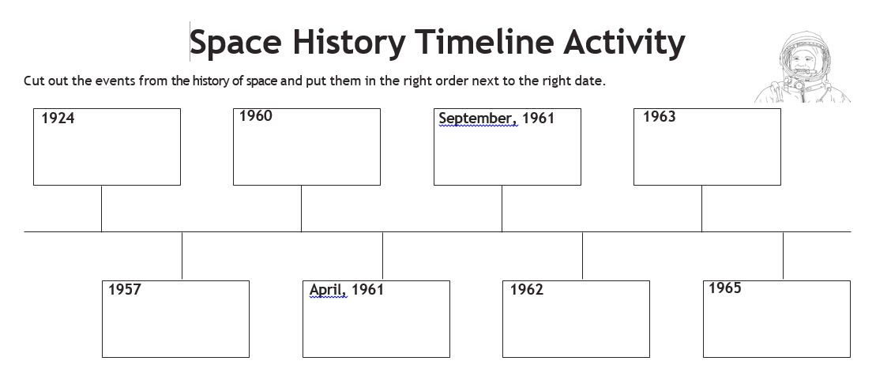
KEY to “History of space in Russia”
Tsiolkovsky’s students established the First Society for Studies of Interplanetary Travel.
Two dogs Belka and Strelka set off on a space journey.
The Earth was filmed during the Gherman Titov’s flight for the first time.
Valentina Tereshkova became the first woman to go to space and successfully return alone.
Soviet Union reported that the “Sputnik 2” with a dog Laika on board was launched into space.
Yuri Gagarin flew into space in “Vostok 1”.
The first group flight took place.
Aleksey Leonov became the first man who went to open space and spent there 12 minutes.

Slide 8
Reading: Spotlight on Russia, p. 5
Fact file
an inventor - изобретатель
a space suit - скафандр
to research - исследовать
to orbit the Earth – выйти на орбиту
to cross – пересекать
an ambassador - посол
Name
Was born
Occupation
Achievements
Died

Slide 9
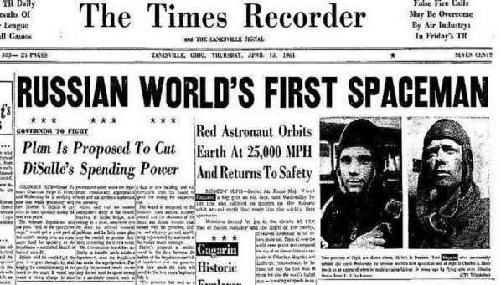
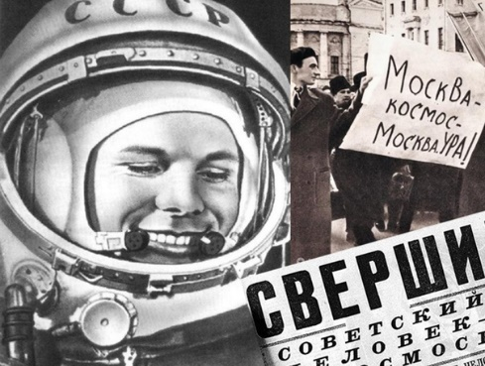
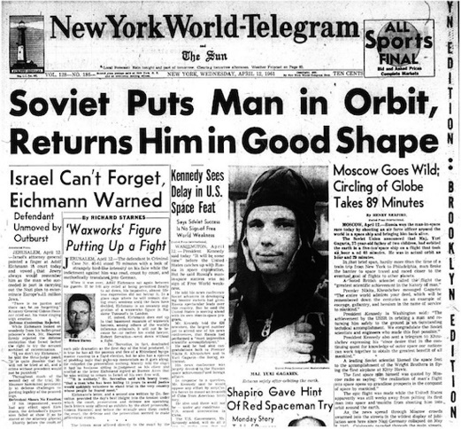
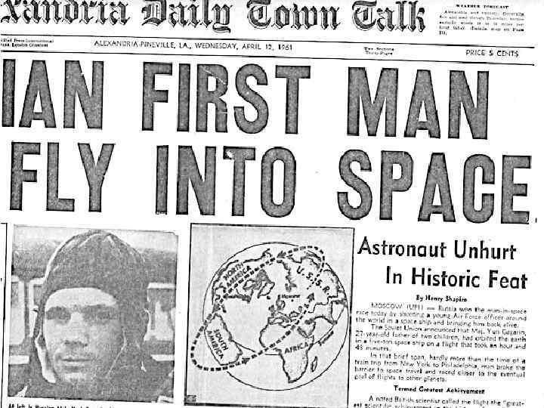
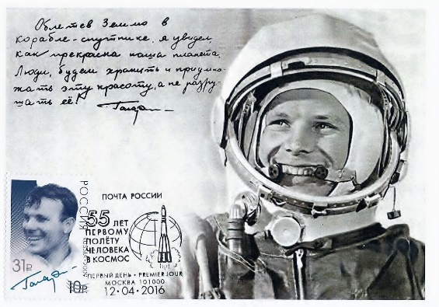
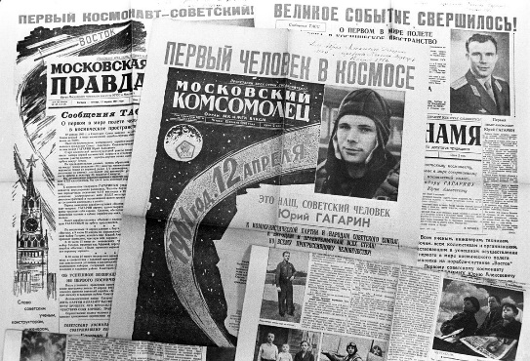
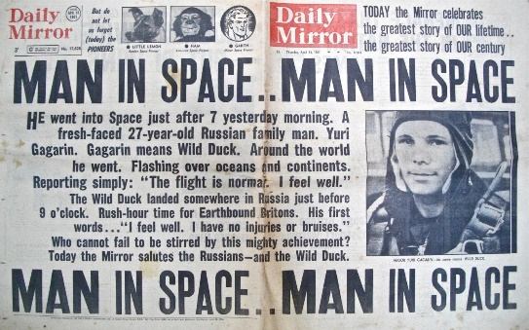
Yuri Gagarin, the First Man in Space!
12th April, 1961

Slide 10
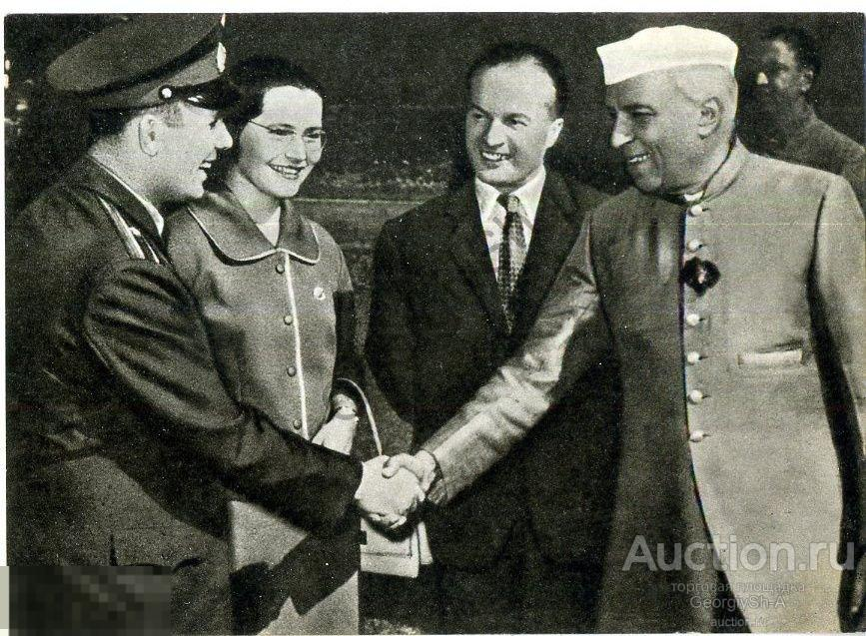
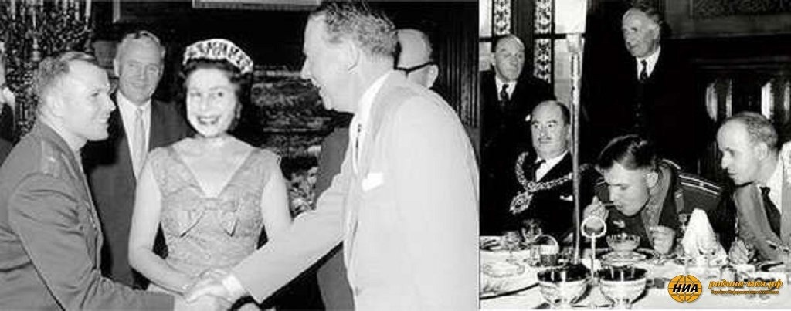
Yuri Gagarin became an ambassador for Russia telling about its achievements (80)

Slide 11
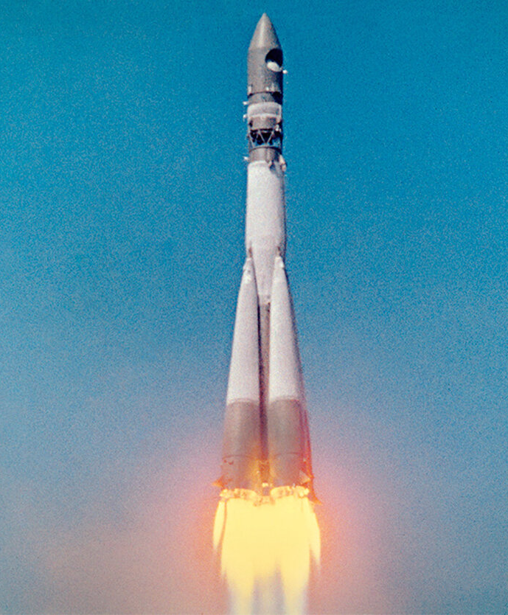
Gagarin’s interview to BBC

Slide 12
Choose the right answer
1. What feeling is commonly associated with being nervous about something?
A) Butterflies in the stomach
B) Fireflies in the tummy
C) Ladybugs in the stomach
2. How long did the American astronaut spend in the spaceship before takeoff?
A) 30 minutes
B) He didn't spend any time
C) Three to four hours
3. How was Y. Gagarin feeling before the spaceship takeoff?
A) Just normal
B) Excited
C) Sleepy
4. What film is everyone anxiously waiting to see?
A) A romantic comedy
B) A documentary on butterflies
C) The color film of the spaceship takeoff
5. How is the spaceship cabin compared to the cabin of a jet plane?
A) More spacious
B) Uncomfortable
C) Smaller
6. How was the spaceship shown at the Toshino airshow?
A) Fully
B) Incomplete
C) Partially
7. Where is the film of the spaceship takeoff currently being shown?
A) Europe
B) USA
C) Soviet Union
KEY: 1A, 2C, 3A, 4C, 5B, 6A, 7C

Slide 13
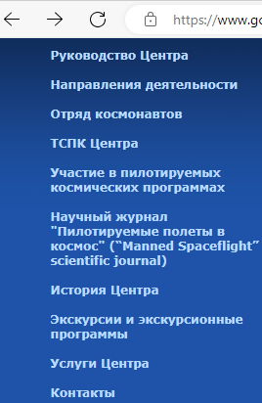
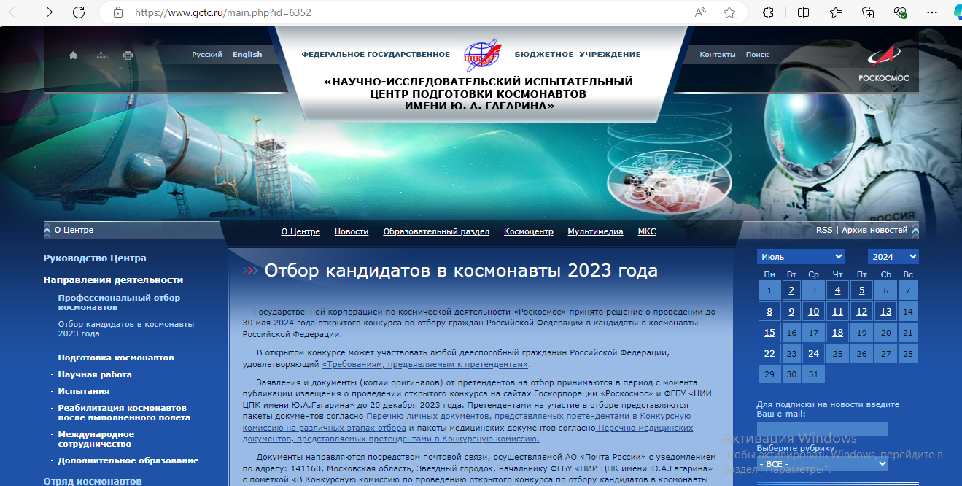
Website GCTC Yuri Gagarin Cosmonaut Training Centre

Slide 14
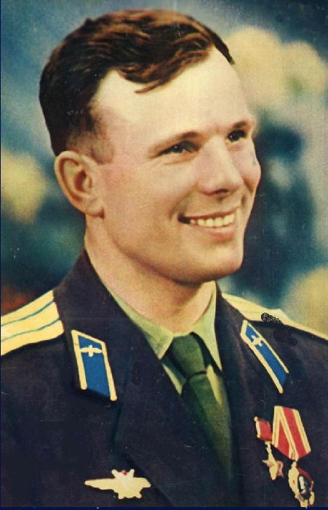
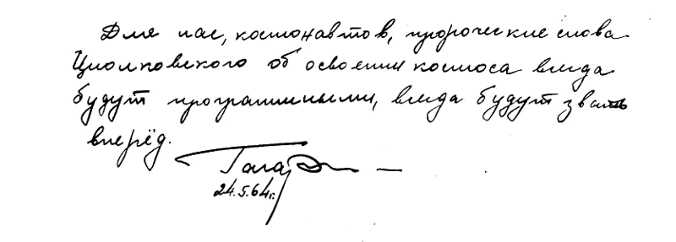
In the Book of Honor of the Tsiolkovsky’s museum visitors Gagarin made a memorial entry:
“…For us cosmonauts, Tsiolkovsky's prophetic words about the conquest of space will always be programmatic. They will always call ahead.”

Slide 15
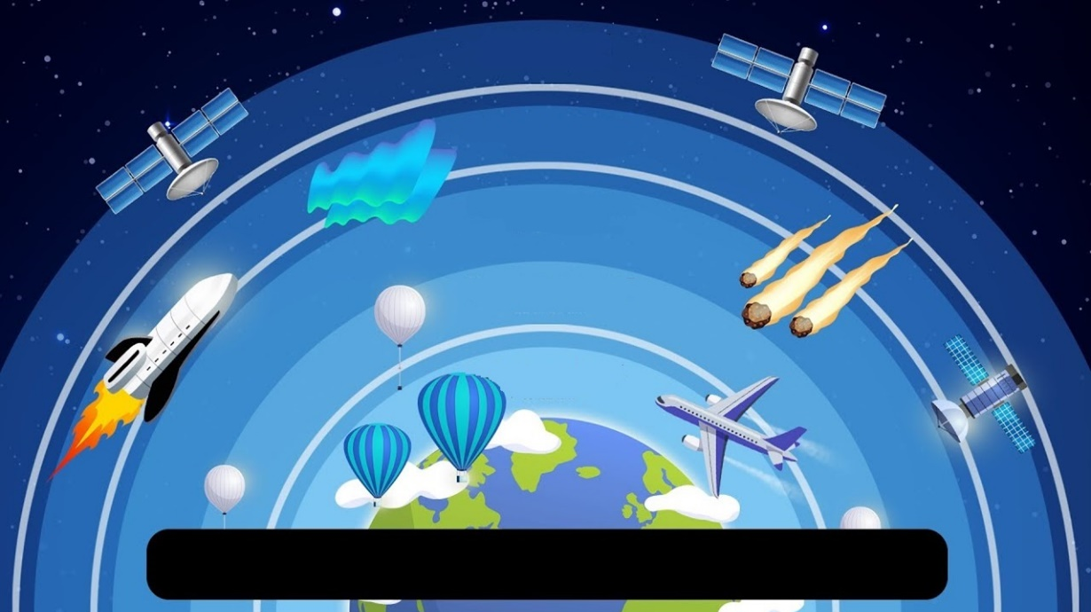
СПАСИБО
I did my best
I worked hard
It was difficult
The layers of the atmosphere

Slide 16
Home assignment
1
2
3
To learn the words, read and translate the text, SponR p.5
To learns the words and tell about one of the Russian cosmonauts
To learn the words and do the quiz about space exploration in Russia

