Slide 1
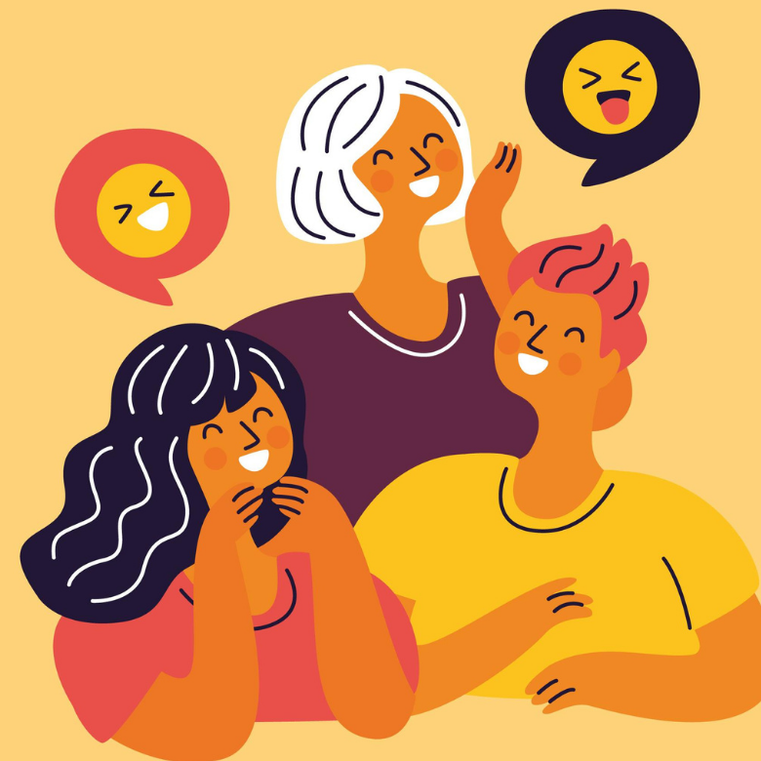
What makes
you laugh?
Notes:
To get an editable version of this presentation:
1. Click File > Make a copy > Entire presentation
OR
2. Click File > Download > Microsoft Powerpoint

Slide 2

Let’s get started
with a warm-up

Slide 3
In pairs, discuss how to complete the jokes.
Helvetica and Times New Roman walk into a bar. “Get out of here!” shouts the bartender. “We don’t serve your ………………………………… .”
Parallel lines have so much in common. It is a shame they will never ………………………………. .
“What did the ocean say to the beach?” “Nothing, it just ………………………………… .”
a. Knock knock.
b. Who's there?
a. …………………………………… .
b. …………………………………… who?
a. …………………………………… do anything we want!
Why do we tell actors to “break a leg”? Because every play has a ………………………………… .

Slide 4
Let’s check your answers.
Helvetica and Times New Roman walk into a bar. “Get out of here!” shouts the bartender. “We don’t serve your ………………………………… .”
Parallel lines have so much in common. It is a shame they will never ………………………………… .
“What did the ocean say to the beach?” “Nothing, it just ………………………………… .”
a. Knock knock.
b. Who's there?
a. …………………………………… .
b. …………………………………… who?
a. …………………………………… do anything we want!
Why do we tell actors to “break a leg”? Because every play has a ………………………………… .
type
meet
waved
Weekend
Weekend
Weekend
cast

Slide 5

Discuss the questions.
What do you think of the jokes? Did any of them make you laugh?
Did you think the way you finished them was better than the original version?
Why do people laugh?
How does our culture and background affect the way we laugh and the things we laugh at?

Slide 6

Why do humans laugh? Link to the video : https://www.youtube.com/watch?v=Nu5j_rODT9o
In a moment, you’ll watch a video titled:

Slide 7
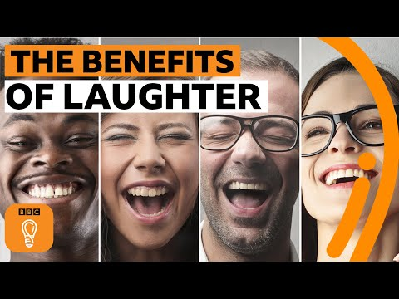
Watch the first part of the video (to 00:42) and write the reasons people laugh that are outlined in the video.

Slide 8
Let’s check your answers.
We laugh to…
show we agree with what someone said
show that we remember the same thing the speaker is alluding to
mask other emotions
try and pretend we’re not upset
cover up being angry or embarrassed or in pain
get other people to do things

Slide 9
Watch the rest of the video (00:42–05:21) and make notes on the following topics.
kinds of laughter
behaviourally contagious phenomena
how apes and humans laugh
darker side of laughter
benefits of laughter

Slide 10
Discuss the questions.
Did you find anything surprising or new in the video?
If laughter is so beneficial, should we fake it for health reasons?
Did you start laughing at the end of the video when looking at the girl who couldn’t stop laughing?
What makes you laugh?
Have you ever:
laughed at inappropriate times? When did that happen?
been unable to stop laughing? What was so funny?
laughed to mask your emotions? What emotion did you try to cover up with laughter?

Slide 11

Let’s learn some vocabulary

Slide 12

Listen to the different types of laughter and read an example situation to see the context each can be used in. Then, write one more situation using each synonym of the verb laugh. [part 1/2]
cackle
The great and evil mastermind cackled from the top of his castle thinking about his plan!
giggle
When a man resembling a young Brad Pitt entered the room, all the girls started giggling.
chuckle
“Do you remember the time when I mistook Auntie Christie for your mother?” Steve chuckled.
snigger (BrE)/snicker (AmE)
Kate felt deeply hurt when she noticed a group of colleagues sniggering at her during her speech.
Notes:
Possible situations:
Even after many years have passed, I can still hear my bully cackling wildly as he followed me.
When I was a teenager, I used to giggle uncontrollably when someone was wiggling their finger.
Andy chuckled a few times while reading the letter from his beloved sister.
The audience showed no empathy and sniggered when the actor forgot his lines.

Slide 13
Listen to the different types of laughter and read an example situation to see the context each can be used in. Then, write one more situation using each synonym of the verb laugh. [part 2/2]
guffaw
The play was so hilarious that you could hear the audience guffawing through almost the entire performance.
titter
For his age, James was really immature. He tittered whenever he heard the word kiss or date.
chortle
I was hesitant about giving her that present, yet when she unwrapped the gift and began to chortle, I knew it was a good choice.
Notes:
Possible situations:
The students couldn’t stop guffawing after they heard the teacher’s witty remark.
Stop tittering as if you are a teenager seeing a naked person for the first time!
Ann chortled with glee when it was announced her project had taken first place.

Slide 14
Listen to the different types of laughter and read an example situation to see the context each can be used in. Then, write one more situation using each synonym of the verb laugh. [part 2/2]
guffaw
The play was so hilarious that you could hear the audience guffawing through almost the entire performance.
titter
For his age, James was really immature. He tittered whenever he heard the word kiss or date.
chortle
I was hesitant about giving her that present, yet when she unwrapped the gift and began to chortle, I knew it was a good choice.
Notes:
Possible situations:
The students couldn’t stop guffawing after they heard the teacher’s witty remark.
Stop tittering as if you are a teenager seeing a naked person for the first time!
Ann chortled with glee when it was announced her project had taken first place.

Slide 15
Correct the mistakes in the definitions of the synonyms of the word laugh.
Chuckle means to laugh loudly, usually because you are thinking or reading something hilarious.
Giggle means to laugh in a high voice, usually because you are embarrassed or angry.
Snigger or snicker means to laugh quietly in a kind manner, especially when someone is hurt.
Cackle means to laugh quietly in an unpleasant way.
Guffaw means to laugh very loudly in a controlled way.
Titter means to laugh quietly about something that might be comfortable for someone else.
Chortle means to laugh because you are disappointed about something.

Slide 16
Let’s check your answers. [part 1/2]
Chuckle means to laugh loudly, usually because you are thinking or reading something hilarious.
quietly not loudly
Giggle means to laugh in a high voice, usually because you are embarrassed or angry.
nervous not angry
Snigger or snicker means to laugh quietly in a kind manner, especially when someone is hurt.
an unkind not a kind manner
Cackle means to laugh quietly in an unpleasant way.
loudly not quietly

Slide 17
Let’s check your answers. [part 2/2]
Guffaw means to laugh very loudly in a controlled way.
an uncontrolled not a controlled way
Titter means to laugh quietly about something that might be comfortable for someone else.
uncomfortable/embarrassing not comfortable
Chortle means to laugh because you are disappointed about something.
pleased not disappointed

Slide 18
Choose the most suitable word in each sentence.
Instead of helping the poor woman who dropped all her shopping on the pavement, a group of lads sniggered/chortled/giggled and called her names.
The stand-up comedian’s jokes were so hilarious that I was sniggering/guffawing/giggling for the whole show. I simply couldn’t stop laughing.
The girl in front of me was chuckling/cackling/sniggering the whole journey. I guess the book she was reading was extremely funny.
Listening to Harry cackling/chuckling/giggling was a nightmare, I just wished he would stop making those awful laughing sounds.
When Ellen saw her date, she started cackling/tittering/giggling uncontrollably, I guess that was her way of covering her embarrassment.
I chortled/tittered/cackled with delight when I saw the financial report of our company.
The teenagers chuckled/sniggered/tittered when one of them started asking intimate questions.

Slide 19
Let’s check your answers.
Instead of helping the poor woman who dropped all her shopping on the pavement, a group of lads sniggered/chortled/giggled and called her names.
The stand-up comedian’s jokes were so hilarious that I was sniggering/guffawing/giggling for the whole show. I simply couldn’t stop laughing.
The girl in front of me was chuckling/cackling/sniggering the whole journey. I guess the book she was reading was extremely funny.
Listening to Harry cackling/chuckling/giggling was a nightmare, I just wished he would stop making those awful laughing sounds.
When Ellen saw her date, she started cackling/tittering/giggling uncontrollably, I guess that was her way of covering her embarrassment.
I chortled/tittered/cackled with delight when I saw the financial report of our company.
The teenagers chuckled/sniggered/tittered when one of them started asking intimate questions.

Slide 20

Let’s discuss!

Slide 21
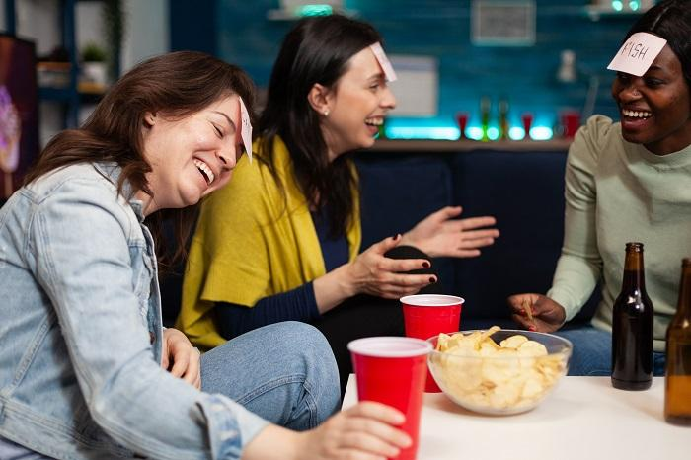
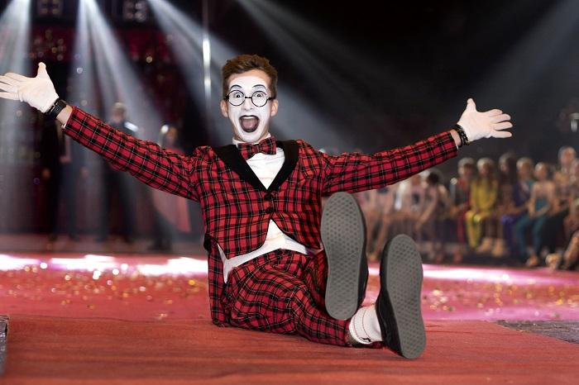
Look at the photos showing people laughing in different situations. Talk about the similarities and differences between the photos. Then, discuss some other aspects of laughing using the questions below the pictures. [part 1/3]
A day without laughter is a wasted day. Do you agree? Why/Why not?
We should take children as an example, who laugh easily even at the smallest things. Do you agree? Why/Why not?
Notes:
Students should work in pairs or groups of three.

Slide 22
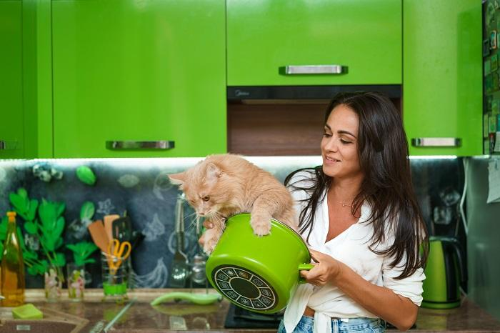
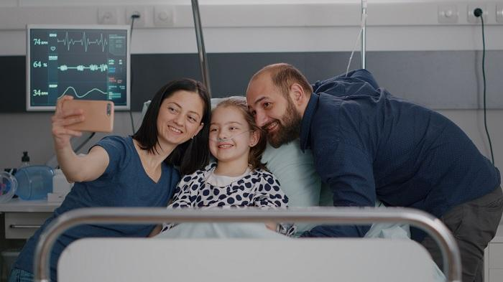
Look at the photos showing people laughing in different situations. Talk about the similarities and differences between the photos. Then, discuss some other aspects of laughing using the questions below the pictures. [part 2/3]
The older we become, the less we laugh and smile. Do you agree? Why/Why not?
Doctors should prescribe watching comedies as a remedy for some illnesses. Do you agree? Why/Why not?
Notes:
Students should work in pairs or groups of three.

Slide 23
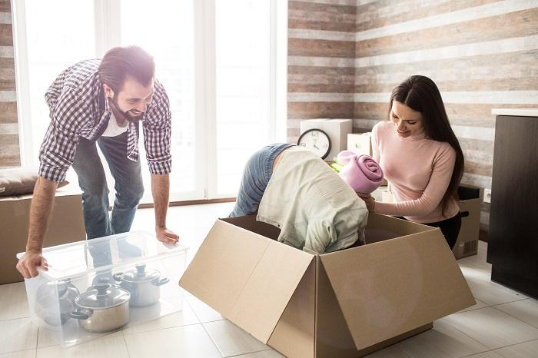
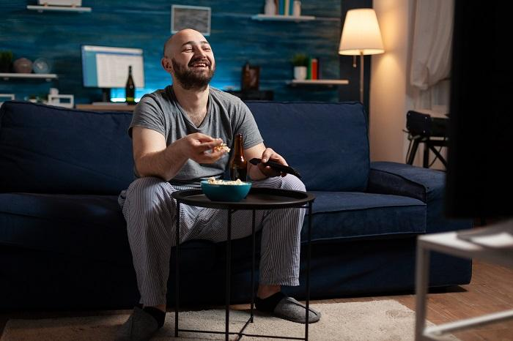
Look at the photos showing people laughing in different situations. Talk about the similarities and differences between the photos. Then, discuss some other aspects of laughing using the questions below the pictures. [part 3/3]
Comedians should earn a lot of money as they help people stay healthy. Do you agree? Why/Why not?
Not everyone has to be funny and cheerful all the time. We should allow some people to be serious if they prefer that. Do you agree? Why/Why not?
Notes:
Students should work in pairs or groups of three.

Slide 24
Thanks!

