Slide 1
THE TRETYAKOV GALLERY COLLECTION
ART
Notes:
Эта презентация демонстрирует новые возможности PowerPoint. Ее рекомендуется просматривать в режиме показа слайдов. Эти слайды должны дать вам представление о том, какие эффектные презентации можно создать с помощью PowerPoint 2011.
Для доступа к другим образцам шаблонов откройте меню "Файл", а затем щелкните "Создать из шаблона". В разделе "Шаблоны" щелкните "Презентации".

Slide 2
GUESS THE PAINTING
RULES
1
2
3
Choose a speaker each time you give an answer
Split up into teams
Take turns
УГАДАЙ КАРТИНУ
ПРАВИЛА
Разбейтесь на команды
Каждая команда выбирает при ответе одного человека, который будет называть картину
Команды отвечают по очереди

Slide 3
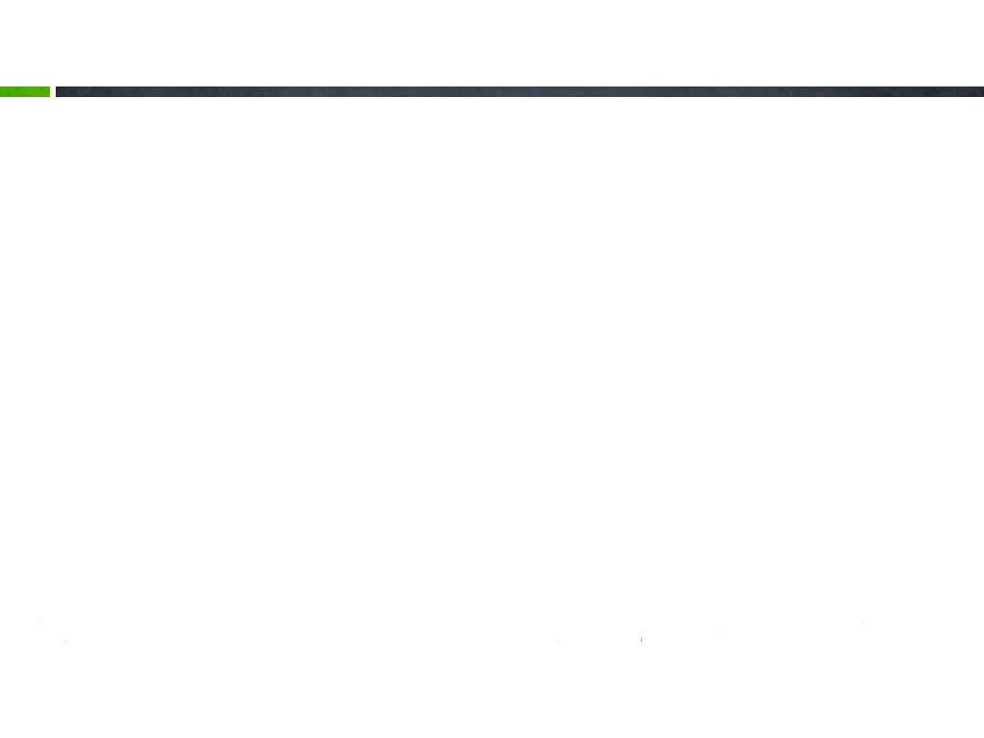
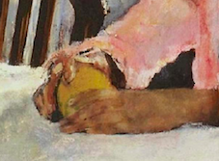
GUESS THE PAINTING
Questions
What is this painting called in English? (1 point)
What is the Russian name of this picture? (1 point)
Who painted the picture? Do you remember the artist’s first name? (2 points)
When was the picture painted? (1 point)
Can you describe the picture? (3 points)
Fragment 1
8 points
If your team can’t answer a question, another team is allowed to answer it and get an extra point.
Если ваша команда не может ответить на один из вопросов, другим командам разрешается ответить на него и получить дополнительный балл.

Slide 4
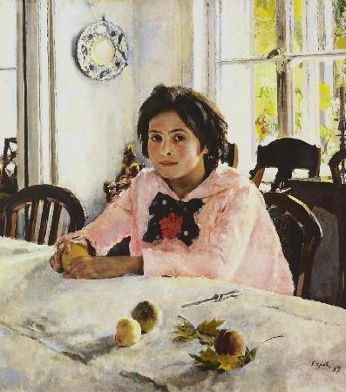
GUESS THE PAINTING
Fragment 1
Answers
The painting is called…
Girl with Peaches
Девочка с персиками
It was created by…
Valentin Serov
1887
It was painted in…
It is in the collection of…
The Tretyakov Gallery

Slide 5
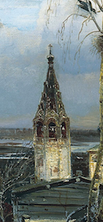
GUESS THE PAINTING
Fragment 2
8 points
Questions
What is this painting called in English? (1 point)
What is the Russian name of this picture? (1 point)
Who painted the picture? Do you remember the artist’s first name? (2 points)
When was the picture painted? (1 point)
Can you describe the painting? (3 points)
If your team can’t answer a question, another team is allowed to answer it and get an extra point.
Если ваша команда не может ответить на один из вопросов, другим командам разрешается ответить на него и получить дополнительный балл.

Slide 6
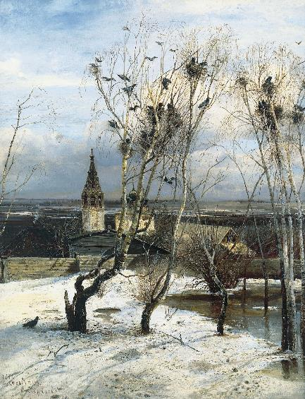
GUESS THE PAINTING
Fragment 2
Answers
The painting is called…
The Rooks Have Come
Грачи прилетели
It was created by…
Alexei Savrasov
1871
It was painted in…
It is in the collection of…
The Tretyakov Gallery

Slide 7
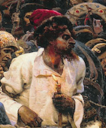
GUESS THE PAINTING
Questions
What is this painting called in English? (1 point)
What is the Russian name of this picture? (1 point)
Who painted the picture? Do you remember the artist’s first name? (2 points)
When was the picture painted? (1 point)
Can you describe the picture? (3 points)
Fragment 3
8 points
If your team can’t answer a question, another team is allowed to answer it and get an extra point.
Если ваша команда не может ответить на один из вопросов, другим командам разрешается ответить на него и получить дополнительный балл.

Slide 8
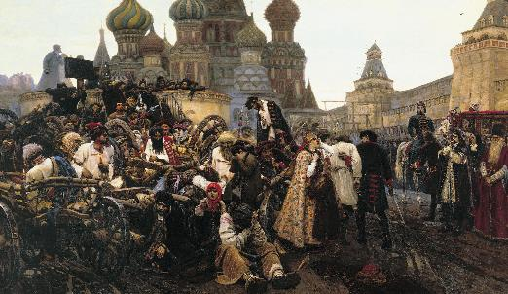
GUESS THE PAINTING
Fragment 3
Answers
The painting is called…
The Morning of the Execution of the Streltsy
Утро стрелецкой казни
It was created by…
Vasiliy Surikov
1881
It was painted in…
It is in the collection of…
The Tretyakov Gallery

Slide 9
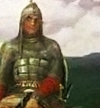
GUESS THE PAINTING
Questions
What is this painting called in English? (1 point)
What is the Russian name of this picture? (1 point)
Who painted the picture? Do you remember the artist’s first name? (2 points)
When was the picture painted? (1 point)
Can you describe the picture? (3 points)
Fragment 4
8 points
If your team can’t answer a question, another team is allowed to answer it and get an extra point.
Если ваша команда не может ответить на один из вопросов, другим командам разрешается ответить на него и получить дополнительный балл.

Slide 10
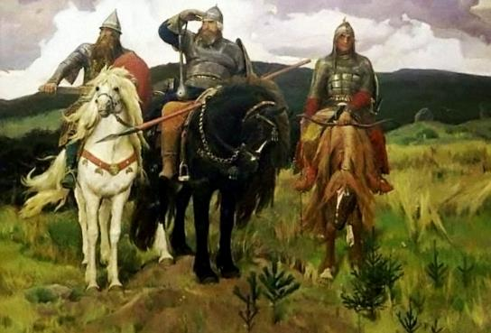
GUESS THE PAINTING
Fragment 4
Answers
The painting is called…
Bogatyrs
Богатыри
It was created by…
Viktor Vasnetsov
1898
It was finished in…
It is in the collection of…
The Tretyakov Gallery

Slide 11
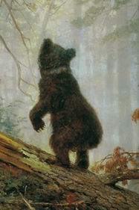
GUESS THE PAINTING
Questions
What is this painting called in English? (1 point)
What is the Russian name of this picture? (1 point)
Who painted the picture? Do you remember the artist’s first name? (2 points)
When was the picture painted? (1 point)
Can you describe the picture? (3 points)
Fragment 5
8 points
If your team can’t answer a question, another team is allowed to answer it and get an extra point.
Если ваша команда не может ответить на один из вопросов, другим командам разрешается ответить на него и получить дополнительный балл.

Slide 12
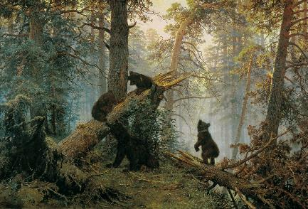
GUESS THE PAINTING
Fragment 5
Answers
The painting is called…
Morning in a Pine Wood
Утро в сосновом лесу
It was created by…
Ivan Shishkin
1889
It was painted in…
It is in the collection of…
The Tretyakov Gallery

Slide 13
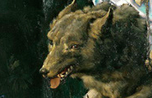
GUESS THE PAINTING
Questions
What is this painting called in English? (1 point)
What is the Russian name of this picture? (1 point)
Who painted the picture? Do you remember the artist’s first name? (2 points)
When was the picture painted? (1 point)
Can you describe the picture? (3 points)
Fragment 6
8 points
If your team can’t answer a question, another team is allowed to answer it and get an extra point.
Если ваша команда не может ответить на один из вопросов, другим командам разрешается ответить на него и получить дополнительный балл.

Slide 14
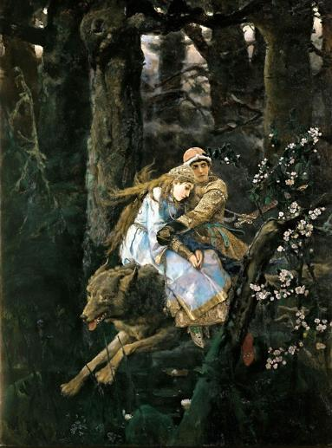
GUESS THE PAINTING
Fragment 6
Answers
The painting is called…
Ivan Tsarevich Riding a Grey Wolf
Иван-Царевич на сером волке
It was created by…
Viktor Vasnetsov
1889
It was painted in…
It is in the collection of…
The Tretyakov Gallery

Slide 15
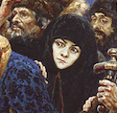
GUESS THE PAINTING
Questions
What is this painting called in English? (1 point)
What is the Russian name of this picture? (1 point)
Who painted the picture? Do you remember the artist’s first name? (2 points)
When was the picture painted? (1 point)
Can you describe the picture? (3 points)
Fragment 7
8 points
If your team can’t answer a question, another team is allowed to answer it and get an extra point.
Если ваша команда не может ответить на один из вопросов, другим командам разрешается ответить на него и получить дополнительный балл.

Slide 16
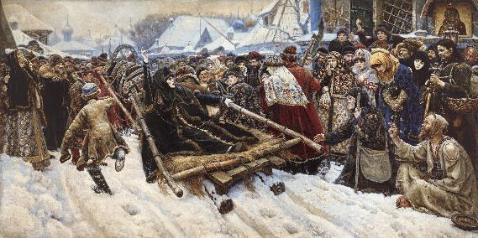
GUESS THE PAINTING
Fragment 7
Answers
The painting is called…
Boyaryna Morozova
Боярыня Морозова
It was created by…
Vasiliy Surikov
1887
It was finished in…
It is in the collection of…
The Tretyakov Gallery

Slide 17
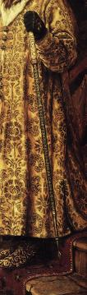
GUESS THE PAINTING
Questions
What is this painting called in English? (1 point)
What is the Russian name of this picture? (1 point)
Who painted the picture? Do you remember the artist’s first name? (2 points)
When was the picture painted? (1 point)
Can you describe the picture? (3 points)
Fragment 8
8 points
If your team can’t answer a question, another team is allowed to answer it and get an extra point.
Если ваша команда не может ответить на один из вопросов, другим командам разрешается ответить на него и получить дополнительный балл.

Slide 18
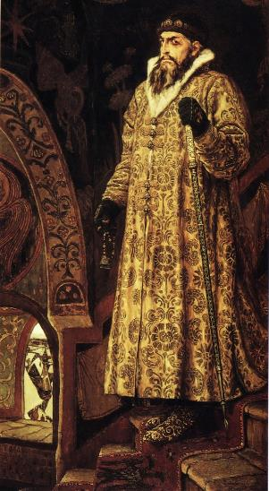
GUESS THE PAINTING
Fragment 8
Answers
The painting is called…
Ivan the Terrible
Иван Грозный
It was created by…
Viktor Vasnetsov
1898
It was painted in…
It is in the collection of…
The Tretyakov Gallery

Slide 19
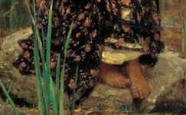
GUESS THE PAINTING
Questions
What is this painting called in English? (1 point)
What is the Russian name of this picture? (1 point)
Who painted the picture? Do you remember the artist’s first name? (2 points)
When was the picture painted? (1 point)
Can you describe the picture? (3 points)
Fragment 9
8 points
If your team can’t answer a question, another team is allowed to answer it and get an extra point.
Если ваша команда не может ответить на один из вопросов, другим командам разрешается ответить на него и получить дополнительный балл.

Slide 20
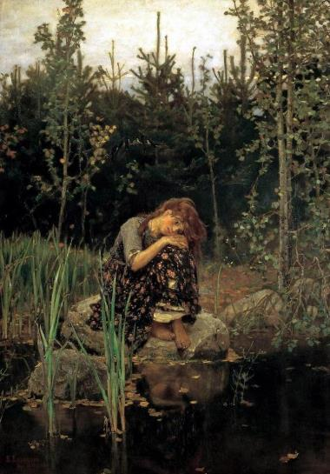
GUESS THE PAINTING
Fragment 9
Answers
The painting is called…
Alyonushka
Аленушка
It was created by…
Viktor Vasnetsov
1881
It was painted in…
It is in the collection of…
The Tretyakov Gallery

Slide 21
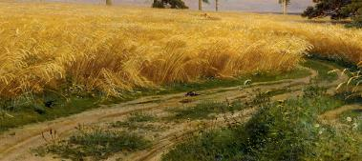
GUESS THE PAINTING
Questions
What is this painting called in English? (1 point)
What is the Russian name of this picture? (1 point)
Who painted the picture? Do you remember the artist’s first name? (2 points)
When was the picture painted? (1 point)
Can you describe the picture? (3 points)
Fragment 10
8 points
If your team can’t answer a question, another team is allowed to answer it and get an extra point.
Если ваша команда не может ответить на один из вопросов, другим командам разрешается ответить на него и получить дополнительный балл.

Slide 22
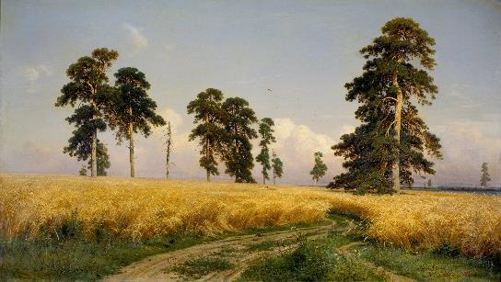
GUESS THE PAINTING
Fragment 10
Answers
The painting is called…
Rye
Рожь
It was created by…
Ivan Shishkin
1878
It was painted in…
It is in the collection of…
The Tretyakov Gallery

Slide 23
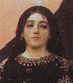
GUESS THE PAINTING
Questions
What is this painting called in English? (1 point)
What is the Russian name of this picture? (1 point)
Who painted the picture? Do you remember the artist’s first name? (2 points)
When was the picture painted? (1 point)
Can you describe the picture? (3 points)
Fragment 11
8 points
If your team can’t answer a question, another team is allowed to answer it and get an extra point.
Если ваша команда не может ответить на один из вопросов, другим командам разрешается ответить на него и получить дополнительный балл.

Slide 24
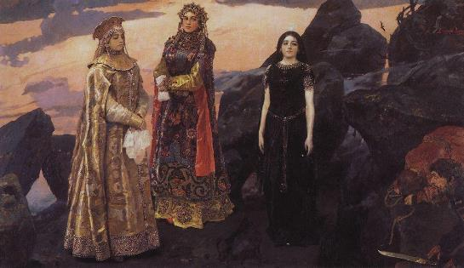
GUESS THE PAINTING
Fragment 11
Answers
The painting is called…
Three Tsarevnas of the Underground Kingdom
Три царевны подземного царства
It was created by…
Viktor Vasnetsov
1881
It was painted in…
It is in the collection of…
The Tretyakov Gallery

Slide 25

GUESS THE PAINTING
Questions
What is this painting called in English? (1 point)
What is the Russian name of this picture? (1 point)
Who painted the picture? Do you remember the artist’s first name? (2 points)
When was the picture painted? (1 point)
Can you describe the picture? (3 points)
Fragment 12
8 points
If your team can’t answer a question, another team is allowed to answer it and get an extra point.
Если ваша команда не может ответить на один из вопросов, другим командам разрешается ответить на него и получить дополнительный балл.

Slide 26
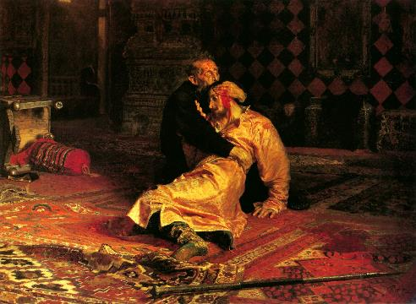
GUESS THE PAINTING
Fragment 12
Answers
The painting is called…
Ivan the Terrible and His Son
Иван Грозный и сын его Иван
It was created by…
Ilya Repin
1885
It was finished in…
It is in the collection of…
The Tretyakov Gallery

Slide 27
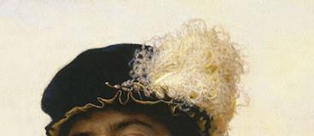
GUESS THE PAINTING
Questions
What is this painting called in English? (1 point)
What is the Russian name of this picture? (1 point)
Who painted the picture? Do you remember the artist’s first name? (2 points)
When was the picture painted? (1 point)
Can you describe the picture? (3 points)
Fragment 13
8 points
If your team can’t answer a question, another team is allowed to answer it and get an extra point.
Если ваша команда не может ответить на один из вопросов, другим командам разрешается ответить на него и получить дополнительный балл.

Slide 28
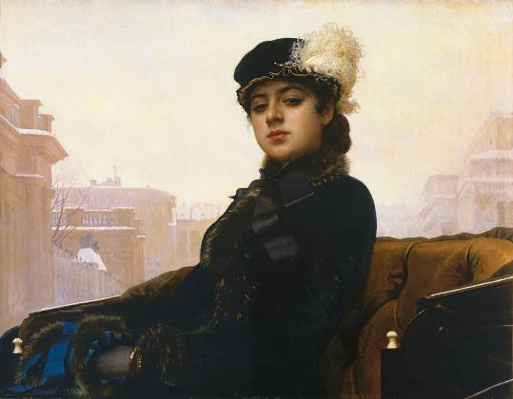
GUESS THE PAINTING
Fragment 13
Answers
The painting is called…
Portrait of an Unknown Woman
Неизвестная
It was created by…
Ivan Kramskoy
1883
It was painted in…
It is in the collection of…
The Tretyakov Gallery

Slide 29
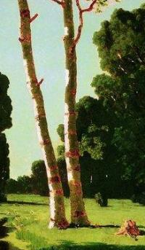
GUESS THE PAINTING
Questions
What is this painting called in English? (1 point)
What is the Russian name of this picture? (1 point)
Who painted the picture? Do you remember the artist’s first name? (2 points)
When was the picture painted? (1 point)
Can you describe the picture? (3 points)
Fragment 14
8 points
If your team can’t answer a question, another team is allowed to answer it and get an extra point.
Если ваша команда не может ответить на один из вопросов, другим командам разрешается ответить на него и получить дополнительный балл.

Slide 30
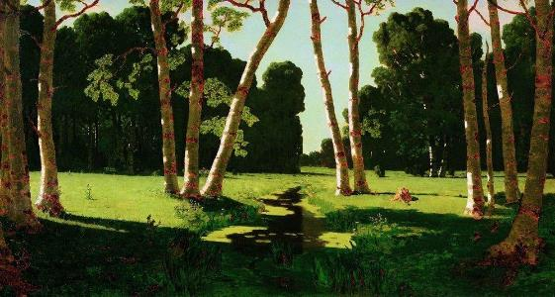
GUESS THE PAINTING
Fragment 14
Answers
The painting is called…
Birch Grove
Березовая роща
It was created by…
Arkhip Kuindzhi
1879
It was painted in…
It is in the collection of…
The Tretyakov Gallery

Slide 31
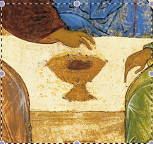
GUESS THE PAINTING
Questions
What is this painting called in English? (1 point)
What is the Russian name of this picture? (1 point)
Who painted the picture? Do you remember the artist’s first name? (2 points)
When was the picture painted? (1 point)
Can you describe the picture? (3 points)
Fragment 15
8 points
If your team can’t answer a question, another team is allowed to answer it and get an extra point.
Если ваша команда не может ответить на один из вопросов, другим командам разрешается ответить на него и получить дополнительный балл.

Slide 32
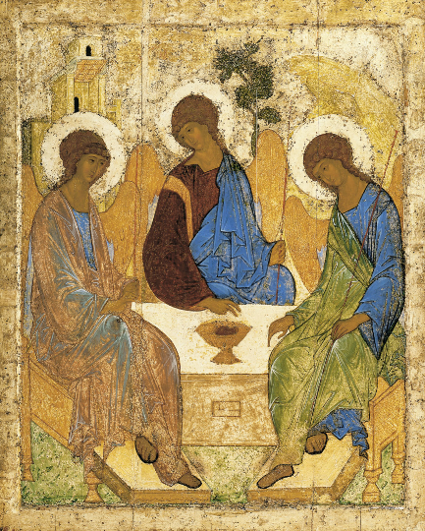
GUESS THE PAINTING
Fragment 15
Answers
The painting is called…
Trinity
Троица
It was created by…
Andrei Rublev
1411
It was painted in…
It is in the collection of…
The Tretyakov Gallery

Slide 33
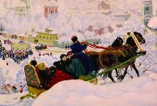
GUESS THE PAINTING
Questions
What is this painting called in English? (1 point)
What is the Russian name of this picture? (1 point)
Who painted the picture? Do you remember the artist’s first name? (2 points)
When was the picture painted? (1 point)
Can you describe the picture? (3 points)
Fragment 16
8 points
If your team can’t answer a question, another team is allowed to answer it and get an extra point.
Если ваша команда не может ответить на один из вопросов, другим командам разрешается ответить на него и получить дополнительный балл.

Slide 34
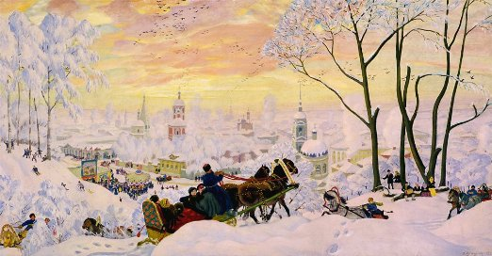
GUESS THE PAINTING
Fragment 16
Answers
The painting is called…
Pancake Week (Maslenitsa)
Масленица
It was created by…
Boris Kustodiev
1916
It was painted in…
It is in the collection of…
The Tretyakov Gallery

Slide 35
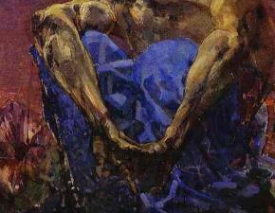
GUESS THE PAINTING
Questions
What is this painting called in English? (1 point)
What is the Russian name of this picture? (1 point)
Who painted the picture? Do you remember the artist’s first name? (2 points)
When was the picture painted? (1 point)
Can you describe the picture? (3 points)
Fragment 17
8 points
If your team can’t answer a question, another team is allowed to answer it and get an extra point.
Если ваша команда не может ответить на один из вопросов, другим командам разрешается ответить на него и получить дополнительный балл.

Slide 36
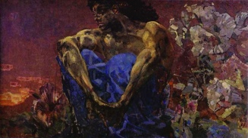
GUESS THE PAINTING
Fragment 17
Answers
The painting is called…
Demon Seated
Демон сидящий
It was created by…
Mikhail Vrubel
1890
It was painted in…
It is in the collection of…
The Tretyakov Gallery

Slide 37

GUESS THE PAINTING
Questions
What is this painting called in English? (1 point)
What is the Russian name of this picture? (1 point)
Who painted the picture? Do you remember the artist’s first name? (2 points)
When was the picture painted? (1 point)
Can you describe the picture? (3 points)
Fragment 18
8 points
If your team can’t answer a question, another team is allowed to answer it and get an extra point.
Если ваша команда не может ответить на один из вопросов, другим командам разрешается ответить на него и получить дополнительный балл.

Slide 38
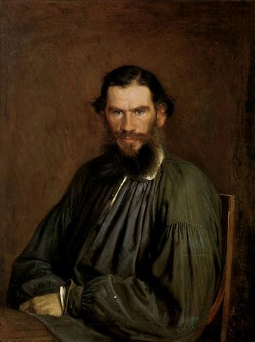
GUESS THE PAINTING
Fragment 18
Answers
The painting is called…
Portrait of Leo Tolstoy
Портрет Л.Н. Толстого
It was created by…
Ivan Kramskoy
1873
It was painted in…
It is in the collection of…
The Tretyakov Gallery

Slide 39
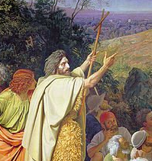
GUESS THE PAINTING
Questions
What is this painting called in English? (1 point)
What is the Russian name of this picture? (1 point)
Who painted the picture? Do you remember the artist’s first name? (2 points)
When was the picture painted? (1 point)
Can you describe the picture? (3 points)
Fragment 19
8 points
If your team can’t answer a question, another team is allowed to answer it and get an extra point.
Если ваша команда не может ответить на один из вопросов, другим командам разрешается ответить на него и получить дополнительный балл.

Slide 40
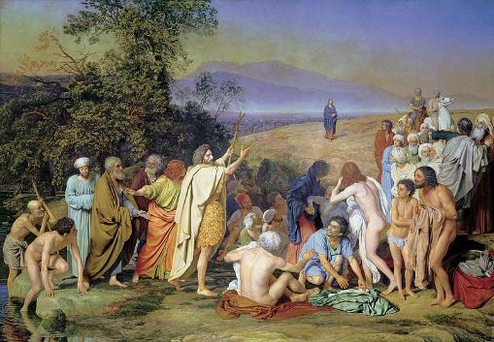
GUESS THE PAINTING
Fragment 19
Answers
The painting is called…
The Appearance of Christ before People
Явление Христа народу
It was created by…
Alexander Ivanov
1857
It was finished in…
It is in the collection of…
The Tretyakov Gallery

Slide 41

GUESS THE PAINTING
Questions
What is this painting called in English? (1 point)
What is the Russian name of this picture? (1 point)
Who painted the picture? Do you remember the artist’s first name? (2 points)
When was the picture painted? (1 point)
Can you describe the picture? (3 points)
Fragment 20
8 points
If your team can’t answer a question, another team is allowed to answer it and get an extra point.
Если ваша команда не может ответить на один из вопросов, другим командам разрешается ответить на него и получить дополнительный балл.

Slide 42
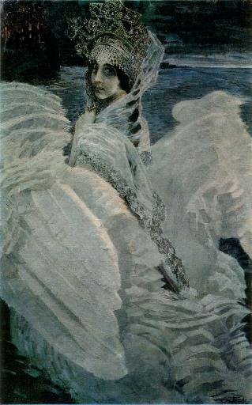
GUESS THE PAINTING
Fragment 20
Answers
The painting is called…
The Swan Princess
Царевна-Лебедь
It was created by…
Mikhail Vrubel
1900
It was painted in…
It is in the collection of…
The Tretyakov Gallery

Slide 43
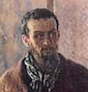
GUESS THE PAINTING
Questions
What is this painting called in English? (1 point)
What is the Russian name of this picture? (1 point)
Who painted the picture? Do you remember the artist’s first name? (2 points)
When was the picture painted? (1 point)
Can you describe the picture? (3 points)
Fragment 21
8 points
If your team can’t answer a question, another team is allowed to answer it and get an extra point.
Если ваша команда не может ответить на один из вопросов, другим командам разрешается ответить на него и получить дополнительный балл.

Slide 44
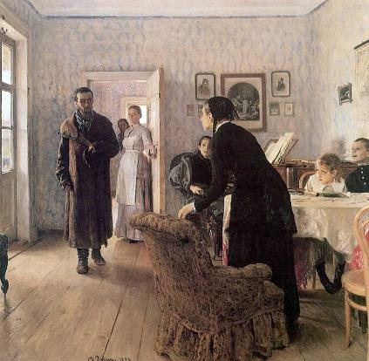
GUESS THE PAINTING
Fragment 21
Answers
The painting is called…
Unexpected Return
Не ждали
It was created by…
Ilya Repin
1888
It was painted in…
It is in the collection of…
The Tretyakov Gallery

Slide 45
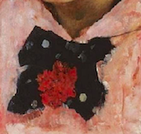
GUESS THE PAINTING
Questions
What is this painting called in English? (1 point)
What is the Russian name of this picture? (1 point)
Who painted the picture? Do you remember the artist’s first name? (2 points)
When was the picture painted? (1 point)
Can you describe the picture? (3 points)
Fragment 22
8 points
If your team can’t answer a question, another team is allowed to answer it and get an extra point.
Если ваша команда не может ответить на один из вопросов, другим командам разрешается ответить на него и получить дополнительный балл.

Slide 46
GUESS THE PAINTING
Fragment 22
Answers
The painting is called…
Girl with Peaches
Девочка с персиками
It was created by…
Valentin Serov
1887
It was painted in…
It is in the collection of…
The Tretyakov Gallery

Slide 47
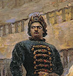
GUESS THE PAINTING
Questions
What is this painting called in English? (1 point)
What is the Russian name of this picture? (1 point)
Who painted the picture? Do you remember the artist’s first name? (2 points)
When was the picture painted? (1 point)
Can you describe the picture? (3 points)
Fragment 23
8 points
If your team can’t answer a question, another team is allowed to answer it and get an extra point.
Если ваша команда не может ответить на один из вопросов, другим командам разрешается ответить на него и получить дополнительный балл.

Slide 48
GUESS THE PAINTING
Fragment 23
Answers
The painting is called…
The Morning of the Execution of the Streltsy
Утро стрелецкой казни
It was created by…
Vasiliy Surikov
1881
It was painted in…
It is in the collection of…
The Tretyakov Gallery

Slide 49
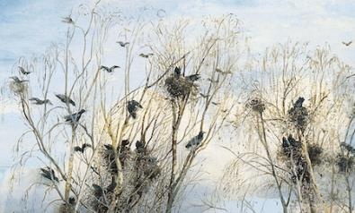
GUESS THE PAINTING
Fragment 24
8 points
Questions
What is this painting called in English? (1 point)
What is the Russian name of this picture? (1 point)
Who painted the picture? Do you remember the artist’s first name? (2 points)
When was the picture painted? (1 point)
Can you describe the painting? (3 points)
If your team can’t answer a question, another team is allowed to answer it and get an extra point.
Если ваша команда не может ответить на один из вопросов, другим командам разрешается ответить на него и получить дополнительный балл.

Slide 50
GUESS THE PAINTING
Fragment 24
Answers
The painting is called…
The Rooks Have Come
Грачи прилетели
It was created by…
Alexei Savrasov
1871
It was painted in…
It is in the collection of…
The Tretyakov Gallery

Slide 51
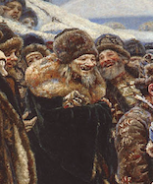
GUESS THE PAINTING
Questions
What is this painting called in English? (1 point)
What is the Russian name of this picture? (1 point)
Who painted the picture? Do you remember the artist’s first name? (2 points)
When was the picture painted? (1 point)
Can you describe the picture? (3 points)
Fragment 25
8 points
If your team can’t answer a question, another team is allowed to answer it and get an extra point.
Если ваша команда не может ответить на один из вопросов, другим командам разрешается ответить на него и получить дополнительный балл.

Slide 52
GUESS THE PAINTING
Fragment 25
Answers
The painting is called…
Boyaryna Morozova
Боярыня Морозова
It was created by…
Vasiliy Surikov
1887
It was finished in…
It is in the collection of…
The Tretyakov Gallery

Slide 53
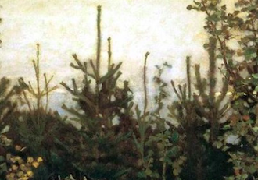
GUESS THE PAINTING
Questions
What is this painting called in English? (1 point)
What is the Russian name of this picture? (1 point)
Who painted the picture? Do you remember the artist’s first name? (2 points)
When was the picture painted? (1 point)
Can you describe the picture? (3 points)
Fragment 26
8 points
If your team can’t answer a question, another team is allowed to answer it and get an extra point.
Если ваша команда не может ответить на один из вопросов, другим командам разрешается ответить на него и получить дополнительный балл.

Slide 54
GUESS THE PAINTING
Fragment 26
Answers
The painting is called…
Alyonushka
Аленушка
It was created by…
Viktor Vasnetsov
1881
It was painted in…
It is in the collection of…
The Tretyakov Gallery

Slide 55



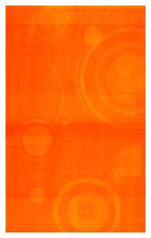

Каково ваше сообщение?

