Slide 1

ARE YOU A TRUE LINGUIST?

Slide 2

1. What is the study of languages?
А. PHONETICS
B. SYNTAX
C. LINGUISTICS
D. SEMANTICS

Slide 3
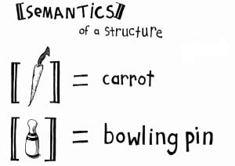
2. It is the study of the meaning of words and phrases.
А. PHONETICS
B. SYNTAX
C. LINGUISTICS
D. SEMANTICS

Slide 4
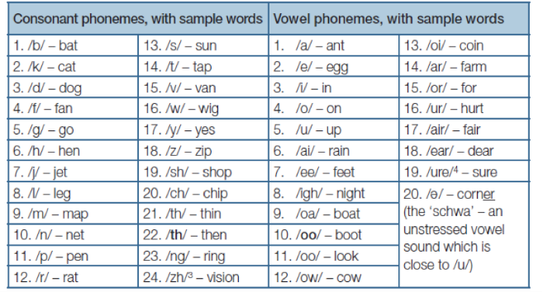
3. Phonetics is the study of the sounds. What do we call these sounds?
А. MORPHEMES
B. PHONEMES
C. SYNTAX
D. LEXICOLOGY

Slide 5
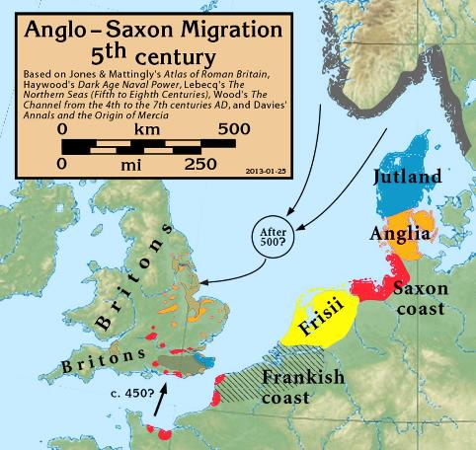
4. The English language begins with the Anglo-Saxons.
А. TRUE
B. FALSE

Slide 6
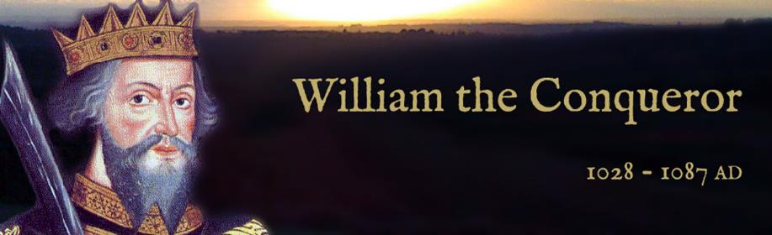
5. Julius Caesar, Duke of Normandy, invades and conquers England in 1066.
А. TRUE
B. FALSE
The Duke of Normandy is William the Conqueror.
He invaded and conquered England in 1066.

Slide 7
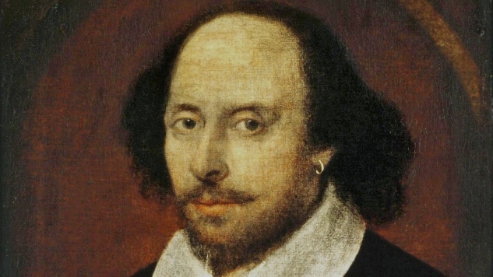
6. Shakespeare was born in 1464 and died in 1516.
А. TRUE
B. FALSE
William Shakespeare was born in 1564 and died in 1616.

Slide 8
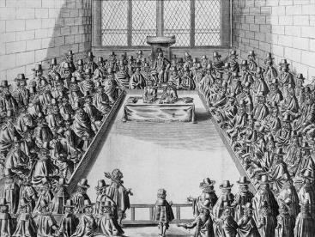
7. French replaced English as the language of law.
А. TRUE
B. FALSE
1362: English replaced French as the language of law. English is used in Parliament for the first time.
English replaced French as the language of law.

Slide 9
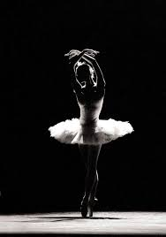
8. Which ones do not rhyme with ballet?
А. BILLET
|ˈbɪlɪt|
B. CHALET
|ˈʃaleɪ|
C. BOUQUET
|bʊˈkeɪ|
D. WALLET
|ˈwɒlɪt|
|ˈbaleɪ|

Slide 10
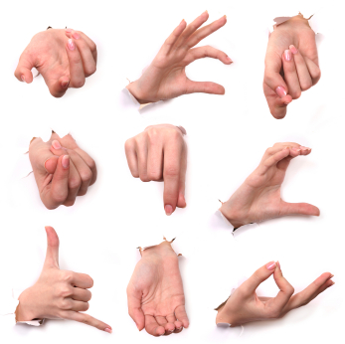
9. What language is this?
А. HAND LANGUAGE
B. ITALIAN LANGUAGE
C. SIGN LANGUAGE
D. NO LANGUAGE

Slide 11

10. Slang is most often created to
А. EXCLUDE OUTSIDERS
B. HIDE FROM PEOPLE IN POSITIONS OF POWER
C. ALL OF THE ABOVE

Slide 12
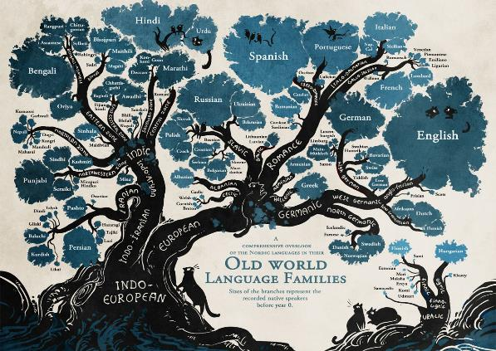
11. To which language group does English belong?
А. ROMANCE
B. GERMANIC
C. CELTIC
D. AMERICAN

Slide 13
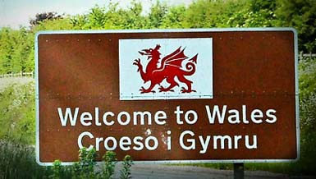
12. To which language group does Welsh belong?
А. ROMANCE
B. GERMANIC
C. SLAVIC
D. CELTIC

Slide 14
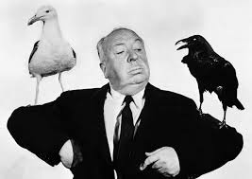
13. Which one of the following famous people is/was NOT a linguist?
А. J.R.R. TOLKEIN
B. NOAM CHOMSKY
C. ALFRED HITCHCOCK
D. YURI LOTMAN
Alfred Hitchcock was an English film director and producer.

Slide 15

14. What is meant by ‘etymology’?
А. THE STUDY OF THE NAMES GIVEN TO INSECTS
B. THE STUDY OF THE ORIGINS OF WORDS AND HOW THEY HAVE CHANGED OVER TIME
C. THE STUDY OF WORDS WHICH SOUND SIMILAR TO ONE ANOTHER
D. THE STUDY OF LANGUAGE POLITENESS

Slide 16

15. What is the term given to the study of language and society?
А. SOCIALISM
B. BILINGUALISM
C. SOCIOLINGUISTICS
D. PRAGMATISM

Slide 17
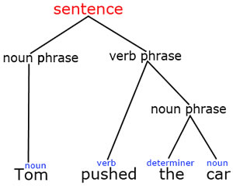
16. Which of the following definitions best explains the term ‘syntax’?
А. THE USE OF CORRECT (STANDARD) GRAMMAR
B. A STRUCTURE OR FORM OF INDIVIDUAL WORDS
C. A FINE FOR PEOPLE WHO BREAK LANGUAGE RULES
D. THE ARRANGEMENT OF WORDS AND PHRASES TO MAKE WELL-FORMED SENTENCES

Slide 18
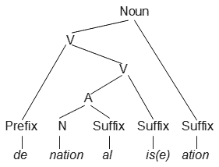
17.Which of the following definitions best explains the term ‘morphology’?
А. THE STUDY OF DIALECTS
B. THE STUDY OF THE FORMS OF WORDS
C. THE TENDENCY TO ABBREVIATE LONG WORDS

Slide 19
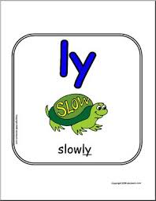
18. Which part of speech is ‘QUICKLY’ in the phrase ‘he drove quickly to her house’?
А. AN ADVERB
B. AN ADJECTIVE
C. A VERB
D. A PREPOSITION

Slide 20
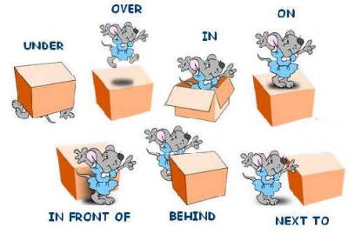
19. Which part of speech is ‘TO’ in the phrase ‘he drove quickly to her house’?
А. A NOWN
B. AN ADVERB
C. A VERB
D. A PREPOSITION

Slide 21
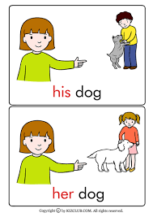
20. Which part of speech is ‘HER’ in the phrase ‘he drove quickly to her house’?
А. AN ADVERB
B. AN ADJECTIVE
C. A POSSESSIVE DETERMINER
D. A PREPOSITION

Slide 22




21. From which language were the following borrowed: ‘government’, ‘peasant’, ‘prisoner’?
А. GERMAN
B. FRENCH
C. GREEK
D. KLINGON

Slide 23
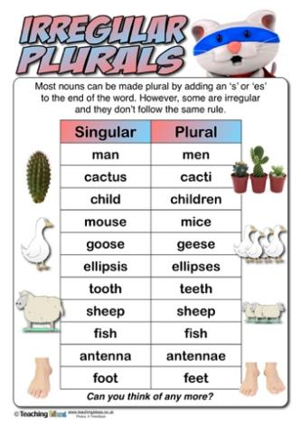
22.Which term best describes the irregular plurals ‘men’ and ‘oxen’?
А. OXYMORONS
B. IRREGULAR PLURAL NOUNS
C. IRREGULAR VERBS
D. INCORRECT WORD FORMATIONS

Slide 24
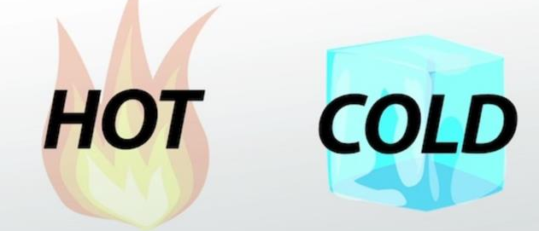
23.What is an ‘antonym’?
А. A WORD OPPOSITE IN MEANING TO ANOTHER
B. A WORD WHICH IS SUBSTITUTED FOR ANOTHER TO SOFTEN THE EFFECTS OF A MORE UNPLEASANT-SOUNDING TERM
C. A WORD WITH THE SAME MEANING AS ANOTHER

Slide 25
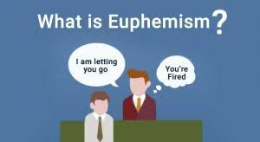
24.What is a ‘euphemism’?
А. A WORD USED TO ADDRESS A MEMBER OF THE YOUNGER GENERATION
B. A WORD WHICH IS SUBSTITUTED FOR ANOTHER TO SOFTEN THE EFFECTS OF A MORE UNPLEASANT-SOUNDING TERM
C. A WORD WITH THE SAME MEANING AS ANOTHER
‘Pass away’ is а euphemism for ‘die’.

Slide 26
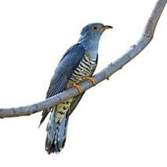
25.What is ‘onomatopoeia’?
А. PIGEON
B. DODO
C. CUCKOO
D. DUCK
Onomatopoeia – the use of words that sound like the thing that they describe, for example ‘hiss’ or ‘boom’.

Slide 27
ARE YOU A TRUE LINGUIST?
A TRUE
LINGUIST
20-25 CORRECT ANSWERS
A GOOD STUDENT
15-19 CORRECT ANSWERS
MUST BE GOOD AT MATHS
10-14 CORRECT ANSWERS
SEE YOU AT THE GYM
0-9 CORRECT ANSWERS

Slide 28
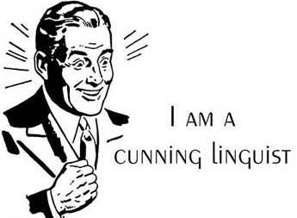
A TRUE LINGUIST
20-25 CORRECT ANSWERS

