Slide 1
ОБУЧЕНИЕ ЧТЕНИЮ НА УРОКАХ АНГЛИЙСКОГО ЯЗЫКА С ИСПОЛЬЗОВАНИЕМ ЦИФРОВОГО РЕСУРСА TWEE
Байшева Галина Генадьевна,
учитель английского языка
Логвенчева Вера Николаевна,
учитель английского языка

Slide 2

ЧТЕНИЕ
ФУНКЦИОНАЛЬНОЕ ЧТЕНИЕ
ЧИТАТЕЛЬСКАЯ ГРАМОТНОСТЬ

Slide 3
УМЕНИЕ ЧИТАТЬ
владение техникой чтения,
узнавание зрительных образов речевых единиц и озвучивание их во внутренней или внешней речи
мгновенное соотношение лексических единиц и грамматического оформления с их значением

Slide 4
ЗАДАЧИ
увеличивать оперативную единицу восприятия текста
учить воспринимать текст с одноразового восприятия
учить восприятию и узнаванию новых сочетаний известных, изученных единиц
развивать скорость чтения (про себя)
развивать содержательную и структурную антиципацию
развивать языковую догадку, то есть умение догадываться о значении неизвестных единиц по разным признакам
учить мгновенно соотносить форму со значением
развивать логико-смысловое восприятие текстов разного характера
развивать умение игнорировать неизвестное, при условии, что оно не мешает пониманию в целом

Slide 5
ВИДЫ СМЫСЛОВОГО ЧТЕНИЯ
1
2
3
изучающее чтение (intensive reading)
просмотровое
(skimming reading)
поисковое
(scanning reading)
просмотреть и понять основную мысль
просмотр с целью поиска ответа на запрашиваемую информацию
чтение с полным пониманием

Slide 6

ТРЕБОВАНИЯ К МАТЕРИАЛАМ
Просмотровое чтение - тексты, содержащие до 3% неизвестных слов
Изучающее чтение – тексты, содержащие не более 6% незнакомых явлений

Slide 7
МЕТОДИКА РАБОТЫ С ТЕКСТАМИ
Содержательная и структурная антиципации
Языковая догадка
Логическое понимание

Slide 8
УПРАЖНЕНИЯ
Содержательная идентификация
- найти в прочитанном тексте предложения, схожие по содержанию с данными
- определить, соответствуют ли данные предложения содержанию текста
- выбрать предложения из данных, которые соответствуют содержанию текста
- определить, из каких высказываний они взяты
- найти в тексте предложения, которые уточняют или расширяют данные высказывания

Slide 9
УПРАЖНЕНИЯ
Содержательный поиск
- найти предложения, которые подтверждают…
- найти что-то, характеризующее…
- найти причины того, что…
- найти проблемы, волнующие….
- найти ответы в тексте
- определить, насколько полно данный план передаёт содержание

Slide 10
УПРАЖНЕНИЯ
Смысловой выбор
- выбрать подходящее заглавие из данных
- выбрать в соответствии с содержанием правильный ответ из предложенных
- выбрать по одной фразе из абзацев, передающей смысл
- выделить смысловые куски текста и озаглавить их
- дать характеристику обстоятельств, при которых происходят действия героев
- кратко изложить суть текста в письменной форме
- сократить число предложений за счёт удаления малоинформативных, оставив те предложения, которые передают смысл текста
- своими словами передать основной смысл текста

Slide 11
многократное, коммуникативно-оправданное обращение к тексту
последовательное выполнение трёх групп упражнений
отсутствие необходимости в открытом контроле

Slide 12
TWEE
вопросы, диалоги, истории, письма, статьи, вопросы с несколькими вариантами ответов, верные/ложные утверждения
генерация вопросов для обсуждения, фактов и цитат известных людей
мозговой штурм словарного запаса
функции для чтения, письма, аудирования, разговорной речи и грамматики
упражнения на заполнение пробелов и раскрытие скобок
создание текстов, эссе, видеотранскрипты

Slide 13
Проблема урока:
The first letter to a pen-friend.
LESSON 1
Речевая подготовка:
Many children live in small families. They haven’t got any sisters or brothers. But they have friends.
Is your family big or small?
Have you got any sisters or brothers?
Have you got many friends?
How much time do you spend with your friends?
Would you like to have pen-friends?

Slide 14
EX. 1
Susan, from the USA, wants to find out a pen-friend in Russia. She wrote a letter and put a photo of her family. Read the letter and complete the information about Susan’s family members.
Tony is Susan’s ………...
…………… is her mother.
…………… and …………… are Tony’s ……………
Jack is children’s …………….
……………. Is Susan’s sister.
V

Slide 15
Hello, guys!
It's great to have a pen friend. My name is Susan. I'm really happy to write to you and tell you about my family.
I'm a student and I live with my family in Maryland, USA. I'm short and slim with long brown hair and green eyes. My brother's name is Tony. He's six years old. He's got short fair hair and blue eyes. He's too noisy. Louise, my sister, is tall with blonde hair and blue eyes. She is an attractive girl of seventeen.
My mother's name is Rose. She's thirty-nine years old and she's a dentist. She's not tall, she's very pretty, kind and friendly. She's got curly brown hair and brown eyes.
My dad's name is Jack. He's forty-two years old and he's a teacher of English. He's quite tall and he's got short fair hair and green eyes. He's very clever.
This is a picture of all of us in the garden. There's my dad, my mum and my sister in the centre. My brother and me are sitting on the bench.
Please write me soon, tell me about your family and send me a photo of all of you. Have you got any brothers or sisters? What about your family members’ occupations? Have you got any pets? What's your favourite sport? What's your favourite music?
Susan.

Slide 16
EX. 2
In her letter Susan finds describes the appearance of her family members. Look through the letter again and find the sentences which describe Susan, her mother, father, sister and brother.
EX. 3
a) Susan’s family members have got different occupations. Look at these pictures and try to guess who these things belong to. Why do you think so?
Use the example: I think these things belong to……..., because ……...
V

Slide 17



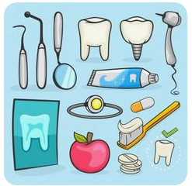


Slide 18
EX. 4
Susan is not tall and not fat.
Her father teaches students.
Her mother is Rose.
Susan’s brother is six.
Susan’s hair is not short.
Her eyes are green.
She doesn’t work, but study.
Tony’s her brother.
His hair is blond and his eyes are blue.
Tony likes to make noise.
Susan’s sister is beautiful.
Her mother’s hair is not straight.
The picture of Susan’s family is taken in the garden.
What do you know about Susan’s family? To check yourself scan the letter, find and read out the sentences which are close in meaning to the following ones.
Homework:
Answer the questions from Susan’s letter.

Slide 19
LESSON 2
EX. 1
Let’s start our lesson with checking your home task.
So, answer the questions.
There’s one more letter. It is from Mark. He is from England. Read his letter. Is it more interesting? What makes it more interesting? Will he find a pen-friend quicker than Susan? Why?

Slide 20
02
43, St Catherine Street
Castleford, GB
WF10
England
Hi friends, my name's Mark and I'm 17 years old. I live in a small town called Castleford, which is near Leeds in England. I'm a student at Castleford High School. I'm quite tall and slim with short dark hair and brown eyes.
There are five of us in my family - my parents, Steve and Kate, my sister, Liz, aged nine, my brother, Leo, aged six, my dog and of course, me! My father is a doctor. He works at the local hospital and my mother is a teacher in a primary school. We live in a big house about 20 minutes from the city centre. It's near a park and a swimming pool, so we go there a lot in the summer.
In my free time I like playing computer games, watching TV and listening to rock music. My favourite band is One Direction. They're fantastic! I am an MTV maniac. I also love going to the cinema and going out with my friends. My best friend is Dave. He's really funny and we have the same interests. We often go to the cinema on Saturdays. I don’t like going to the theatre, though.
I love travelling, indeed. I'd like to visit my grandparents' house one day. It's in a small town near Vancouver in Canada. That would be cool! I can speak a little bit of French, but not very well. I'd love to have a pen friend from Russia and learn to speak Russian a little. I've never been there, but I think it's really interesting. I'd like to know more about the country, its people and culture. I hope you can understand this letter! Do you speak English? Can you tell me about your family and your town? What do you like doing in your free time? Do you have any brothers or sisters? I’m looking forward to hearing from you soon.
Best wishes,
Mark
PS Can you send me a photo of you and your family?

Slide 21
EX. 2
Find in Mark’s letter and read out the sentences which describes his likes. Would you like to have such a pen-friend? Why? Choose the information which proves that you have got some common interests?
EX. 3
What do you know about Mark and his family? Scan the letter again and find the sentences which can enlarge the following ones:
1) Mark has got a big family.
2) His parents have got different occupations.
3) Mark likes doing different things.
4) Mark is attractive.
V

Slide 22
EX. 4
Which letter do you find more informative? Compare their families.
Whose family is bigger? Why?
How old are their sisters and brothers?
What are their fathers’ occupations?
What about their mothers?
What do they say about their family members’ appearance?
Homework: Answer these questions in written form.

Slide 23
LESSON 3
a) Look at the outlines of Louise’s and Mark’s letters. Restore the letters cut into pieces according to their outlines.
EX. 1
Address.
Greeting.
Mark’s age and appearance.
Family members introduction.
Mark’s father.
His mother.
Mark’s family house
His interests.
Greeting.
Susan’s appearance.
Her occupation.
Susan’s brother.
Her sister.
About her mother.
About her father.
Farewell words.
Farewell words
So, who would you like to write to? What would you like to write about?
b) Make up and write down the outline of your own letter.

Slide 24
LESSON 3
Номе task. Using your outline write about you and your family, describe your family members so that to find a pen-friend in the Internet.
EX. 2

Slide 25
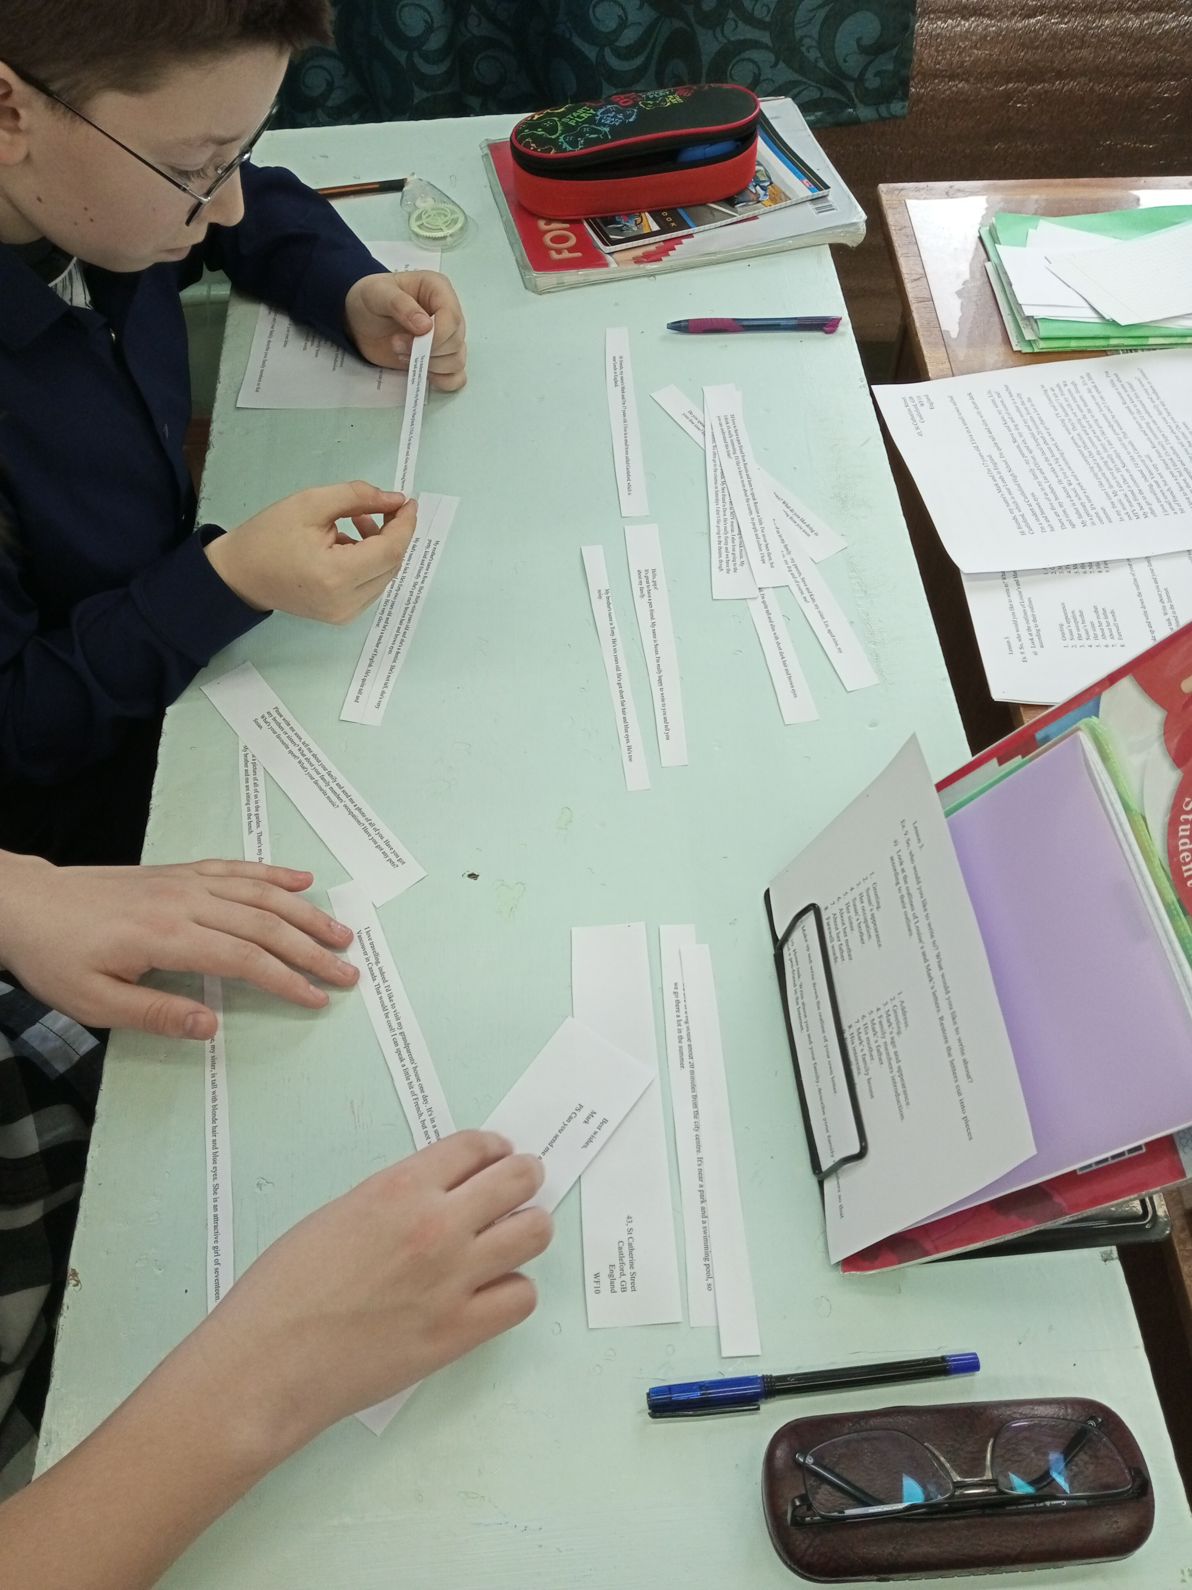
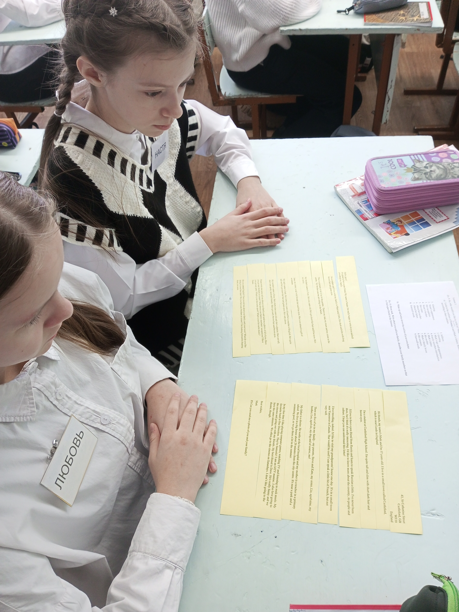
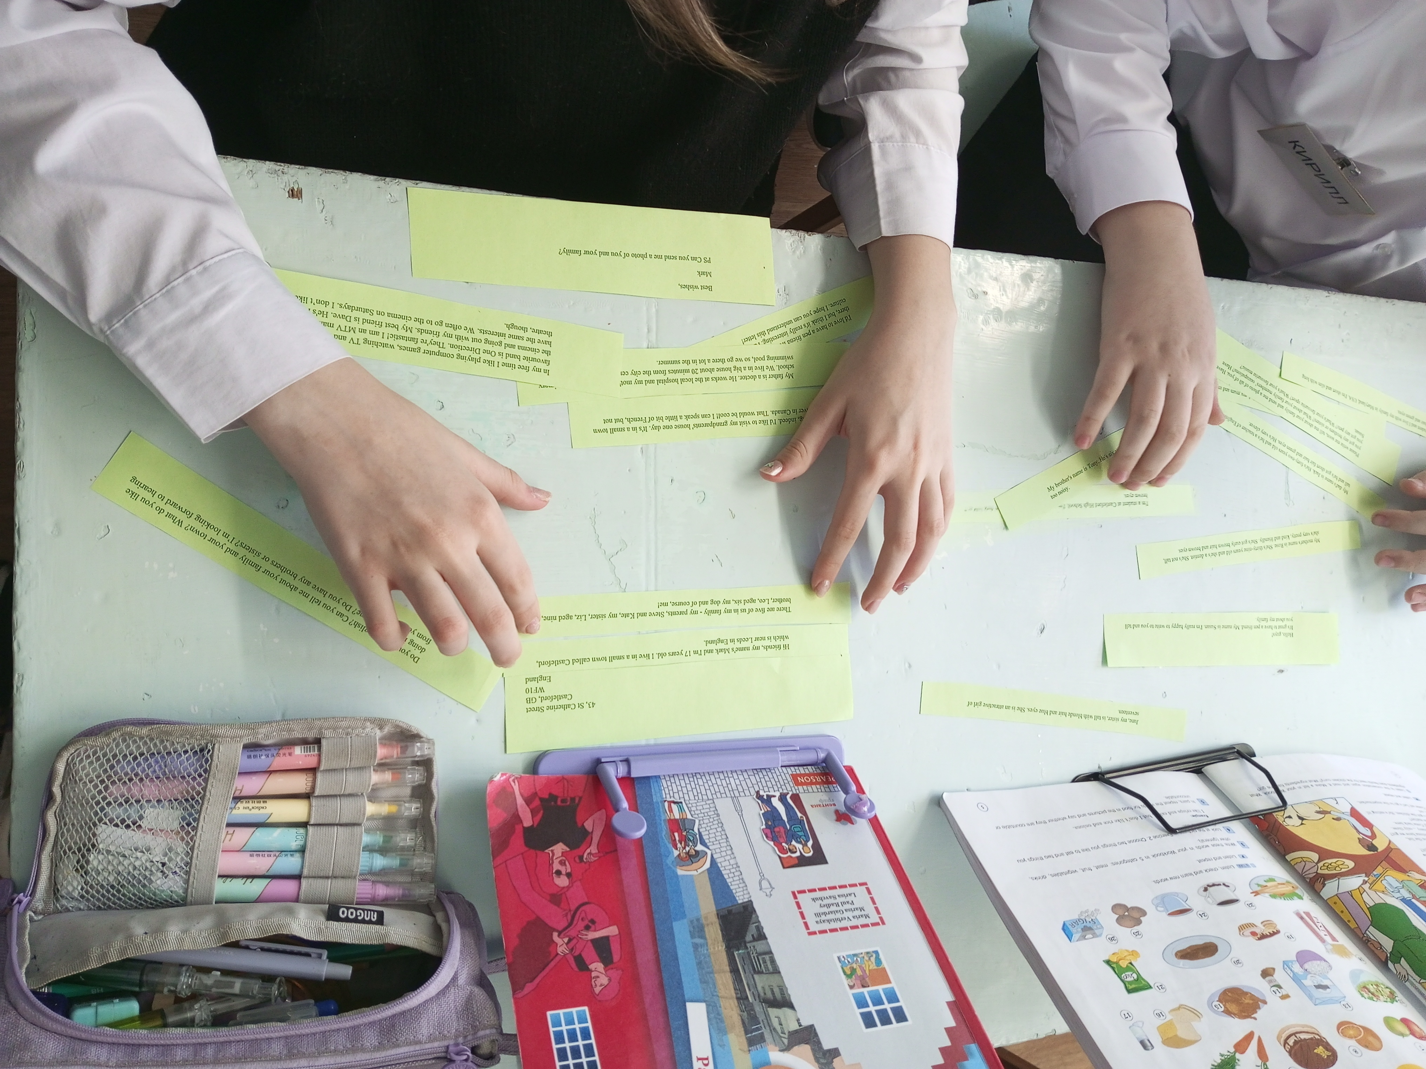

Slide 26
