Slide 1

visual arts

Slide 2
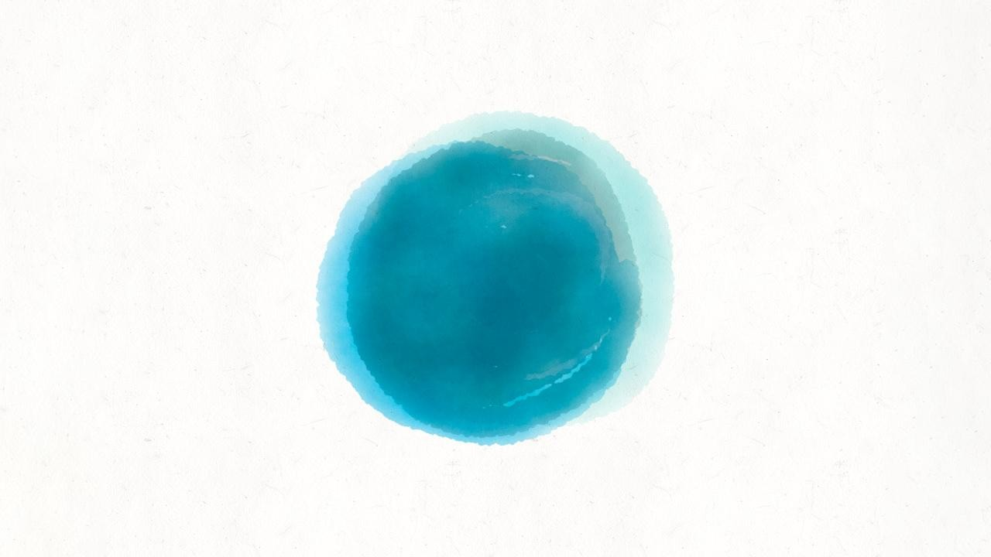
what is art?

Slide 3

something that people“feel has value because it is beautiful or expresses ideas

Slide 4

“
paintings, drawings, and sculptures that are created to be beautiful or to express ideas

Slide 5
“
Watch a short video answering the question «What is art?» Write down the main points
https://www.youtube.com/watch?v=QZQyV9BB50E&t=1s

Slide 6

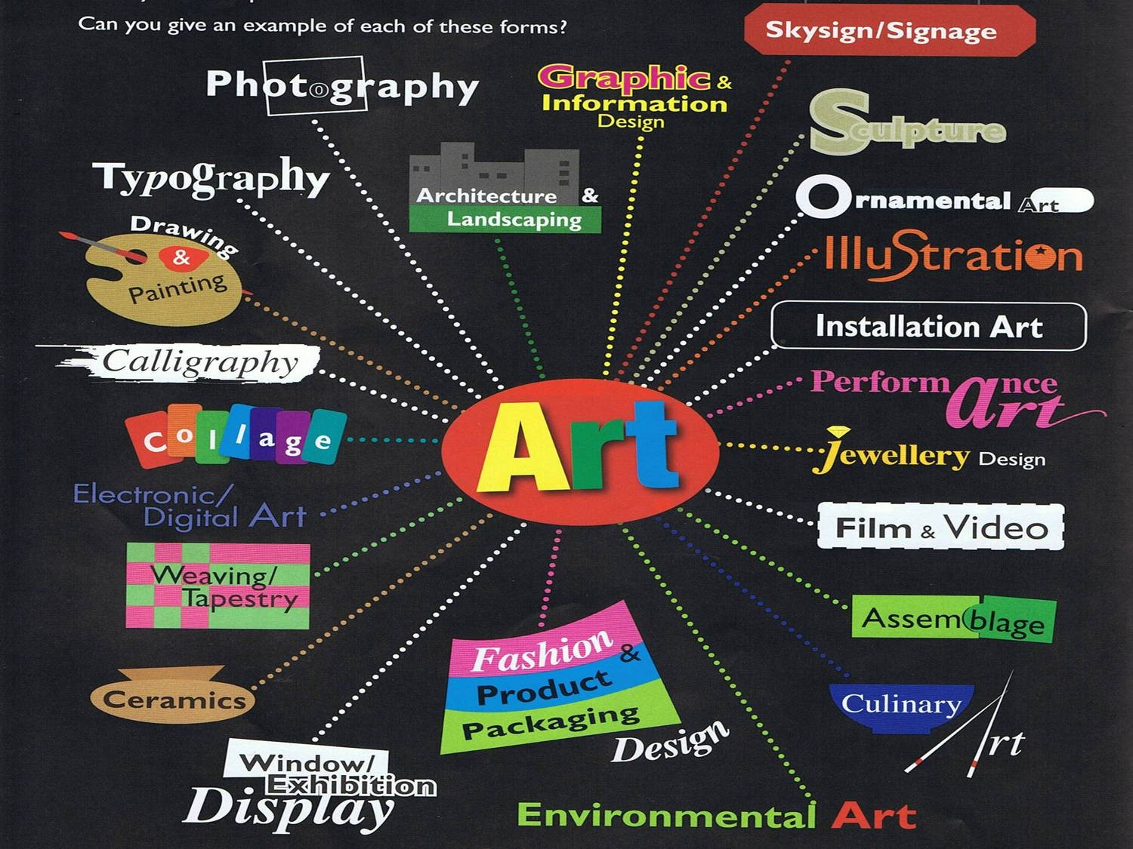

Slide 7
D i s c u s s t h e q u e s t i o n s
▸ Are you interested in art? If yes, what kind of?
▸ Do you visit museums or galleries? Read news, books about art?
▸ Have you ever tried to create a work of art by yourself?
▸ Do you know any famous paintings?
▸ What is the most famous painting in the world?

Slide 8
“
Visual arts - types of art in which you make something for people to look at, for example painting, drawing, and photography.

Slide 9

Match the words and the definitions
a painter
a studio
a model
a palette
a masterpiece
a sketch
a brush
a. a thin board on which a painter lays and mixes his colours
b. a rough, quickly made drawing
c. a well-lit workroom of a painter or sculptor
d. a thing to paint with
e. something made or done with very great skill
f. a person who paints pictures
g. a person who poses for painters and sculptors

Slide 10
fill in the gaps
1. The s- was a large well-lit room.
2. A man sitting on a raised platform is a m-
.
3. The a- was mixing p- on his p- .
4. Michelangelo took his b- and drew a rough s- of the scene.

Slide 11

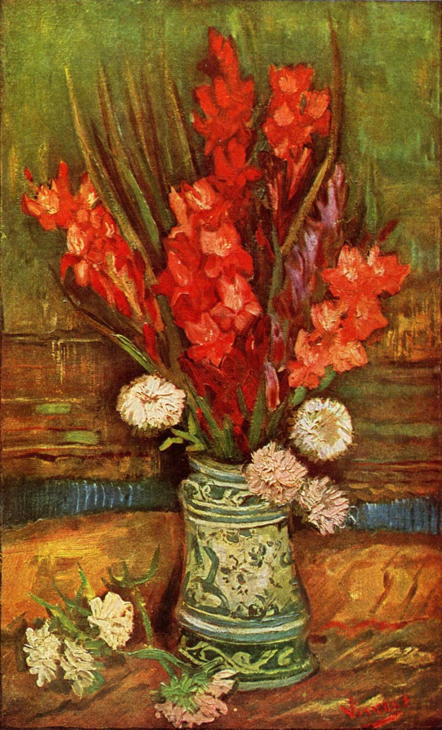
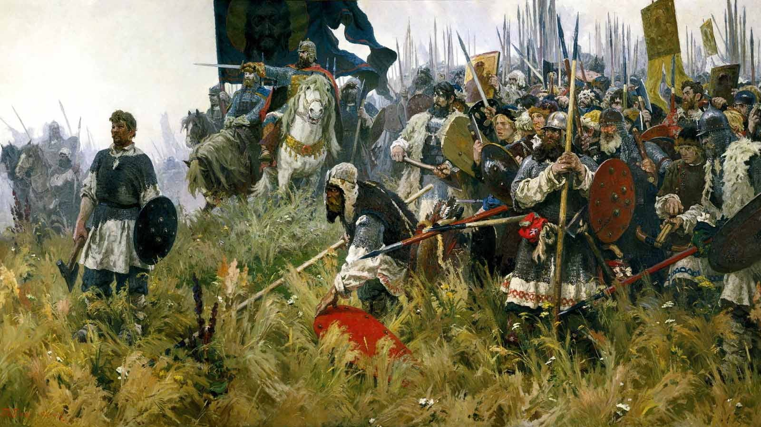
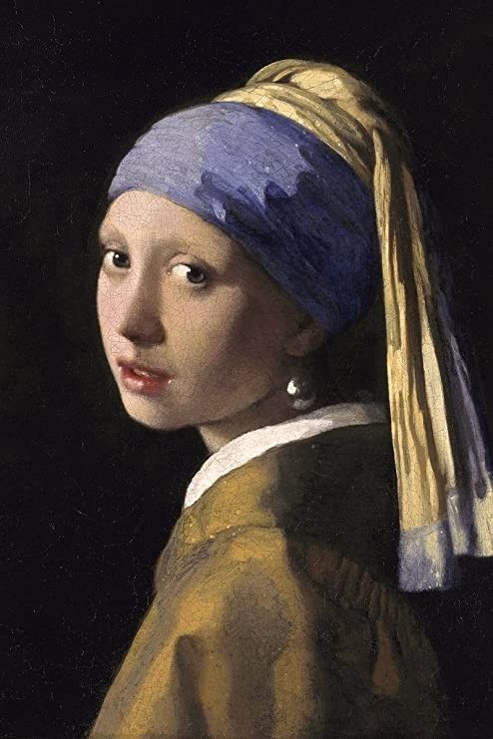
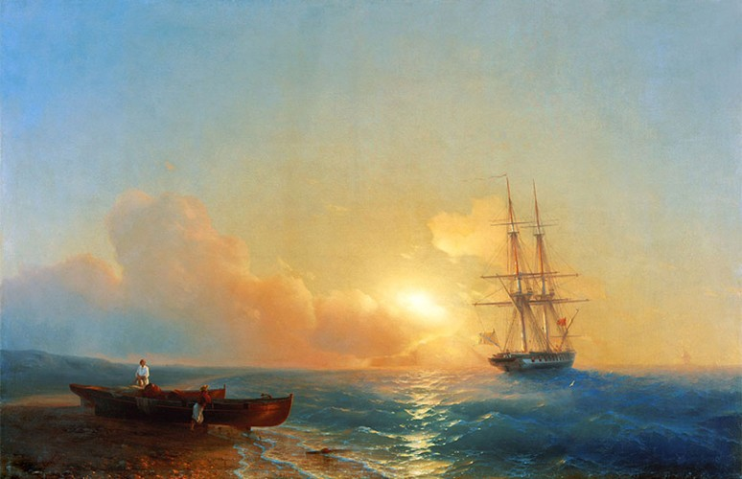
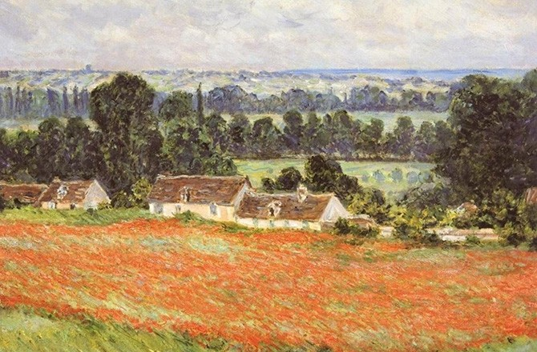
Match the pictures and the words
3
a landscape
a still life
a portrait
a seascape e)
4
a battle piece
2
5
1
11

Slide 12
Match the underlined words with the definitions
Not realistic abstract_
A picture showing an expanse of scenery.
▸
▸
▸
▸
still life portrait landscape the
Impressionists
abstract monochrome cubist
3 Painters who used colour to capture the feeling of a scene rather than specific details. ___
4 Of one colour or shades of one colour
5 Picture of a person
6 A style of art that depicts objects as geometric shapes that are seen from many different angles at the same time _________
7 A picture of inanimate everyday objects ____
▸
▸
▸
▸
▸

Slide 13
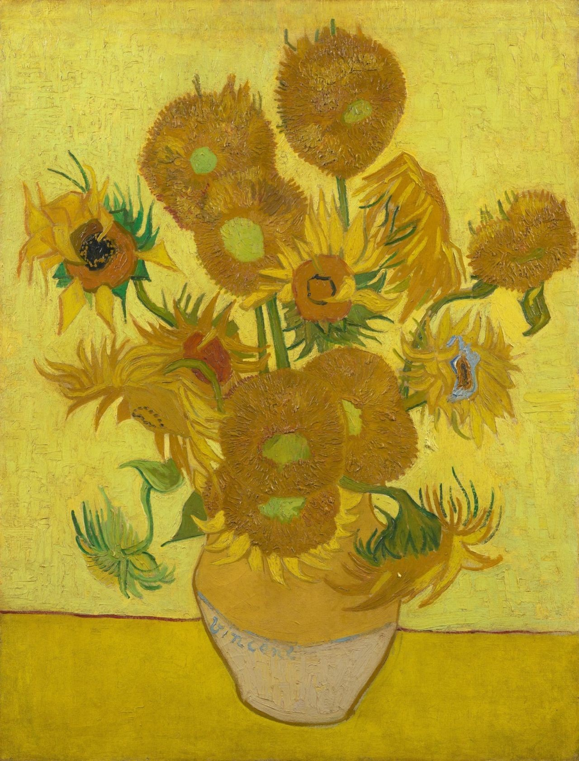
Fill in the gaps with the correct word describing the painting
▸ This painting of flowers in a vase is one of the artist’s most recognisable works.
▸ still life
▸ portrait
▸ landscape
▸ the Impressionists
▸ abstract
▸ monochrome
▸ cubist

Slide 14
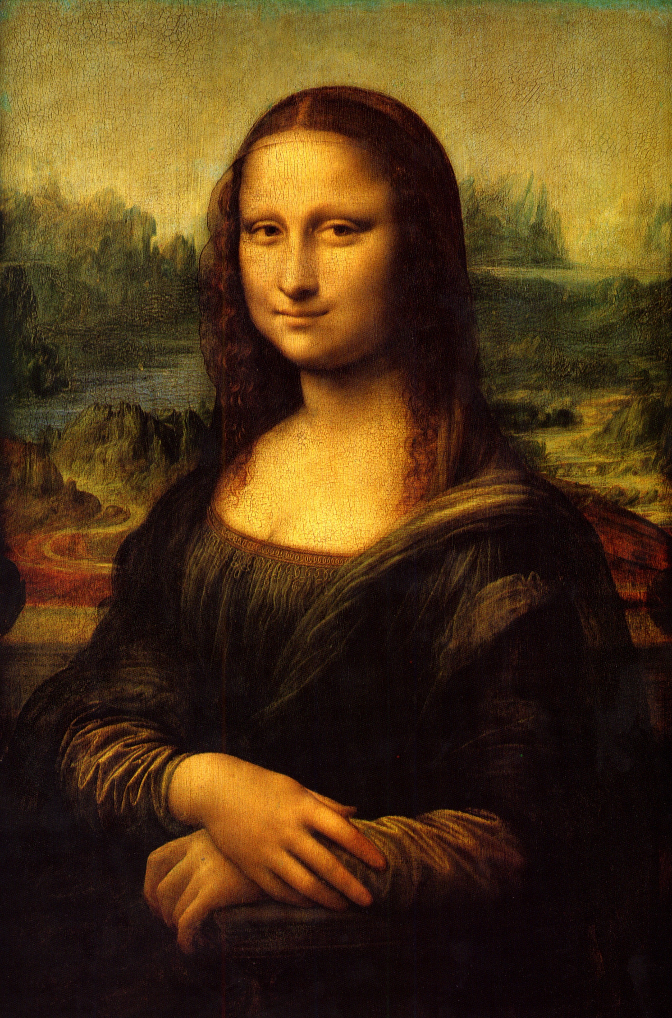
Fill in the gaps with the correct word describing the painting
▸ still life
▸ portrait
▸ landscape
▸ the Impressionists
▸ abstract
▸ monochrome
▸ The enigmatic smile of this has captured the imagination of the world. It has been stolen twice and now it is displayed
in the Louvre, Paris.
▸
cubist

Slide 15
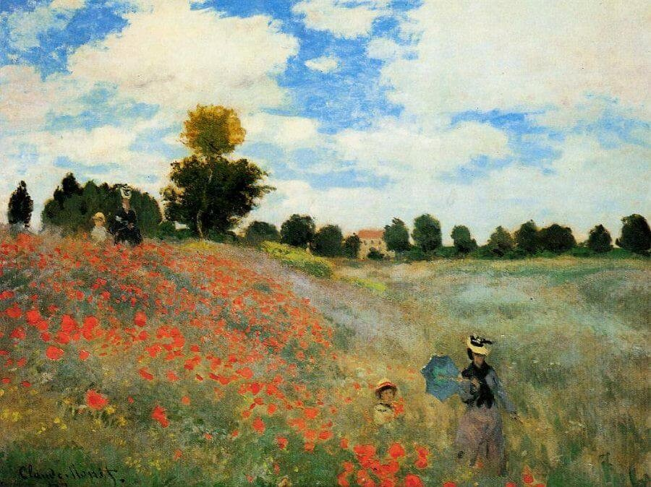
Fill in the gaps with the correct word describing the painting
▸ This shows how depict the beauty and simplicity of nature.
▸ still life
▸ portrait
▸ landscape
▸ the Impressionists
▸ abstract
▸ monochrome
▸
cubist

Slide 16
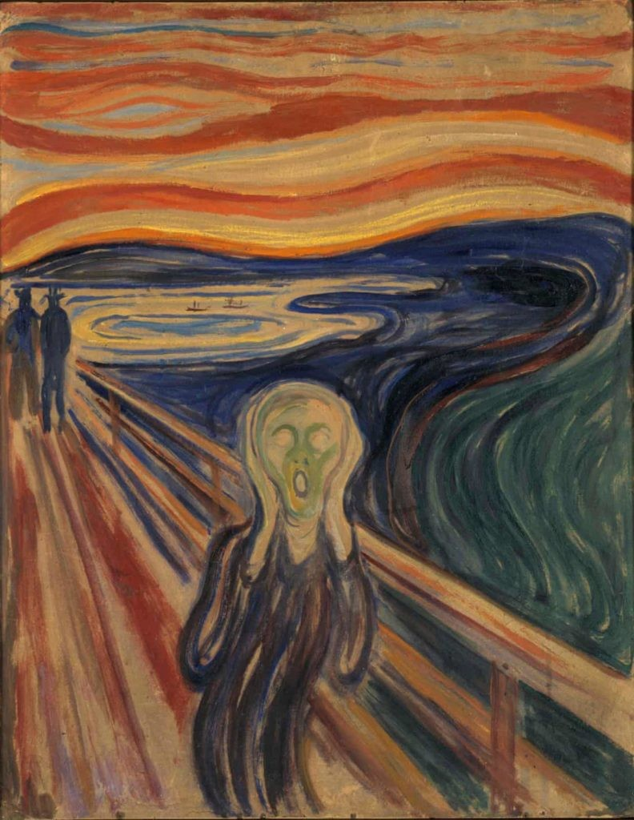
Fill in the gaps with the correct word describing the painting
▸ still life
▸ portrait
▸ landscape
▸ the Impressionists
▸ abstract
▸ monochrome
▸ cubist
▸ This is an painting that symbolises the
anguish and pain of modern life.

Slide 17
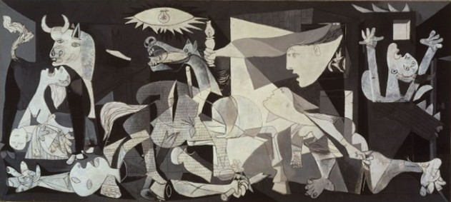
Fill in the gaps with the correct word describing the painting
▸ This painting has become a
reminder of the tragedies of war, an anti- war symbol, and an embodiment of
▸ still life
▸ portrait
▸ landscape
▸ the Impressionists
▸ abstract
▸ monochrome
▸ cubist
peace. The painter is famous for his style.

Slide 18
Can you complete the names the artists who painted them?
Vincent van Gogh
Pablo Picasso
Claude Monet
Leonardo da Vinci
Edvard Munch
1. Mona Lisa
2. The Scream
3. Sunflowers
4. Guernica
5. Poppies in a Field

Slide 19
complete the description with the words in the box
In the foreground 1 a man standing on a bridge. He 2 he is screaming.
His face is expressing surprise and fear. His mouth is open in an ‘O’ shape, his eyes are wide open and his hands are on his bald head. In the 3 , on the 4 ,
two people walking towards him but they don’t look worried. The sky is blood red and beneath the bridge, a blue river
flowing to the sea.
▸ background
▸ left-hand side
▸ looks like
▸ seems to be
▸ there are
▸ there is

Slide 20
HOW TO DESCRIBE A WORK OF ART?
Form:
What colours does the artist use?
What kind of shapes and forms can you find?
Context:
What do you know about the artist?
How does the work relate to other art of the time?
Content:
What is happening?
What message does it communicate?
Mood:
How does the work make you feel?
Does the colour, texture, form or theme of the work affect your mood?
Does the work create an atmosphere?

Slide 21

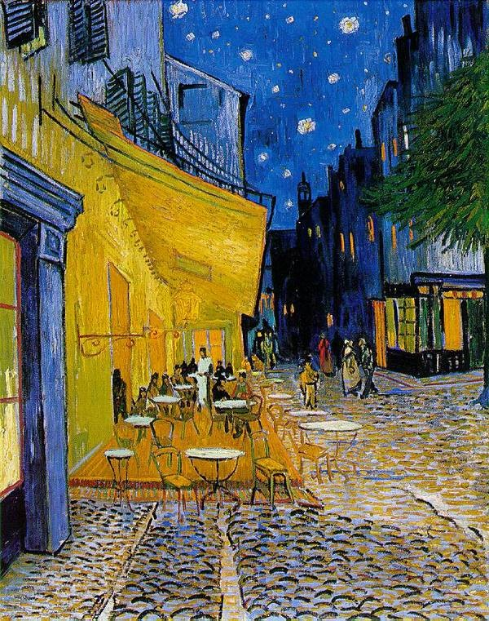
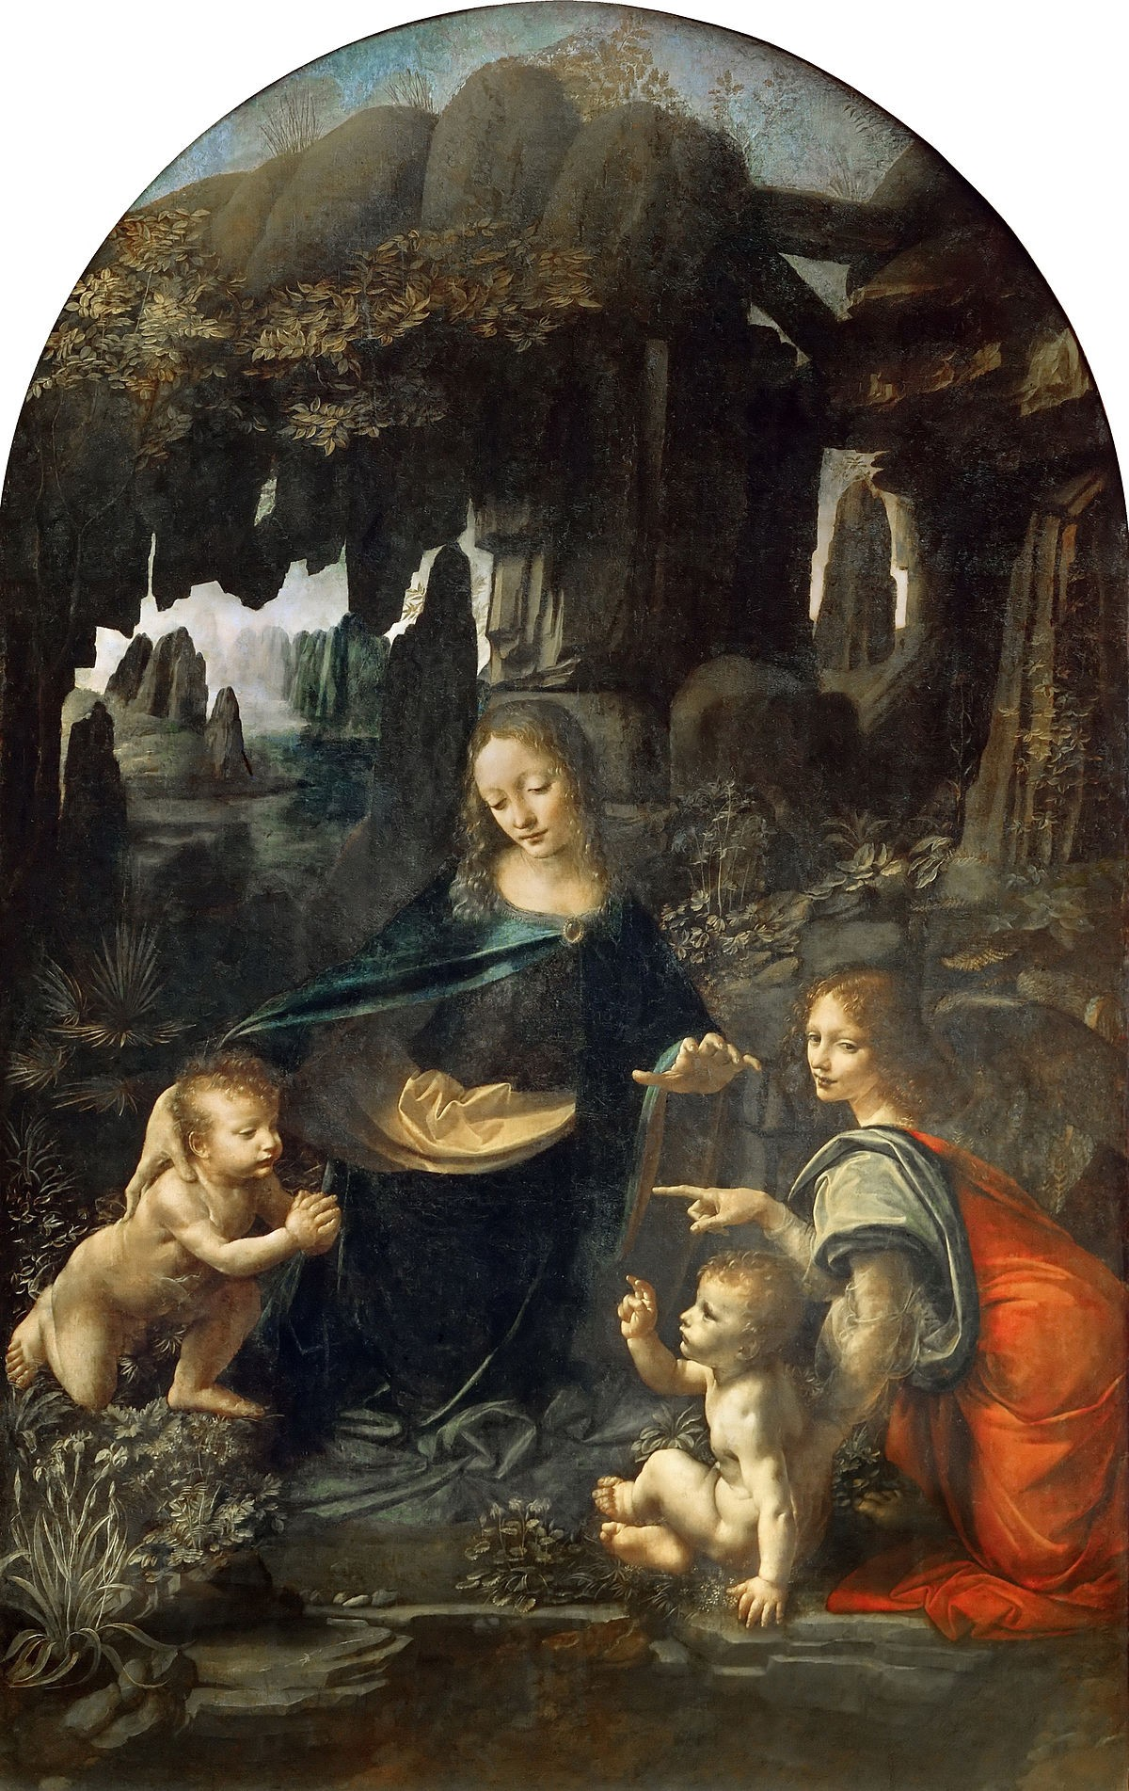

Slide 22
Thank you! Any questions?

Slide 23
Lesson plan“by Alexandra Voropaeva https://t.me/bi_fluency
▸
▸

