Slide 1
ГБОУ школа №246 Приморского района Санкт-Петербурга
Презентация к уроку английского языка на тему:
«Special days.Celebrations.»
Выполнена: учителем английского языка Кондрашкиной Светланой Владимировной.
2024 год

Slide 2
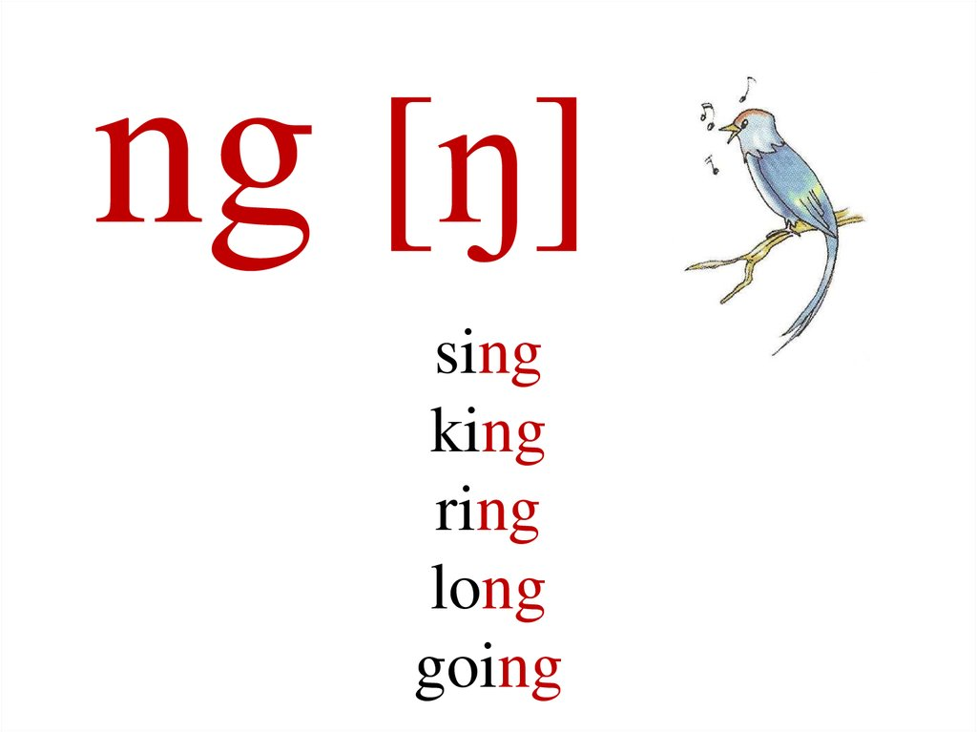
Celebrations
It’s lovely spring!
And birds begin to sing!
The sun is very high.
It’s smiling in the sky!
It’s lovely spring!
And all the children sing.
They sing a merry song.
They sing:”Ding-dong”!

Slide 3
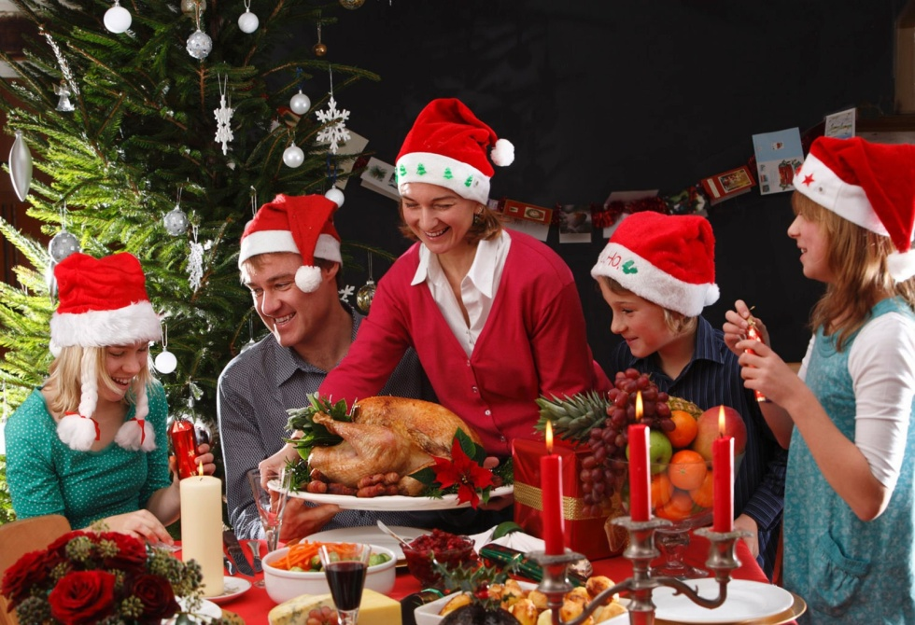

Celebrations
we’ll talk about popular celebrations in different countries;
We’ll talk about the variety of festivals and what we would like to do while celebrating a festival.

Slide 4
Name the words you associate with the word FESTIVAL
New Year Christmas
Songs games
Decorate parades presents
FESTIVALS

Slide 5

1.What is your favourite festival?
My favourite festival is…..
2.Why do you like it?
I like it because…………
3. Which of the activities do you do at the festivals?
Do you dance? Do you sing songs? Do you make any food?

Slide 6
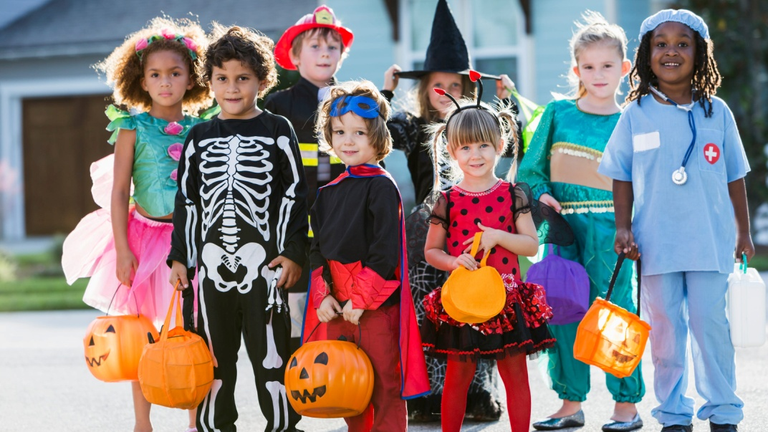
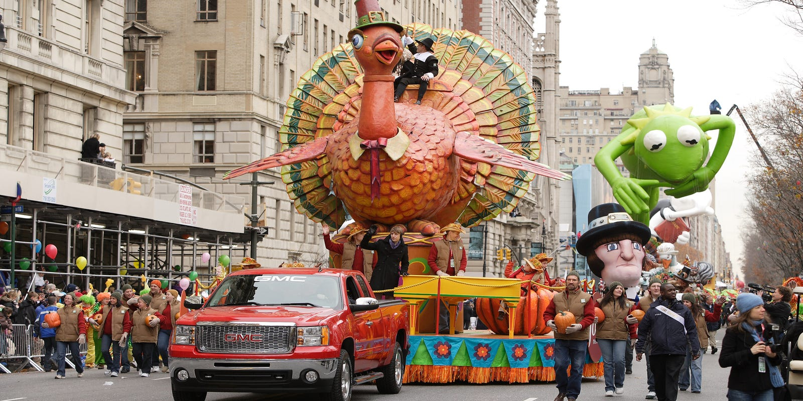
New words for you.
Dress up
Have street parades

Slide 7
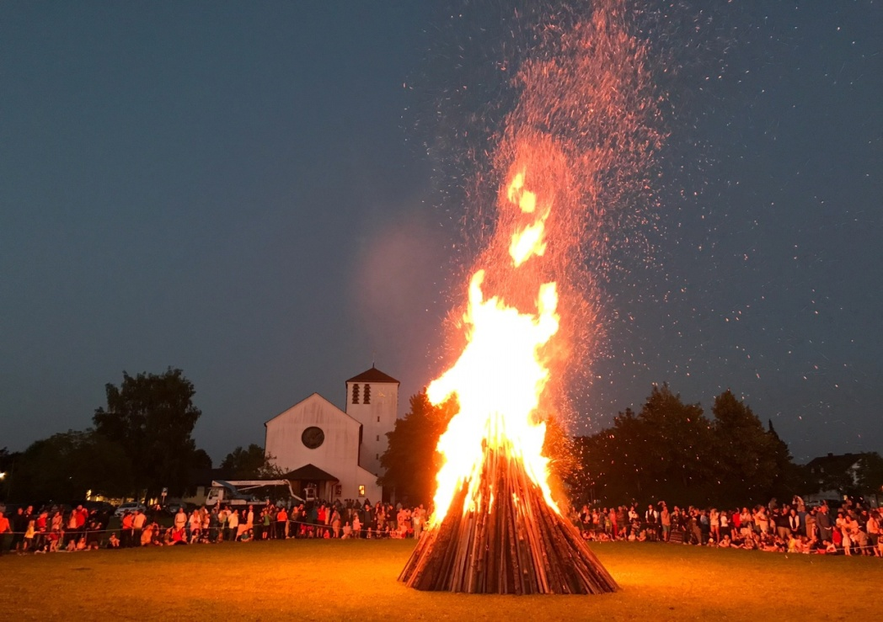
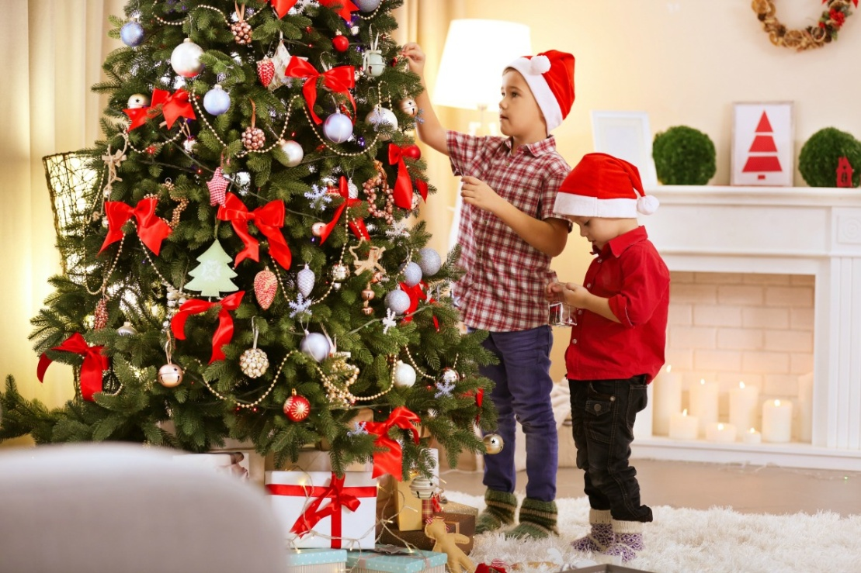
.
Light bonfires
Decorate the house

Slide 8
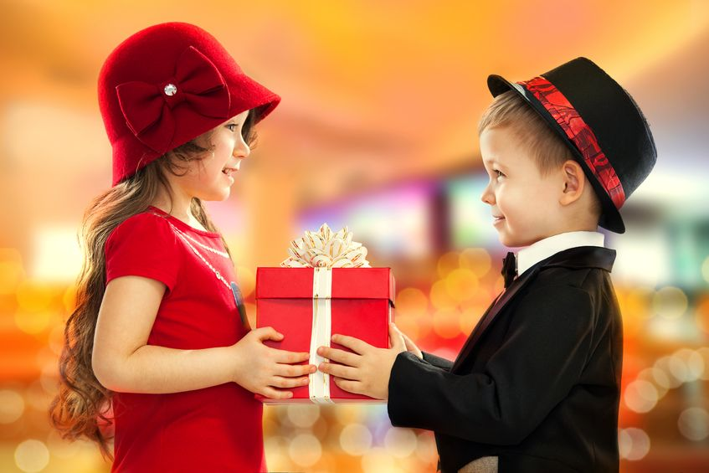
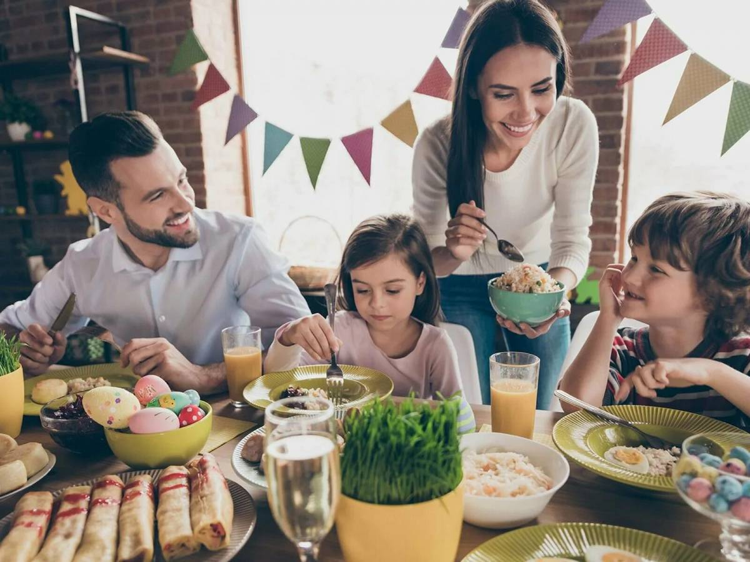
.
Exchange gifts
Have a family dinner

Slide 9
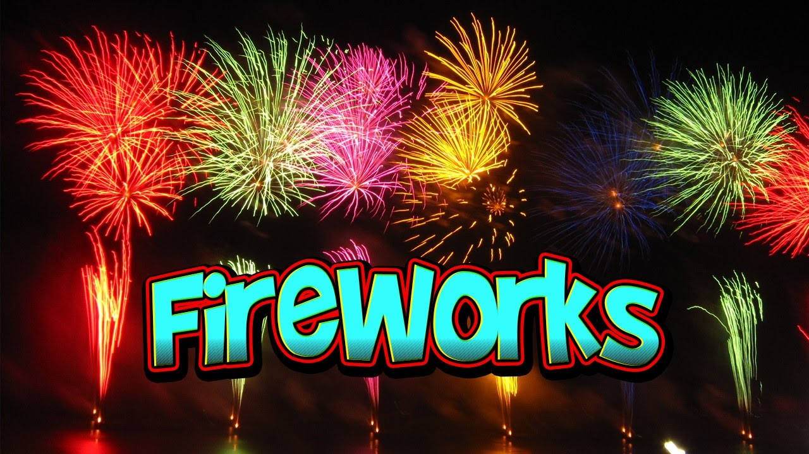
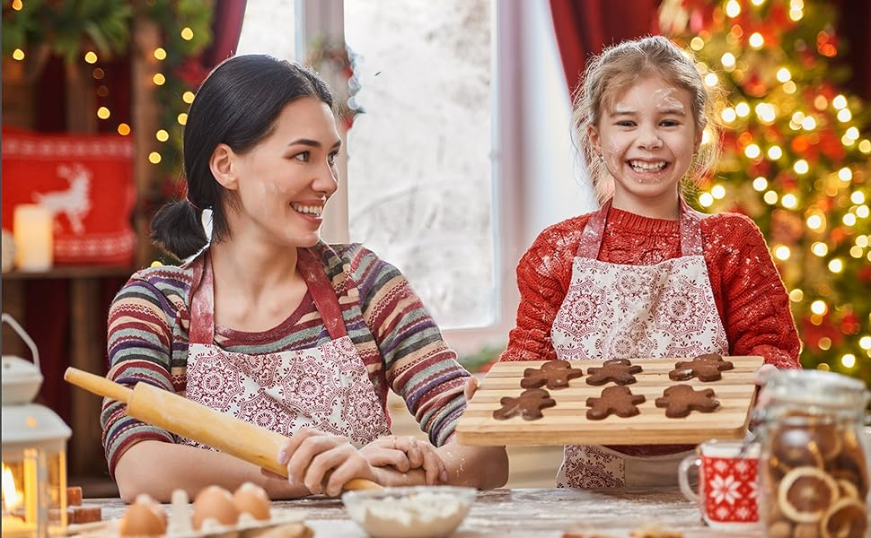
.
Set off fireworks
Cook special food

Slide 10
Read and list all the festivals. How do people celebrate them?
FESTIVALS | WHEN | ACTIVITIES
1. Thanksgiving | In October and in November | Have parades, have family dinner
2.

Slide 11
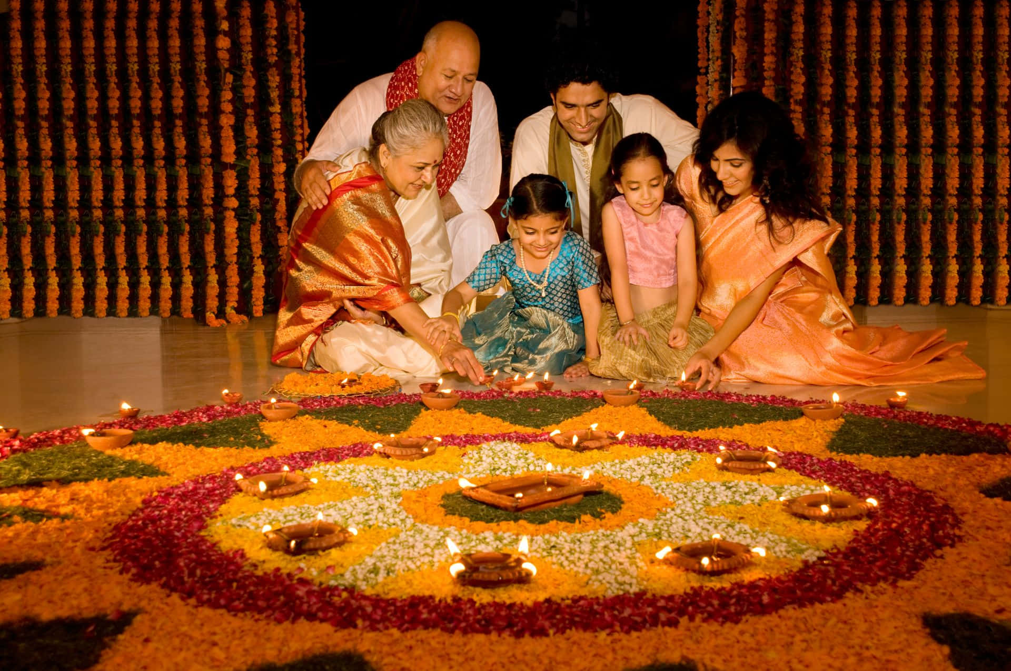
Welcome to the Diwali festival!
Diwali is the five-day Hindu Festival of Lights, which is celebrated in October or November.

Slide 12
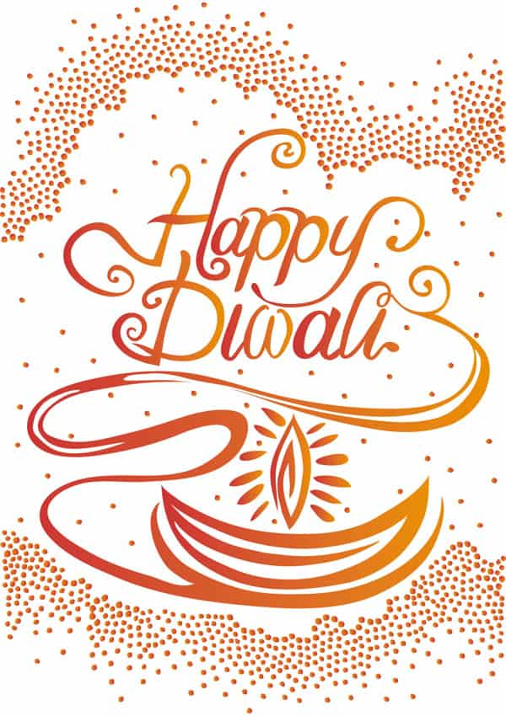
Let’s watch the film. Tick the words you’ve heard in this film.
Come and have lots of fun with us!
Find your way out of a maze and take part
in a sack race.
2.Have street parades.
3.Light fireworks and Diwa lamps.
4.Eat delicious food and lots of sweets.
5.Make a snowman and have a snowball fight.
6.Sing and dance with Diwa lamps
7.Join clowns and magicians.
8.Listen to the beautiful music and make lots of friends.

Slide 13

Are you tired? Let’s relax. Listen to the song and join in by clapping hands.
When you light a Diwa lamp, you clap your hands.
When you light a Diwa lamp, you clap your hands.
Dance and sing this song.
When you ……, you clap your hands.
When you ……, you clap your hands.
Dance and sing this song.

Slide 14
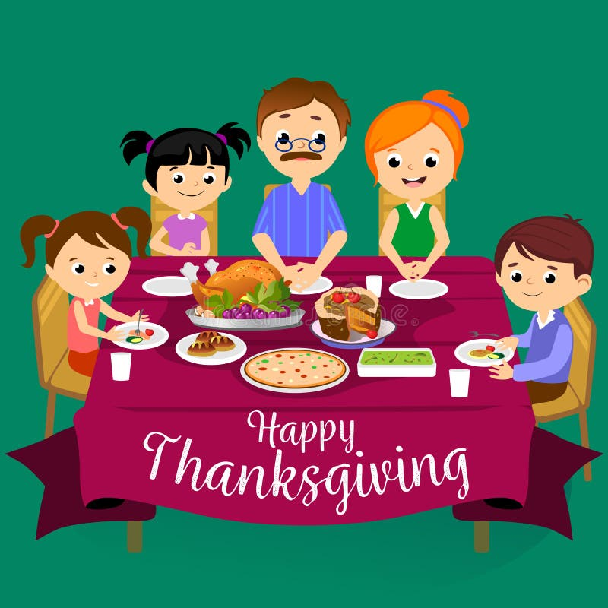
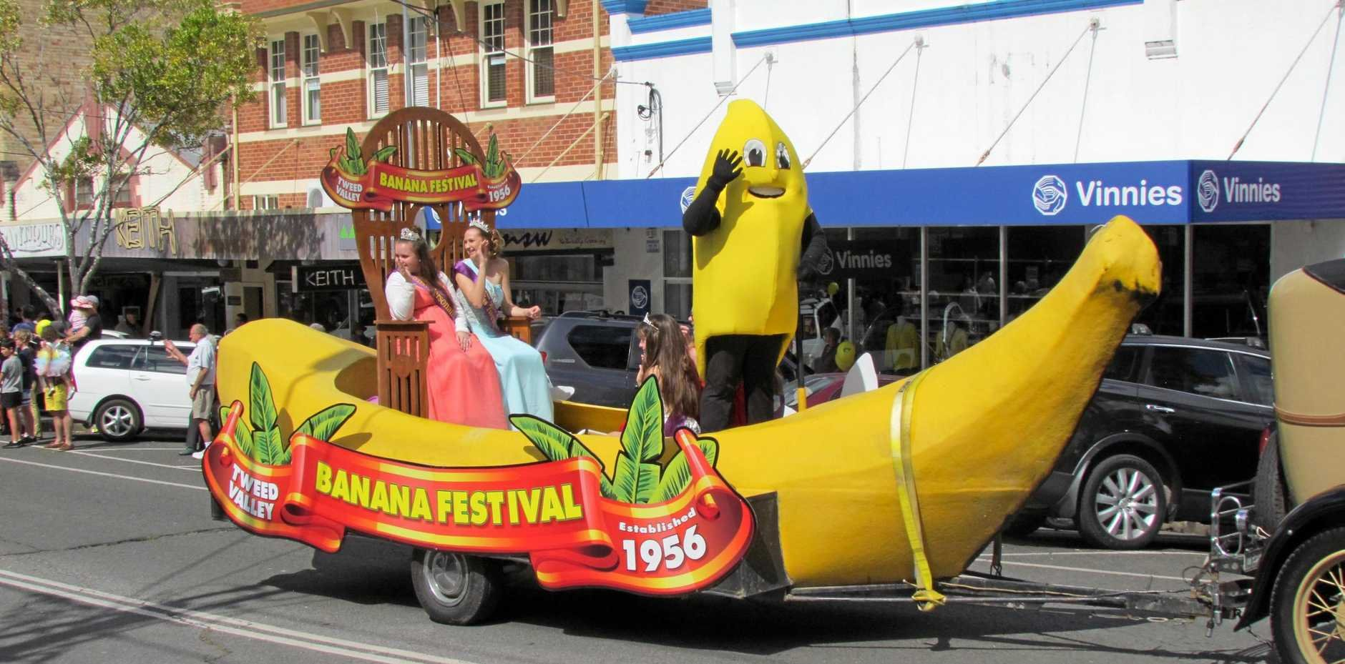
You have a radio show.
Choose a celebration from the text and make notes. Present it to the class.
Thanksgiving is a popular festival in the USA and Canada. On this day, people……..

Slide 15
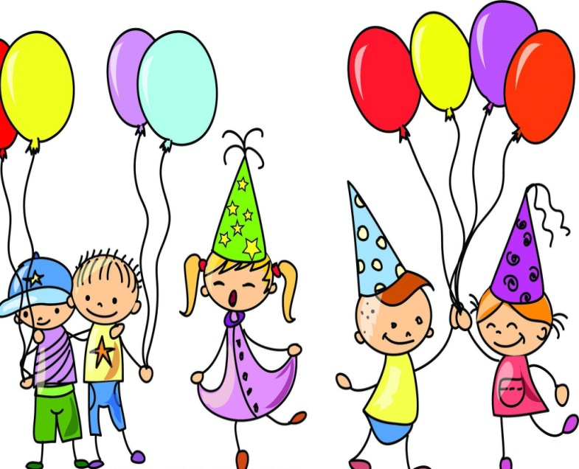
Read the advert, choose the activity you like.
Crazy Parade
When: Sunday, May 1st
Where: London Mayflower Primary School
-Make crazy musical instruments from spoons, bottles, and plastic bags.
-Find the way out of a maze.
-Make up your own song or poem.
-Make colourful masks from paper.
-Make a crazy fancy dress.
-Come and get a prize!

Slide 16
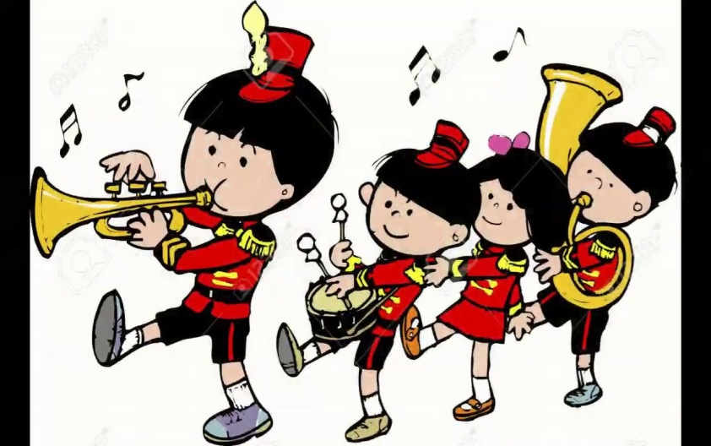
Read the advert, choose the activity you like and make suggestions to your friends Work in groups.
Why don’t we take part in the Crazy Parade? I think it’s fantastic!
No, thanks. Why don’t we make a crazy fancy dress?
Great! We’ll make funny dress and colourful masks!

Slide 17

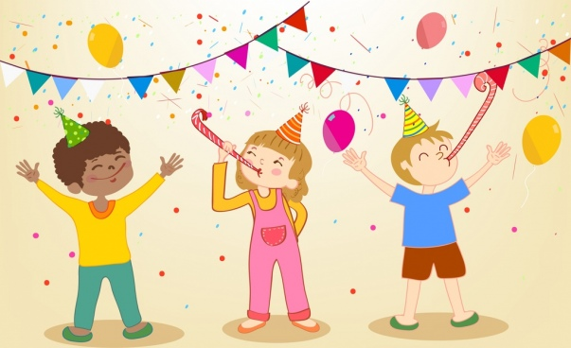
We speak about
celebrations, festivals and festive activities.
To my mind ...
I know ...
(words, words combinations about special days)
I can...
(translate words, make up phrases, sentences, tell about the festivals).

