Slide 1

What colour is a tree?

Slide 2
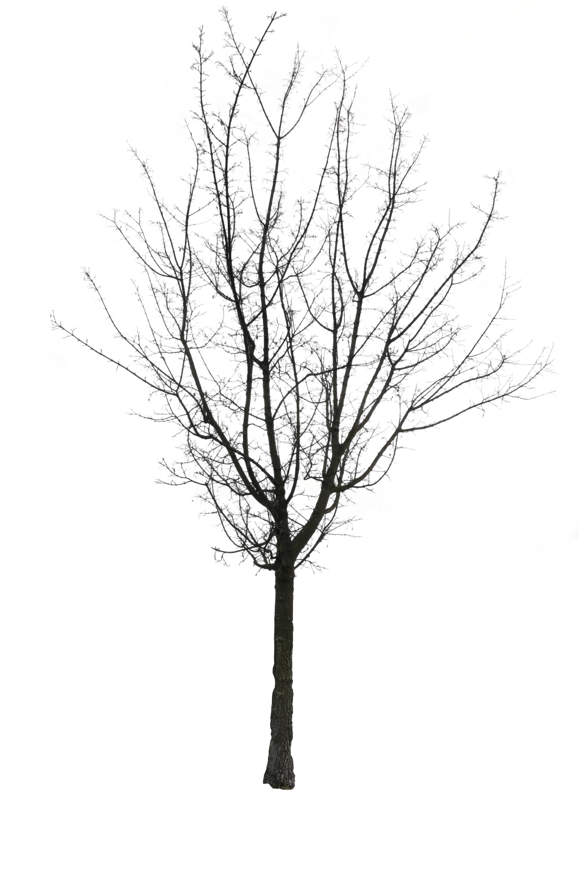
Is it a tree?

Slide 3
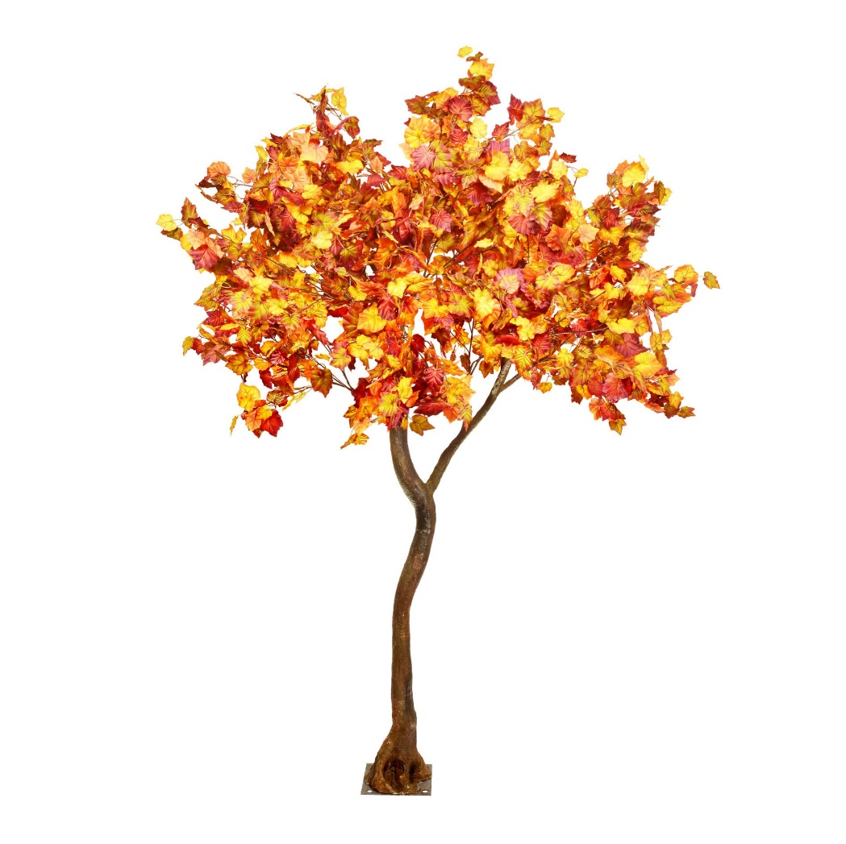
Is this a tree?

Slide 4
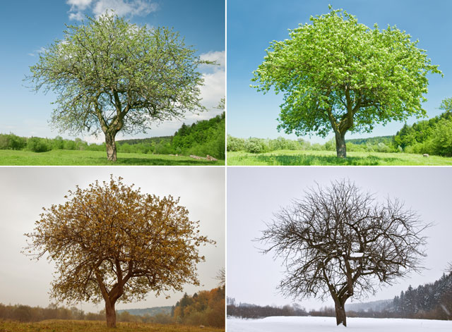
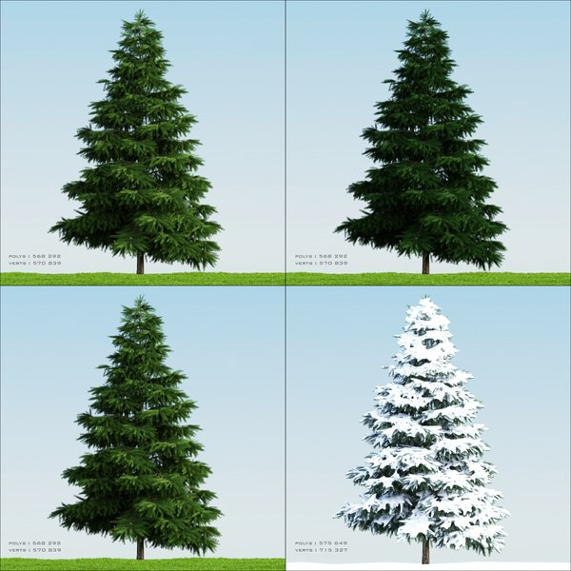
Trees can be:
deciduous
evergreen

Slide 5
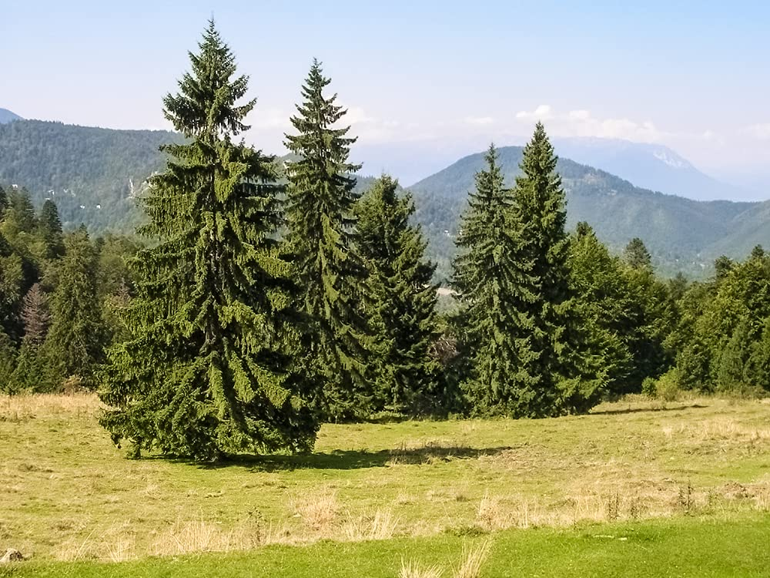
Deciduous or evergreen?
evergreen

Slide 6
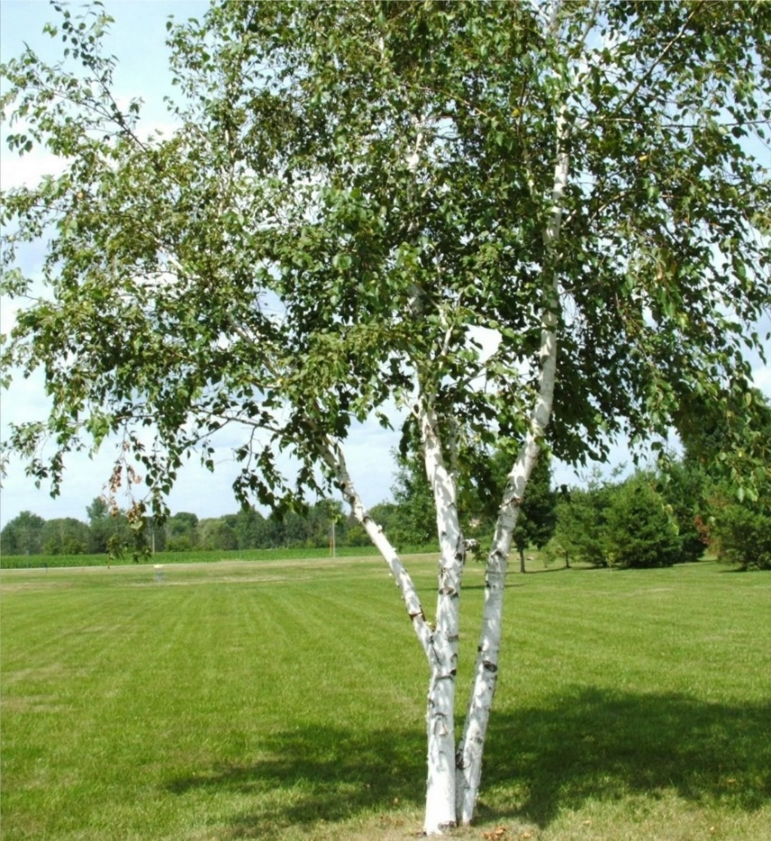
Deciduous or evergreen?
deciduous

Slide 7
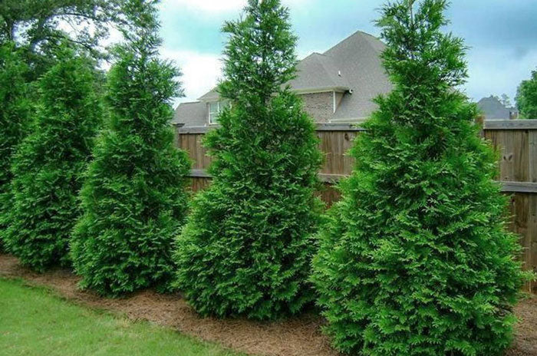
Deciduous or evergreen?
evergreen

Slide 8
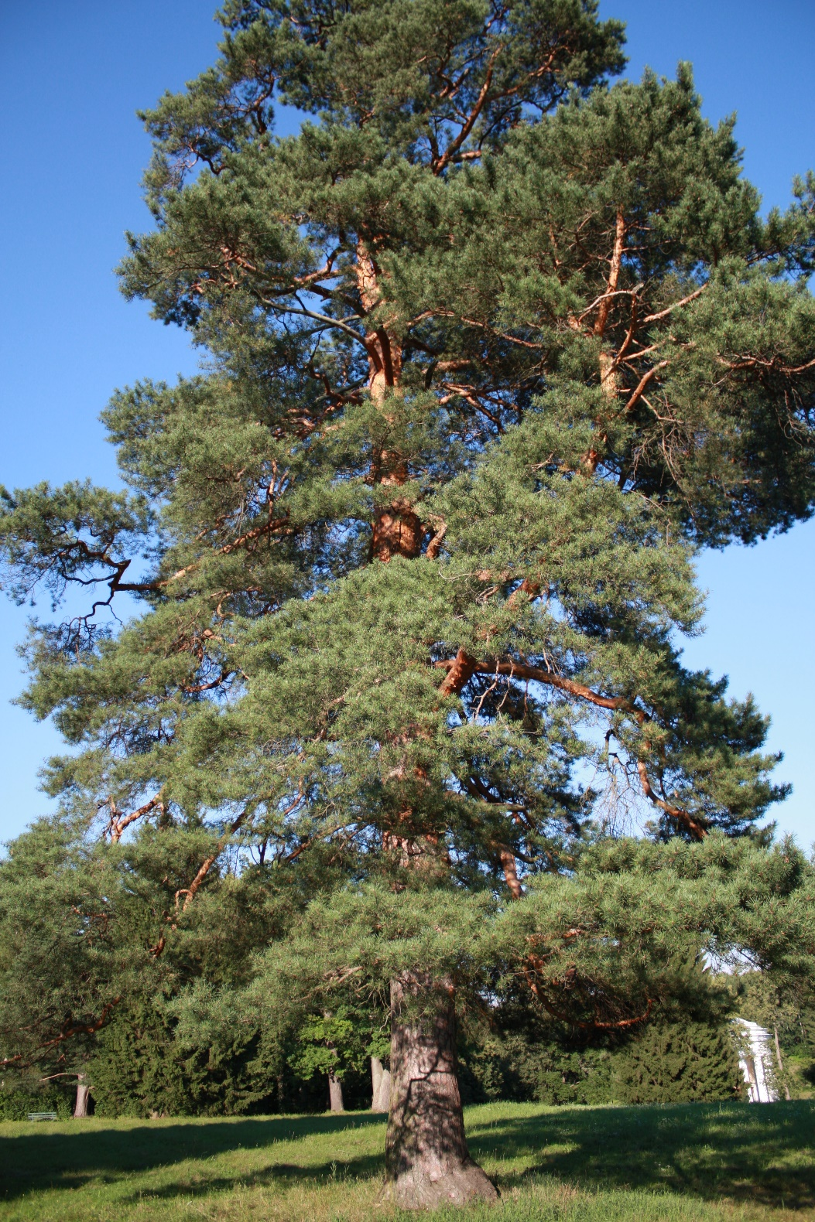
Deciduous or evergreen?
evergreen

Slide 9
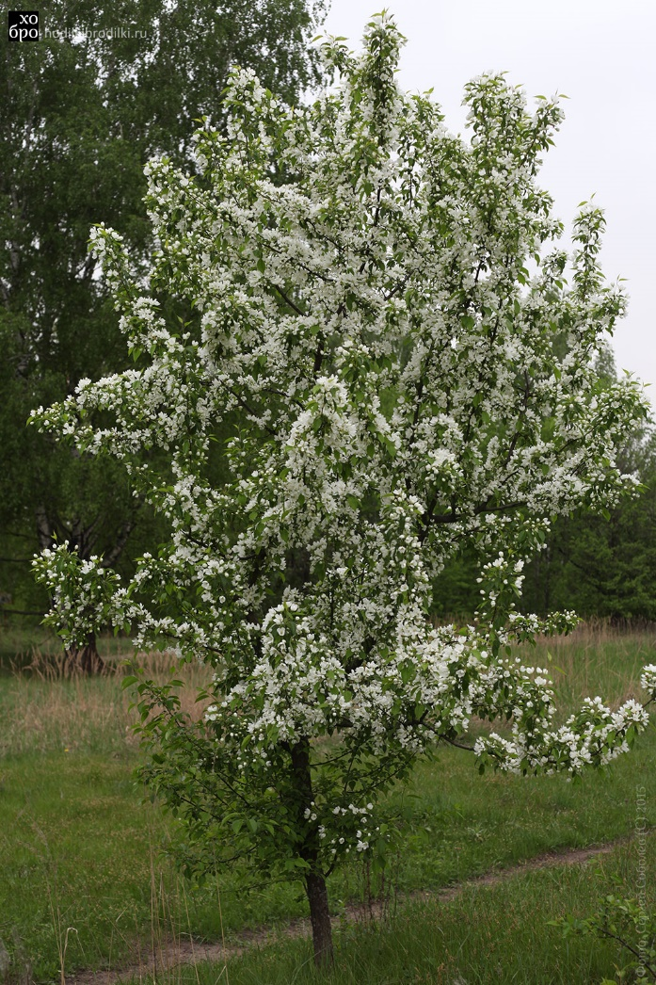
Deciduous or evergreen?
deciduous

Slide 10
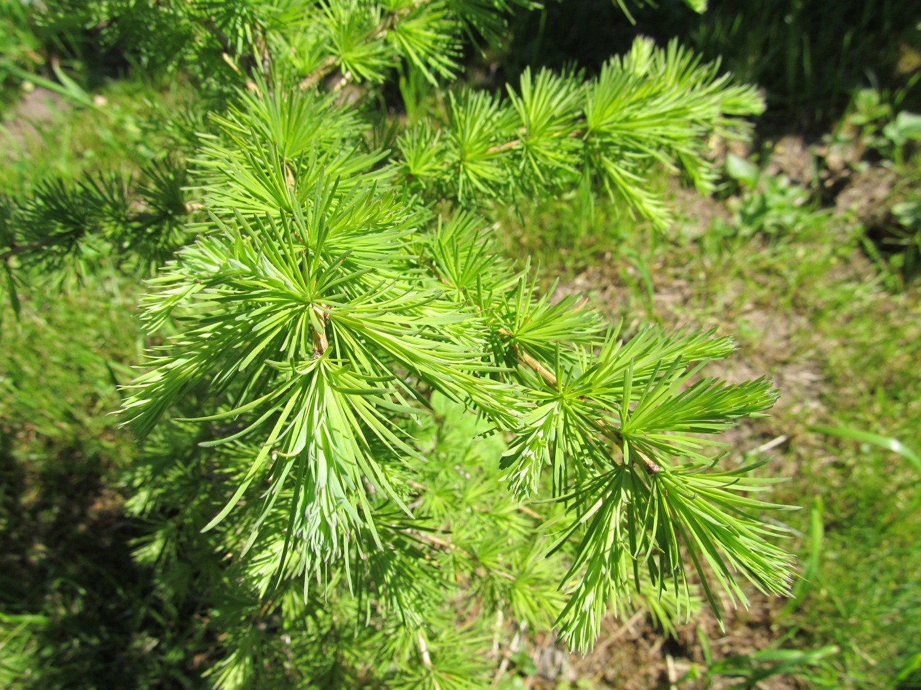
Deciduous or evergreen?
evergreen

Slide 11
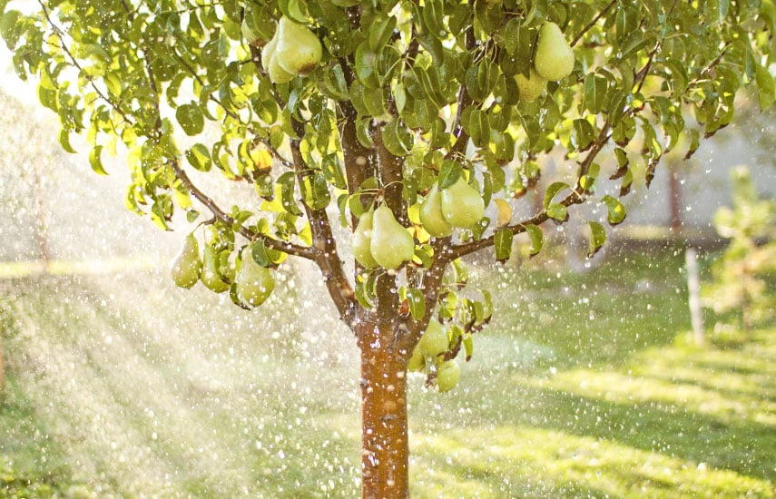
Deciduous or evergreen?
deciduous

Slide 12
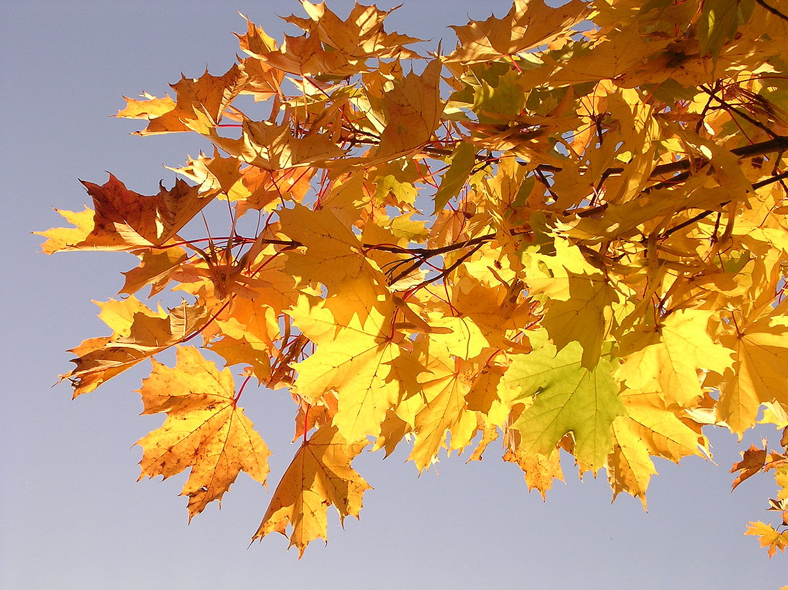
Deciduous or evergreen?
deciduous

Slide 13
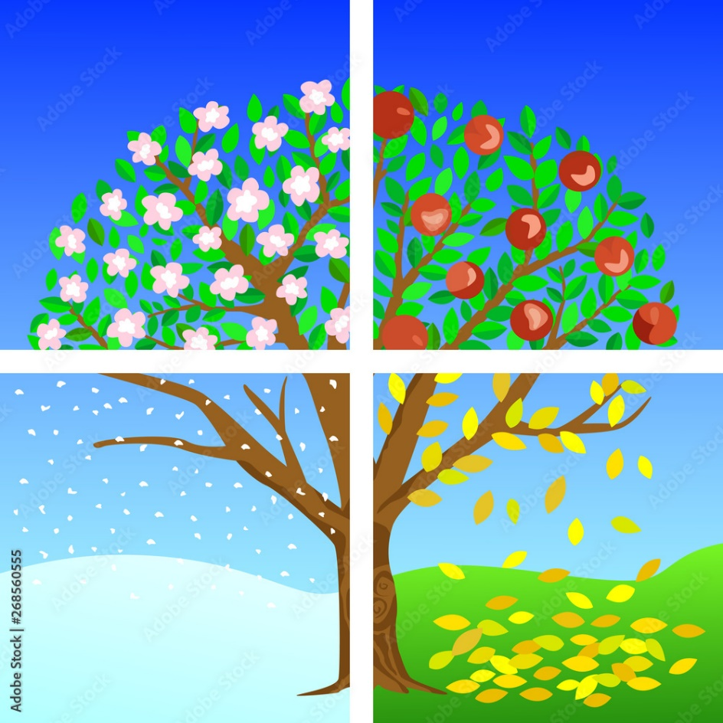
Deciduous trees
Have flowers in spring
Have fruit in summer
Don’t have flowers, fruit or leaves in winter
Lose their leaves in autumn

