Slide 1
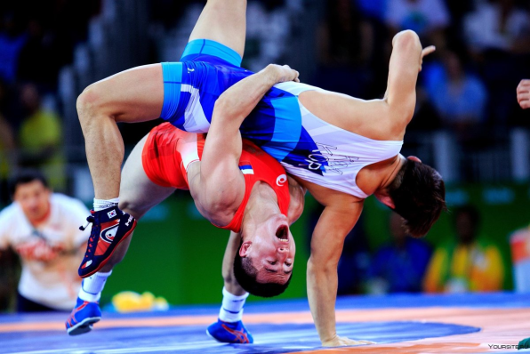
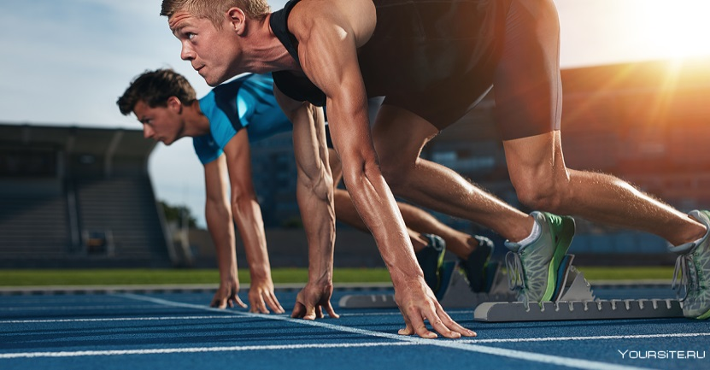
Professional sport:
For or Against?

Slide 2
Rules of Debates
1. Find good arguments.
2. Give reasons.
3. Be polite.
4. Don’t interrupt when others speak.
5. Respect other people’s opinions.
6. Raise your hand when you want to speak.
7. Listen to other people.
8. Express your opinion and give reasons.
9. Keep to the time limit.

Slide 3
Evaluation card
Student’s name | Role | Contents | Accuracy | Answering questions | Average mark
Team I
Team II

Slide 4
Conversational
1.Personal Opinions
In my opinion,
I personally believe…
I personally feel…
To my mind,…
2. Arguments and Counter-arguments
You could be right but I think…
I see what you mean, but…
.
Expressions
3.Interrupting game
Sorry, but…
Can I add here that
I'd like to comment on that.
Can I ask the question?
4. Offering a Suggestion
Why not…
Have you thought about…
I have an idea…
What if…

Slide 5
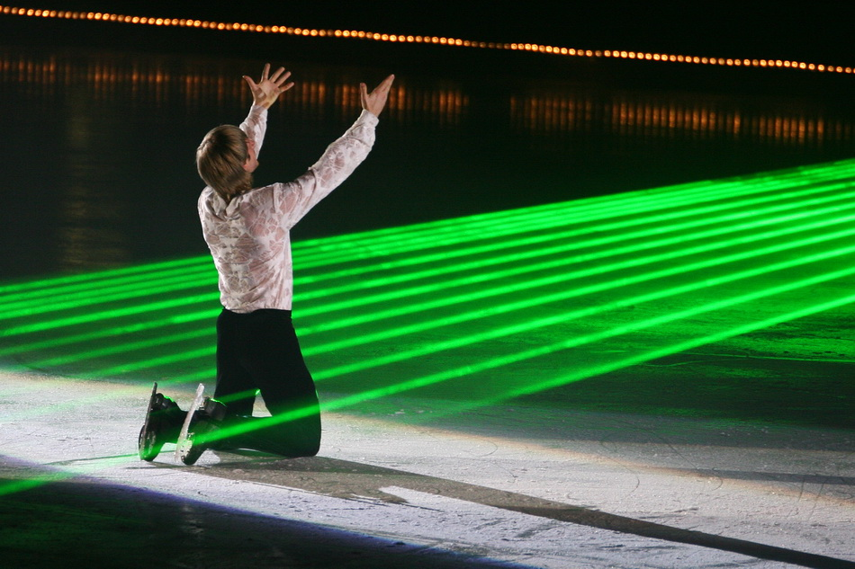
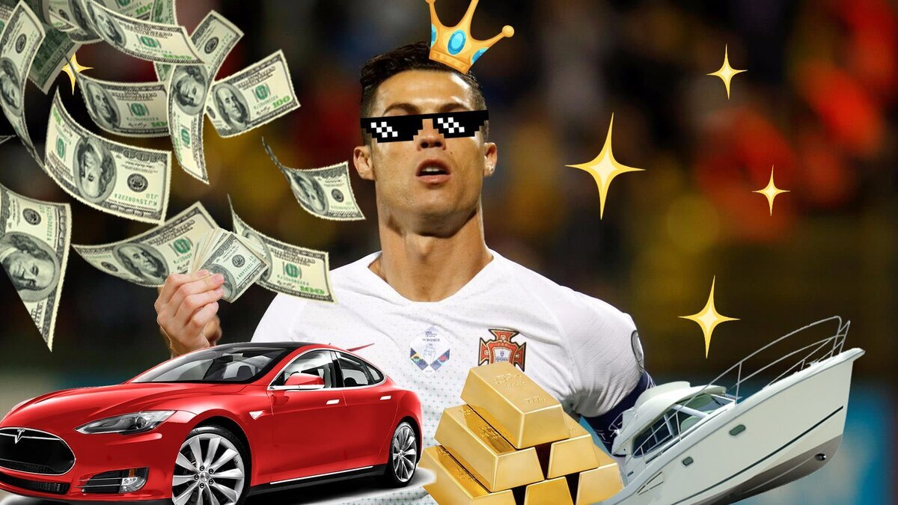
Pros of Рrofessional Sport
The ahtlete has an opportunity to become a celebrity and lead a luxurious lifestyle.
The pro ahtlete has a chance to have big income.

Slide 6


Advantages of Рrofessional Sport
Professionals have the opportunity to travel around the world.
They keep fit and have a healthy lifestyle.

Slide 7
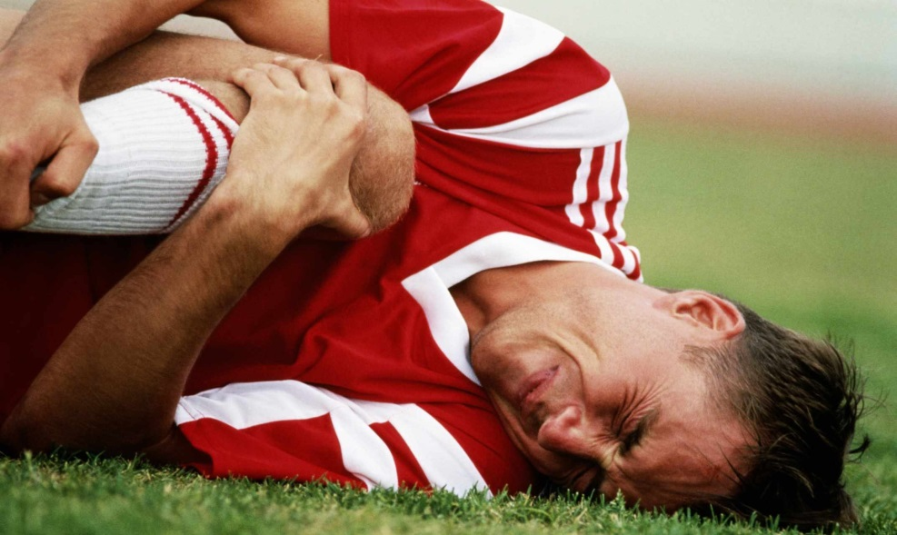
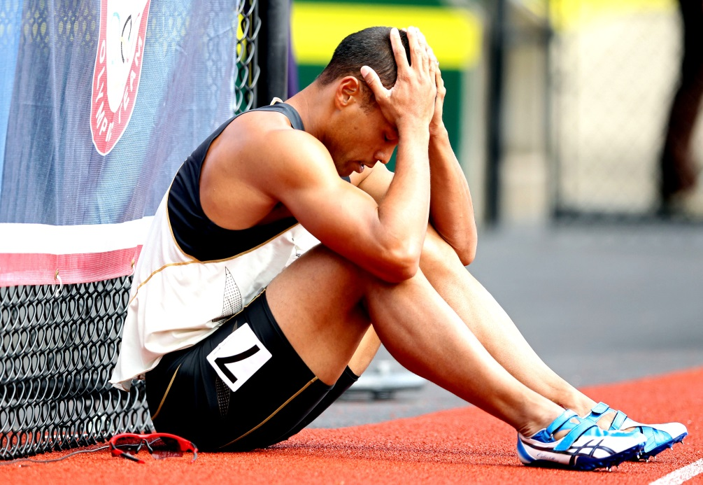
Disadvantages of Рrofessional Sport
Injuries can have extremely serious consequences and even lead to death.
Athletes lose their career in sport because of bad sports results.

Slide 8

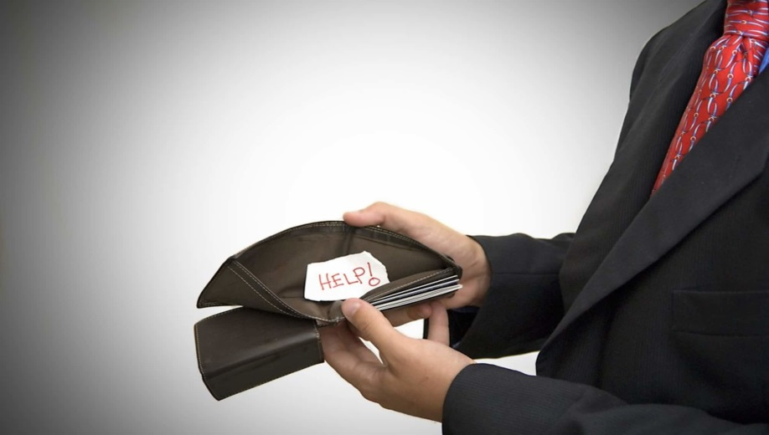
Disadvantages of Рrofessional Sport
Lots of pro athletes take anabolic steroids which can damage health
Athletes have to retire early, have few qualifications to do another job and lose
income.
.

Slide 9
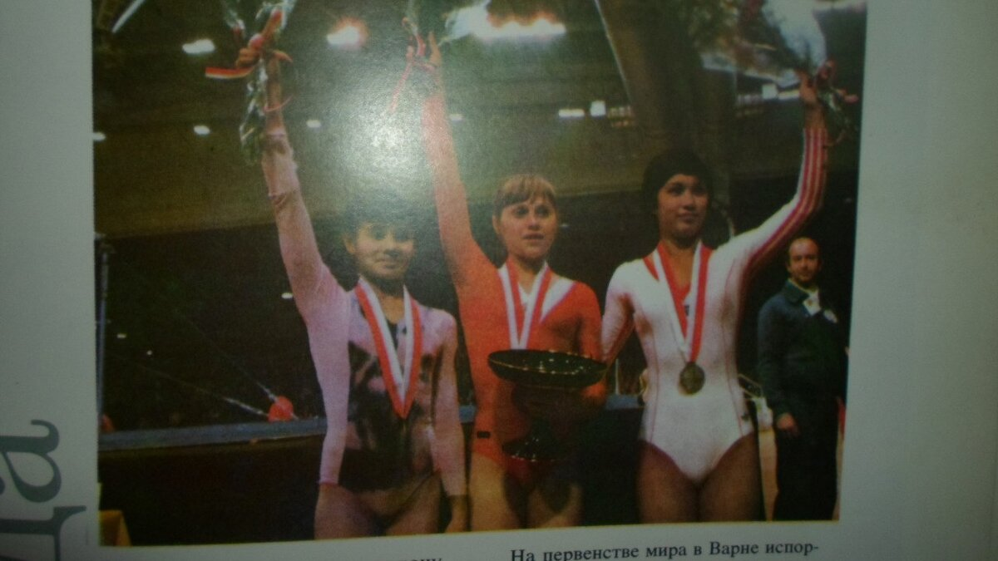
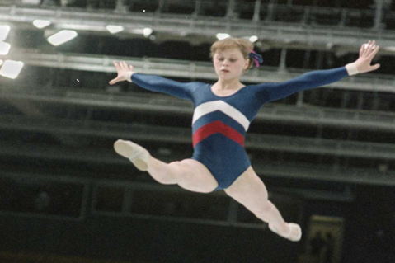
Elena Mukhina: Rise of Career
Soviet gymnast, honored Master of Sports of the USSR, absolute champion of the USSR, European and World Champion.
Awarded the highest sign of Olympic honor - the Silver Olympic Order (1984)

Slide 10
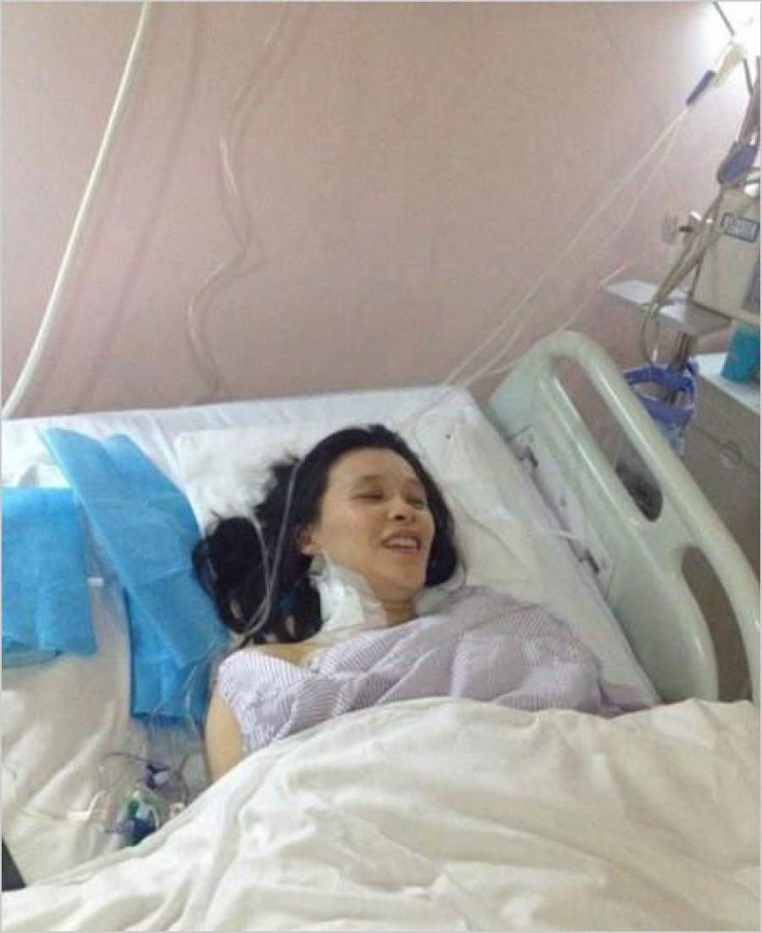
Elena Mukhina:Career Collapse
July 3, 1980 – was injured at the competition.
.
For 26 years was stuck to bed.
Died on December 22, 2006 in Moscow from heart attack at the age of 46,

Slide 11

Introspection
Before the debates I did not know how to…but now…
I need it for…
This technology helps….
I would like to use it…

