Slide 1
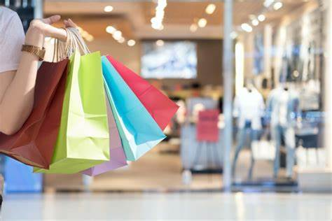
Shopping
English club (10th-11th grades)

Slide 2
SELLING AND BUYING
Translate these words into Russian:
Value for money
Top of the range
Reliable
Luxurious
Timeless
Inexpensive
Fashionable
Well-made
Cool
Genuine
Fake (a replica)

Slide 3
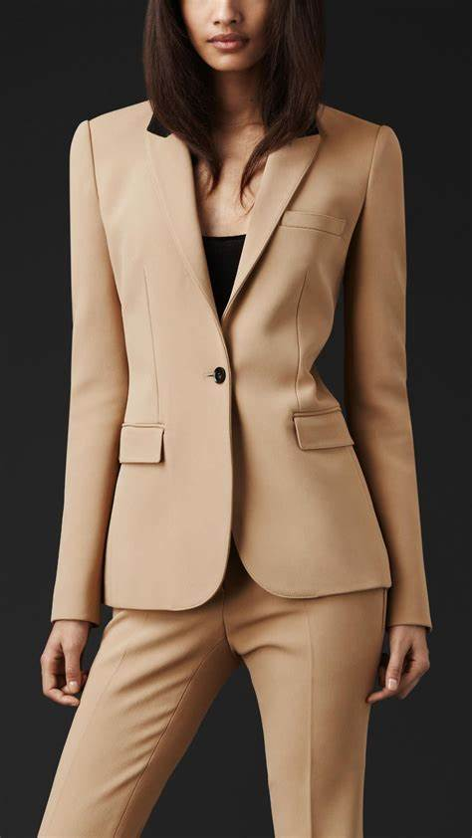
Ladies’ wear
Cowl neck jumper (свитер с воротником трубой)
Cowl collar (воротник труба)
Polo neck jumper
Pinafore dress (сарафан)
Blouse
A button through dress
Belt
Waist length jacket
Winter slacks (широкие зимние брюки)
Patch pocket (накладной карман)
Wrap over dress (платье с запахом)

Slide 4
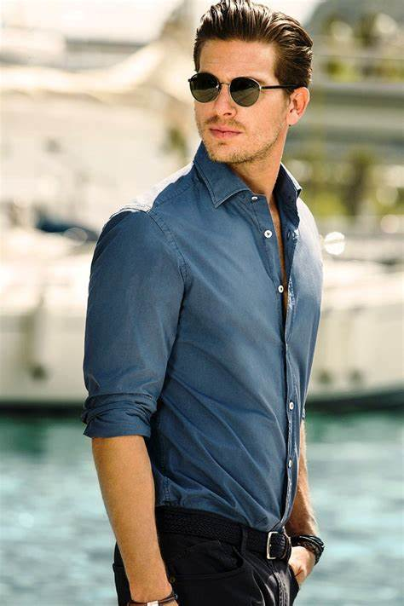
Men’s wear
Cuff link (манжета)
Dress shirt (рубашка с манишкой)
Bow tie (галстук-бабочка)
Breast pocket (карман на груди)
Business suit
Tiepin (зажим для галстука)
Trousers with pleat front (штаны со стрелками)
Anorak
Alpine jacket
Casual trousers

Slide 5
Listen to two speakers talking about brands. What reasons does each person give for liking or disliking brands?

Slide 6
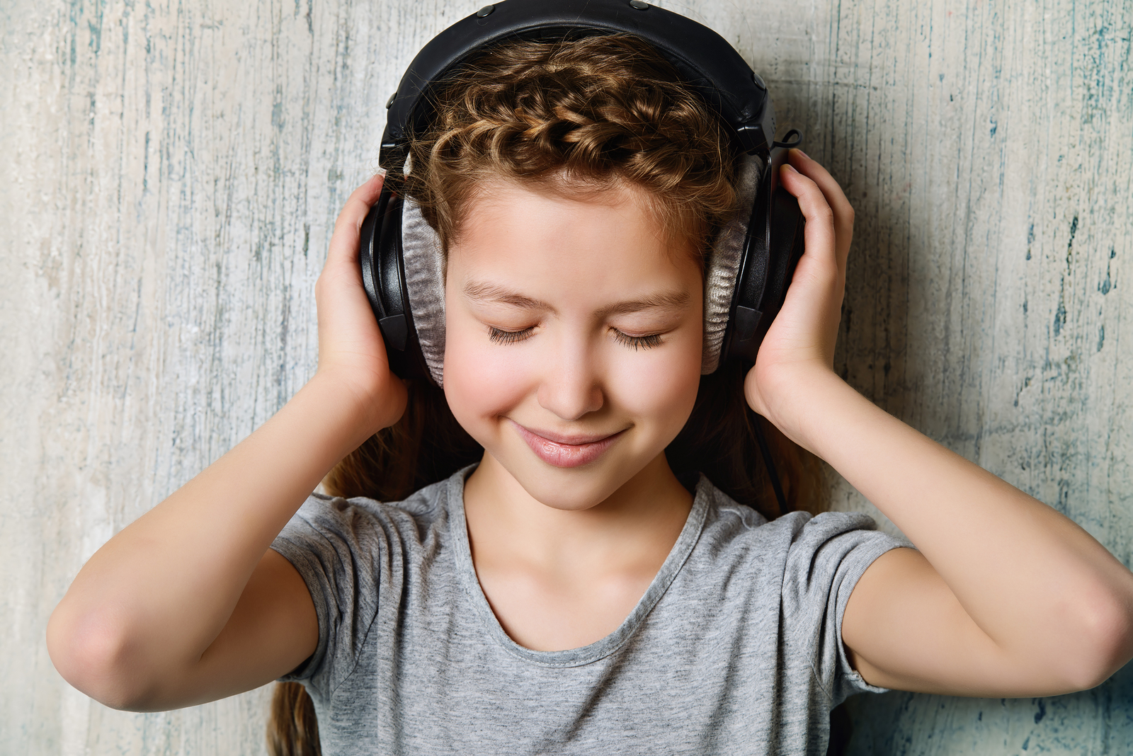
:
Listen to a song and fill in the gaps

Slide 7
Can't buy me love, oh, love, oh Can't buy me love, oh I'll buy you a_________, my friend If it makes you feel all right I'll get you anything my friend If it makes you feel all right 'Cause I don't _________too much for money For money can't buy me love I'll give you all I ________ to give If you say you love me too I may not have a lot to give Not what I've got I'll give to you I don't ________ too much for money For money can't buy me love Can't buy me love, oh Everybody tells me so Can't buy me love, oh No, no, no ...no!

Slide 8
Say you don't need no ___________ And I'll be ____________ Tell me that you want the __________ of things That money just can't buy I don't care too much for money Money can't buy me love Can't buy me love, oh, love, oh

Slide 9
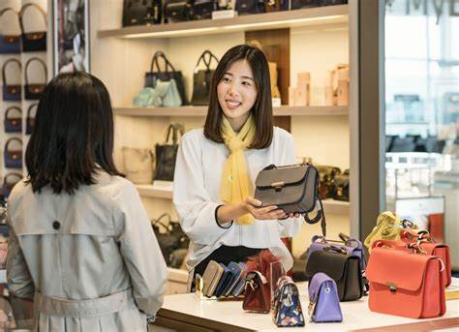
Read out the shopping (script) from a TV-show, make sure that all the words understandable, once they are not, ask the teacher:

Slide 10
- How would you spend your time? - I'll tell you what you could do.
- Shop.
- Jesus! - No, you didn't! - That's like $3,000.
Or 150.
Fake.
- No.
- It looks so real.
- I know.
- Give me that.
You'd never know it wasn't real unless you looked at the lining.
I don't have that luxury.
All my insides are on the outside now.
- I don't like fakes.
- All that matters is what it looks like.
It's good.
We could get more.
I got the guy's card.
He lives in the "valley".

Slide 11
2. - Look at that one, isn't it adorable? - Which one?
- The red one in the middle. I love it! - The Birkin bag? Really? That's not even your style.
Honey, it's not so much the style as what carrying it means.
It means you're out $4,000.
Exactly. When I'm tooling around town with that bag, I'll know I've made it.
Ok, let's go, the visiting hours are over. – Bye-bye, Birkin.
- It’s $4,000. - I know.
- And there's a waiting list. - I assumed.
- Five years. - For a bag?
It’s not a bag. It’s a Birkin.
She was never one for waiting in line. So she cut right to the front.
It’s not for me, it's for Lucy Liu. I'm her press rep and I would love for her to carry this bag to a premiere next week. It would be photographed to death. Does that make a difference?

Slide 12
Role-play the dialogues in-between the customer and the shopping-assistant. Make sure to use the words offered below:
Here is an example of the dialogue to give you a hint:
Shop Assistant: How can I help you, sir?
Customer: I want to buy a shirt. Do you have any white shirts?
Shop Assistant: Sure, sir. We have a lot of white shirts. Come over here, sir. These are new arrivals.
Customer: How much is it?
Shop Assistant: It is eight hundred fifty pounds.
Customer: That’s too much. Can you reduce the price?
Shop Assistant: How much do you want to pay?
Customer: Seven hundred pounds.
Shop Assistant: That’s quite impossible. You can pay eight hundred pounds.
Customer: Well, I’ll take it. Here’s one thousand pounds.
Shop Assistant: Two hundred pounds change.
Customer: Thank you very much.
Shop Assistant: You’re welcome.
Customer: Good bye.
Shop Assistant: Goodbye, sir. Come again.

Slide 13
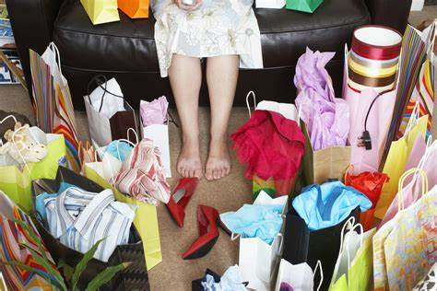

Slide 14
Thank you for your hard work!!!

