Slide 1

Where do people live?
Филиал государственного образовательного учреждения высшего образования Московской области «Государственный социально-гуманитарный университет» в городе Зарайске –
Зарайский педагогический колледж
Teacher: Minaeva Rimma Vladimirovna
2024
Notes:
Цвета вашего класса отличаются от цветов этого шаблона? Не проблема! На вкладке "Дизайн" нажмите "Варианты" (стрелка вниз) и выберите подходящую вам цветовую схему.
Вы можете менять любые пункты в списках обязанностей в соответствии с правилами вашего класса!

Slide 2


East or West – home is best

Slide 3



Slide 4
Regular and Irregular verbs
watch
make
 | Regular verbs | Irregular verbs
1
2
3
4
like
stop
have
build
eat
visit

Slide 5
Regular and Irregular verbs
Key
 | Regular verbs | Irregular verbs
1
2
3
4
watched
built
liked
made
visited
had
stopped
ate

Slide 6

Speaking
Use three of the verbs above to write sentences.
E.g. Yesterday I ate ice-cream.

Slide 7


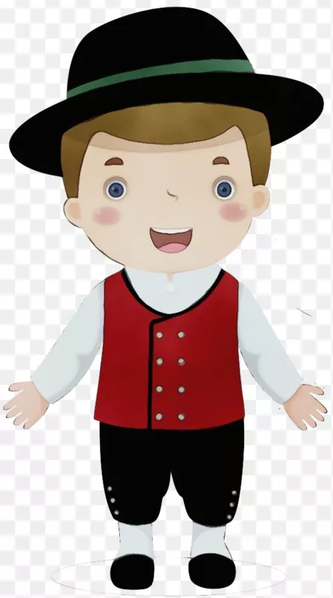









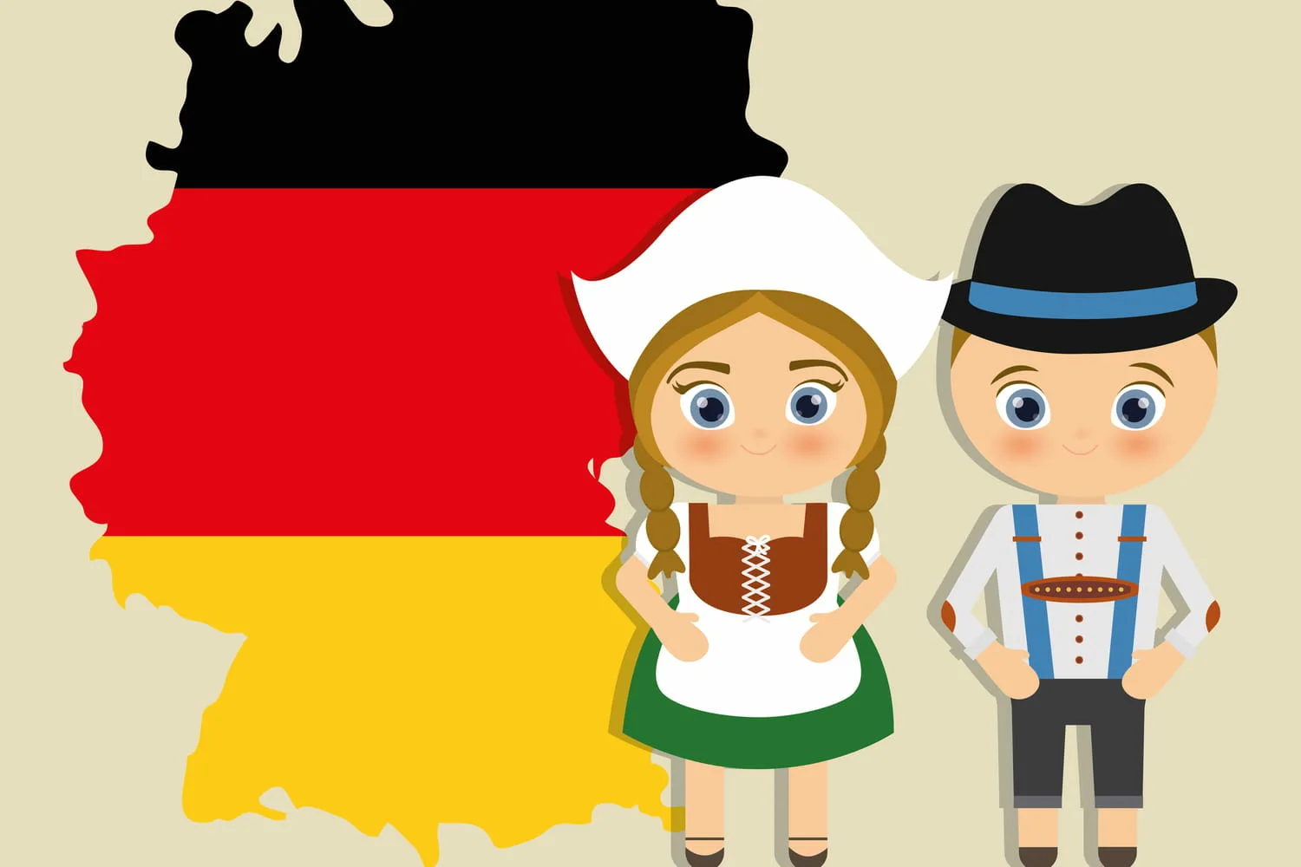








Countries and nationalities
Nationality |  | Национальность
British |  | великобританец
Czech |  | чех
Spanish |  | испанец
Italian |  | итальянец
Japanese |  | японец
German |  | немец
Hungarian |  | венгр
Russian |  | русский
Portuguese |  | португалец
French |  | француз
Country |  | Государство
Great Britain |  | Великобритания
Czech Republic |  | Чешская Республика
Spain |  | Испания
Italy |  | Италия
Japan |  | Япония
Germany |  | Германия
Hungary |  | Венгрия
Russia |  | Россия
Portugal |  | Португалия
France |  | Франция

Slide 8
Countries and nationalities
Hungarian
British
Czech
Italian
Russian
Spanish
French
Portuguese
Japanese
German

Slide 9
Key
Hungarian
British
Czech
Italian
Russian
Spanish
French
Portuguese
Japanese
German

Slide 10

Speaking

Slide 11







Flags and Countries
B
D
G
English is the official language of the seven countries listed below. Match the countries (1-7) to the flags (A-G).
1. The United States
2. Australia
3. Canada
4. Ireland
5. The United Kingdom
6. New Zealand
7. South Africa
E
F
C
A

Slide 12


Key
1 – E
2 – A
3 – C
4 – F
5 – G
6 – D
7 – B

Slide 13
East or West – home is best

Slide 14
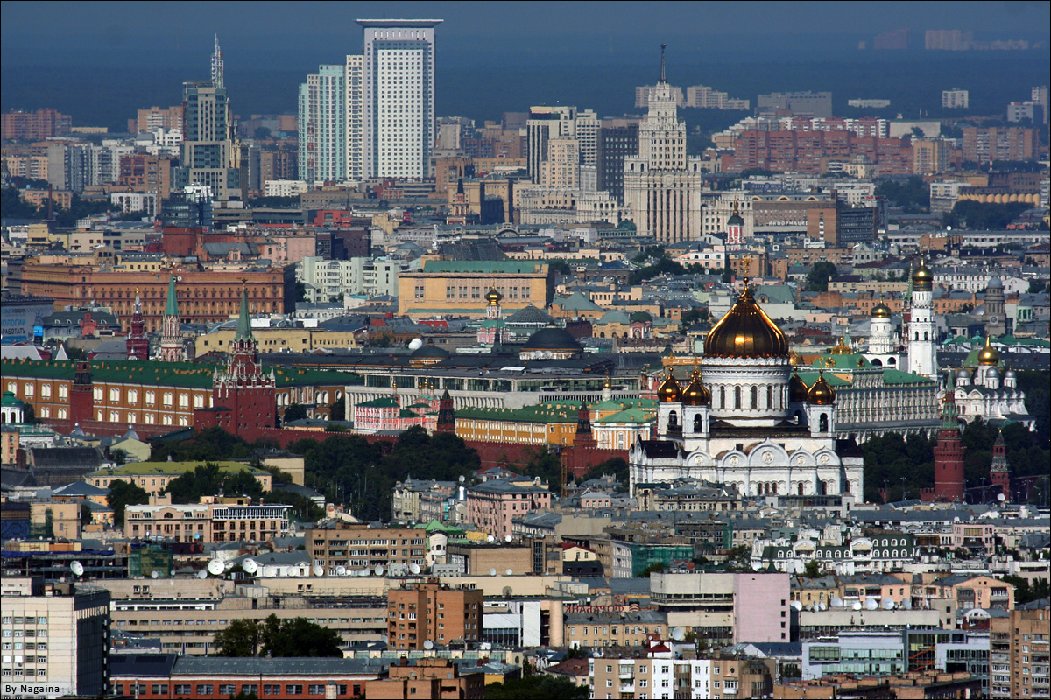
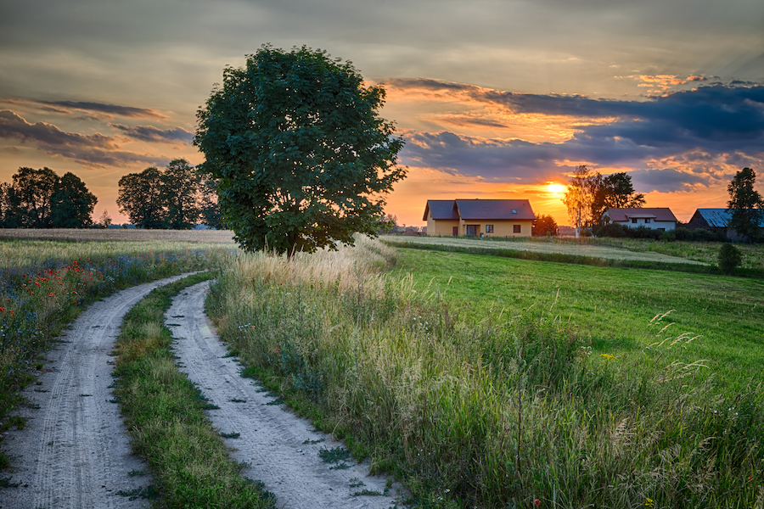
City and village

Slide 15

Vocabulary
facility-приспособление, средство
plumbing facilities-водопровод и канализация
environment-окружающая среда
to pollute-загрязнять
criminal activities-уголовные преступления
noise-шум
vehicle-транспортное средство
to live in harmony and peace-жить в гармонии и мире
community-населенный пункт
rush-суета, спешка
to keep up with-идти в ногу с
to face-встречаться, сталкиваться
to supply-удовлетворять

Slide 16



Reading
p. 176 ex. 8,9

Slide 17

Key
1 – T
2 – T
3 – F
4 – F
5 – T
6 – F
7 – T
8 – T
9 – F
10 – T

Slide 18
Match the words to make word combinations
1. traffic
2. rush
3. latest
4. poor
5. fast
6. large
7. hard
8. transport
9. fresh
10. modern
a. hour
b. transport
c. facilities
d. accident
e. conveniences
f. living conditions
g. air
h. worker
i. technology
j. population

Slide 19
Key
1. traffic
2. rush
3. latest
4. poor
5. fast
6. large
7. hard
8. transport
9. fresh
10. modern
a. hour
b. transport
c. facilities
d. accident
e. conveniences
f. living conditions
g. air
h. worker
i. technology
j. population

Slide 20
Speaking

Slide 21
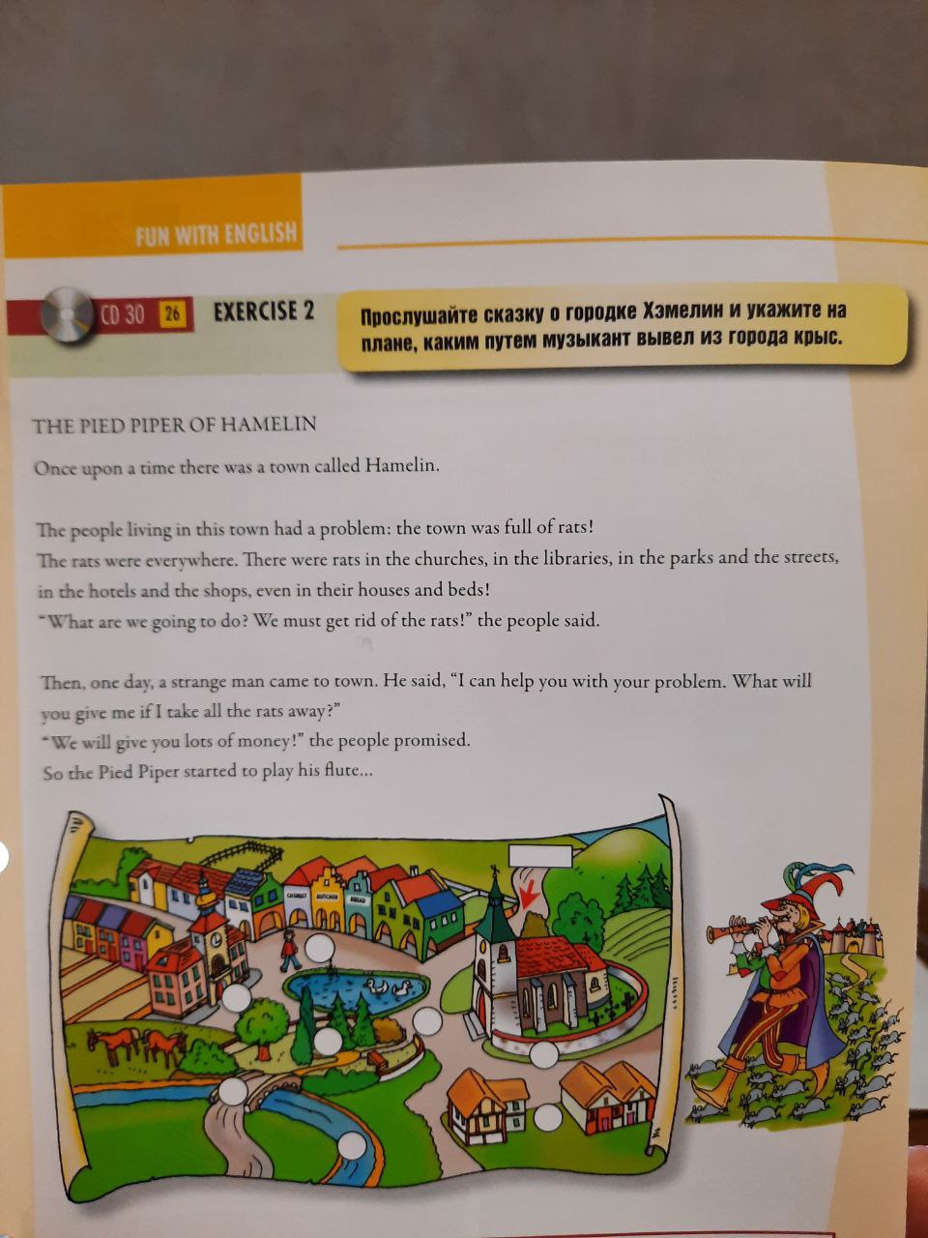
A fairy tale

Slide 22
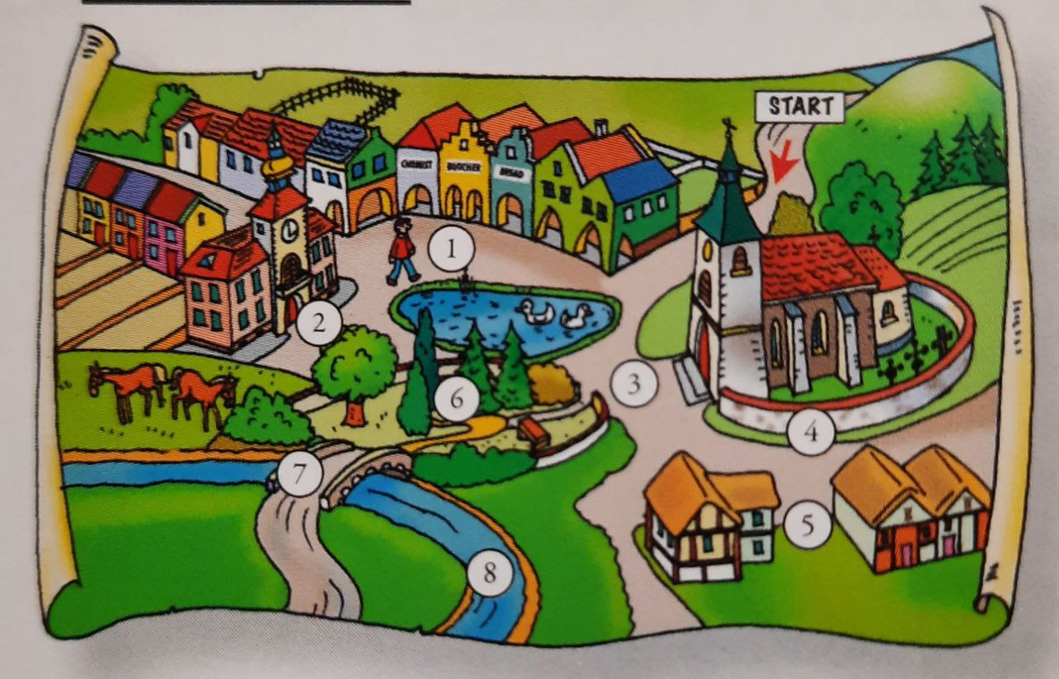
Key

Slide 23
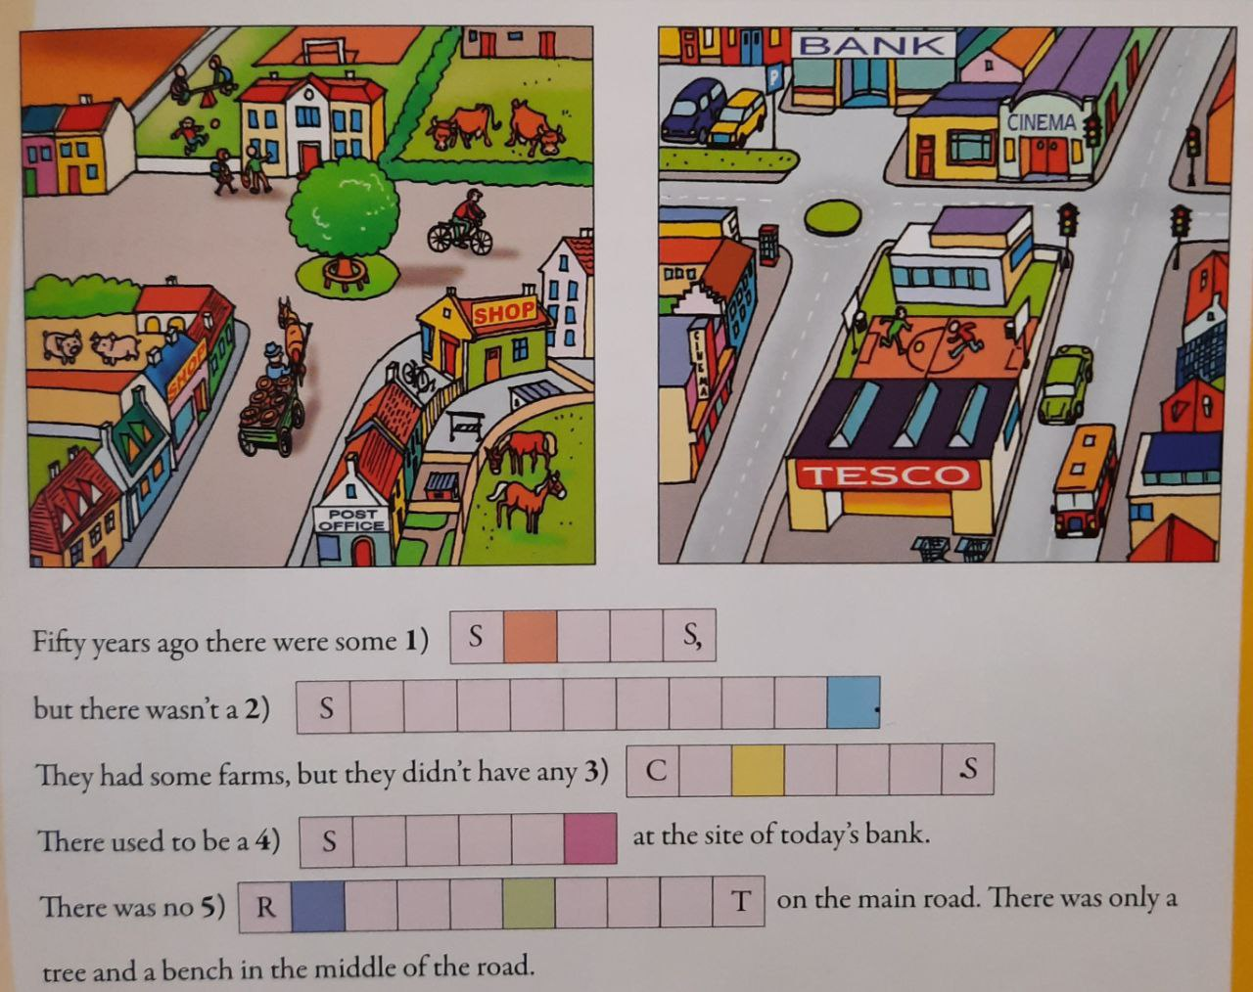

Compare

Slide 24

Key
shops
supermarket
cinemas
school
roundabout

Slide 25

Little Mouse
Little Mouse, Little Mouse,
Will you come out of your house?
Thank you, Pussy! says the mouse
I won’t leave my little house.

Slide 26


Slide 27
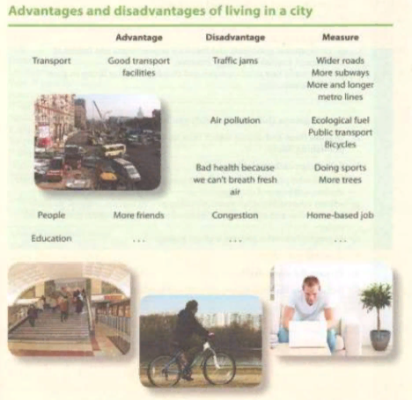
Advantages and disadvantages of living in a city

Slide 28

Homework
Work in groups (Project)
p. 181 ex.16

Slide 29

Thanks for your work!

