Slide 1




Minsk is worth visiting
BY MARINA FEDOSOVA

Slide 2
Dear Marina,
I hope this message finds you well. I am planning a trip to Minsk and I would greatly appreciate your advice on which sights and attractions are must-visit in the city. As someone who knows the area well, I trust your recommendations and would love to hear about any hidden gems or popular landmarks that I shouldn't miss.
I am particularly interested in historical sites, cultural attractions, and any local experiences that will give me a true sense of the city. Your insights and suggestions would be invaluable in helping me plan a memorable visit to Minsk.
Thank you in advance for your time and assistance. I look forward to hearing from you soon.
Warm regards,
Sophie Clark.

Slide 3



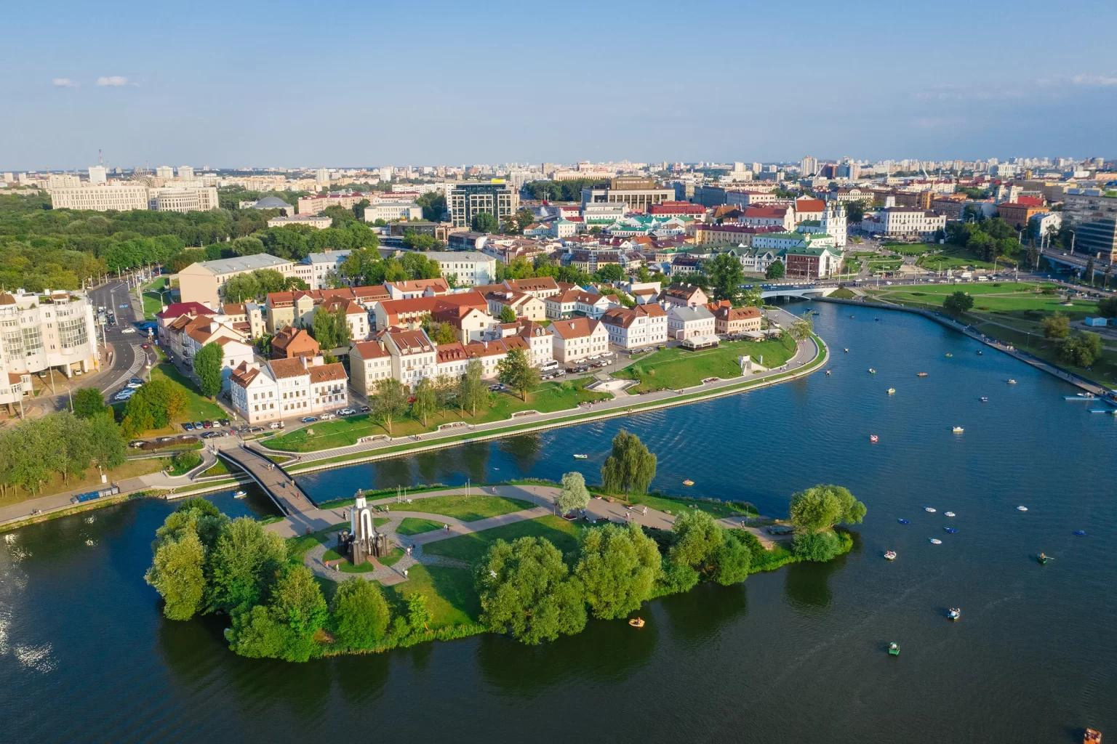
Minsk is a beautiful green city with wide streets and modern architecture.

Slide 4
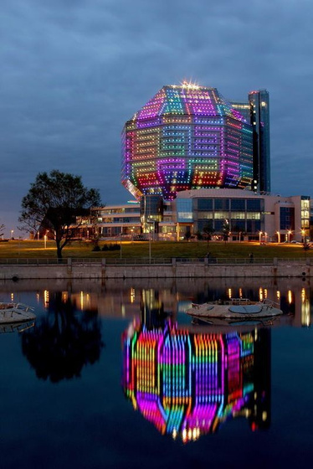
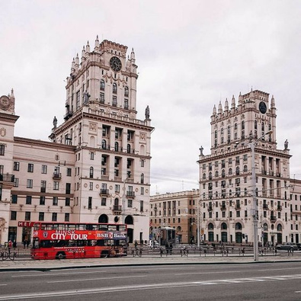
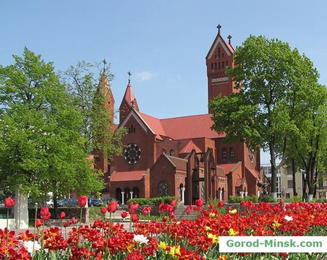
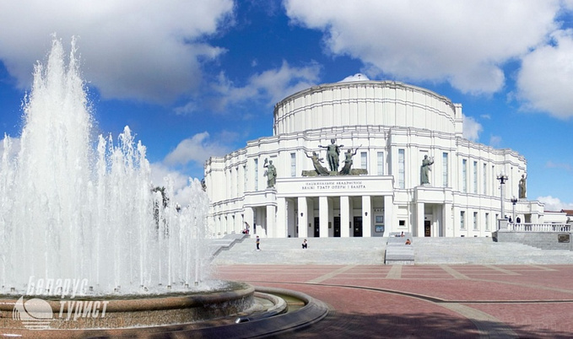
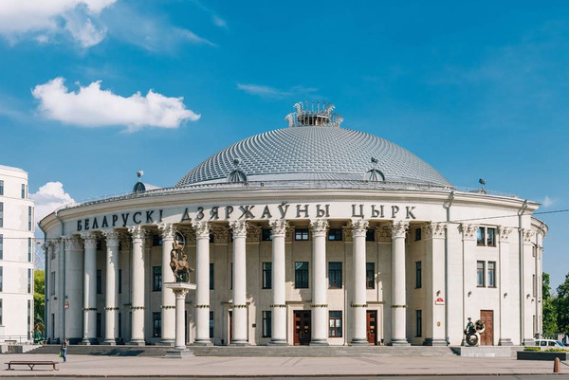
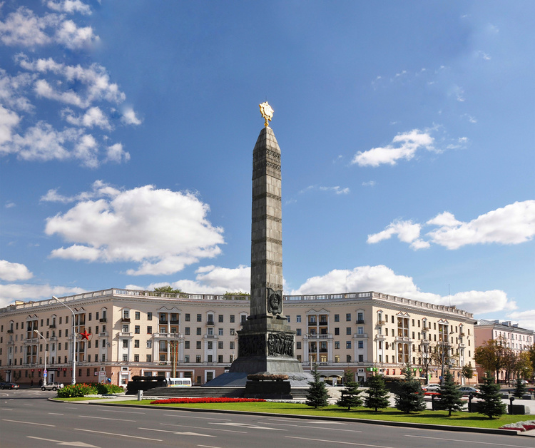
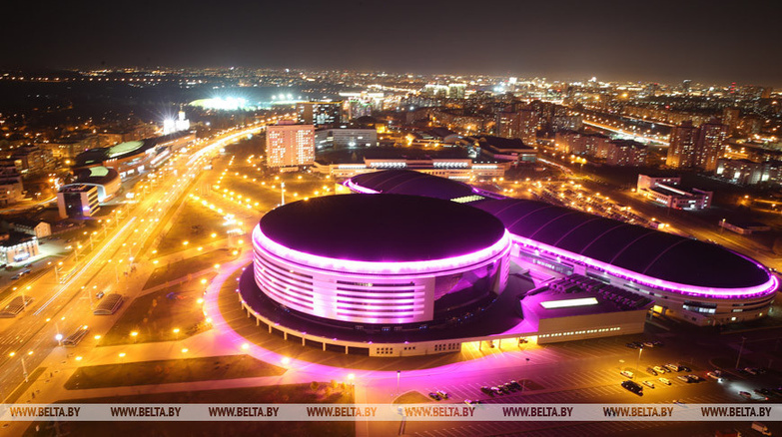
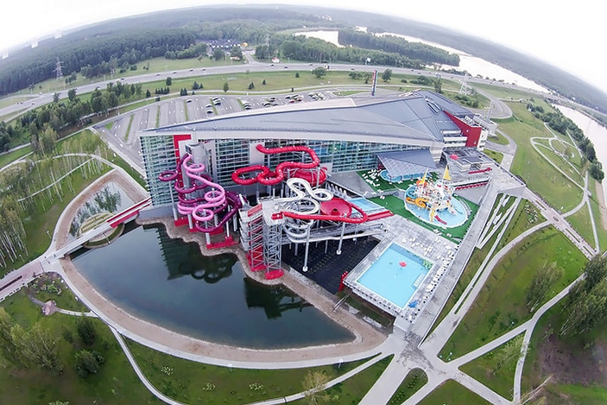
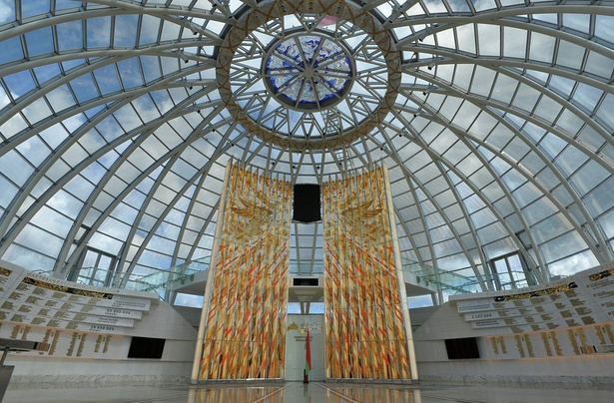
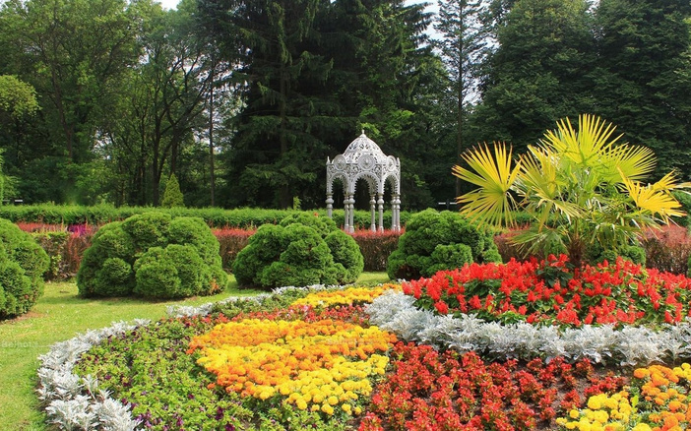

MINSK SIGHTS
The National Library
The Railway Station
The Red Church
The National Opera and Ballet House
The Belarusian State Circus
Victory Square
Minsk Arena
Lebyazhy Aqua Park
The Museum of the History of the Great Patriotic War
The Botanical Garden

Slide 5
Minsk sights crossword

Slide 6
 |  |  |  |  |  |  |  | 1
 |  |  |  |  |  | 2
3
 |  |  | 4 |  |  | 5
 | 6
7 |  |  |  |  |  |  |  |  |  |  | 8
 |  |  |  | 9 |  |  |  |  |  |  |  |  |  |  |  | 10
 |  |  | 11
1. It's the fifth largest aquapark in Europe.

Slide 7
 |  |  |  |  |  |  |  | 1
 |  |  |  |  |  |  |  | L
 |  |  |  |  |  | 2 |  | E
 |  |  |  |  |  |  |  | B
 |  |  |  |  |  |  |  | Y
3 |  |  |  |  |  |  |  | A
 |  |  | 4 |  |  | 5 |  | Z
 |  |  |  |  |  |  |  | H
 | 6 |  |  |  |  |  |  | I
7 |  |  |  |  |  |  |  |  |  |  | 8
 |  |  |  | 9 |  |  |  |  |  |  |  |  |  |  |  | 10
 |  |  | 11
1. It's the fifth largest aquapark in Europe.

Slide 8
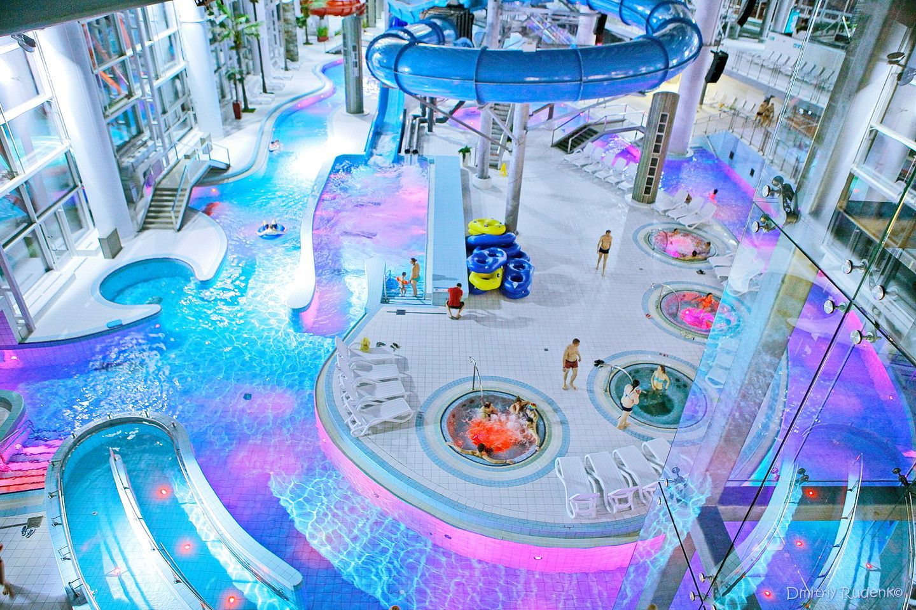
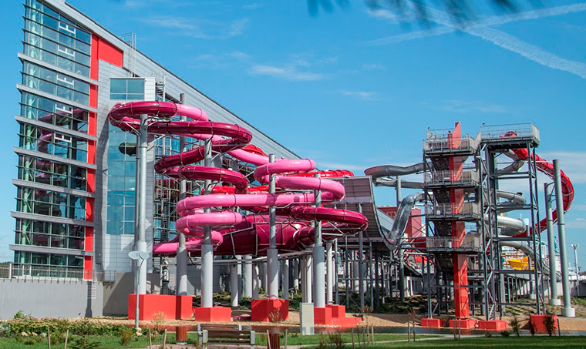

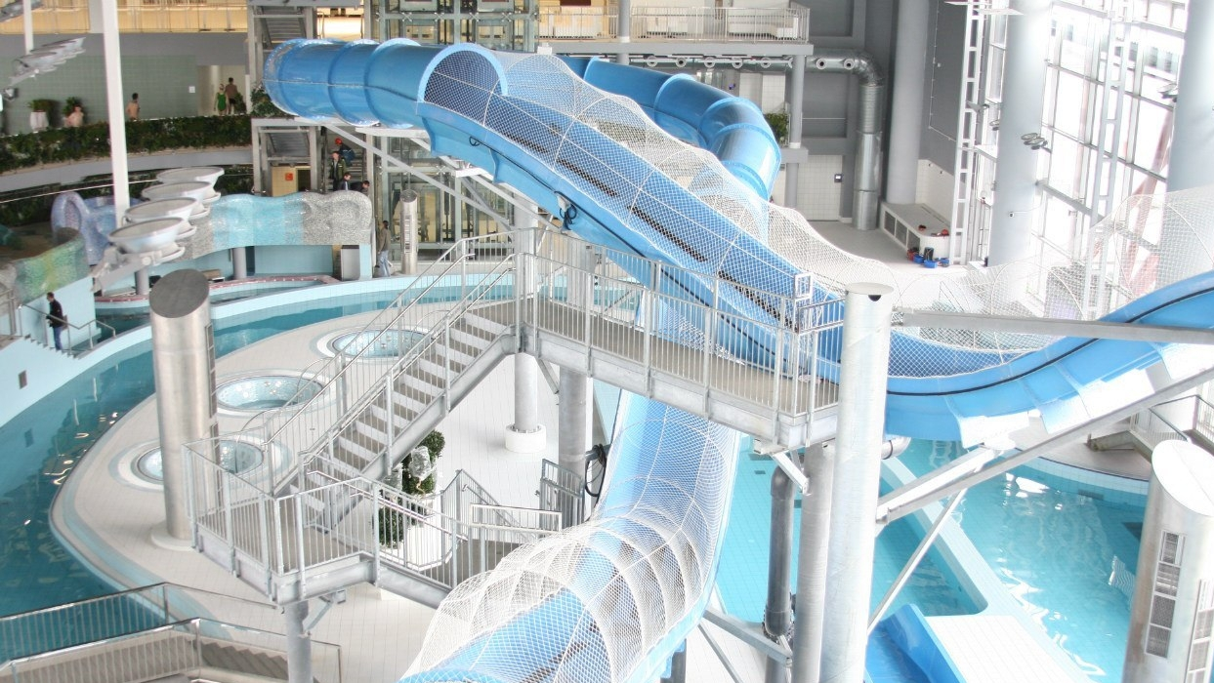
Lebyazhy Aqua Park

Slide 9
 |  |  |  |  |  |  |  | 1
 |  |  |  |  |  |  |  | L
 |  |  |  |  |  | 2 |  | E
 |  |  |  |  |  |  |  | B
 |  |  |  |  |  |  |  | Y
3 |  |  |  |  |  |  |  | A
 |  |  | 4 |  |  | 5 |  | Z
 |  |  |  |  |  |  |  | H
 | 6 |  |  |  |  |  |  | I
7 |  |  |  |  |  |  |  |  |  |  | 8
 |  |  |  | 9 |  |  |  |  |  |  |  |  |  |  |  | 10
 |  |  | 11
2. It was built in 1905 in memory of Minsk landlord's children. This church is called the … Church.

Slide 10
 |  |  |  |  |  |  |  | 1
 |  |  |  |  |  |  |  | L
 |  |  |  |  |  | 2 | R | E | D
 |  |  |  |  |  |  |  | B
 |  |  |  |  |  |  |  | Y
3 |  |  |  |  |  |  |  | A
 |  |  | 4 |  |  | 5 |  | Z
 |  |  |  |  |  |  |  | H
 | 6 |  |  |  |  |  |  | I
7 |  |  |  |  |  |  |  |  |  |  | 8
 |  |  |  | 9 |  |  |  |  |  |  |  |  |  |  |  | 10
 |  |  | 11
2. It was built in 1905 in memory of Minsk landlord's children. This church is called the … Church.

Slide 11
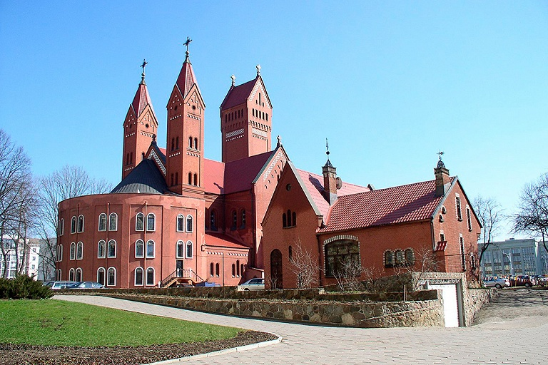
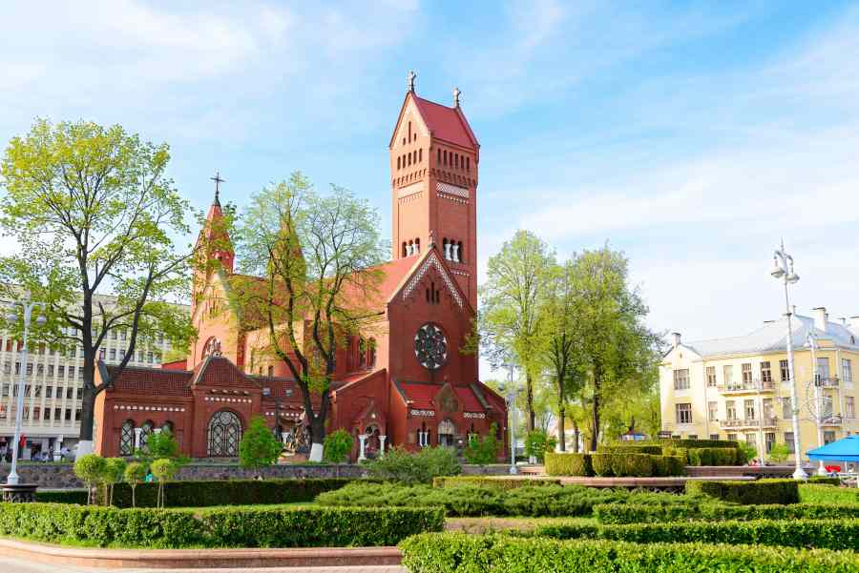
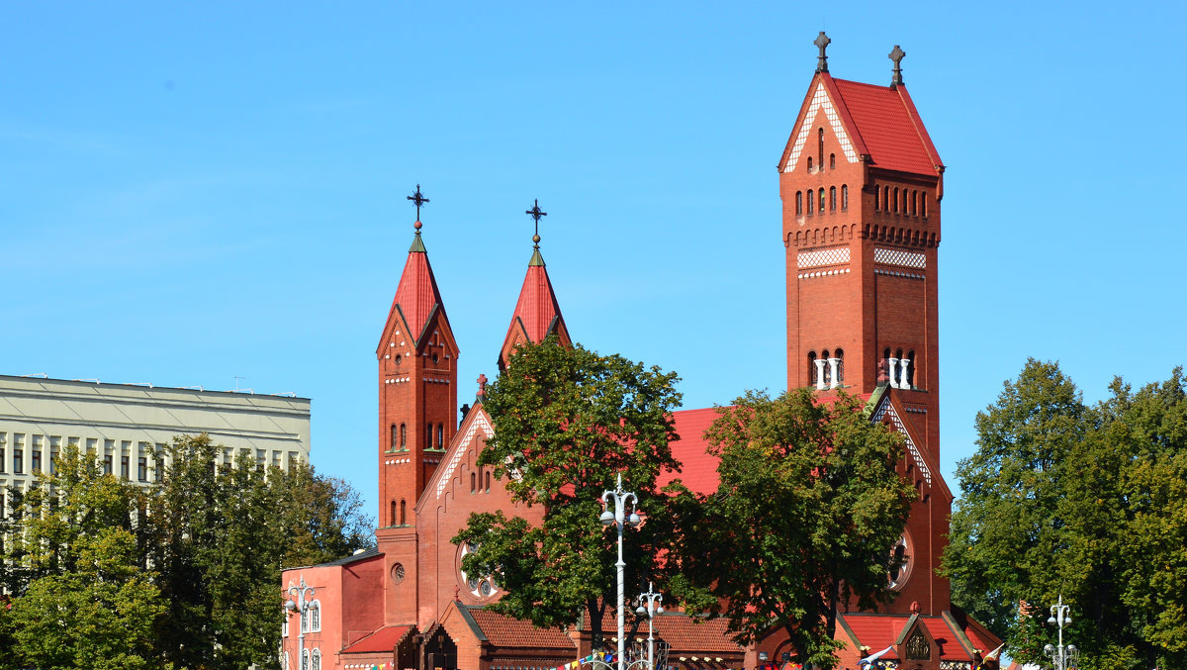
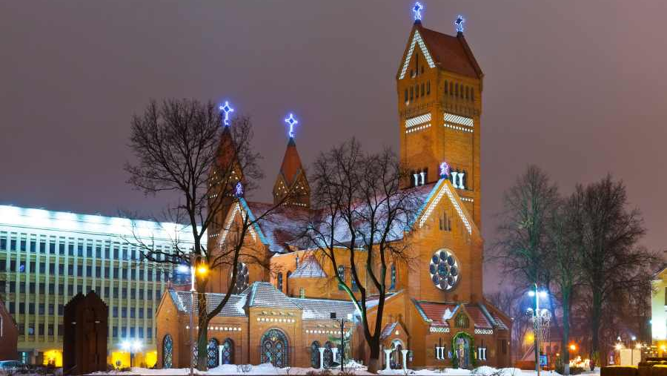
The Red Church

Slide 12
 |  |  |  |  |  |  |  | 1
 |  |  |  |  |  |  |  | L
 |  |  |  |  |  | 2 | R | E | D
 |  |  |  |  |  |  |  | B
 |  |  |  |  |  |  |  | Y
3 |  |  |  |  |  |  |  | A
 |  |  | 4 |  |  | 5 |  | Z
 |  |  |  |  |  |  |  | H
 | 6 |  |  |  |  |  |  | Y
7 |  |  |  |  |  |  |  |  |  |  | 8
 |  |  |  | 9 |  |  |  |  |  |  |  |  |  |  |  | 10
 |  |  | 11
3. Today it has plants from all around the world.
It's a … Garden.

Slide 13
 |  |  |  |  |  |  |  | 1
 |  |  |  |  |  |  |  | L
 |  |  |  |  |  | 2 | R | E | D
 |  |  |  |  |  |  |  | B
 |  |  |  |  |  |  |  | Y
3 | B | O | T | A | N | I | C | A | L
 |  |  | 4 |  |  | 5 |  | Z
 |  |  |  |  |  |  |  | H
 | 6 |  |  |  |  |  |  | Y
7 |  |  |  |  |  |  |  |  |  |  | 8
 |  |  |  | 9 |  |  |  |  |  |  |  |  |  |  |  | 10
 |  |  | 11
3. Today it has plants from all around the world.
It's a … Garden.

Slide 14

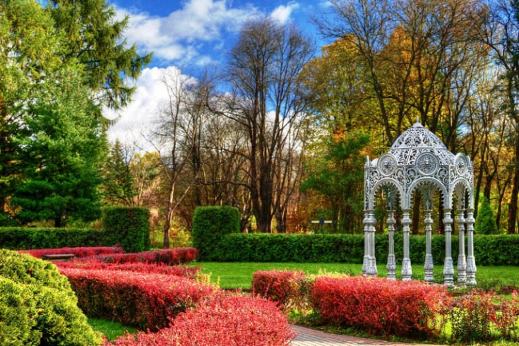
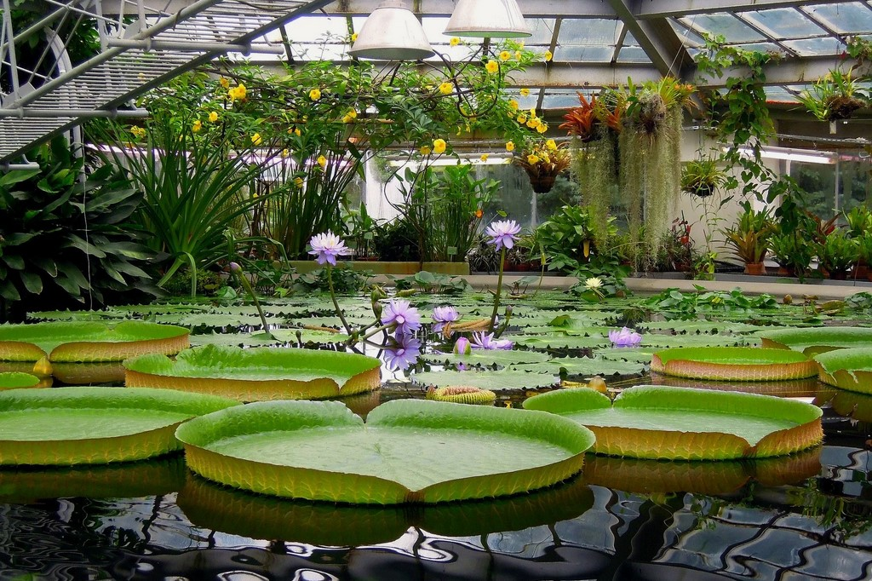
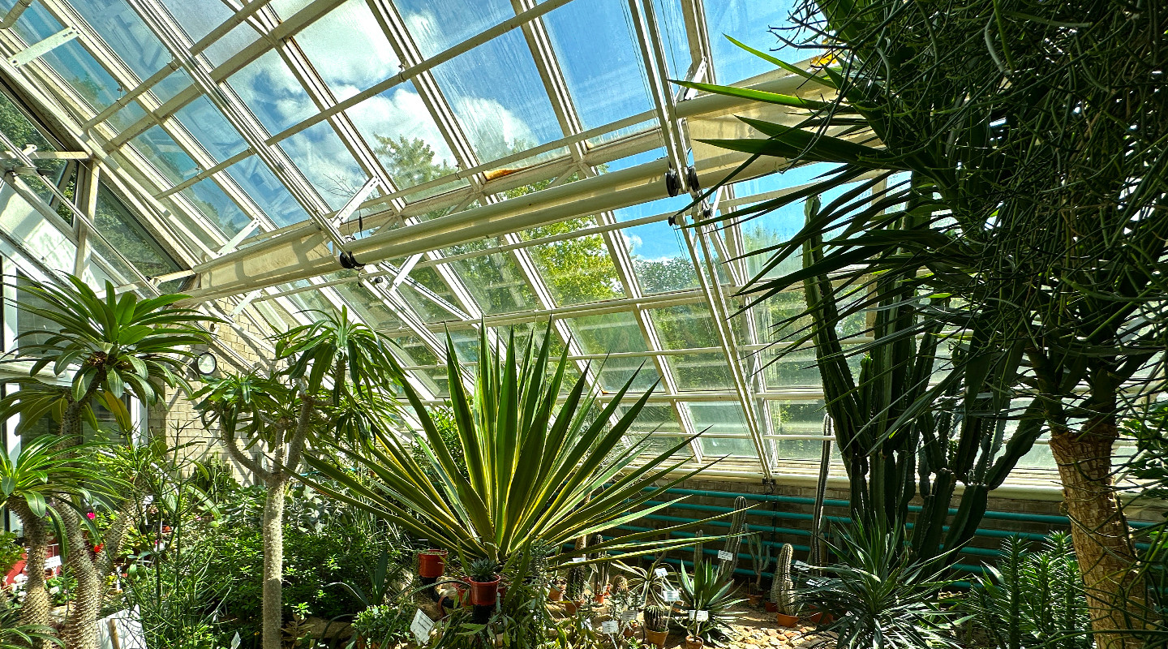
The Botanical Garden

Slide 15
 |  |  |  |  |  |  |  | 1
 |  |  |  |  |  |  |  | L
 |  |  |  |  |  | 2 | R | E | D
 |  |  |  |  |  |  |  | B
 |  |  |  |  |  |  |  | Y
3 | B | O | T | A | N | I | C | A | L
 |  |  | 4 |  |  | 5 |  | Z
 |  |  |  |  |  |  |  | H
 | 6 |  |  |  |  |  |  | Y
7 |  |  |  |  |  |  |  |  |  |  | 8
 |  |  |  | 9 |  |  |  |  |  |  |  |  |  |  |  | 10
 |  |  | 11
4. It's situated next to Gorky Park.

Slide 16
 |  |  |  |  |  |  |  | 1
 |  |  |  |  |  |  |  | L
 |  |  |  |  |  | 2 | R | E | D
 |  |  |  |  |  |  |  | B
 |  |  |  |  |  |  |  | Y
3 | B | O | T | A | N | I | C | A | L
 |  |  | 4 |  |  | 5 |  | Z
 |  |  | C |  |  |  |  | H
 | 6 |  | I |  |  |  |  | Y
 |  |  | R
7 |  |  | C |  |  |  |  |  |  |  | 8
 |  |  | U
 |  |  | S | 9 |  |  |  |  |  |  |  |  |  |  |  | 10
 |  |  | 11
4. It's situated next to Gorky Park.

Slide 17
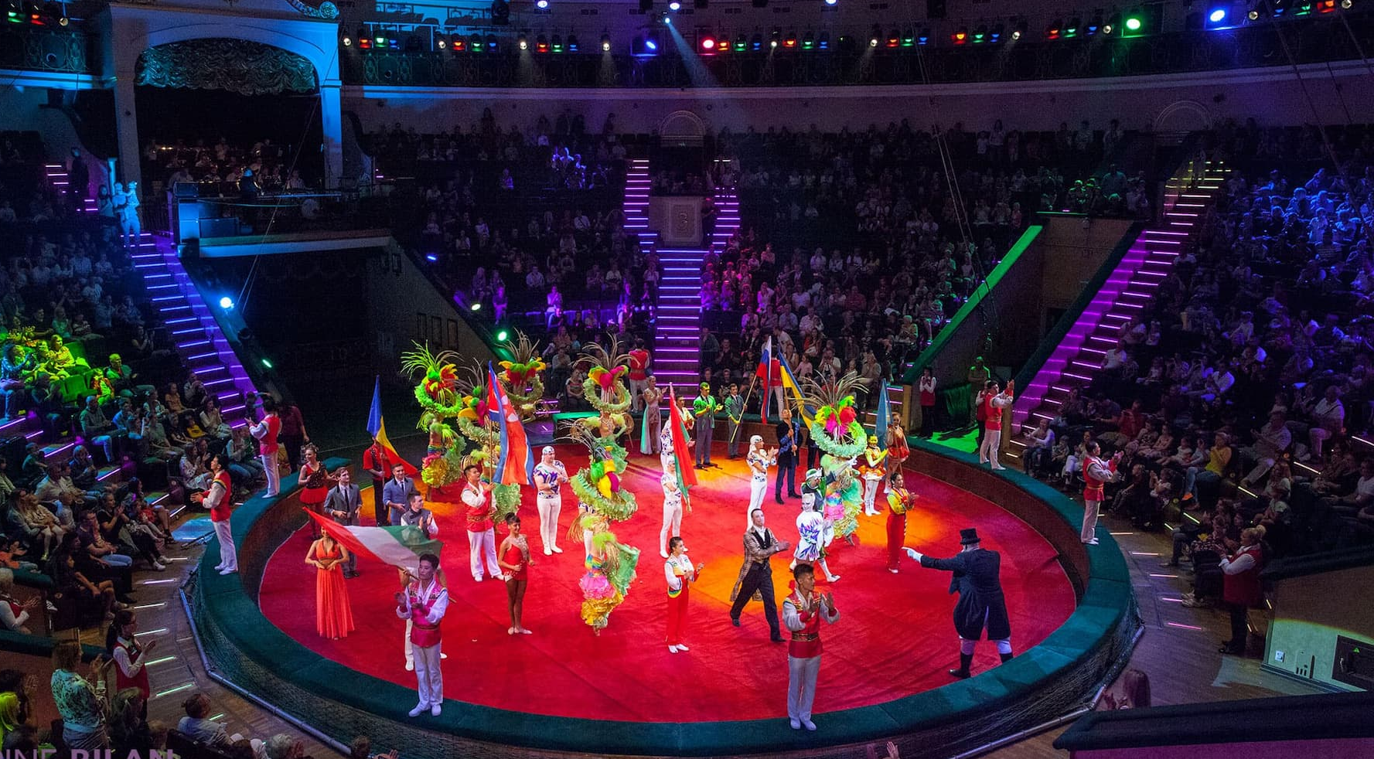
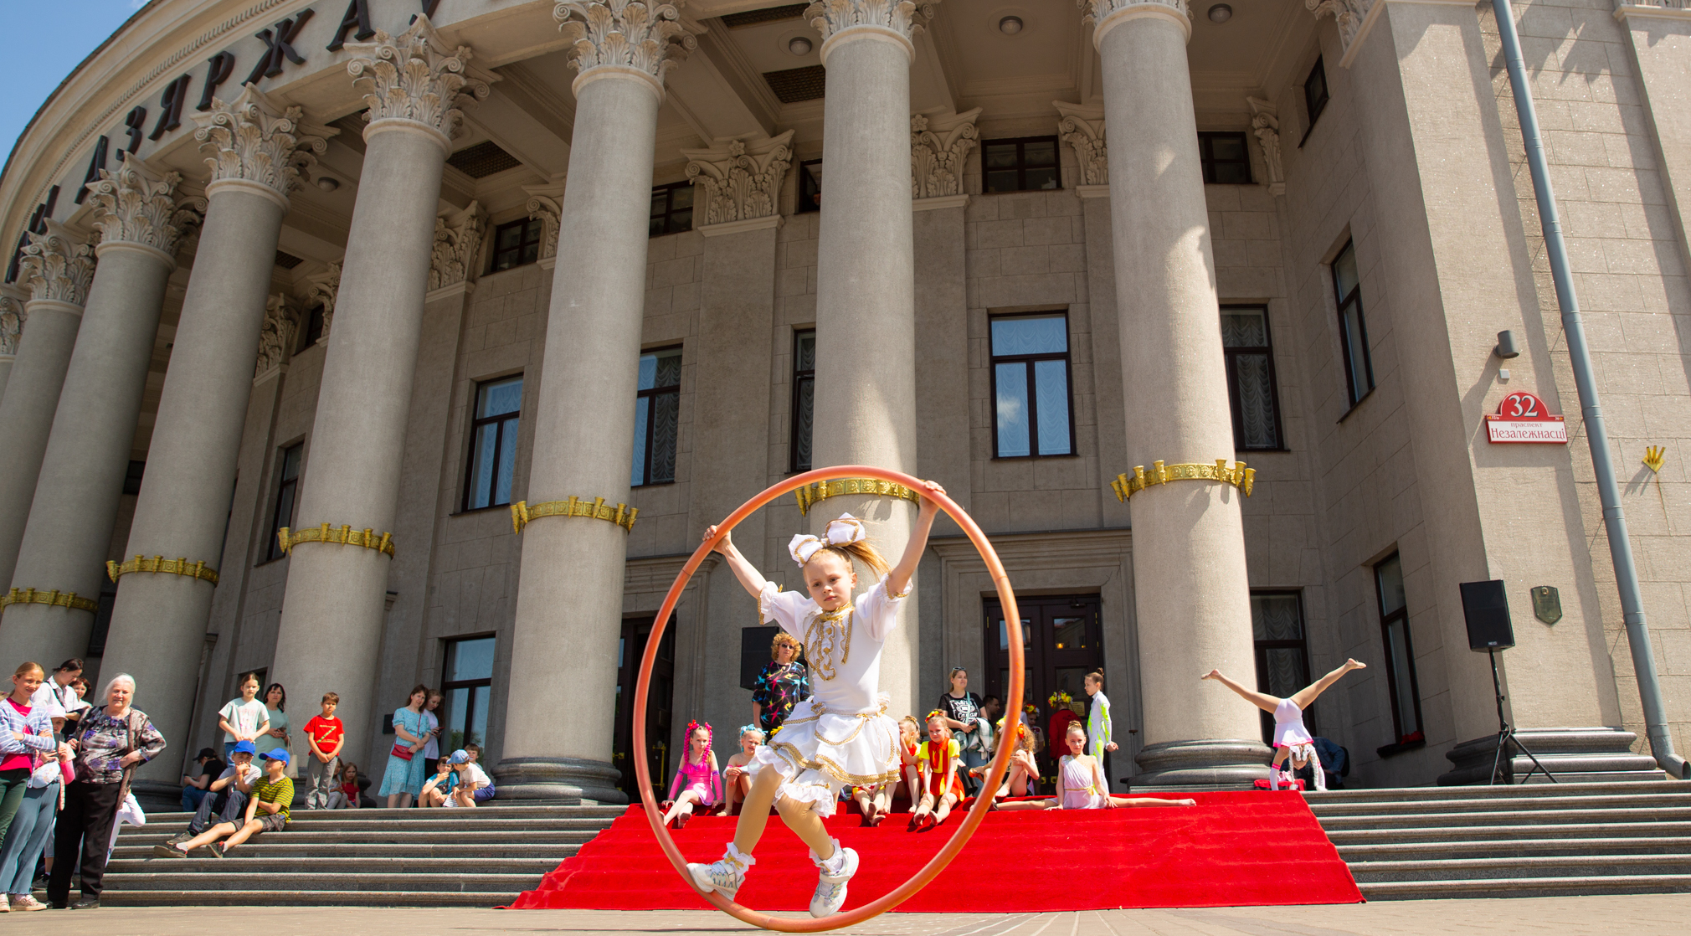
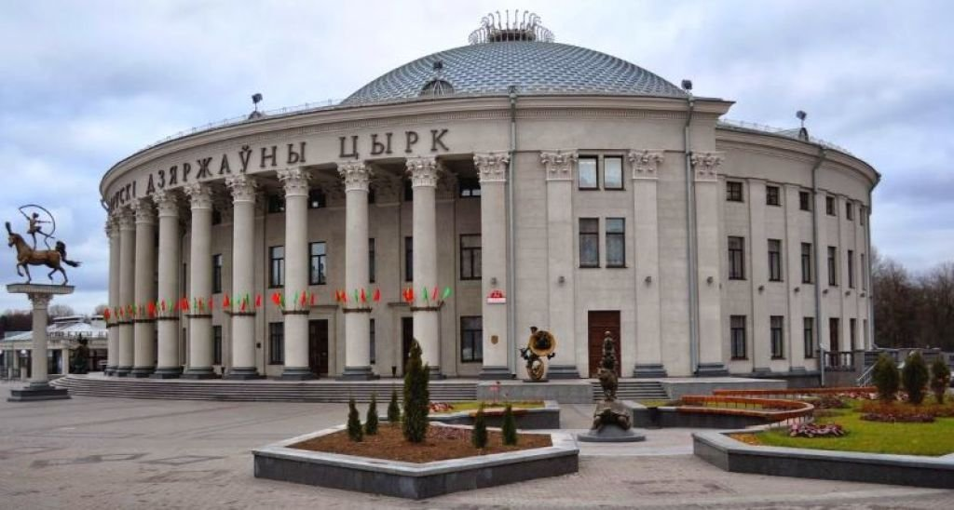
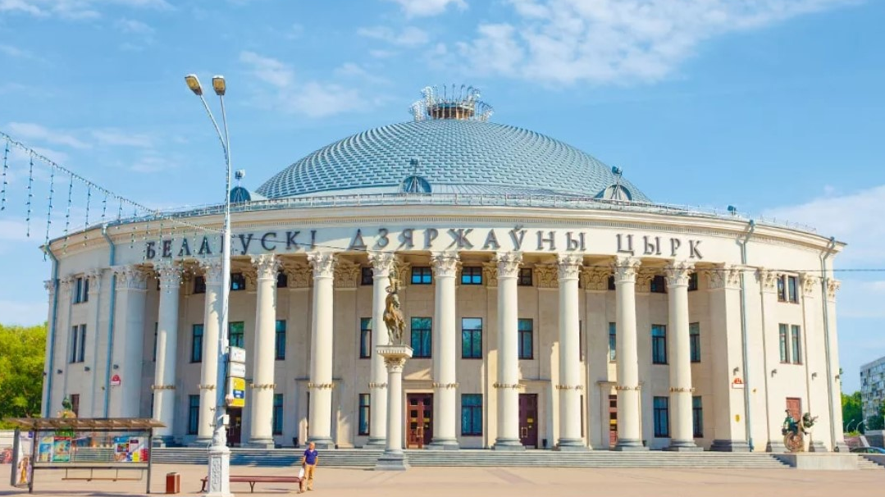
The Belarusian State Circus

Slide 18
 |  |  |  |  |  |  |  | 1
 |  |  |  |  |  |  |  | L
 |  |  |  |  |  | 2 | R | E | D
 |  |  |  |  |  |  |  | B
 |  |  |  |  |  |  |  | Y
3 | B | O | T | A | N | I | C | A | L
 |  |  | 4 |  |  | 5 |  | Z
 |  |  | C |  |  |  |  | H
 | 6 |  | I |  |  |  |  | Y
 |  |  | R
7 |  |  | C |  |  |  |  |  |  |  | 8
 |  |  | U
 |  |  | S | 9 |  |  |  |  |  |  |  |  |  |  |  | 10
 |  |  | 11
5. This museum contains more than 40.000 Wartime photos. It's called the Museum of the History of the Great … War.

Slide 19
 |  |  |  |  |  |  |  | 1
 |  |  |  |  |  |  |  | L
 |  |  |  |  |  | 2 | R | E | D
 |  |  |  |  |  |  |  | B
 |  |  |  |  |  |  |  | Y
3 | B | O | T | A | N | I | C | A | L
 |  |  | 4 |  |  | 5 |  | Z
 |  |  | C |  |  | P |  | H
 | 6 |  | I |  |  | A |  | Y
 |  |  | R |  |  | T
7 |  |  | C |  |  | R |  |  |  |  | 8
 |  |  | U |  |  | I
 |  |  | S | 9 |  | O |  |  |  |  |  |  |  |  |  | 10
 |  |  |  |  |  | T
 |  |  | 11 |  |  | I
 |  |  |  |  |  | C
5. This museum contains more than 40.000 Wartime photos. It's called the Museum of the History of the Great … War.

Slide 20
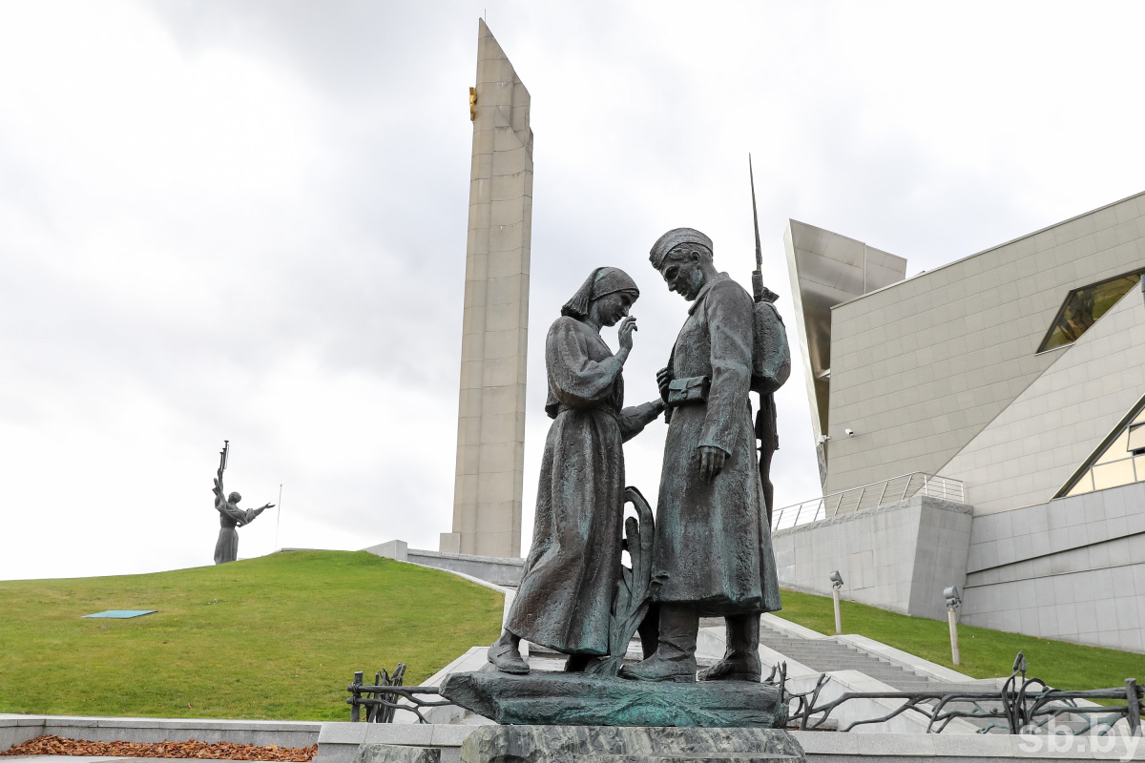
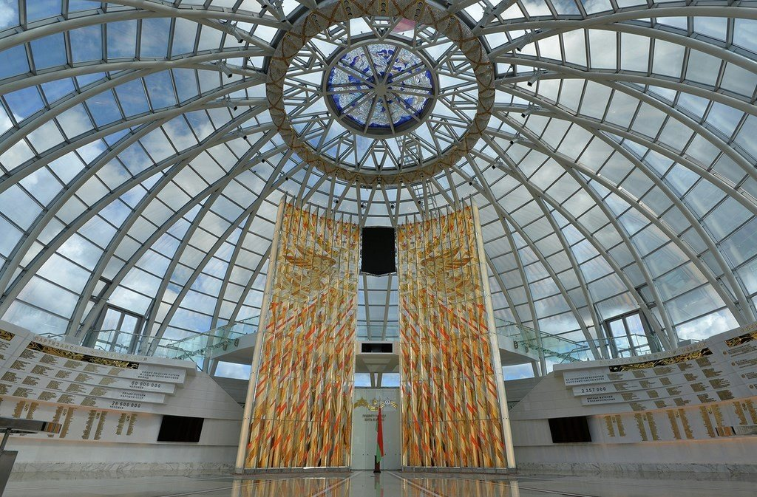
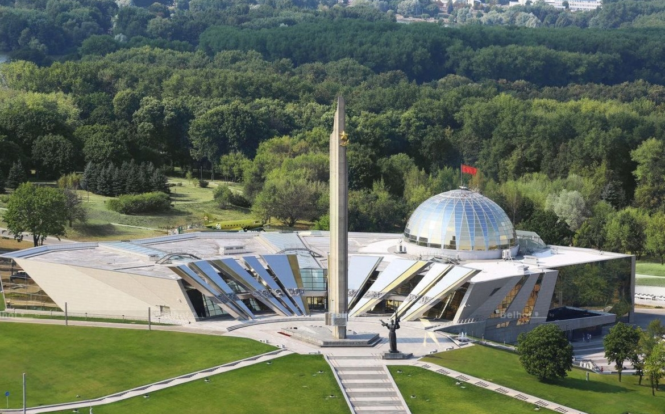
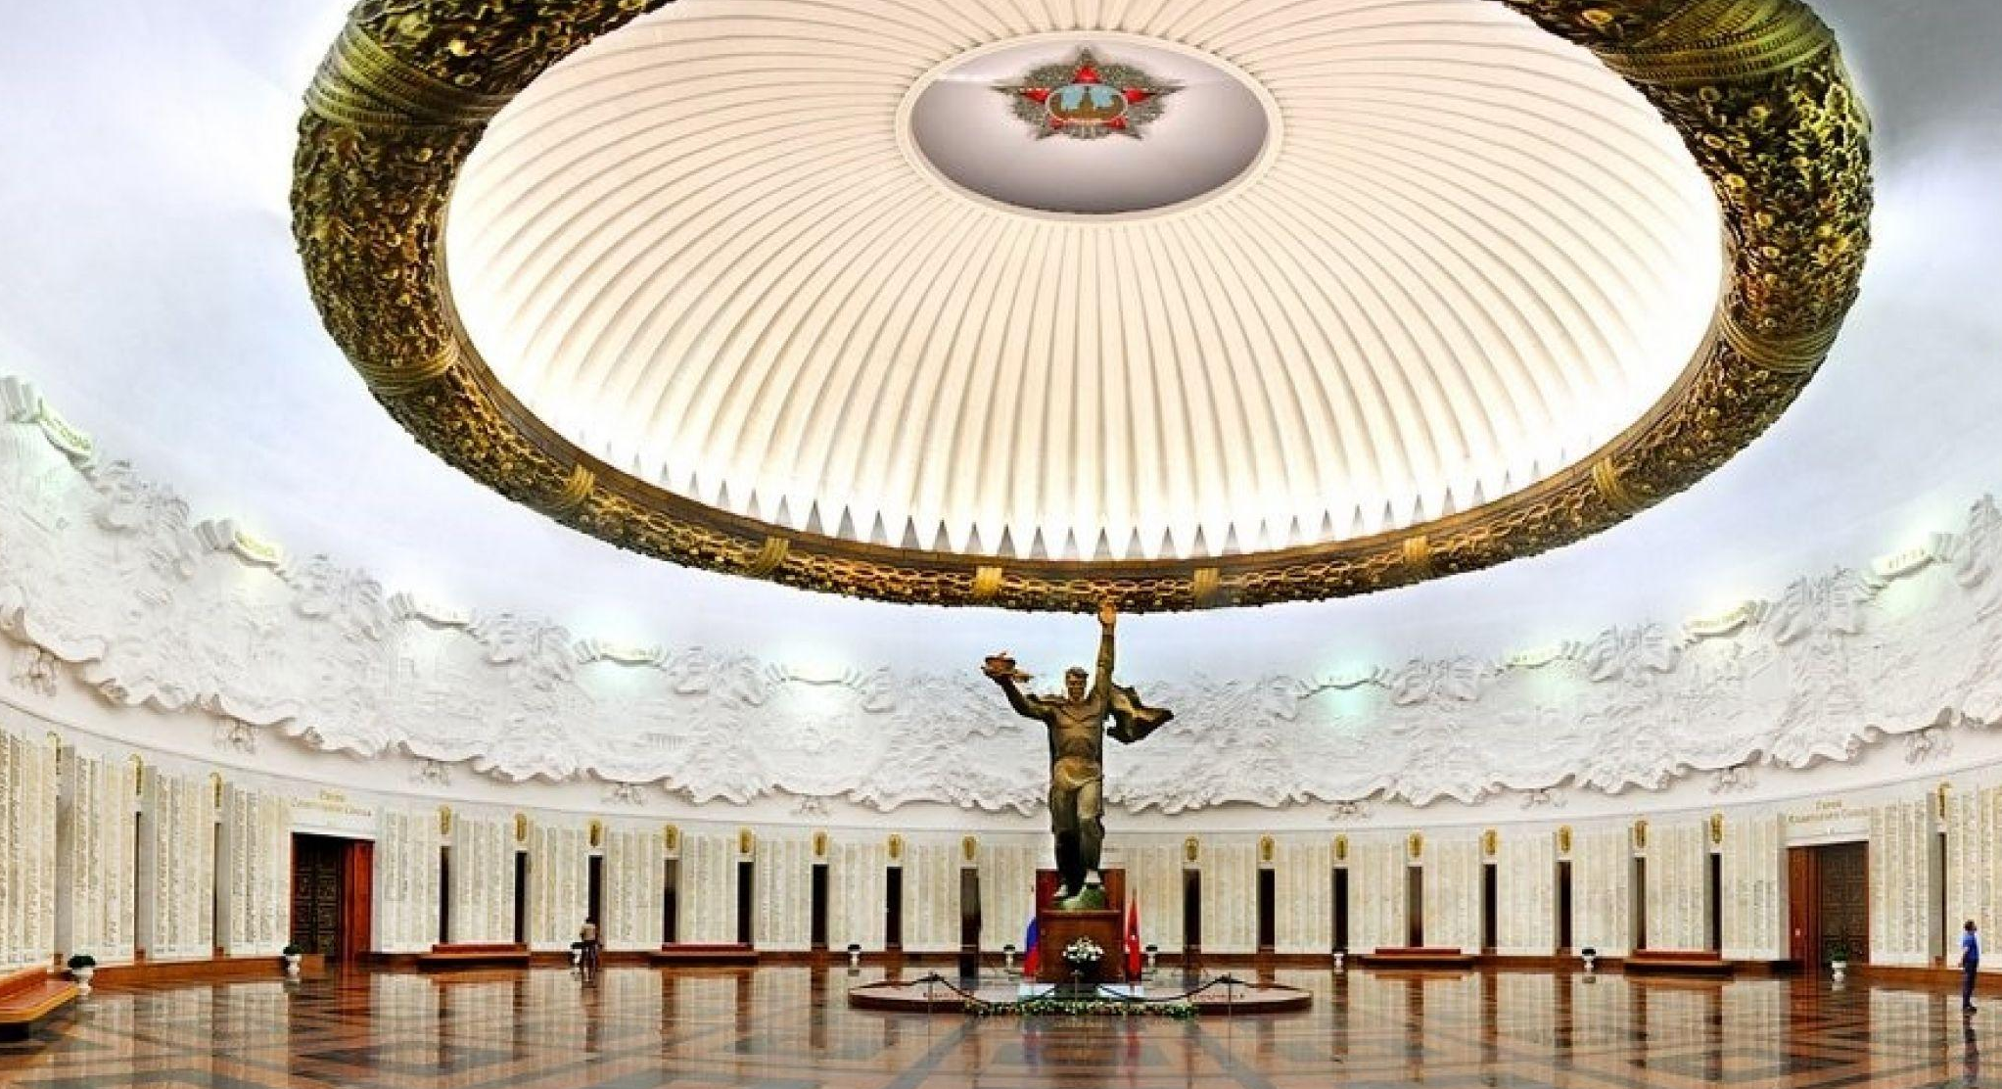
The Museum of the History of the Great Patriotic War

Slide 21
 |  |  |  |  |  |  |  | 1
 |  |  |  |  |  |  |  | L
 |  |  |  |  |  | 2 | R | E | D
 |  |  |  |  |  |  |  | B
 |  |  |  |  |  |  |  | Y
3 | B | O | T | A | N | I | C | A | L
 |  |  | 4 |  |  | 5 |  | Z
 |  |  | C |  |  | P |  | H
 | 6 |  | I |  |  | A |  | Y
 |  |  | R |  |  | T
7 |  |  | C |  |  | R |  |  |  |  | 8
 |  |  | U |  |  | I
 |  |  | S | 9 |  | O |  |  |  |  |  |  |  |  |  | 10
 |  |  |  |  |  | T
 |  |  | 11 |  |  | I
 |  |  |  |  |  | C
6. It's in the form of a diamond.

Slide 22
 |  |  |  |  |  |  |  | 1
 |  |  |  |  |  |  |  | L
 |  |  |  |  |  | 2 | R | E | D
 |  |  |  |  |  |  |  | B
 |  |  |  |  |  |  |  | Y
3 | B | O | T | A | N | I | C | A | L
 |  |  | 4 |  |  | 5 |  | Z
 |  |  | C |  |  | P |  | H
 | 6 | L | I | B | R | A | R | Y
 |  |  | R |  |  | T
7 |  |  | C |  |  | R |  |  |  |  | 8
 |  |  | U |  |  | I
 |  |  | S | 9 |  | O |  |  |  |  |  |  |  |  |  | 10
 |  |  |  |  |  | T
 |  |  | 11 |  |  | I
 |  |  |  |  |  | C
6. It's in the form of a diamond.

Slide 23
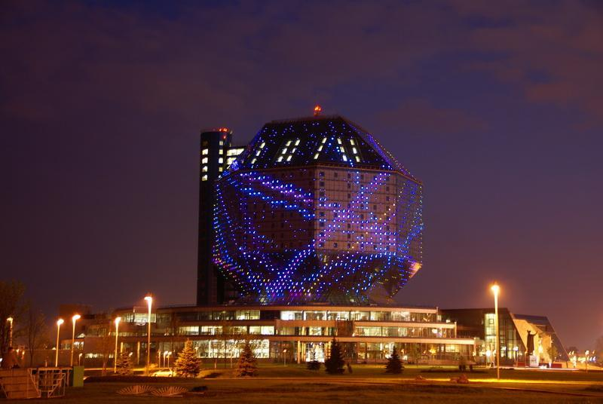
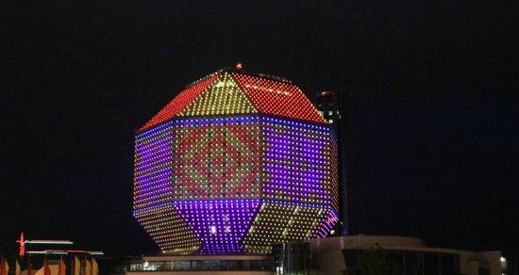
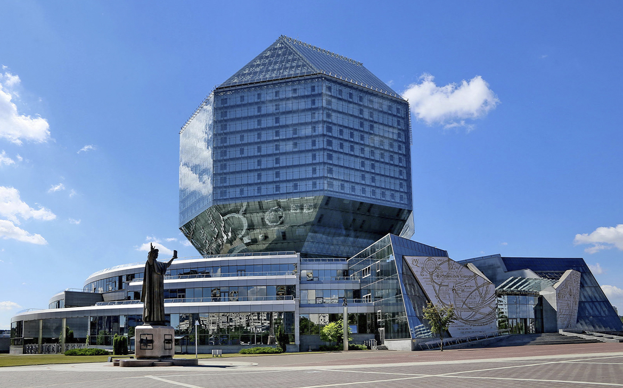
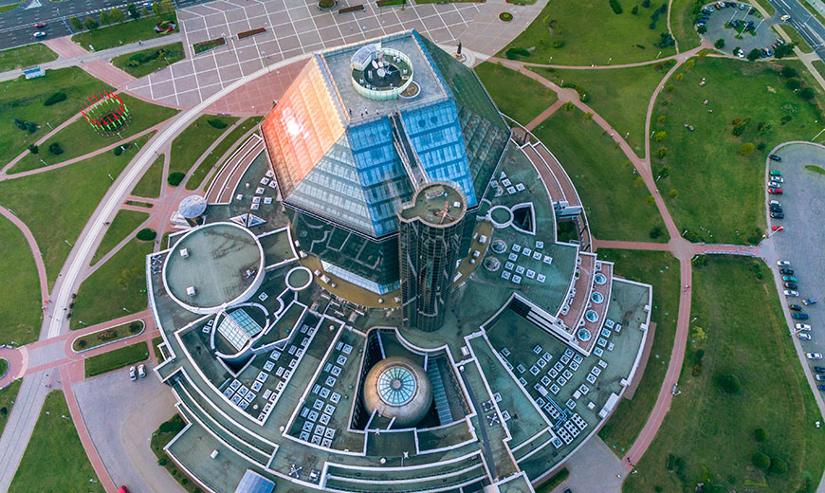
The National Library

Slide 24
 |  |  |  |  |  |  |  | 1
 |  |  |  |  |  |  |  | L
 |  |  |  |  |  | 2 | R | E | D
 |  |  |  |  |  |  |  | B
 |  |  |  |  |  |  |  | Y
3 | B | O | T | A | N | I | C | A | L
 |  |  | 4 |  |  | 5 |  | Z
 |  |  | C |  |  | P |  | H
 | 6 | L | I | B | R | A | R | Y
 |  |  | R |  |  | T
7 |  |  | C |  |  | R |  |  |  |  | 8
 |  |  | U |  |  | I
 |  |  | S | 9 |  | O |  |  |  |  |  |  |  |  |  | 10
 |  |  |  |  |  | T
 |  |  | 11 |  |  | I
 |  |  |  |  |  | C
7. The monument with an eternal fire is located in … Square.

Slide 25
 |  |  |  |  |  |  |  | 1
 |  |  |  |  |  |  |  | L
 |  |  |  |  |  | 2 | R | E | D
 |  |  |  |  |  |  |  | B
 |  |  |  |  |  |  |  | Y
3 | B | O | T | A | N | I | C | A | L
 |  |  | 4 |  |  | 5 |  | Z
 |  |  | C |  |  | P |  | H
 | 6 | L | I | B | R | A | R | Y
 |  |  | R |  |  | T
7 | V | I | C | T | O | R | Y |  |  |  | 8
 |  |  | U |  |  | I
 |  |  | S | 9 |  | O |  |  |  |  |  |  |  |  |  | 10
 |  |  |  |  |  | T
 |  |  | 11 |  |  | I
 |  |  |  |  |  | C
7. The monument with an eternal fire is located in … Square.

Slide 26

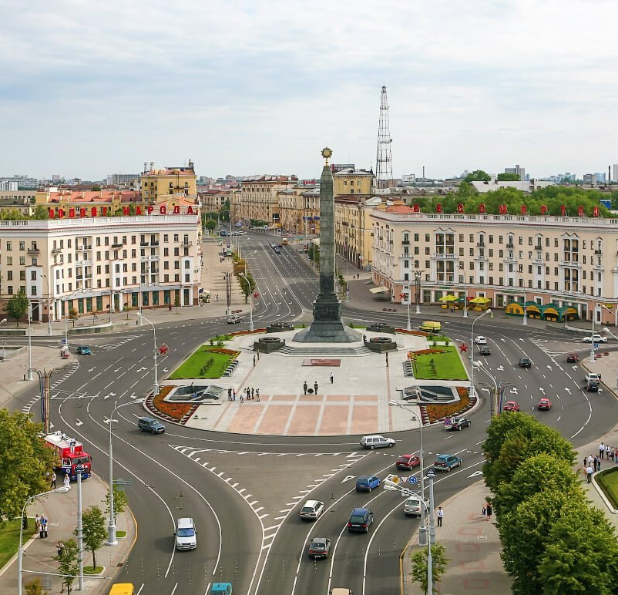
Victory Square

Slide 27
 |  |  |  |  |  |  |  | 1
 |  |  |  |  |  |  |  | L
 |  |  |  |  |  | 2 | R | E | D
 |  |  |  |  |  |  |  | B
 |  |  |  |  |  |  |  | Y
3 | B | O | T | A | N | I | C | A | L
 |  |  | 4 |  |  | 5 |  | Z
 |  |  | C |  |  | P |  | H
 | 6 | L | I | B | R | A | R | Y
 |  |  | R |  |  | T
7 | V | I | C | T | O | R | Y |  |  |  | 8
 |  |  | U |  |  | I
 |  |  | S | 9 |  | O |  |  |  |  |  |  |  |  |  | 10
 |  |  |  |  |  | T
 |  |  | 11 |  |  | I
 |  |  |  |  |  | C
8. It's one of the biggest ice arenas. … Arena.

Slide 28
 |  |  |  |  |  |  |  | 1
 |  |  |  |  |  |  |  | L
 |  |  |  |  |  | 2 | R | E | D
 |  |  |  |  |  |  |  | B
 |  |  |  |  |  |  |  | Y
3 | B | O | T | A | N | I | C | A | L
 |  |  | 4 |  |  | 5 |  | Z
 |  |  | C |  |  | P |  | H
 | 6 | L | I | B | R | A | R | Y
 |  |  | R |  |  | T
7 | V | I | C | T | O | R | Y |  |  |  | 8
 |  |  | U |  |  | I |  |  |  |  | M
 |  |  | S | 9 |  | O |  |  |  |  | I |  |  |  |  | 10
 |  |  |  |  |  | T |  |  |  |  | N
 |  |  | 11 |  |  | I |  |  |  |  | S
 |  |  |  |  |  | C |  |  |  |  | K
8. It's one of the biggest ice arenas. … Arena.

Slide 29

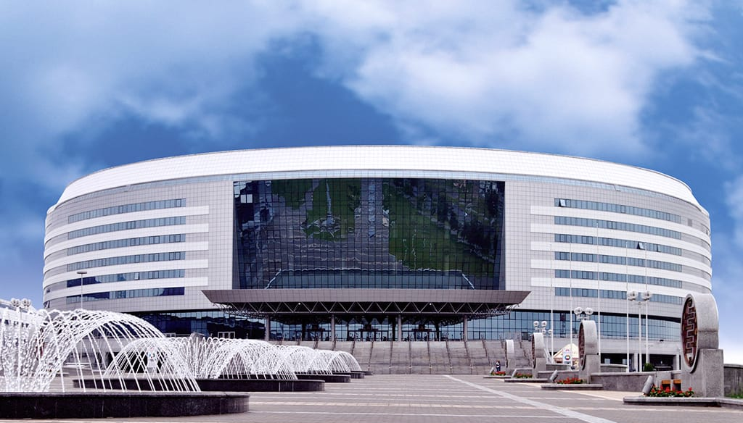
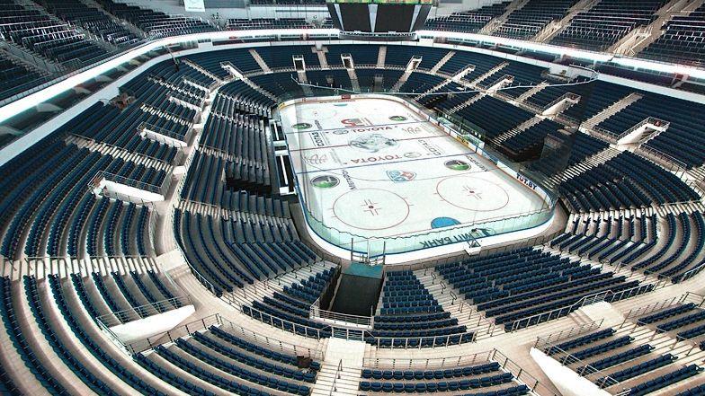
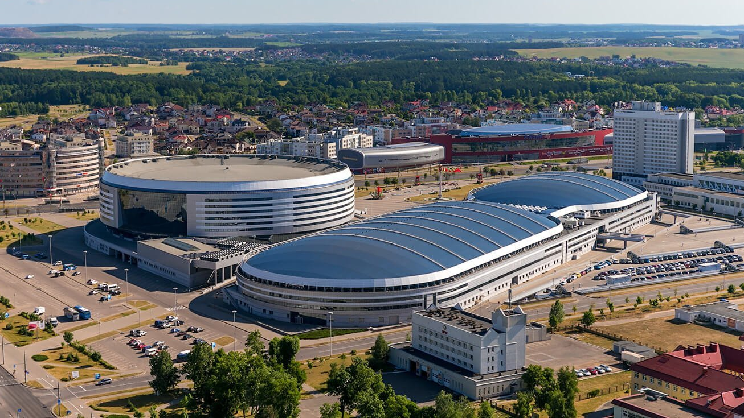
Minsk Arena

Slide 30
 |  |  |  |  |  |  |  | 1
 |  |  |  |  |  |  |  | L
 |  |  |  |  |  | 2 | R | E | D
 |  |  |  |  |  |  |  | B
 |  |  |  |  |  |  |  | Y
3 | B | O | T | A | N | I | C | A | L
 |  |  | 4 |  |  | 5 |  | Z
 |  |  | C |  |  | P |  | H
 | 6 | L | I | B | R | A | R | Y
 |  |  | R |  |  | T
7 | V | I | C | T | O | R | Y |  |  |  | 8
 |  |  | U |  |  | I |  |  |  |  | M
 |  |  | S | 9 |  | O |  |  |  |  | I |  |  |  |  | 10
 |  |  |  |  |  | T |  |  |  |  | N
 |  |  | 11 |  |  | I |  |  |  |  | S
 |  |  |  |  |  | C |  |  |  |  | K
9. The Opera and Ballet House is also called … Theater.

Slide 31
 |  |  |  |  |  |  |  | 1
 |  |  |  |  |  |  |  | L
 |  |  |  |  |  | 2 | R | E | D
 |  |  |  |  |  |  |  | B
 |  |  |  |  |  |  |  | Y
3 | B | O | T | A | N | I | C | A | L
 |  |  | 4 |  |  | 5 |  | Z
 |  |  | C |  |  | P |  | H
 | 6 | L | I | B | R | A | R | Y
 |  |  | R |  |  | T
7 | V | I | C | T | O | R | Y |  |  |  | 8
 |  |  | U |  |  | I |  |  |  |  | M
 |  |  | S | 9 | B | O | L | S | H | O | I |  |  |  |  | 10
 |  |  |  |  |  | T |  |  |  |  | N
 |  |  | 11 |  |  | I |  |  |  |  | S
 |  |  |  |  |  | C |  |  |  |  | K
9. The Opera and Ballet House is also called … Theater.

Slide 32
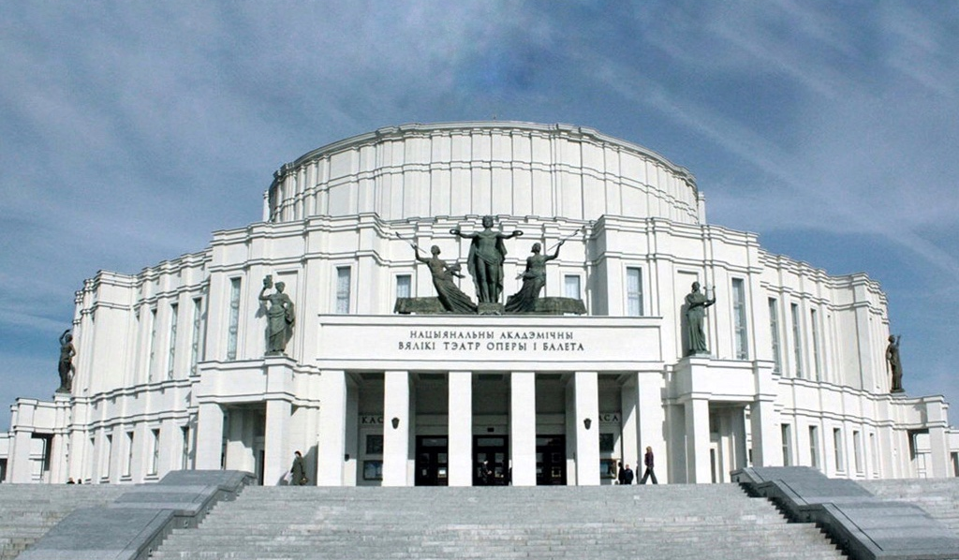
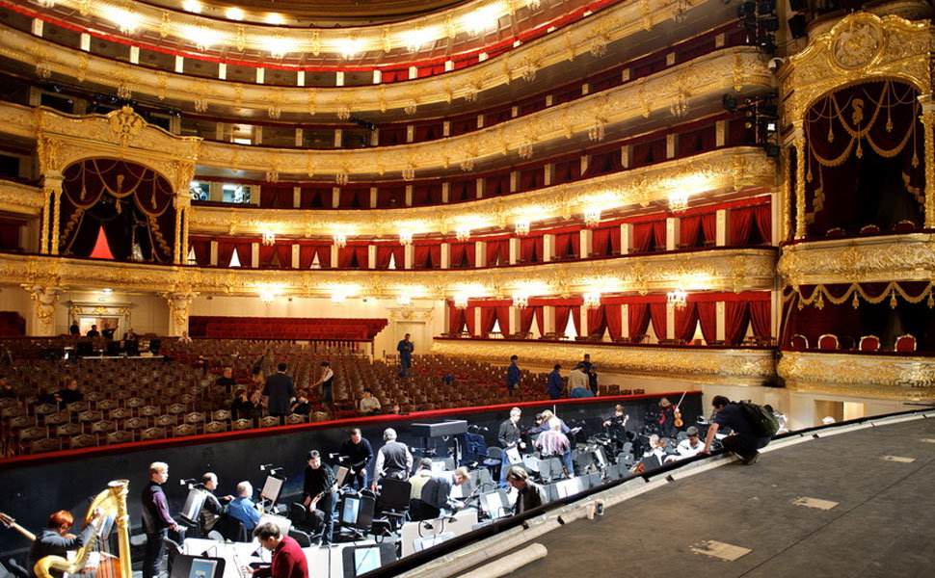
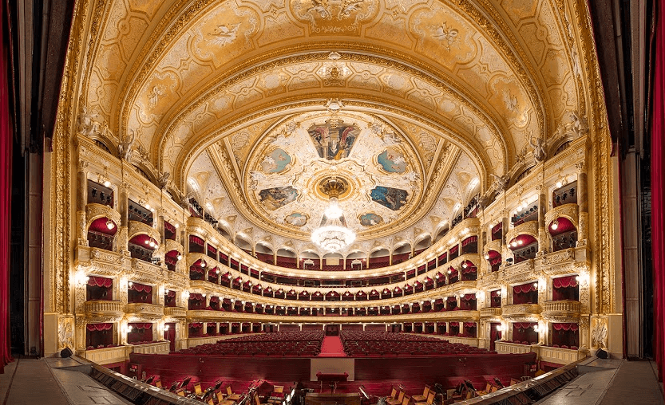

The National Opera and Ballet House

Slide 33
 |  |  |  |  |  |  |  | 1
 |  |  |  |  |  |  |  | L
 |  |  |  |  |  | 2 | R | E | D
 |  |  |  |  |  |  |  | B
 |  |  |  |  |  |  |  | Y
3 | B | O | T | A | N | I | C | A | L
 |  |  | 4 |  |  | 5 |  | Z
 |  |  | C |  |  | P |  | H
 | 6 | L | I | B | R | A | R | Y
 |  |  | R |  |  | T
7 | V | I | C | T | O | R | Y |  |  |  | 8
 |  |  | U |  |  | I |  |  |  |  | M
 |  |  | S | 9 | B | O | L | S | H | O | I |  |  |  |  | 10
 |  |  |  |  |  | T |  |  |  |  | N
 |  |  | 11 |  |  | I |  |  |  |  | S
 |  |  |  |  |  | C |  |  |  |  | K
10. It's all children's favorite … Park.

Slide 34
 |  |  |  |  |  |  |  | 1
 |  |  |  |  |  |  |  | L
 |  |  |  |  |  | 2 | R | E | D
 |  |  |  |  |  |  |  | B
 |  |  |  |  |  |  |  | Y
3 | B | O | T | A | N | I | C | A | L
 |  |  | 4 |  |  | 5 |  | Z
 |  |  | C |  |  | P |  | H
 | 6 | L | I | B | R | A | R | Y
 |  |  | R |  |  | T
7 | V | I | C | T | O | R | Y |  |  |  | 8
 |  |  | U |  |  | I |  |  |  |  | M
 |  |  | S | 9 | B | O | L | S | H | O | I |  |  |  |  | 10
 |  |  |  |  |  | T |  |  |  |  | N |  |  |  |  | G
 |  |  | 11 |  |  | I |  |  |  |  | S |  |  |  |  | O
 |  |  |  |  |  | C |  |  |  |  | K |  |  |  |  | R
 |  |  |  |  |  |  |  |  |  |  |  |  |  |  |  | K
 |  |  |  |  |  |  |  |  |  |  |  |  |  |  |  | Y
10. It's all children's favorite … Park.

Slide 35
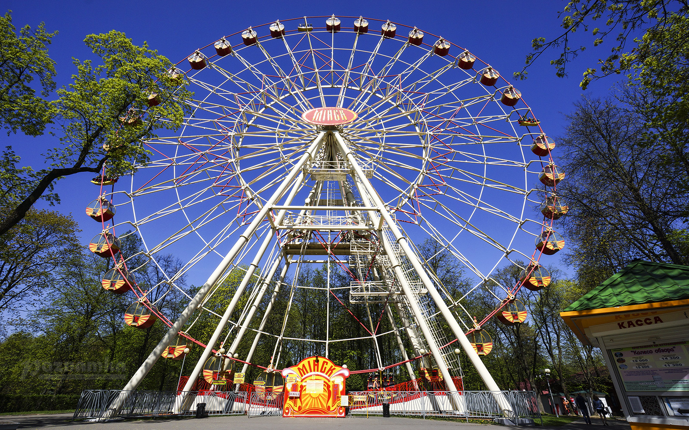
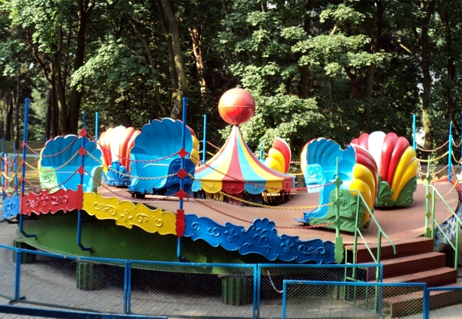
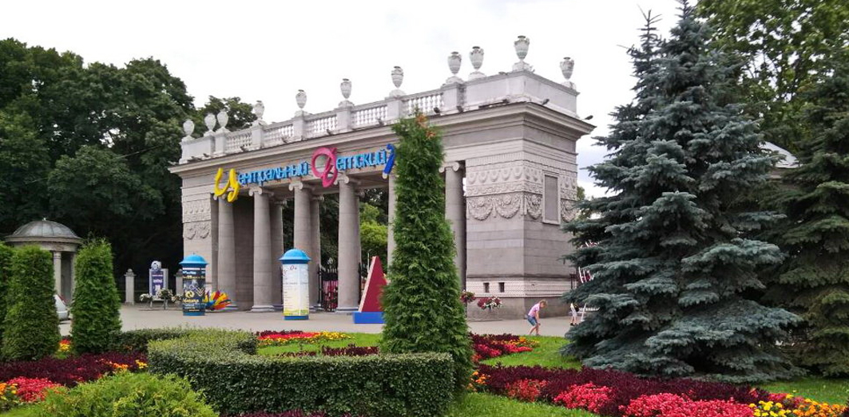
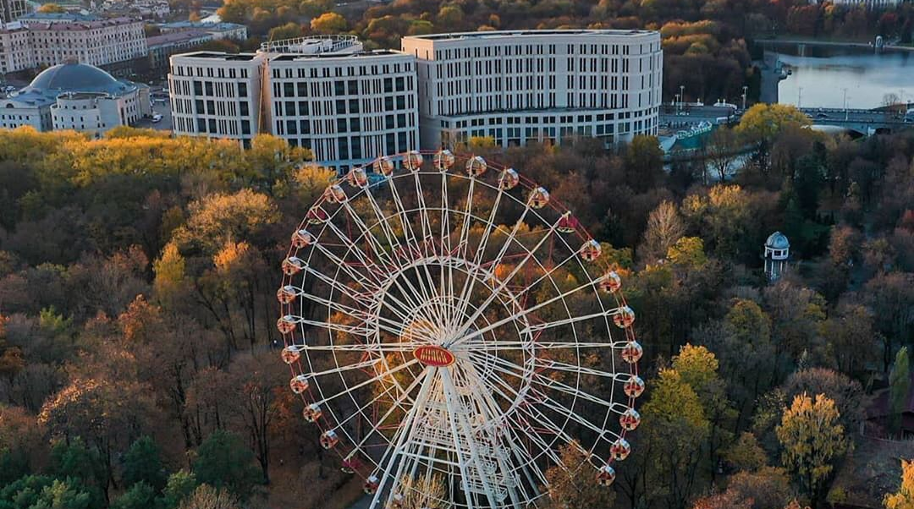
Gorky Park

Slide 36
 |  |  |  |  |  |  |  | 1
 |  |  |  |  |  |  |  | L
 |  |  |  |  |  | 2 | R | E | D
 |  |  |  |  |  |  |  | B
 |  |  |  |  |  |  |  | Y
3 | B | O | T | A | N | I | C | A | L
 |  |  | 4 |  |  | 5 |  | Z
 |  |  | C |  |  | P |  | H
 | 6 | L | I | B | R | A | R | Y
 |  |  | R |  |  | T
7 | V | I | C | T | O | R | Y |  |  |  | 8
 |  |  | U |  |  | I |  |  |  |  | M
 |  |  | S | 9 | B | O | L | S | H | O | I |  |  |  |  | 10
 |  |  |  |  |  | T |  |  |  |  | N |  |  |  |  | G
 |  |  | 11 |  |  | I |  |  |  |  | S |  |  |  |  | O
 |  |  |  |  |  | C |  |  |  |  | K |  |  |  |  | R
 |  |  |  |  |  |  |  |  |  |  |  |  |  |  |  | K
 |  |  |  |  |  |  |  |  |  |  |  |  |  |  |  | Y
11. This modern building was built in 2001.

Slide 37
 |  |  |  |  |  |  |  | 1
 |  |  |  |  |  |  |  | L
 |  |  |  |  |  | 2 | R | E | D
 |  |  |  |  |  |  |  | B
 |  |  |  |  |  |  |  | Y
3 | B | O | T | A | N | I | C | A | L
 |  |  | 4 |  |  | 5 |  | Z
 |  |  | C |  |  | P |  | H
 | 6 | L | I | B | R | A | R | Y
 |  |  | R |  |  | T
7 | V | I | C | T | O | R | Y |  |  |  | 8
 |  |  | U |  |  | I |  |  |  |  | M
 |  |  | S | 9 | B | O | L | S | H | O | I |  |  |  |  | 10
 |  |  |  |  |  | T |  |  |  |  | N |  |  |  |  | G
 |  |  | 11 | R | A | I | L | W | A | Y | S | T | A | T | I | O | N
 |  |  |  |  |  | C |  |  |  |  | K |  |  |  |  | R
 |  |  |  |  |  |  |  |  |  |  |  |  |  |  |  | K
 |  |  |  |  |  |  |  |  |  |  |  |  |  |  |  | Y
11. This modern building was built in 2001.

Slide 38
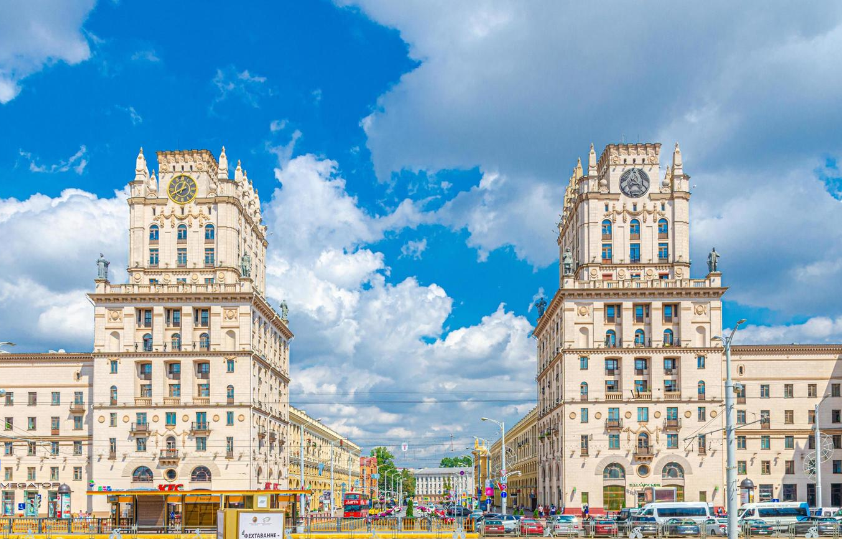
The Railway Station

Slide 39
TEAM WORK
CREATE ONE DAY TOUR
AROUND MINSK
Follow the steps below:
1. Choose the main sights which will be interesting for tourists.
2. Do some research and find some information about the sights.
3. Write a short description of each place.
4. Create an advertisement for your guided tour.
5. Draw the route of your tour on the Ziteboard.
6. Use the expressions from the help box.
7. Place the names of the sights around the classroom.
8. Take your classmates on your guided tour. Use the phrases from the box.

Slide 40

THANKS FOR YOUR WORK!
HOMEWORK:
Write a letter in response to Sophie's letter with advice on what attractions are worth visiting in Minsk. (20 sentences )

