Slide 1
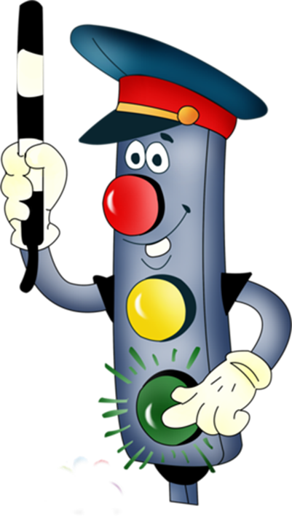
Today is the 5th of February
Jeopardy Game
On the Move
Иванова Вера Владимировна,
Учитель английского языка
МБОУ «Красноармейская СОШ»
Красноармейского муниципального округа

Slide 2

https://resh.edu.ru/subject/lesson/6716/main/231711/

Slide 3
Listening | 100 | 200 | 300 | 400
Reading | 100 | 200 | 300 | 400
Vocabulary | 100 | 200 | 300 | 400
Grammar | 100 | 200 | 300 | 400
Speaking | 100 | 200 | 300 | 400

Slide 4
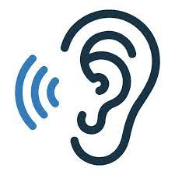
Listen to the interview with a traffic warden and cross out the incorrect sentences: https://resh.edu.ru/subject/lesson/6716/train/231722/

Slide 5
Mr. Johns thinks that some traffic rules are less important than the others.
Mr. Johns says that pedestrians never break traffic rules.

Slide 6
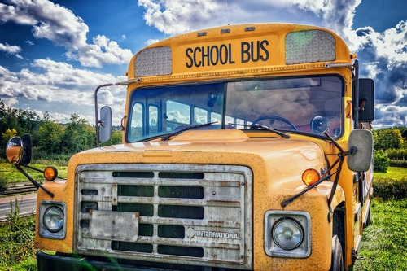
Listen to the speaker and underline the correct answer: https://resh.edu.ru/subject/lesson/6716/train/231728/

Slide 7
1) The teacher is going to go by car.
(True / False)
2) The children will visit the city concert hall.
(True / False)
3) There will be a professional guide.
(True / False)
4) The kids should talk to the driver on the bus.
(True / False)
5) The kids mustn’t push the others on the bus.
(True / False)
6) The teacher asked the pupils to be noisy.
(True / False)

Slide 8
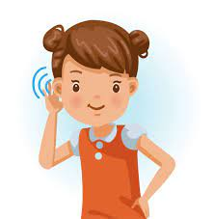
Listen and say the translations of the words:

Slide 9
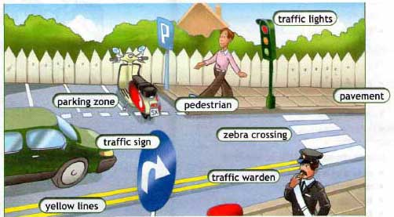
дорожный знак - traffic sign регулировщик - traffic warden пешеходный переход - zebra crossing светофор - traffic light ремень безопасности - seat belt

Slide 10
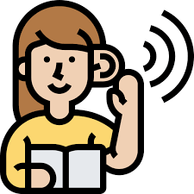
Listen and say the translations of the words:

Slide 11
высовываться в окно - lean out of the window переходить дорогу - walk straight across the road дверная ручка - door handle поток движения - the flow of traffic смотреть в обе стороны – look both ways

Slide 12
Read the traffic rules and highlight those which tell about safety while travelling by bus:
Look for a zebra crossing or a traffic light.
Listen and look both ways for traffic.
Check your brakes before driving.
Don’t annoy the other passengers.
Stand still until the bus stopped completely.
Sit in the back seat if you are under twelve years old.
Don’t lean out of the window.
Don’t talk to the driver.

Slide 13
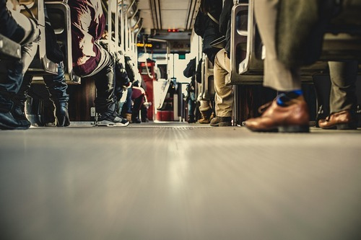
Don’t annoy the other passengers.
Stand still until the bus stopped completely.
Don’t lean out of the window.
Don’t talk to the driver.

Slide 14
Read the text and underline the correct title
While using this kind of transport you must follow a couple of simple rules to stay safe. First of all, you must check the working condition, such as tyres, brakes, etc. Secondly, you must wear a special helmet. Thirdly, you should wear bright clothes in the daytime and white clothes in the dark. It is safe to ride in the flow of traffic, not against it. And finally, never carry the second person as it’s dangerous for both of you.
Travelling by car
Travelling by bike
Travelling by plane
Travelling on foot

Slide 15
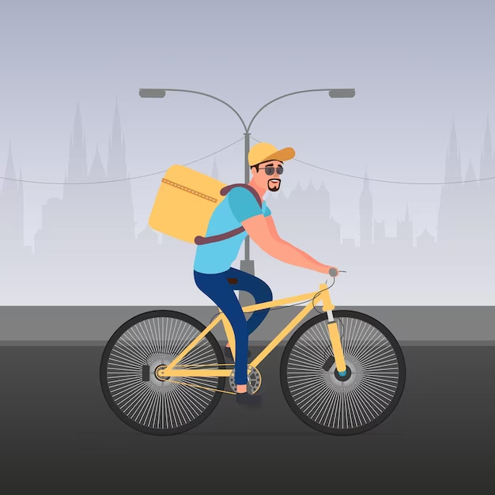
Travelling by bike

Slide 16
Read the definitions and choose the correct answer:
1) This is a person who walks along the road on the pavement - pedestrian traffic warden driver
2) This is a person who regulates the traffic on the crossroads - pedestrian traffic warden driver

Slide 17
1) This is a person who walks along the road on the pavement - pedestrian traffic warden driver
2) This is a person who regulates the traffic on the crossroads - pedestrian traffic warden driver

Slide 18
Read the rules and categorize them: it is dangerous to … it is safe to …
Talk to the driver.
Look both ways.
Lean out of the window.
Run on the road.
Wear a seat belt.
Walk straight on the pavement.
Look both ways for traffic.
Cross the street between parked cars.
Look for zebra crossing or a traffic light.

Slide 19
It is dangerous to … It is safe to …
Talk to the driver.
Look both ways.
Lean out of the window.
Run on the road.
Wear a seat belt.
Walk straight on the pavement.
Look both ways for traffic.
Cross the street between parked cars.
Look for zebra crossing or a traffic light.

Slide 20
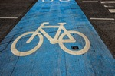
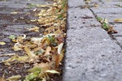
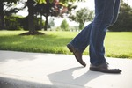
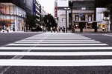

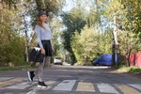
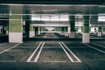
What can you see in the pictures?

Slide 21





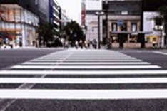
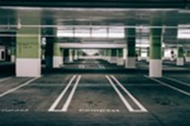
kerb
pavement
Bike lane
traffic sign
pedestrian
zebra crossing
parking zone

Slide 22


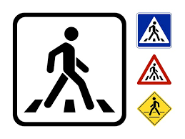


1)
2)
3)
4)
5)
What do these traffic signs mean?

Slide 23
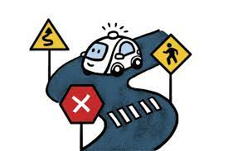
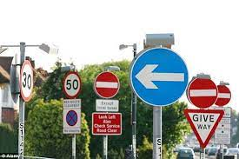
1) You can’t park here!
2) You can turn right!
3) You can cross the road here!
4) You can’t ride a bike here!
5) You can turn left!

Slide 24
Match the words to make phrases:
Run onto | the others on the bus.
Don’t push | the road.
Don’t talk | both ways.
Always wear | a seat belt.
Look | to the driver.

Slide 25
Run onto | the road.
Don’t push | the others on the bus.
Don’t talk | to the driver.
Always wear | a seat belt.
Look | both ways.

Slide 26
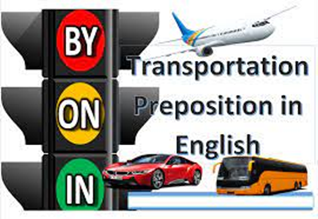
Fill in: by, on, in
1) … foot
2) … car/bus/train/plane/bike
3) … a bus
4) … the 8 o’clock train

Slide 27
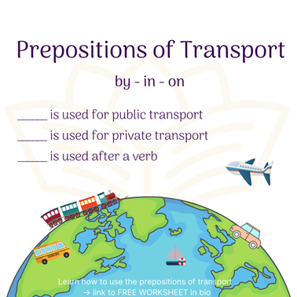
1) On foot
2) By car/bus/train/plane/bike
3) On a bus
4) On the 8 o’clock train

Slide 28
Put the words in the correct order to make road safety rules:
1) the/ road/ Walk/straight/across
2) both/Look/ways/before/ crossing
3) Stop/walk/before/ you/on/ the/ road
4) crossing/ Look/for/ a/ zebra

Slide 29
1) Walk straight across the road.
2) Look both ways before crossing.
3) Stop before you walk on the road.
4) Look for a zebra crossing.

Slide 30
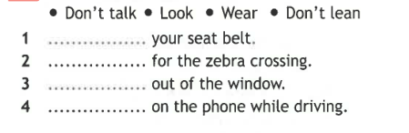
Fill in the correct Imperative:

Slide 31
1. Wear your seat belt.
2. Look for the zebra crossing.
3. Don’t lean out of the window.
4. Don’t talk on the phone while driving.

Slide 32
Translate:
Не играй с дверными ручками в машине!

Slide 33
Don’t play with the car door handles!

Slide 34
Translate: Не разговаривайте с водителем автобуса!

Slide 35
Don’t talk to the bus driver!

Slide 36
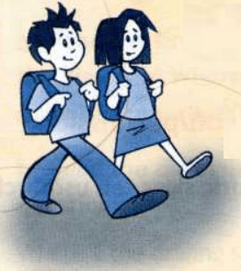
Speak about rules for pedestrians!

Slide 37
Look for a zebra crossing or a traffic lights crossing.
Don’t cross between parked cars.
Stop before you walk onto the road.
Stand on the pavement near the kerb.
Listen and look both ways for traffic.
Make sure it’s clear and walk straight across the road.
Don’t run.

Slide 38
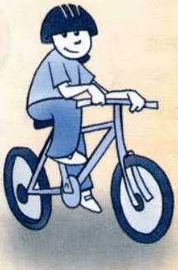
Speak about rules for cyclists!

Slide 39
Make sure your bike is in good working condition.
Check your brakes and tyres regularly.
Wear a bicycle helmet.
Ride with the flow of traffic, not against it.
Use bike lanes.
Wear bright clothes in daytime.
Never carry a second person on your bike.

Slide 40
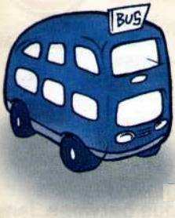
Speak about rules for passengers of a bus!

Slide 41
Stand well back until the bus has stopped completely.
Don’t push others when you enter the bus.
Sit down on your seat quietly and quickly.
If there aren’t free seats, use handgrips.
Don’t talk to the driver or annoy others on the bus.
Don’t lean out of the window.
Don’t wave from the window.

Slide 42
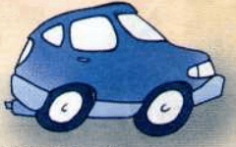
Speak about rules for passengers of the car!

Slide 43
Always sit in the back seat if you are under 12 years old.
Wear a seat belt.
Don’t block the rear view mirror.
Don’t play with the car door handles.
Always use the door on the pavement side to get out of the car.

Slide 44

Thank you for the lesson

