Slide 1
Мбоу Одинцовская гимназия № 13 «Richard the lionheart» элективный курс «Страноведение, 10 класс» выполнила Румянцева марина николаевна

Slide 2
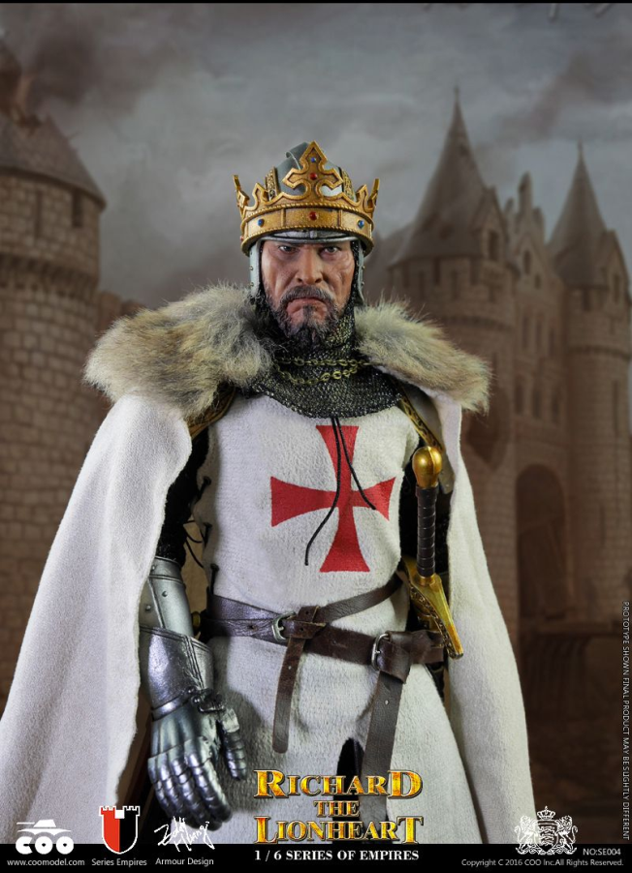
King Richard I or Richard the Lionheart (1157 – 1199) was king of England from 1189 to his death in 1199. He acquired the epithet Lionheart due to his military prowess and fearlessness.
Let’s have a look at the top of the most interesting facts about Richard the Lionheart.

Slide 3
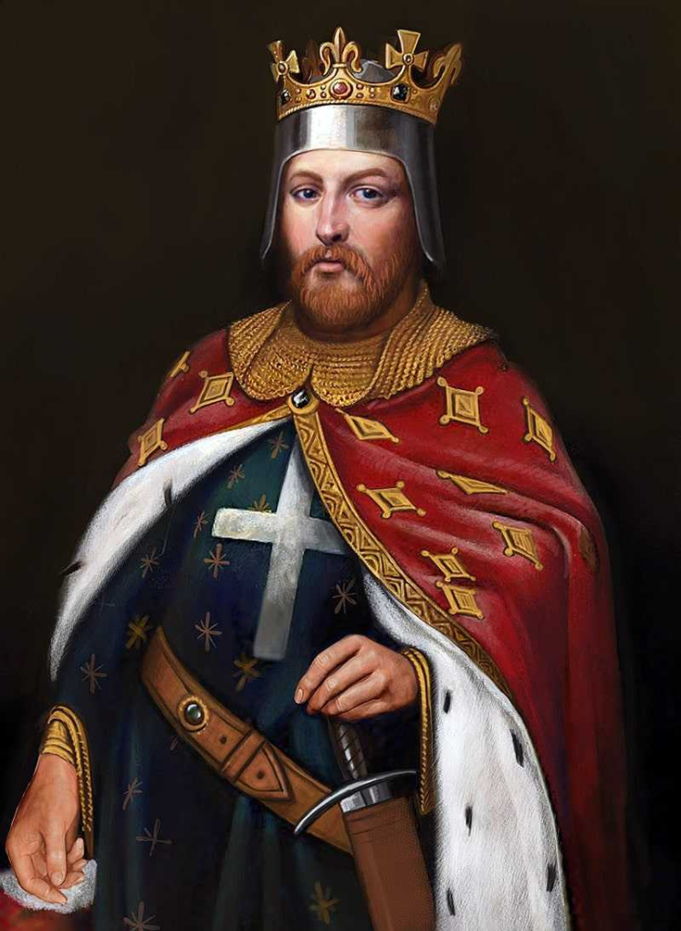
1. Richard the Lionheart was an English king who didn’t speak English.
Richard I was born in Oxford, the third son of King Henry II and Eleanor of Aquitaine. He spent his childhood in England but lived most of his adult life in France. He spoke French, but it’s not known for certain that he spoke English. He became king of England because both his elder brothers preceded his father. But he was also the Duke of several French and other European territories.

Slide 4
He tried to depose his father multiple times.
Richard supported his brothers Henry the Young King and Geoffrey, in a revolt against their father in 1173. The brothers left England and gained the support of Louis VII and some of the French barons. The rebellion was unsuccessful, and the brothers were forced to seek forgiveness from their father. He graciously forgave them, but the terms of their truce were significantly less than a deal they had been offered earlier in the conflict. An interesting fact about Richard the Lionheart is that he took up arms against his father and brothers several more times. In 1189, he joined Phillip II of France, and together they defeated Henry II at Ballans. Henry died two days later, and Richard became the King of England, Duke of Normandy.

Slide 5
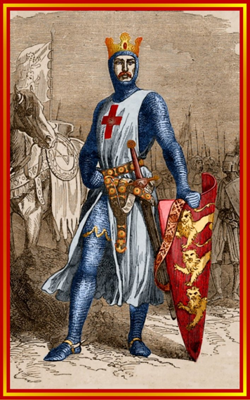
Richard I spent only six months of his reign in England.
In the ten years of his reign, the king spent most of his time on Crusade, in captivity, or defending his lands in France. He seems to have regarded England merely as a source of funding for his military activities. He is estimated to have spent at most six months in the country while he was king.

Slide 6
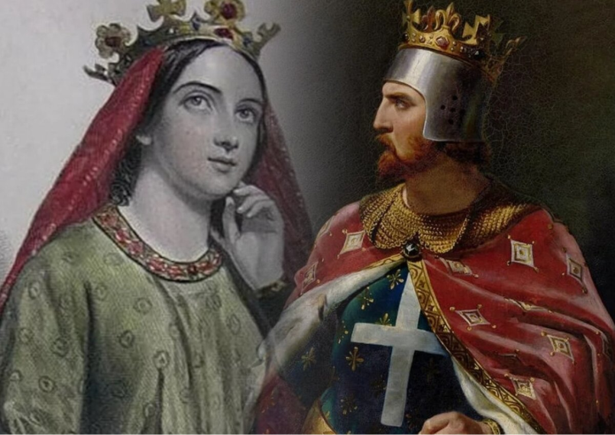
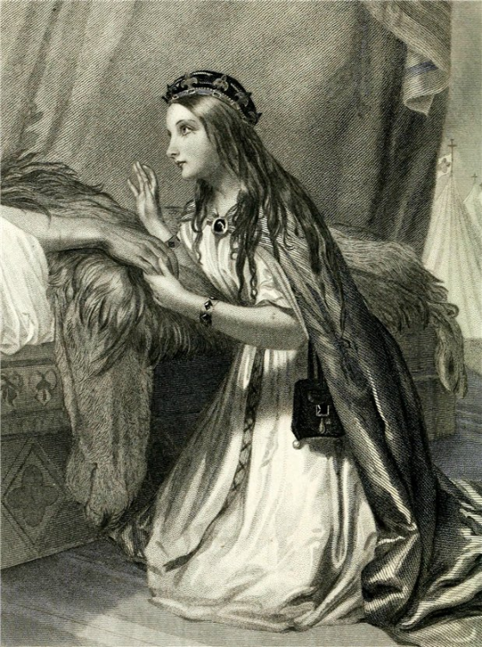
He never had any children.
When Richard was nine years old, he was engaged to marry the fourth daughter of Louis VII of France, Alys, Countess of the Vexin. The marriage never went ahead, and it was suspected that Henry II took Alys for his mistress. In 1191, the ship that Richard’s new fiancé Berengaria of Navarre was sailing in was stranded in Cyprus, and she was taken prisoner. Richard conquered Cyprus to free her and his sister, who was traveling with her. They were married in Cyprus, and she accompanied him on Crusade but returned separately on her own. She didn’t make it to England until after Richard’s death, and the marriage was childless.

Slide 7
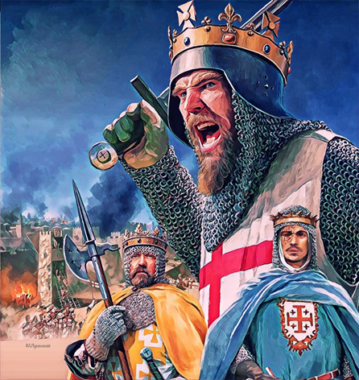
Richard the Lionheart joined the Third Crusade.
Richard I was a pious man and a soldier. So, when the Muslim sultan Saladin captured Jerusalem in 1187, he joined the Third Crusade to win back the Holy City. It was 1191 before the king arrived in the Holy Land, and although he was victorious at Acre and Arsuf, he failed to take back Jerusalem. After trying for a year, he reached a truce with Saladin and headed home, an interesting Richard the Lionheart fact.

Slide 8
The Duke of Austria captured the king on his return from Crusade.
Leopold, Duke of Austria, captured Richard on his way home through Europe, accusing him of murdering his cousin. Leopold later handed the king over to the Holy Roman Emperor, Henry VI, whom Richard’s family had offended in various ways. Holding a crusader was forbidden by public law, and both Leopold and Henry VI were excommunicated by the Pope, but it made no difference. Henry needed funds and demanded a ransom that would be equivalent to over $2.5 billion in today’s currency. While Richard’s mother gathered the payment, his younger brother John approached Henry to keep him hostage until September. But Henry refused, and when the ransom was delivered, Richard was released in March 1194.

Slide 9
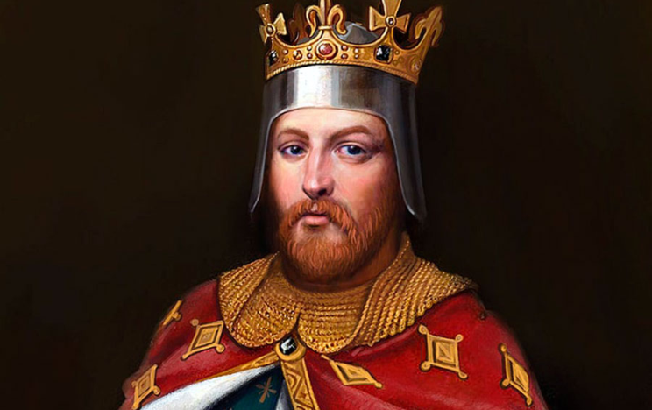
Richard I was crowned a second time.
Richard I returned to England and was crowned a second time because he was worried his huge ransom would have impacted his independence. But he left England again almost immediately to protect his French lands from Phillip II of France. Formally allies, the two had become estranged during their time on the Crusade. He never returned to England.

Slide 10
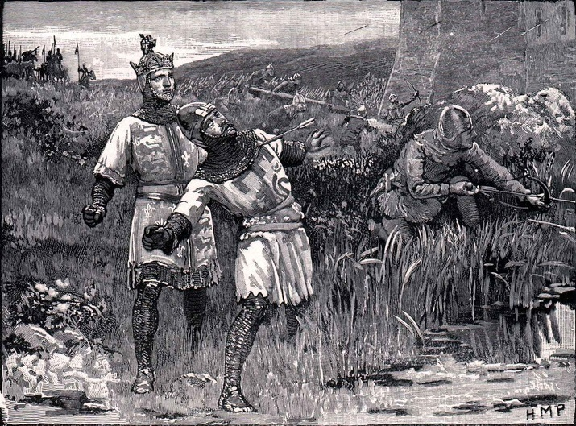
The king was killed by a young boy.
In March 1199, Richard I was attacking the castle of Châlus, allegedly because a peasant had found a hoard of Roman gold, and the Vicomte of Limoges refused to hand it over. He was struck by a crossbow, and even though the bow was removed, the wound turned gangrenous. The king died from his injury on April 6, 1199. But before dying, he ordered the shooter to be brought before him, only to discover it was a young boy. Instead of ordering the boy’s execution, he gave him 100 shillings and forgave him, an interesting fact about Richard I.

