Slide 1
Урок английского языка
«Искусство и дизайн» 9 класс

Slide 2
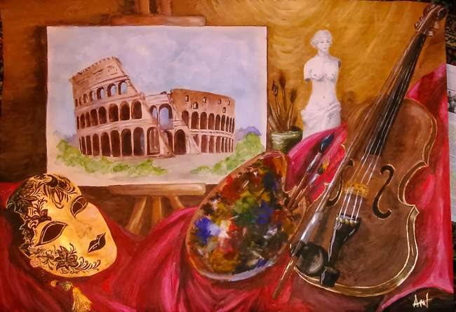
What do these pictures have in common?

Slide 3
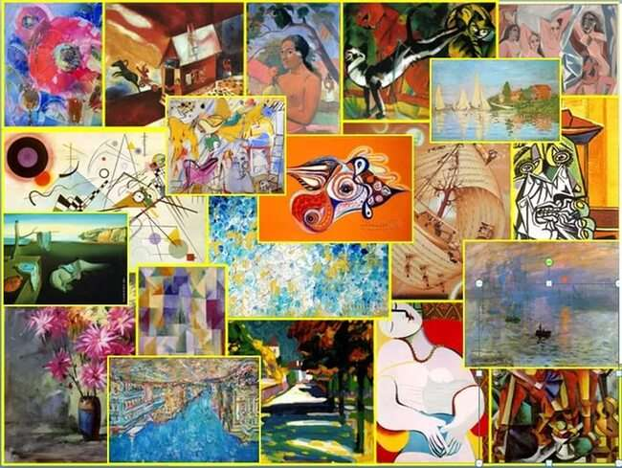
Art

Slide 4
Objectives of the Lesson
1
learn the names of some geometric shapes
2
learn the names of some painting styles
3
learn the characteristic features of some painting styles
4
learn new idioms with «paint»

Slide 5
Read and comment these quotations about art of painting
Art is the desire of a man to express himself, to record the reactions of his personality to the world he lives in.
~Amy Lowell
To send light into the darkness of men's hearts - such is the duty of the artist. ~Schumann
Painting is poetry that is seen rather than felt, and poetry is painting that is felt rather than seen. ~Leonardo da Vinci

Slide 6
Complete the mind map.
Genres of painting
Art
Styles of art
emotions
methods of painting
landscape, colourless daub (мазня) of painting, romanticism, water colour painting, to be made of dots, seascape, cubism, to evoke (вызывать) feelings, a real breath of fresh air, portrait, realism, still life, to make sb gasp, easel painting, to be depicted by transparent colours, sketch, unsurprised masterpiece, oil painting, quick brush strokes

Slide 7
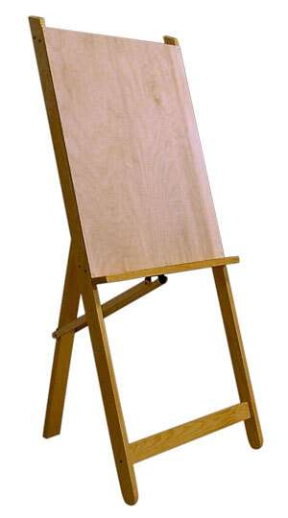
easel

Slide 8
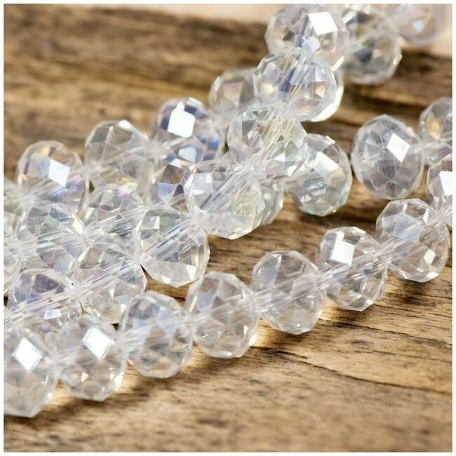
Transparent colour

Slide 9
Artists often show their preferences to
a particular genre.
The most common of them are:

Slide 10
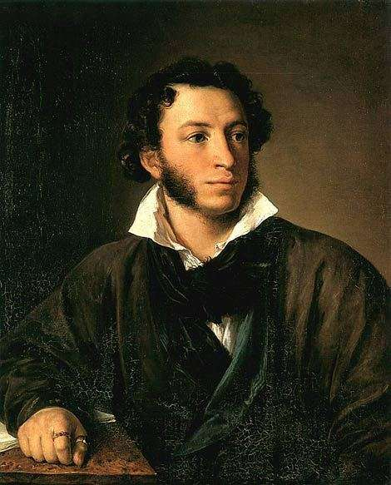
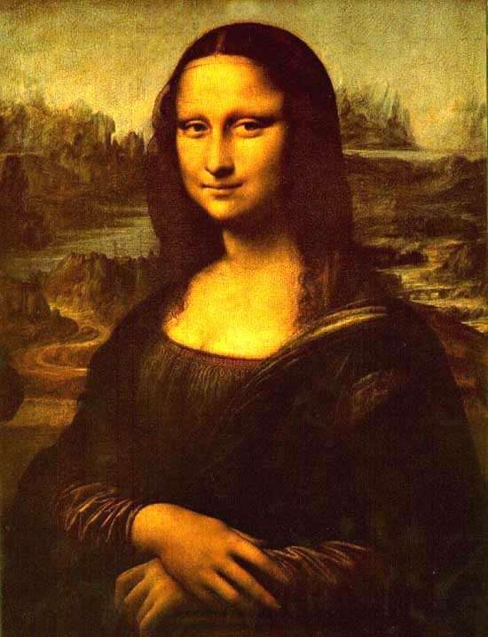
portraits

Slide 11
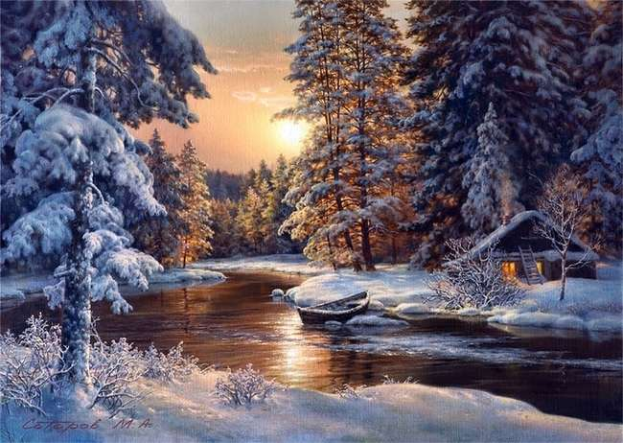
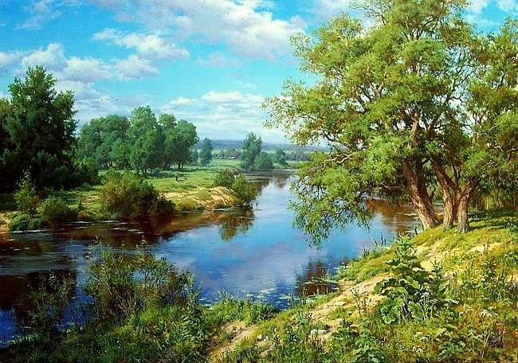
landscapes

Slide 12
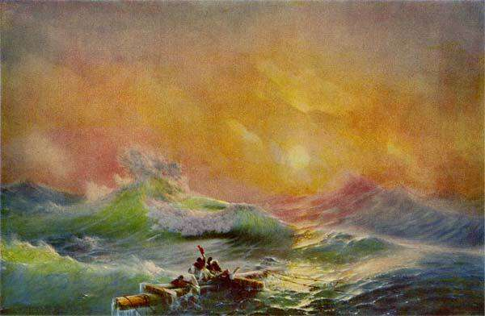
seascapes

Slide 13
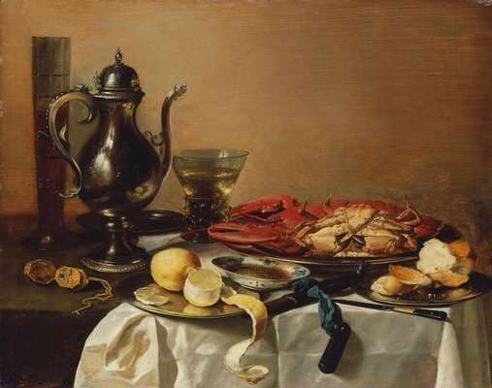
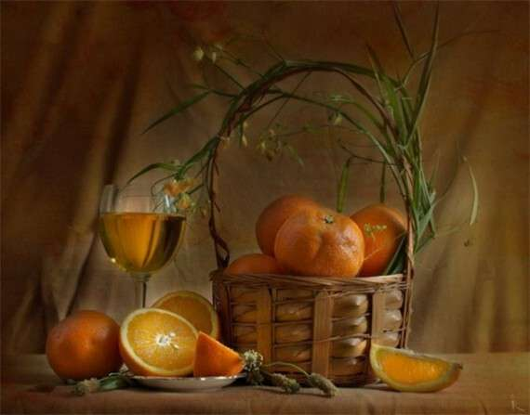
still life (still lifes)

Slide 14
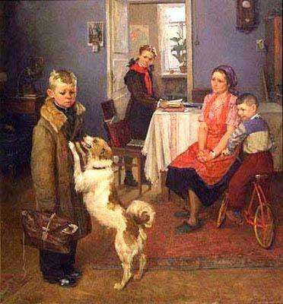
genre painting

Slide 15




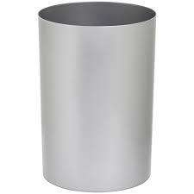

Art and Design
You can see the words. Do you know them?
rectangle [ˈrɛktæŋɡl]
triangle [ˈtraɪæŋɡl]
square [skwɛə]
Painting Styles
Where are these figures used?
cube [kjuːb]
cylinder [ˈsɪlɪndə]

Slide 16
You’ll work with the table where you can find the description of the main painting styles.
Painting styles refer to the way in which the artist chooses to express their subject or vision within their piece.
Match the painting styles with their descriptions.

Slide 17
Styles in painting | Specific features
Classicism | a 20th century movement of artists who used strange dreamlike images
Realism | an art movement developed in Germany early in the 20th century that expresses feelings rather than describing objects and experiences Exaggerated colours and shapes are used to convey feelings
Romanticism | a 20th century style of art, in which objects ahd people are represented by geometric shapes. Things are broken up into angular shapes
Impressionism | art form that represents ideas using geometric and other designs instead of natural forms seeking to break away from traditional representation of physical objects. Pioneered by Kandinsky and others in the early 20th century. It doesn’t show real people or things, but only shapes and colours
Surrealism | a movement in art during the 17th and 18th centuries in Europe that is simple, regular, and does not show strong emotions Balanced and controlled, simple forms, following ancient models
Cubism | a way of painting that was popular in the late 18th and early 19th century, in which feelings, imagination, and wild natural beauty were considered more important that anything else Shows heroic isolation, emphasis on women and children
Abstract art | a style of painting founded in France in the 19th century which uses colour instead of details of form to produce effects of light or feeling Gives changing effect of natural light, colours are pure, vivid and bright
Expressionism | the style of art in which things, especially unpleasant things, are shown or described as they really are in life It shows things as they really are lifelike pictures

Slide 18
Styles in painting | Specific features
Classicism | a movement in art during the 17th and 18th centuries in Europe that is simple, regular, and does not show strong emotions. Balanced and controlled, simple forms, following ancient models
Realism | the style of art in which things, especially unpleasant things, are shown or described as they really are in life. It shows things as they really are lifelike pictures
Romanticism | a way of painting that was popular in the late 18th and early 19th century, in which feelings, imagination, and wild natural beauty were considered more important that anything else. Shows heroic isolation, emphasis on women and children
Impressionism | a style of painting founded in France in the 19th century which uses colour instead of details of form to produce effects of light or feeling Gives changing effect of natural light, colours are pure, vivid and bright
Surrealism | a 20th century movement of artists who used strange dreamlike images
Cubism | a 20th century style of art, in which objects ahd people are represented by geometric shapes. Things are broken up into angular shapes
Abstract art | art form that represents ideas using geometric and other designs instead of natural forms. Pioneered by Kandinsky and others in the early 20th century. It doesn’t show real people or things, but only shapes and colours
Expressionism | an art movement developed in Germany early in the 20th century that expresses feelings rather than describing objects and experiences Exaggerated colours and shapes are used to convey feelings
Keys

Slide 19
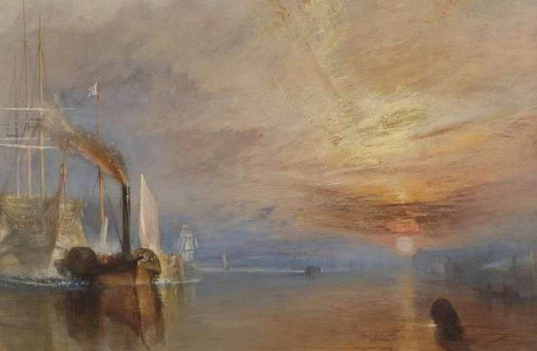
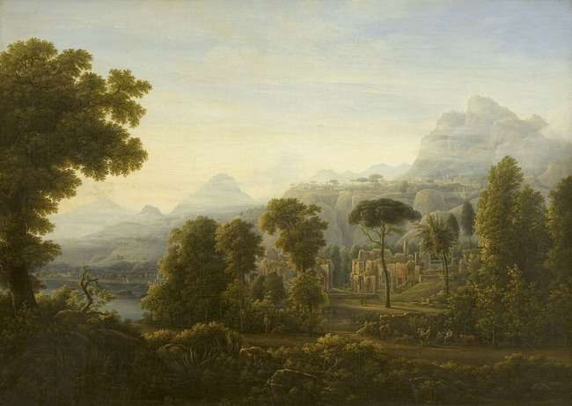
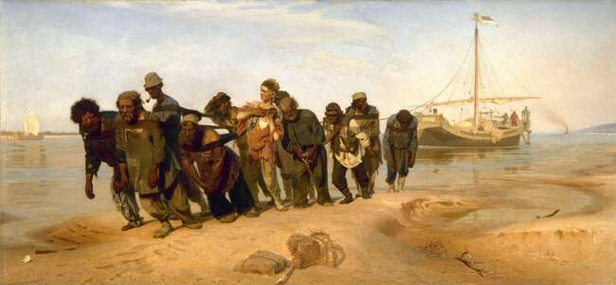
You’ll see some famous pictures and you should guess the painting styles.

Slide 20
Ф. Матвеев. Вид Сицилии. Горы. 1811
Classicism

Slide 21
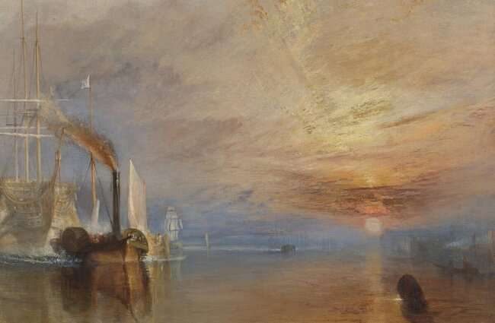
Д.М.У. Тёрнер. Последний рейс корабля «Отважный»
Romanticism

Slide 22
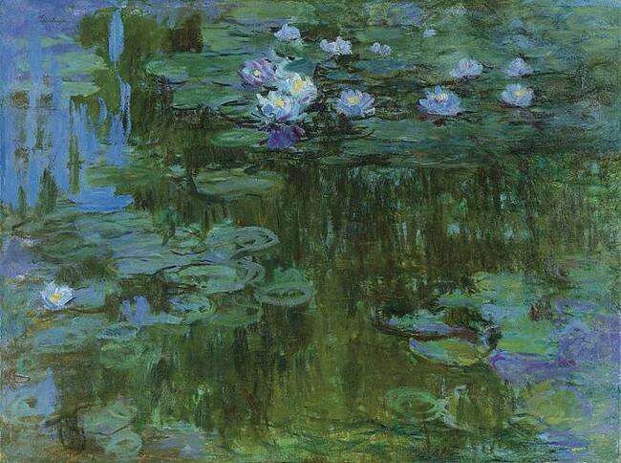
Клод Моне. Водяные лилии
Impressionism

Slide 23
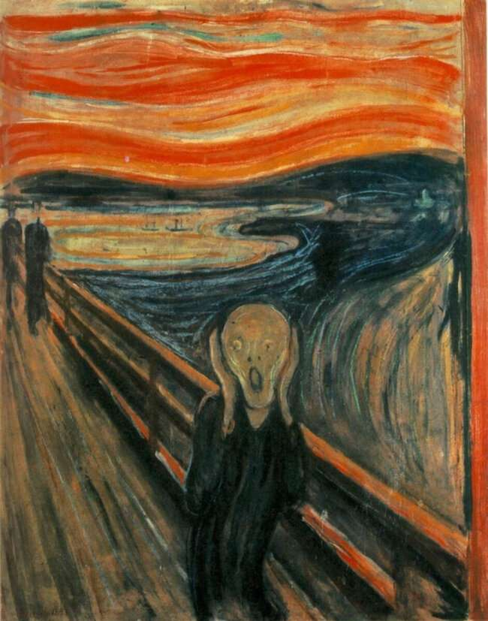
Эдвард Мунк. Крик
Expressionism

Slide 24
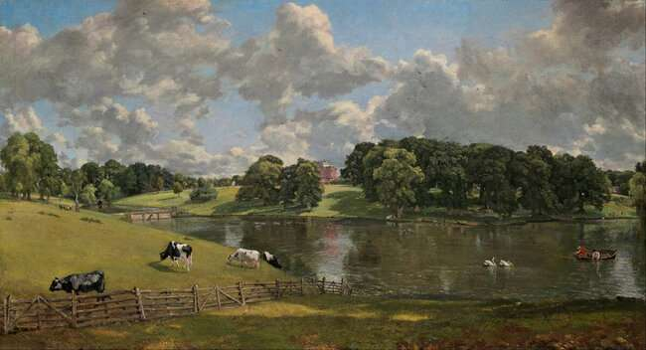
Джон Констебл. Парк Уивенхо
Romanticism

Slide 25
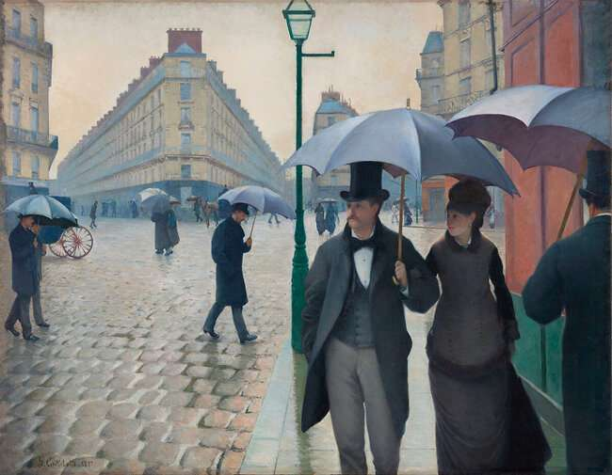
В конечном итоге Кайботт всё же стал членом движения импрессионистов, но его работы явно более реалистичны, чем у других художников этого жанра.
Гюстав Кайботт.
Парижская Улица в Дождливую Погоду
Realism

Slide 26
И. Е. Репин.
Бурлаки на Волге
Realism

Slide 27
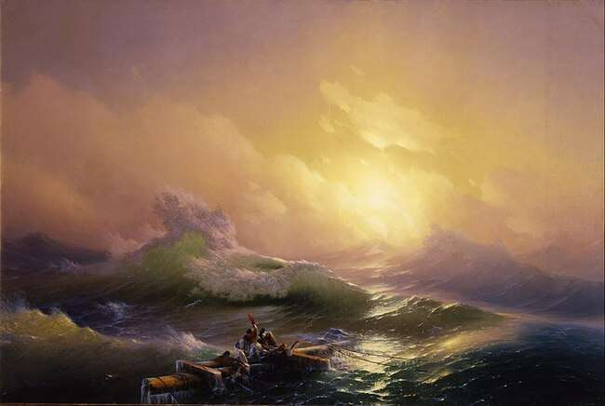
И.К. Айвазовский. Девятый вал, 1850 г.
Romanticism

Slide 28
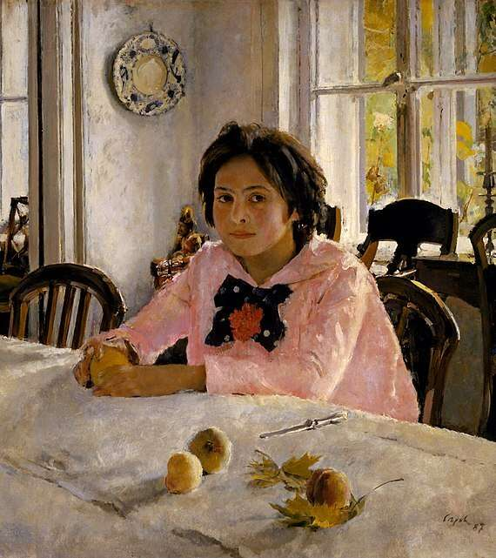
Impressionism
В. Серов. Девочка с персиками, 1887 г.

Slide 29
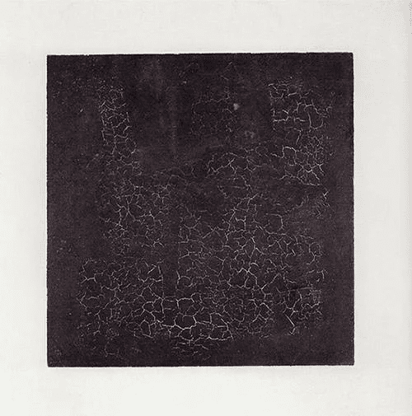
Abstract art
К. Малевич. Черный квадрат, 1915

Slide 30
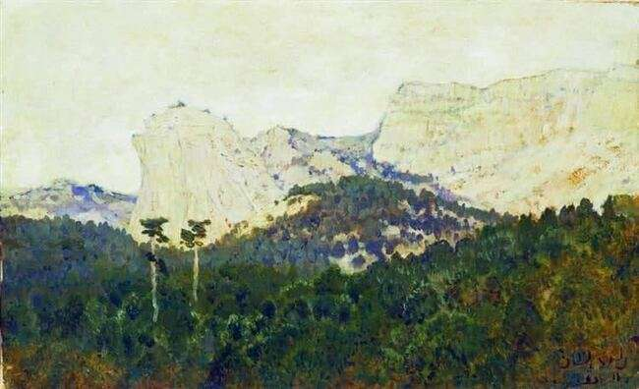
И. Левитан. Горы. Крым, 1886
Impressionism

Slide 31
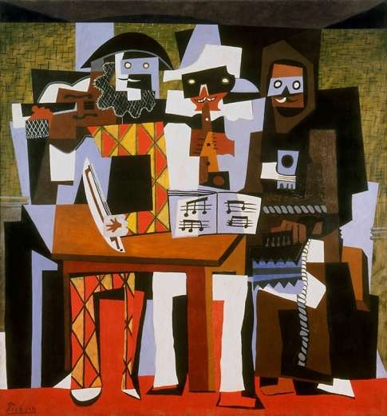
Cubism
П. Пикассо. Три музыканта в масках

Slide 32
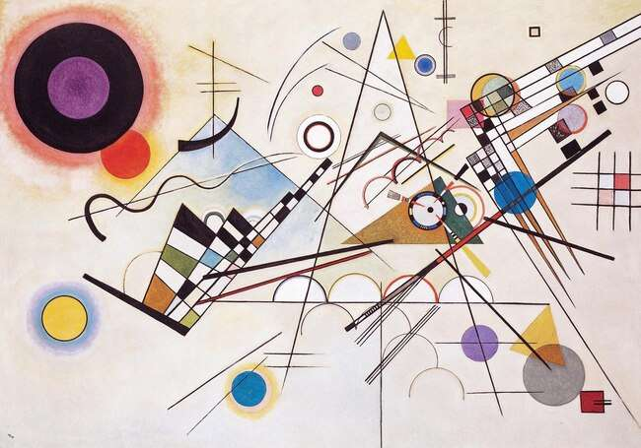
В. Кандинский. Композиция VIII, 1923
Abstract art

Slide 33
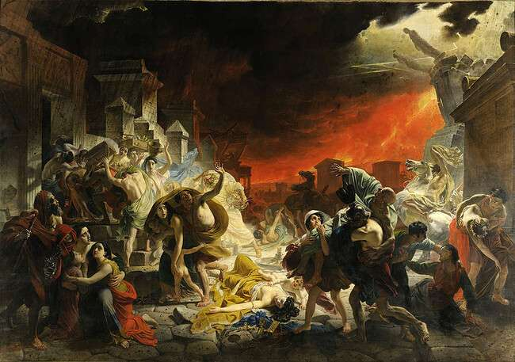
К. Брюллов. Последний день Помпеи, 1833 г.
Classicism

Slide 34
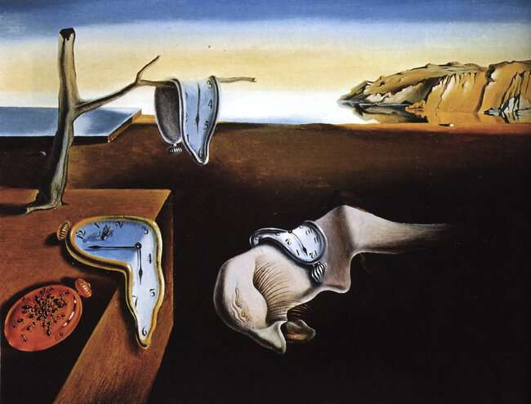
С. Дали. Постоянство Памяти
Surrealism

Slide 35
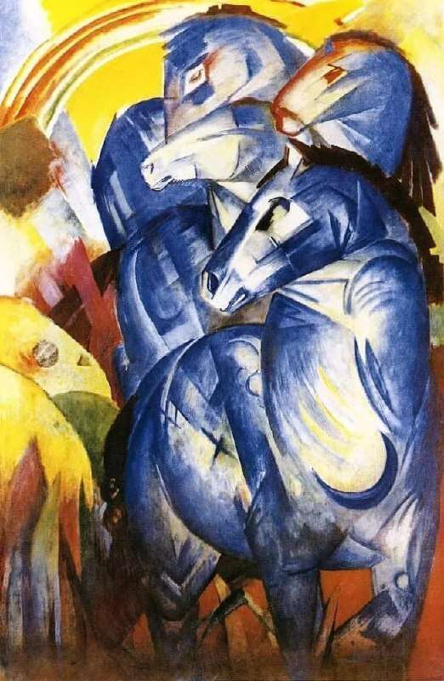
Ф. Марк.
Башня синих лошадей, 1913
Expressionism

Slide 36
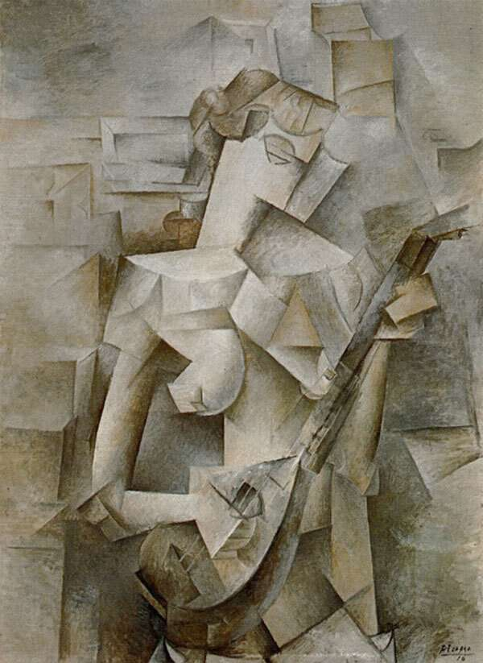
П. Пикассо. Девушка с мандолиной
Cubism

Slide 37
Art & Design.
Painting styles

Slide 38
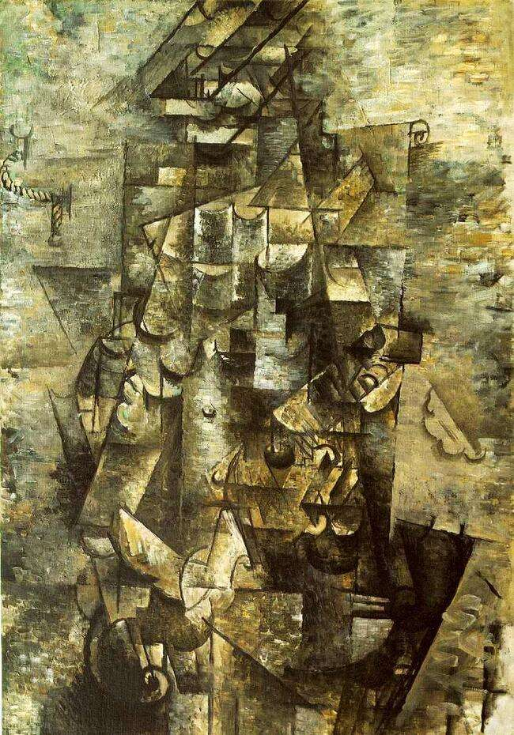
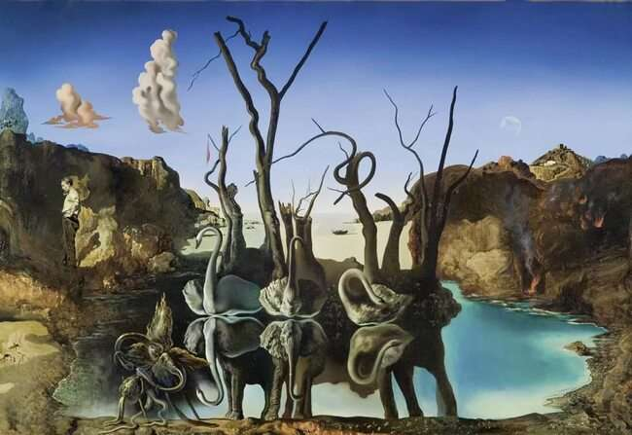
Which painting uses bright colours, dark\dull colours?
Surrealism
Cubism
What style of painting is each picture?

Slide 39
Sb p.54 ex.4
Read the text and fill in the gaps with the correct word formed from the capitalised words
fame
see
origin
differ
art
represent
big
usual
famous
seeing
original
different
artists
representations
bigger
unusual

Slide 40
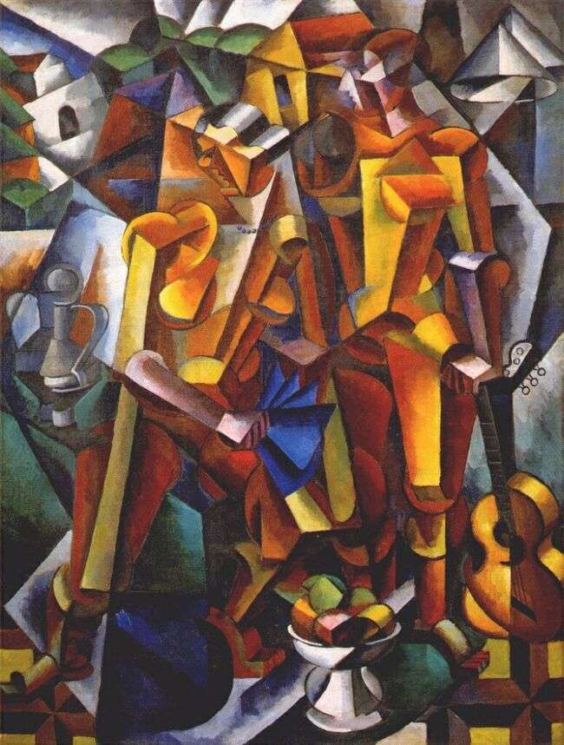
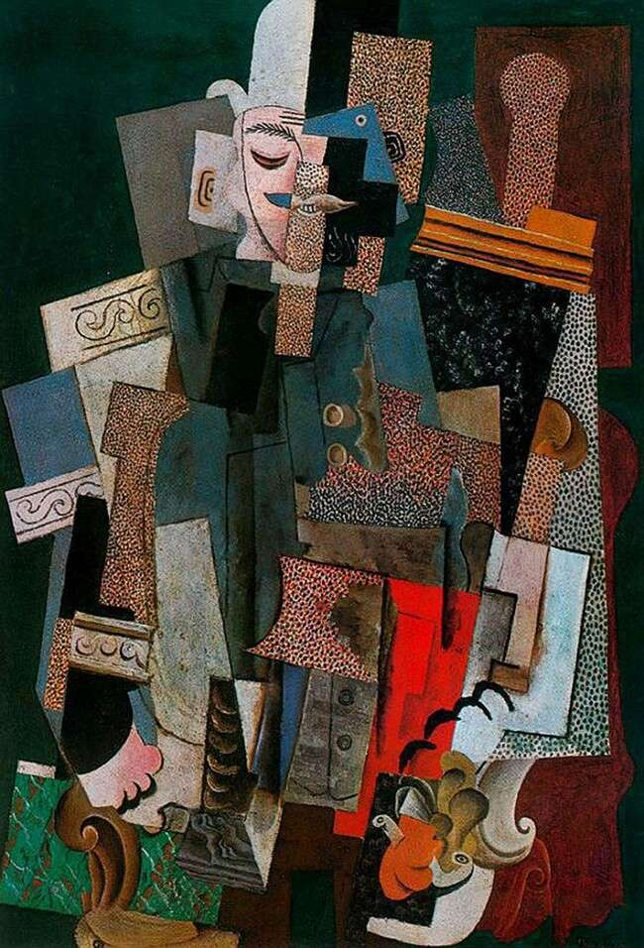
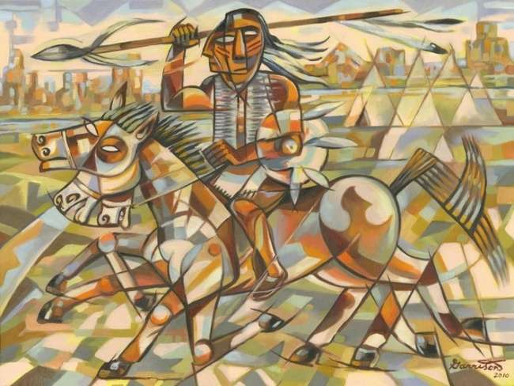
Cubism
Pablo Picasso
George Braque

Slide 41
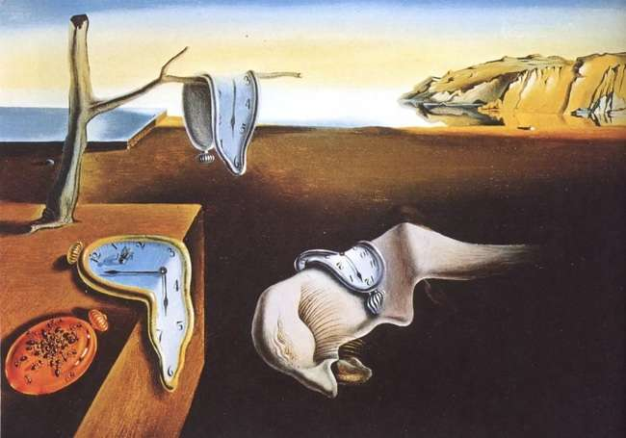
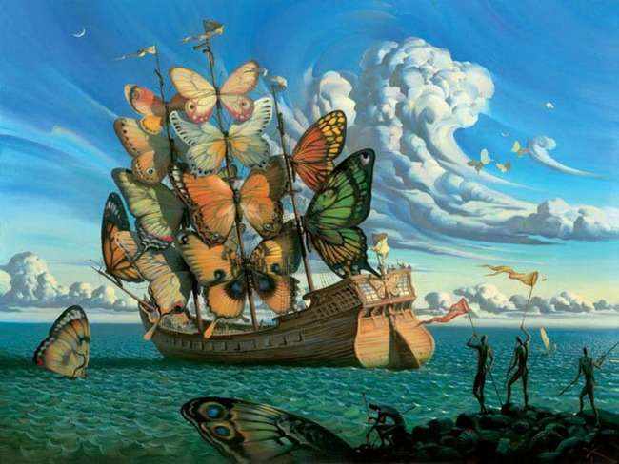
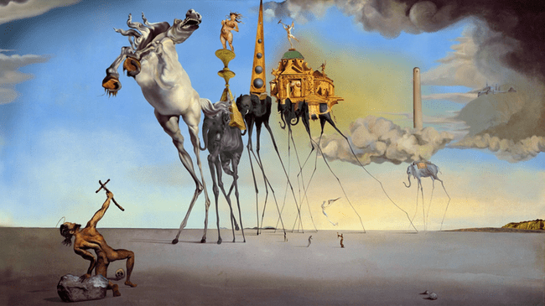
Surrealism
Salvador Dali
Rene Magritte

Slide 42
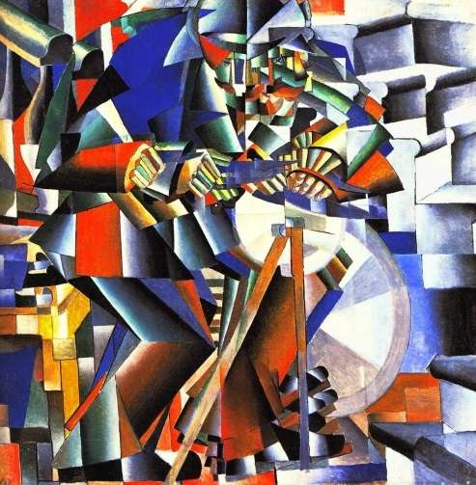
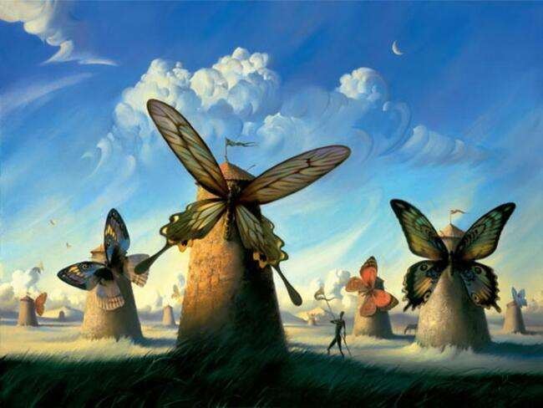
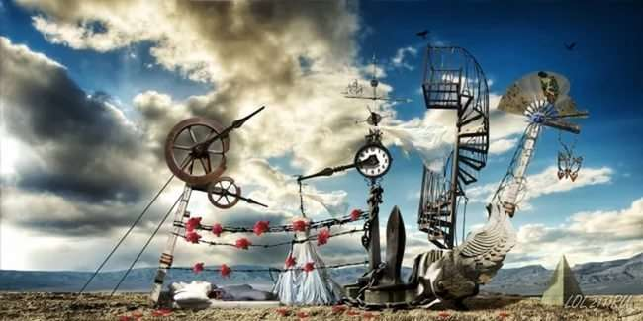
Answer the questions
When was Cubism popular?
How did Cubism get its name?
What style did Dali paint in?
What did Surrealist painters use to get ideas for their paintings?

Slide 43
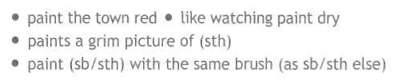
Idioms with “PAINT”
to paint the town red
to have fun
to paint a grim picture of (smth)
to describe sth in negative way
like watching paint dry
it is very boring
to think of people as if
they were all identical
to paint (sb/sth) with the same brush (as smb else)
it is very boring
to have fun
to describe sth in negative way
to think of people as if they were all identical

Slide 44
Match idioms with their equivalents
to paint the town red
Такой скучный, что мухи дохнут
to paint a grim picture of (smth)
Ровнять под одну гребёнку
like watching paint dry
Рисовать мрачную картину чего-либо
to paint (sb/sth) with the same brush (as smb else)
Отпраздновать на всю катушку

Slide 45
Reflection
How do you find the lesson?
What part of the lesson did you like most of all?
Would you like to learn more on this topic?
Have you leant anything new?

Slide 46
Hometask
SB ex. 8,9p.55

Slide 47
Read the description.
Which painting does it match?
How does the author feel about the painting?
This picture shows many different lines and shapes like squares and triangles. When I look very closely, however, I can also see other things such as parts of bodies and objects. The artist has used many dull colours such as brown, grey and green in the painting, which give it a very gloomy feeling. This painting makes me feel quite sad

Slide 48
Use these words to describe this painting
strange object
swans on a smooth lake
reflection of elephants in lake
bright colours
clear blue sky
How does it
make you feel:
astonished
anxious,
curious,
confused,
excited?

